Slide 1
Computational Protein Structure Prediction Using Deep Learning
Zhaoyu Li
Department of Electrical Engineering and Computer Science
University of Missouri – Columbia
Advisor: Dr. Yi Shang
PhD Defense, May 11, 2020

Slide 2
Outline
Introduction and Overview
New Methods Developed
MUFOLD-LM: Protein Loop Modeling
MUFOLD-Contact: Protein Contact Map Prediction
TPCref: Contact Map Prediction Refinement
New Software System Development
MUFOLD Improvements: A Protein Prediction Platform with Web Services
Summary and Future Work
PhD Defense, May 11, 2020

Slide 3
Outline
Introduction and Overview
New Methods Developed
MUFOLD-LM: Protein Loop Modeling
MUFOLD-Contact: Protein Contact Map Prediction
TPCref: Contact Map Prediction Refinement
New Software System Development
MUFOLD Improvements: A Protein Prediction Platform with Web Services
Summary and Future Work
PhD Defense, May 11, 2020

Slide 4
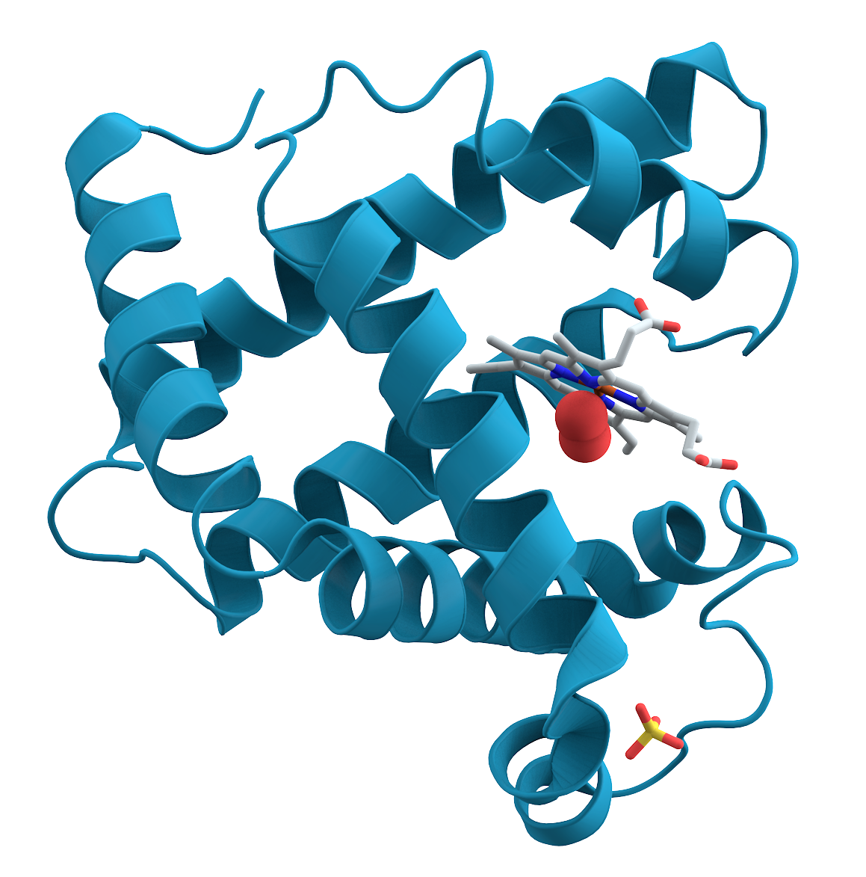
Introduction and Overview
Proteins
most common molecules in cells
different functions with different structures
In 1972, Anﬁnsen and his colleagues received the Nobel Prize
A protein’s structure is uniquely determined by its amino acid sequence
A big challenge to predict a protein’s structure given only the sequence
A visualization of the 3D structure of a protein
PhD Defense, May 11, 2020

Slide 5
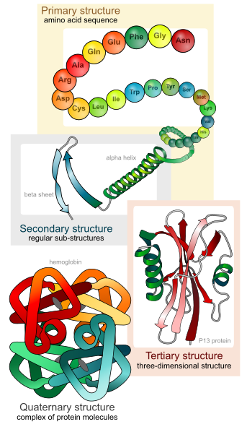
Protein Structure Prediction
Different levels of structural organization of proteins
Primary structure
Secondary structure
Tertiary structure
Quaternary structure
Protein Structure Prediction (3D)
Target Sequence (1D)
Prediction
Contact Map Prediction (2D)
Image Credit: WikiPedia
PhD Defense, May 11, 2020

Slide 6
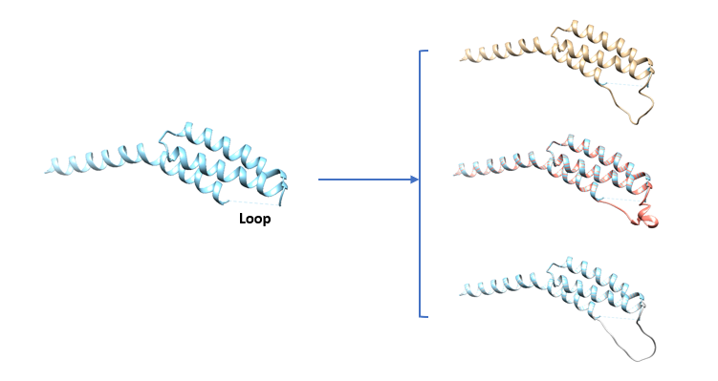
My Research Focuses On
Protein Loop Modeling
What: To predict the structure of a short stretch of protein backbone
Protein Contact Map Prediction
What: To predict whether the distance between two residues in a protein falls within a threshold
Contact Map Prediction Refinement
What: To make the quality of predicted contact maps better
Why: It helps to get a complete structure for protein functions and dynamics studies
Why: It helps to model the 3-D structure
Why: It improves the existing contact map predictors
Predict
Refine
PhD Defense, May 11, 2020

Slide 7
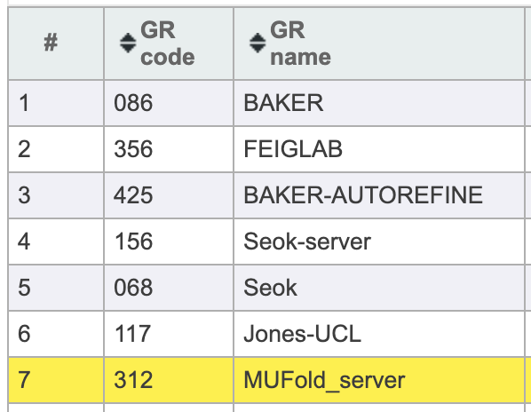
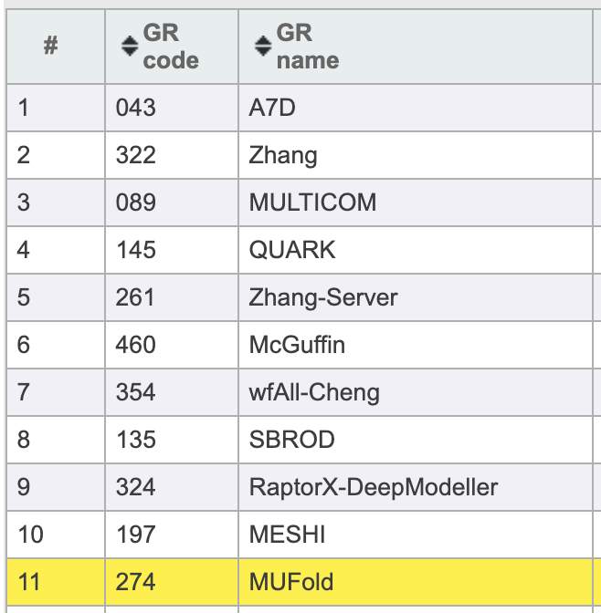
MUFOLD Platform
2010
2015
2017
2018
2020
MUFOLD first published [1]
Redesign using Python
More methods added
Web API added
In CASP13
Unified web portal
More functions
I started working on MUFOLD
Refactor using C++
Refinement
[1] Zhang, Jingfen, et al. "MUFOLD: A new solution for protein 3D structure prediction." Proteins: Structure, Function, and Bioinformatics 78.5 (2010): 1137-1152.
TS
PhD Defense, May 11, 2020
Notes:
11 out of 99 groups, 7 out of 32 groups.

Slide 8
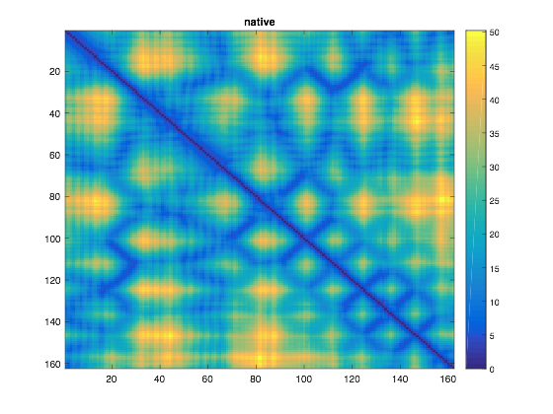
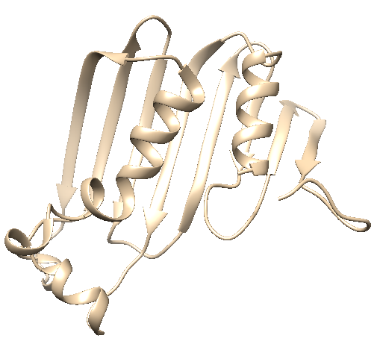
Background: Protein Distance Map
Distance Map of 3D protein structure: Euclidean distance of $Cα$ atoms of all residue pairs
From 3D to 2D
Can be treated as an image
Orientation independent
Multidimensional Scaling (MDS) can restore 3D structure while preserving the distance constraints in the 2D distance map.
MDS
Calculation
PhD Defense, May 11, 2020

Slide 9
Deep Learning
Great success in Computer Vision, NLP, Speech Recognition, etc.
Has been applied to bioinformatics with better performance
Can handle high dimensional features
Can model the complex mapping between input and output
PhD Defense, May 11, 2020

Slide 10
New Methods Developed
Methods | Techniques | Problem Solved
MUFOLD_LM | Context Encoder, Generative Adversarial Network (GAN) | Protein Loop Modeling
MUFOLD_Contact | Fully Convolutional Network (FCN), Dilated Residual Network | Protein Contact Map Prediction
TPCref | Templates Based Refinement, Collaborative Filtering | Predicted Contact Map Refinement
MUFOLD Dev | Objected Oriented Design, Modularized Design | Protein Structure Modeling, Unified Online Portal
PhD Defense, May 11, 2020

Slide 11
Outline
Introduction and Overview
New Methods Developed
MUFOLD-LM: Protein Loop Modeling
MUFOLD-Contact: Protein Contact Map Prediction
TPCref: Contact Map Prediction Refinement
New Software System Development
MUFOLD Improvements: A Protein Prediction Platform with Web Services
Summary and Future Work
PhD Defense, May 11, 2020

Slide 12
Introduction
Loop Modeling: given a sequence and the corresponding structure with a relative short part missing, predict the missing conformation.
MFKGIVQGAGIIKKISKNDDTQRHGITFPKDILESVEKGTVMLVNGCSLTVVRISGDVVYFDIDQAINTTTFRELEVGNKVNLEVRPEFGSLLGKGALTGNIKGVAT
Predict
Input
Output
PhD Defense, May 11, 2020

Slide 13
Related Work
Loop modeling methods can be divided into two categories.
Category | Concepts | Authors | Methods
Ab-Initio/ Statistical | Biological/physical properties Geometry constraints Minimization of energy functions for final selection | Fiser 2000 | ModLoop
 |  | Xiang 2002 | Loopy
 |  | de Bakker 2003 | RAPPER
 |  | Lopez-Blanco 2016 | RCD+
Knowledge/ Database Based | Based on existing structures Further sampling and optimization methods applied for candidate structures generation Combined with energy functions for final selection | Hildebrand 2009 | SuperLooper
 |  | Choi 2010 | FREAD
 |  | Stein 2013 | NGK
 |  | Park 2012 | Galaxy PS1
 |  | Park 2014 | Galaxy PS2
PhD Defense, May 11, 2020

Slide 14
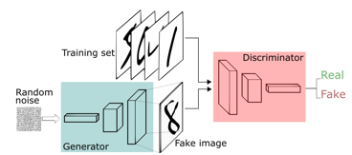
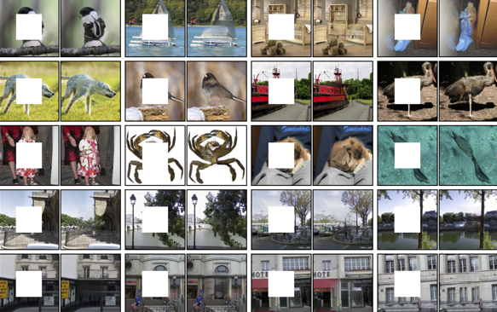
Generative Adversarial Network (GAN)
Two models are trained simultaneously
$G$ captures data distribution
$D$ estimates probability that a sample comes from the training rather than $G$, also provides gradients to $G$
$G$ tries to generate more realistic results to fool $D$, while $D$ tries not to be fooled by $G$
Great performance in image inpainting
Original Idea of GAN
Image Credit: https://skymind.ai
Image Inpainting
Image Credit: Deepak P. et al.
PhD Defense, May 11, 2020
Notes:
Go over quickly

Slide 15
New Method: MUFOLD-LM
Key Ideas
Protein distance map used as an image
Per target training
MUFOLD-LM GAN
Generator
Fill in the missing areas conditioned on the context
Adversarial Discriminator
Make the predictions more realistic and protein-like
Calculate distance map
PhD Defense, May 11, 2020

Slide 16
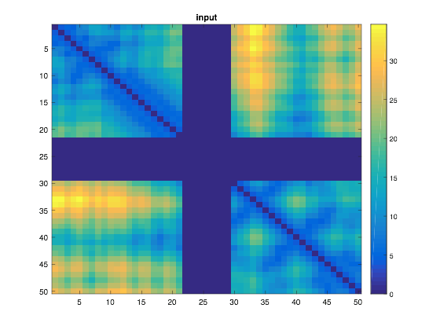
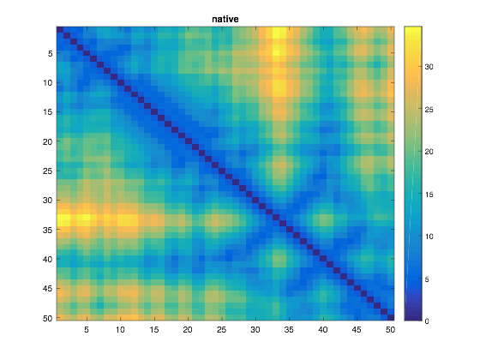
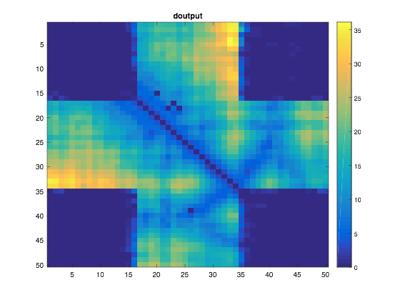
Per-Target Training
Given a target, extract a length $L$ sequence with missing region in the middle (e.g. $L=50$). Generate template pool for training.
Templates Searching
Prediction
Network Input
CDWEEISV…SSVIHDRKSGKKFSIEEALQSG…DRYVNKD
For each template in the pool
Alignment Search
(PSIBlast, HHSearch)
Network Output
Template Pool
(coverage = 100%)
PhD Defense, May 11, 2020

Slide 17
The GAN Network Structure
Output has overlap regions
Encoder
Decoder
8
16
32
64
128
256
128
64
32
16
8
Generated
Input
50
50
50
3x3
3x3
3x3
3x3
3x3
3x3
3x3
3x3
3x3
3x3
3x3
3x3
Label: 0
Generator
Conv
BN
ReLU
Deconv
BN
ReLU
50
25
13
7
4
flatten
Native
...
50
25
13
7
4
64
16
32
4x4
8
4x4
4x4
4x4
Label: 1
Adversarial Discriminator
1024
50
PhD Defense, May 11, 2020
Notes:
Deconv can be understood as a transpose convolution with learned filters. It is like an up-sampling but with the same height and width.

Slide 18
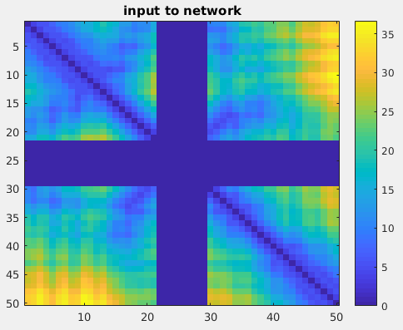
Loss Functions
Generator $Loss_G$
Weighted reconstruction loss: MSE, used to predict the missing part
Adversarial loss of $G$: BCE, make the $G$ generate more realistic output
Adversarial Discriminator $Loss_D$
Adversarial loss of $D$: BCE, make the $D$ better distinguish ground truth from generated output
Overlap region
Missing region
PhD Defense, May 11, 2020
Notes:
The reconstruction loss is to measure the similarity of the reconstructed missing region and the ground truth. We use the L2 distance between the predicted distance map of missing region and the distance map of ground truth.
The adversarial loss is to pick the best distribution according to the training set.
See backup slide for details

Slide 19
Evaluation
Testing Dataset
Benchmark from Park et al. including 20 targets with 8-length loop (8 Res), 20 with 12-length loop (12 Res)
Performance Metrics
RMSD of loops
Calculated using heavy backbone atoms ($N, C_{α}, C, O$)
Suppose true native loop $X=\left\{x_{1},x_{2},…,x_{n}\right\}$, predicted loop $Y=\left\{y_{1},y_{2},…,y_{n}\right\}$
After superimposing $X$ and $Y$, calculate the RMSD using:
$$RMSD\left(X,Y\right)=\sqrt{\frac{1}{n}\sum_{i=1}^{n}{{\left\|x_{i}−y_{i}\right\|}^{2}}}$$
PhD Defense, May 11, 2020

Slide 20
Results – Outperformed Existing Methods
PhD Defense, May 11, 2020

Slide 21
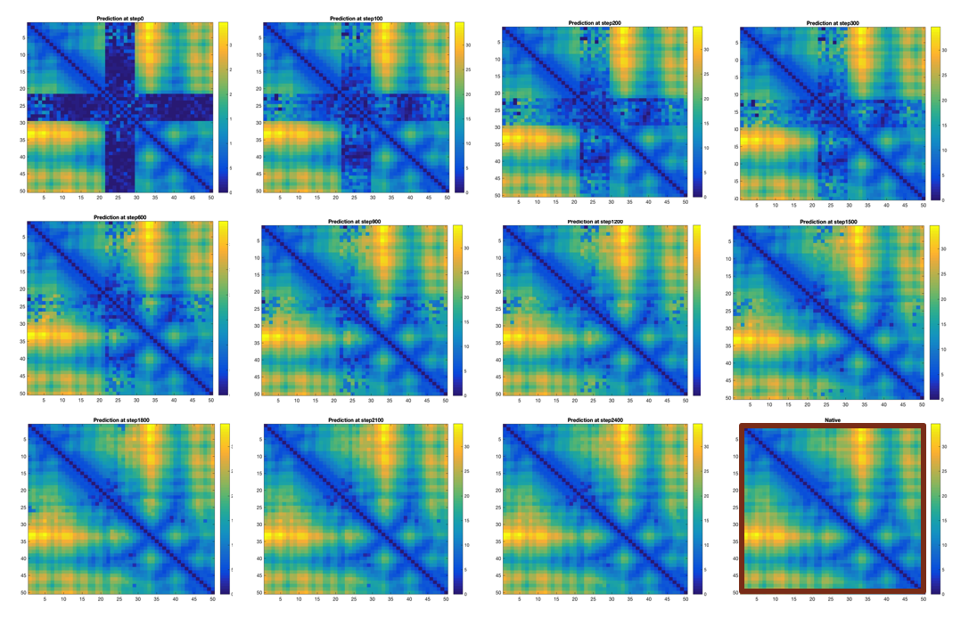
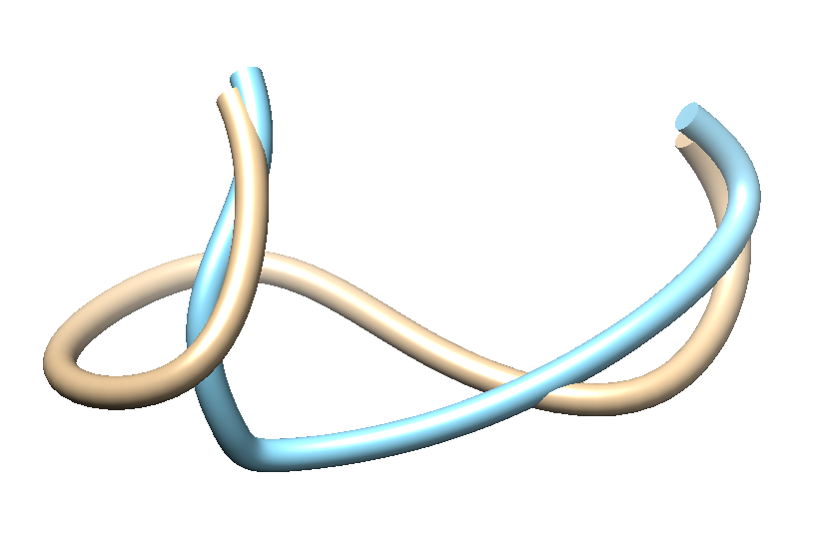
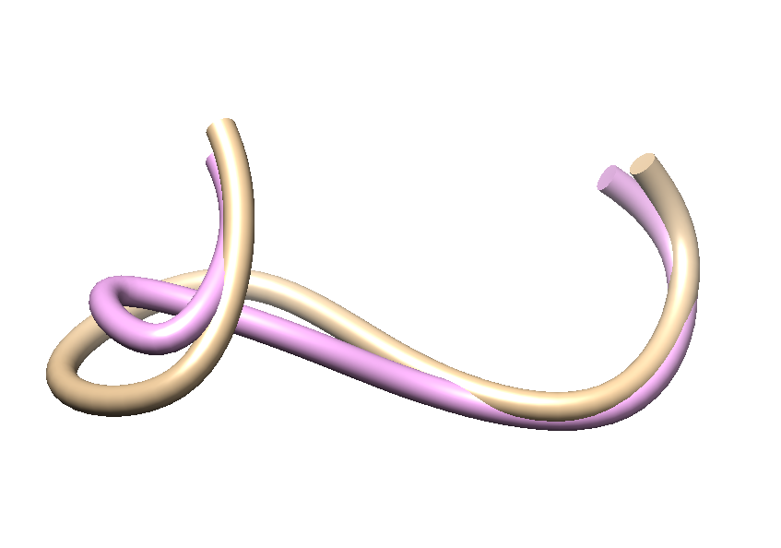
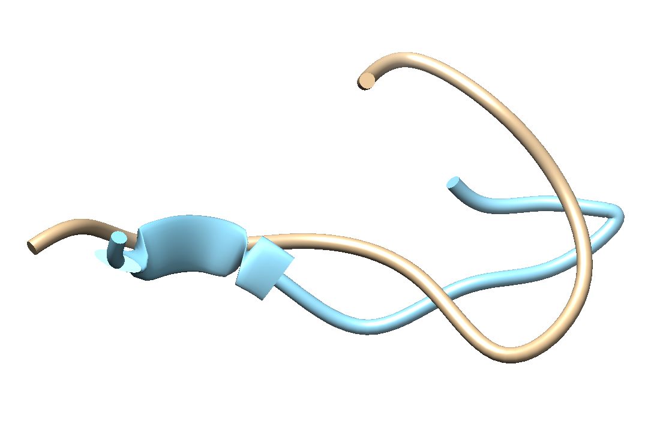
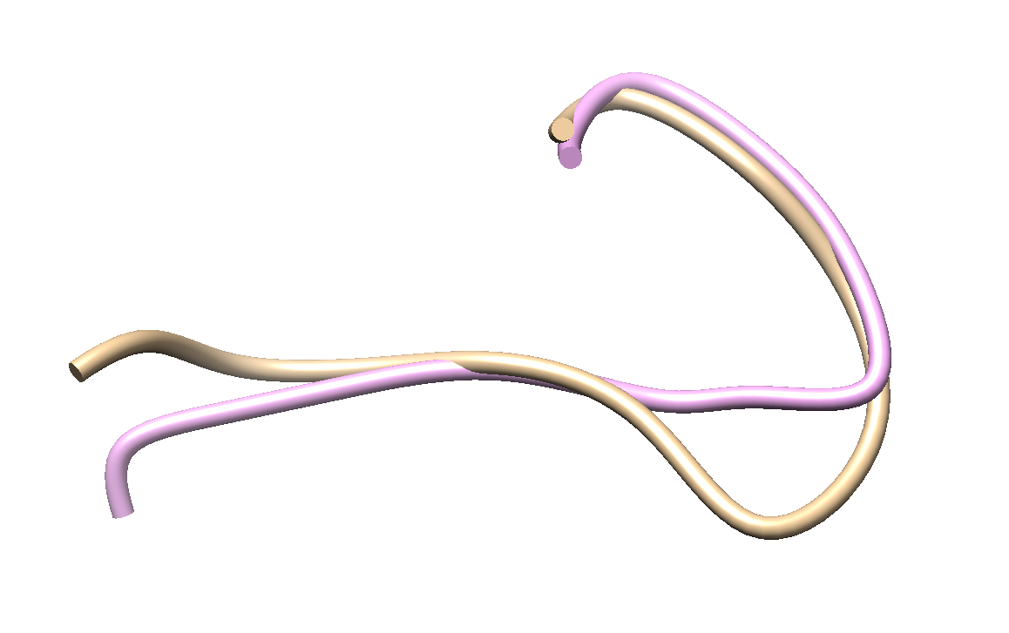
Visualization of Examples
Two structures without GAN and with GAN
Intermediate predicted results for case 1ALC
Golden one is the native.
Last one is ground truth.
 | Without GAN | With GAN
1CLC (8 Res)
1BN8 (12 Res)
RMSD: 1.6
RMSD: 0.6
RMSD: 3.0
RMSD: 1.7
PhD Defense, May 11, 2020

Slide 22
Outline
Introduction and Overview
New Methods Developed
MUFOLD-LM: Protein Loop Modeling
MUFOLD-Contact: Protein Contact Map Prediction
TPCref: Contact Map Prediction Refinement
New Software System Development
MUFOLD Improvements: A Protein Prediction Platform with Web Services
Summary and Future Work
PhD Defense, May 11, 2020

Slide 23
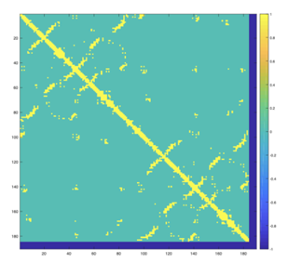
Introduction
Input:
MFKGIVQGAGIIKKISKNDDTQRHGITFPKDILESVEKGTVMLVNGCSLTVVRISGDVVYFDIDQAINTTTFRELEVGNKVNLEVRPEFGSLLGKGALTGNIKGVATVDNITEEEDRLKVYIKIPKDLIENILSEDHIGINGVSHSIEEISDDIIFINYPKNLSITTNLGTLEKGSDVNVETLNVSNEWD
What is contact prediction?
Given a length-L protein sequence, predict a binary matrix $C$:
where $D$ is the Euclidean distance between $C_{β}$ atoms ($C_{α}$ for glycine) of residue $i$ and $j$.
Predict
Output:
$$C_{ij}=f\left(x\right)=\left\{\begin{aligned}1, &if D<threshold \\ 0, &otherwise\end{aligned}\right.$$
PhD Defense, May 11, 2020

Slide 24
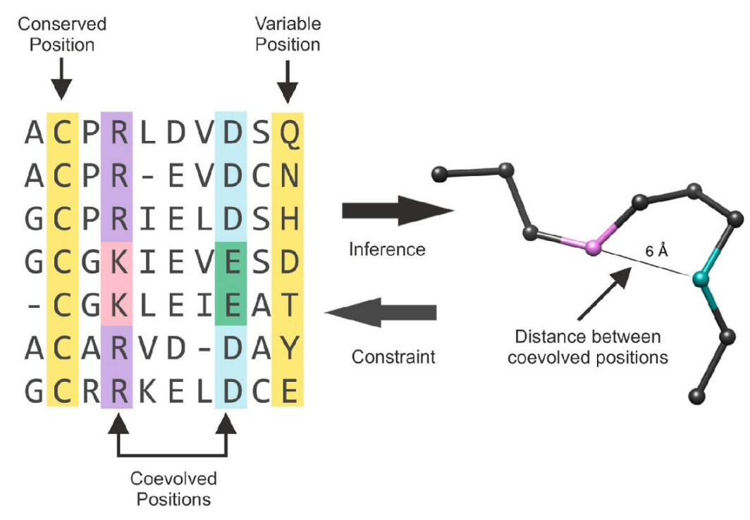
Background
Co-evolution of Protein Residues
Random mutations
A pair of residues mutates together to preserve protein’s function/structure
Those co-evolved positions are more likely to be in contact
Direct Coupling Analysis (DCA)
A statistical inference framework used to infer direct co-evolutionary couplings among residue pairs
Used as one of features for machine learning models
PhD Defense, May 11, 2020

Slide 25
Related Work
Category | Concepts | Authors | Methods
Statistical | Local Local pairwise statistics Pairs statistically independent Global Considering all other pairs in the protein Pott’s Model | Weigt 2009 | mpDCA
 |  | Morcos 2011 | mfDCA
 |  | Ekeberg 2013 | Pseudo-likelihood approx.
 |  | Baldassi 2014 | GaussianDCA
Traditional Machine Learning | MSAs from large sequence database Support vector machines Random forests Neural networks Meta-predictors | Cheng 2007 | SVMCon
 |  | Z. Wang 2013 | PhyCMap
 |  | Tegge 2009 | NNCon
 |  | David 2014 | MetaPSICOV
Deep Learning | Deeper and larger networks More features | Eickholt 2012 | DNCon
 |  | Wang 2017 | RaptorX
 |  | Adhikari 2018 | DNCON2
 |  | Michel 2019 | PconsC4
 |  | Li 2019 | ResPRE
PhD Defense, May 11, 2020

Slide 26
New Methods
MUFOLD-Contact_D: Predict distance map
MUFOLD-Contact_C: Predict binary contact map
MUFOLD-Contact
Two-stages multi-branch network
Combination of MUFOLD-Contact_D and MUFOLD-Contact_C
MUFOLD-Contact_D
Distance Map
Target Sequence
Feature Generation
Features Set
MUFOLD-Contact_C
Contact Map
MUFOLD-Contact
Contact Map
PhD Defense, May 11, 2020

Slide 27
All Features Set
# | Feature Name | Dimension | Software | Database (if any)
1 | PSSM | 20 | BLAST-2.7.1+ | uniref90_042016
2 | SS | 3 | Psipred_4.0 | Profile from 1
3 | SA | 1 | metaPSICOV 2.0.3 | Profile from 1
4 | Multiple Sequence Alignment (MSA) | - | HHsuite-2.0.16 | uniprot20_2016_02
5 | ALN Stats | $$L×L×3$$ | metaPSICOV 2.0.3 → alnstats | MSA from 4
6 | HHM Profile | 30 | Hhsuite-2.0.16 → hhmake | MSA from 4
7 | CCMPred | $$L×L$$ | CCMPred | MSA from 4
8 | EVFold | $$L×L$$ | freecontact-1.0.21 | MSA from 4
9 | PSICOV | $$L×L$$ | PSICOV | MSA from 4
10 | metaPSICOV | $$L×L$$ | metaPSICOV 2.0.3 | From 2, 3, 5, 7, 8, 9
11 | shapeString | 8 | frag1d | PSSM from 1
12 | Raw Co-evolution Statistics | $$L×L×441$$ | cov21stats | MSA from 4
13 | Physicochemical Features | 5 | Fixed values | -
PhD Defense, May 11, 2020

Slide 28
1. MUFOLD-Contact_D
Input Features
Given a sequence $S=\{R_{1},R_{2},…,R_{L}\}$,
For each $R_{i}$, feature size is $L×24$
For each $R_{ij}$, concatenate features of $R_{i}$ and $R_{j}$, plus the pairwise features, final size is $L×L×54$.
# | Feature Name | Dimension
1 | PSSM | 20
2 | SS | 3
3 | SA | 1
4 | Multiple Sequence Alignment (MSA) | -
5 | ALN Stats | $$L×L×3$$
6 | HHM Profile | 30
7 | CCMPred | $$L×L$$
8 | EVFold | $$L×L$$
9 | PSICOV | $$L×L$$
10 | metaPSICOV | $$L×L$$
11 | shapeString | 8
12 | Raw Co-evolution Statistics | $$L×L×441$$
13 | Physicochemical Features | 5
54
$$L$$
$$L$$
PhD Defense, May 11, 2020
Notes:
A

Slide 29
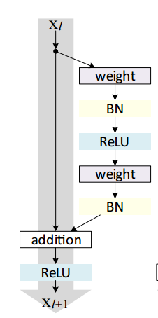
MUFOLD-Contact_D Network Structure
Residual Block
Shortcuts make network deeper
In our network, BN layers are removed
Plain net
Res net
Original Residual Block
Our Residual Block
PhD Defense, May 11, 2020

Slide 30
(Cont’d)
Branch 1: large filters to capture global features
Branch 2: direct connection
Main Net: small filters to capture local feature
Branch 1
Main Net
54
$$L$$
17x17
ResBlock
17x17
ResBlock
17x17
ResBlock
3x3
30 Res Block = 60 layers
$$L$$
Branch 2
$$L$$
$$L$$
1x1 Conv
Distance Prediction
PhD Defense, May 11, 2020

Slide 31
2. MUFOLD-Contact_C
Input Features
Physicochemical features
Features for $R_{i}$ (1D) and $R_{ij}$(2D) are processes separately
# | Feature Name | Dimension
1 | PSSM | 20
2 | SS | 3
3 | SA | 1
4 | Multiple Sequence Alignment (MSA) | -
5 | ALN Stats | $$L×L×3$$
6 | HHM Profile | 30
7 | CCMPred | $$L×L$$
8 | EVFold | $$L×L$$
9 | PSICOV | $$L×L$$
10 | metaPSICOV | $$L×L$$
11 | shapeString | 8
12 | Raw Co-evolution Statistics | $$L×L×441$$
13 | Physicochemical Features | 5
PhD Defense, May 11, 2020

Slide 32
MUFOLD-Contact_C Network Structure
29
9x9
3 ResBlocks
Outer Layer
5x5
6 Res Blocks
= 18 layers
$$L$$
Features for $R_{i}$
$$L$$
1x1 Conv
Concatenation
Features for $R_{ij}$
Binary Prediction
Transform $R_{i}$features to pairwise features
6
$$2N$$
$$N$$
$$L$$
$$R_{i}$$
$$L$$
Outer Layer
$$R_{ij}=R_{i}+R_{j}$$
‘+’ is concatenation
$$R_{j}$$
$$L$$
PhD Defense, May 11, 2020

Slide 33
3. MUFOLD-Contact
Input Features
Most features included such as HHM, ShapeString, metaPSICOV, etc
Features for $R_{i}$ (1D) and $R_{ij}$(2D) are processes separately
# | Feature Name | Dimension
1 | PSSM | 20
2 | SS | 3
3 | SA | 1
4 | Multiple Sequence Alignment (MSA) | -
5 | ALN Stats | $$L×L×3$$
6 | HHM Profile | 30
7 | CCMPred | $$L×L$$
8 | EVFold | $$L×L$$
9 | PSICOV | $$L×L$$
10 | metaPSICOV | $$L×L$$
11 | shapeString | 8
12 | Raw Co-evolution Statistics | $$L×L×441$$
13 | Physicochemical Features | 5
PhD Defense, May 11, 2020
Notes:
Remove the temporal signs

Slide 34
Two-stages Multi-branch Network
Three stage 1 networks are trained separately
Stage 2 network is trained at last using results from stage 1 as additional features
Stage 1 Network 1
Long
Distance
All Feature Set
Stage 1 Network 2
Medium Distance
Stage 2 Network
Contact Prediction
Stage 1 Network 3
Short Distance
Contact Range: Long (separation $≥$ 24); Medium (12 $≤$ separation $≤$ 23); Short (6 $≤$ separation).
PhD Defense, May 11, 2020

Slide 35
Stage 1
Distance map prediction
67
9x9
3 ResBlocks
Outer Layer
5x5
12 Dilated
Res Blocks
= 24 layers
$$L$$
1D
Features
$$L$$
1x1 Conv
5x5
3 ResBlocks
Concatenation
2D Features
Distance Prediction
7
Stage 2
Contact map prediction
67
9x9
3 ResBlocks
Outer Layer
5x5
6 Res Blocks
= 12 layers
$$L$$
1D
Features
$$L$$
1x1 Conv
Concatenation
2D Features
Contact Prediction
11
PhD Defense, May 11, 2020

Slide 36
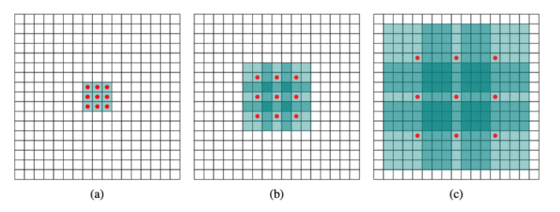
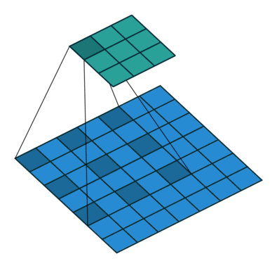
Dilated Residual Block
Traditional residual block with dilated convolution layers
Can increase the size of receptive field
Visualization of dilated layer
Credit: https://github.com/vdumouli
From left to right, the dilation is 0, 1, and 3 respectively in three layers.
Red dots are kernel. Blue part is the receptive filed.
PhD Defense, May 11, 2020

Slide 37
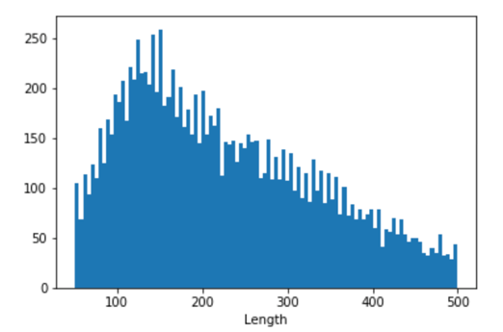
Training Sets
Version 1
Subset from RaptorX’s training set (3799)
Length between 50 and 300
Only used for MUFOLD-Contact_D
Version 2
Subset of CullPDB_042018 (5250)
Sequence max identity 25%
Length between 40 and 500
Remove those with missing residues $≥$ 5%
Length distribution of version 2
PhD Defense, May 11, 2020

Slide 38
Experimental Results
Testing Sets
Tools Compared
Testing Set 1
CASP13
CASP13 targets (19 are used)
Testing Set 2
NewPDB50
50 sequences
Length between 100 and 400
PDB structures released between 2019-04-01 and 2019-04-20
Maximum sequence identity 30%
FreeContact (Kaján 2014)
PSICOV (David 2012)
CCMPred (Seemayer 2014)
metaPSICOV2 (Buchan 2018)
RaptorX-Contact (Wang 2017)
ResPRE (Li 2019)
Run locally if downloadable
Online servers and ResPRE excluded for testing set 1
T0950, T0951, T0953s1, T0953s2, T0954, T0955, T0957s1, T0957s2, T0958, T0960, T0963, T0966, T0968s1, T0968s2, T1003, T1005, T1008, T1011, T1016
PhD Defense, May 11, 2020

Slide 39
Evaluation Metrics
Contact Range
Long range contacts (separation $≥$ 24);
Medium range contacts (12 $≤$ separation $≤$ 23);
Short range contacts (6 $≤$ separation).
List Size $N$
Trim the lists to $N$ contacts with the highest probabilities
$L/2$, $L/5$, and $L/10$
Precision
$Precision=\frac{TP}{TP+FP}$
PhD Defense, May 11, 2020

Slide 40
Testing Set 1 – CASP13
Most important one
PhD Defense, May 11, 2020

Slide 41
PhD Defense, May 11, 2020

Slide 42
Testing Set 2 – NewPDB50
Most important one
PhD Defense, May 11, 2020

Slide 43
Outline
Introduction and Overview
New Methods Developed
MUFOLD-LM: Protein Loop Modeling
MUFOLD-Contact: Protein Contact Map Prediction
TPCref: Contact Map Prediction Refinement
New Software System Development
MUFOLD Improvements: A Protein Prediction Platform with Web Services
Summary and Future Work
PhD Defense, May 11, 2020

Slide 44
Introduction
Contact Map Prediction Refinement
Given a contact map prediction $C$ from a predictor $P$, refine $C$ in order to improve the accuracy of $C$.
Contact Map Prediction Refinement
Long L/5 Acc: 78%
Long L/5 Acc: 90%
PhD Defense, May 11, 2020

Slide 45
New Method - TPCref
Existing contact map predictors drawback: only use sequence features
Templates have important structural information
The first to utilize templates to refine contact map prediction
Inspired by collaborative filtering
Applicable to any contact map predictor
Learn from mistakes: utilizes knowledge of misclassified templates contacts
TPCref
(template prediction correction refinement)
PhD Defense, May 11, 2020

Slide 46
Overall Architecture
1. Target contact map prediction.
1
Target Sequence
Contact Map Predictor
Target Contact Prediction
PhD Defense, May 11, 2020

Slide 47
Overall Architecture
1. Target contact map prediction.
2. Templates selection, templates contact map prediction, and contact map filter generation.
1
Target Sequence
Contact Map Predictor
Target Contact Prediction
Blast
Sequence
clustering
Contact Map Filter Generation
2
20 Template Sequences
20 Template Contact Predictions
Contact Map Filter
PDB Extraction
20 Template Native Contact Maps
PhD Defense, May 11, 2020

Slide 48
Overall Architecture
1. Target contact map prediction.
2. Templates selection, templates contact map prediction, and contact map filter generation.
3. Apply the contact map filter to target contact map prediction.
1
3
Target Sequence
Contact Map Predictor
Target Contact Prediction
Blast
Sequence
clustering
Contact Map Filter Generation
2
20 Template Sequences
20 Template Contact Predictions
Contact Map Filter
Fusion
PDB Extraction
20 Template Native Contact Maps
Refined Contact Map Prediction
PhD Defense, May 11, 2020

Slide 49
Contact Map Filter Generation
Key idea: learn from mistakes, get information from similar templates
User-based collaborative filtering gets information from similar users
Find the most similar users to $U_{1}$ and have rated $Item_{2}$
$S_{12}$ is predicted as weighted average of other scores from similar users
Similar users.
PhD Defense, May 11, 2020

Slide 50
Contact Map Filter Generation
Key idea: get information from similar templates
User-based collaborative filtering gets information from similar users
Similar users.
Similar individual filters from templates.
$F_{i_mn}$ is a “rating”
${CF}_{mn}$ is predicted as weighted average of other “ratings” from other templates
PhD Defense, May 11, 2020

Slide 51
Individual Template Filter Generation
Generate an individual filter $F_{i}$ for each template $T_{i}$ ($N_{i}$ is native template contact map)
$F_{i}$ is initialed as $T_{i}$’s contact prediction.
True Contact
Short & Medium
Long
For short and medium range residue pairs $R(m, n)$:
$$F_{i}\left(m, n\right)=P_{i}×2×\left(N_{i}\left(m, n\right)−0.5\right)$$
For long range residue pairs$R(m, n)$:
$$F_{i}\left(m, n\right)={P_{i}×N}_{i}\left(m, n\right)$$
0
$$F_{i}×−1$$
0
$$F_{i}$$
1
$$F_{i}$$
$$F_{i}$$
PhD Defense, May 11, 2020

Slide 52
Evaluation
Testing Set
NewPDB50 from MUFOLD_Contact
Existing Contact Map Predictor for Comparison
FreeContact (Kaján 2014)
CCMPred (Seemayer 2014)
metaPSICOV2 (Buchan 2018)
ResPRE (Li 2019)
MUFOLD_Contact
PhD Defense, May 11, 2020

Slide 53
Improvements After Applying TPCref
ALL positive values!
EVERY metric of ALL existing predictors are improved.
PhD Defense, May 11, 2020

Slide 54
NewPDB50 Precision with TPCref
Most important one
PhD Defense, May 11, 2020

Slide 55
Additional Results
Long L/5 Precision Comparison Before and After Applying TPCref
PhD Defense, May 11, 2020

Slide 56
Outline
Introduction and Overview
New Methods Developed
MUFOLD-LM: Protein Loop Modeling
MUFOLD-Contact: Protein Contact Map Prediction
TPCref: Contact Map Prediction Refinement
New Software System Development
MUFOLD Improvements: A Protein Prediction Platform with Web Services
Summary and Future Work
PhD Defense, May 11, 2020

Slide 57
New MUFOLD Improvements Overview
Old MUFOLD
C & C++
New MUFOLD
Refactored using C++ and Python
Procedural program, hard to modify
No docs
No code comments
OOP design, easy to modify
Decoupled modules
Add new tools easily
Official searching tools and databases
Web APIs
Need to generate own databases
Web Portal
Database Generation
3D Modeling
Secondary Structure
Secondary and Supersecondary
3D Modeling
Web Services
Loop Modeling
Contact Map
Prediction and Refinement
Model Refinement
Quality Assessment
PhD Defense, May 11, 2020

Slide 58
MUFOLD Modules Design
Unified data objects
Decoupled modules
Communication protocols
Easy to:
Add new tools
Develop new methods
Do fast dev-iterations
Reusing code bases (no need to re-invent wheels)
Etc.
Alignment Generation
Loop Modeling
Modeling
QA
Feature Generation
Refinement
Contact Map Prediction
Data Objects
PhD Defense, May 11, 2020

Slide 59
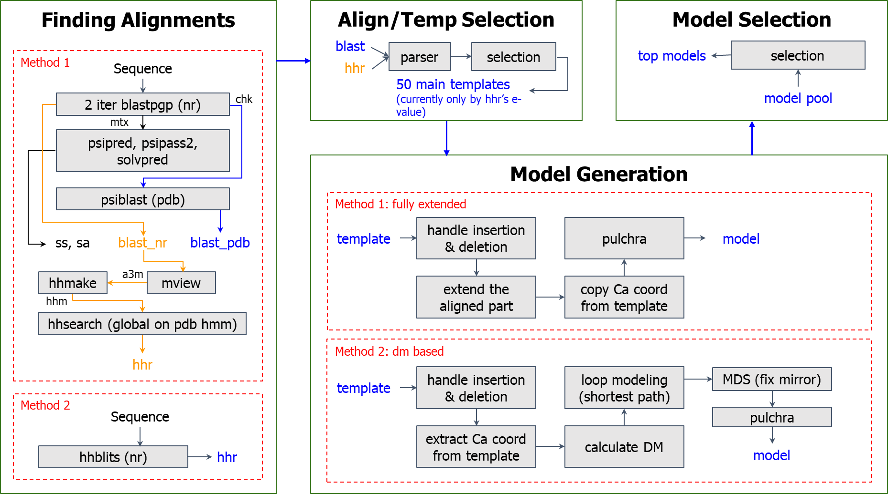
PhD Defense, May 11, 2020

Slide 60
Web Services System
Frontend
Job Scheduler System
Target
Job Scheduler System
(Some runners are responsible for different tasks.)
Web Portal or APIs
Yes
New Job?
No
PHP Scripts
Job Queue for Different Tasks
Listener
Notify the User by Email
Backend
PhD Defense, May 11, 2020

Slide 61
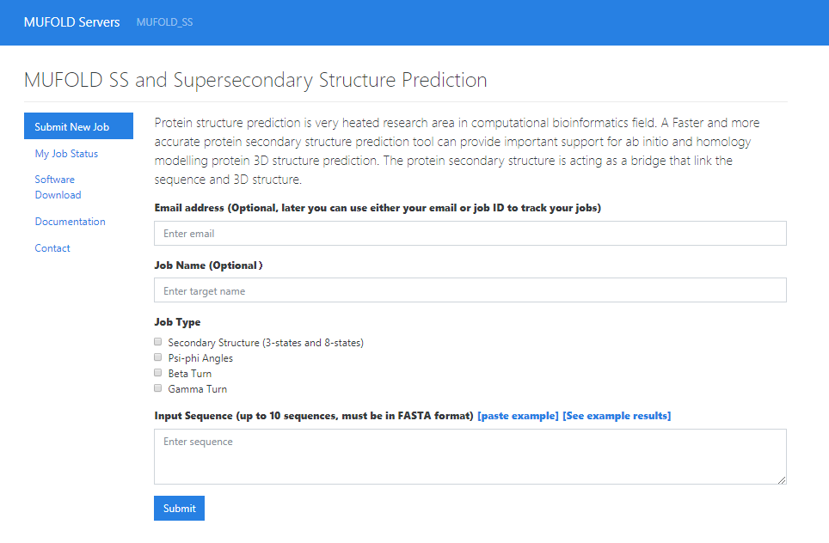
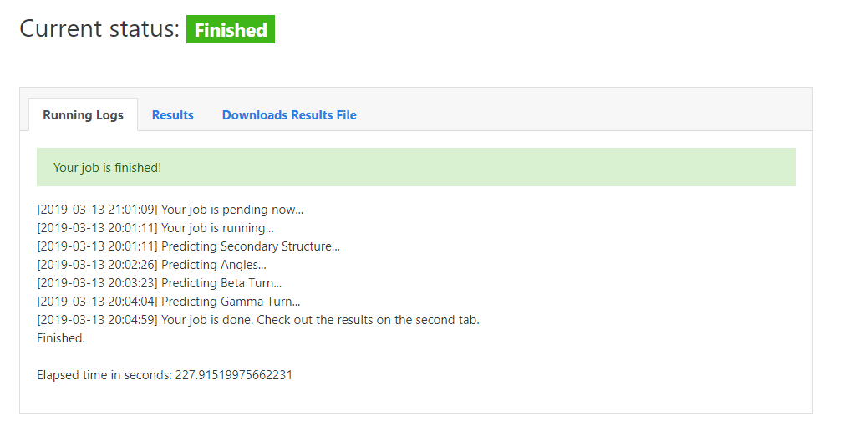
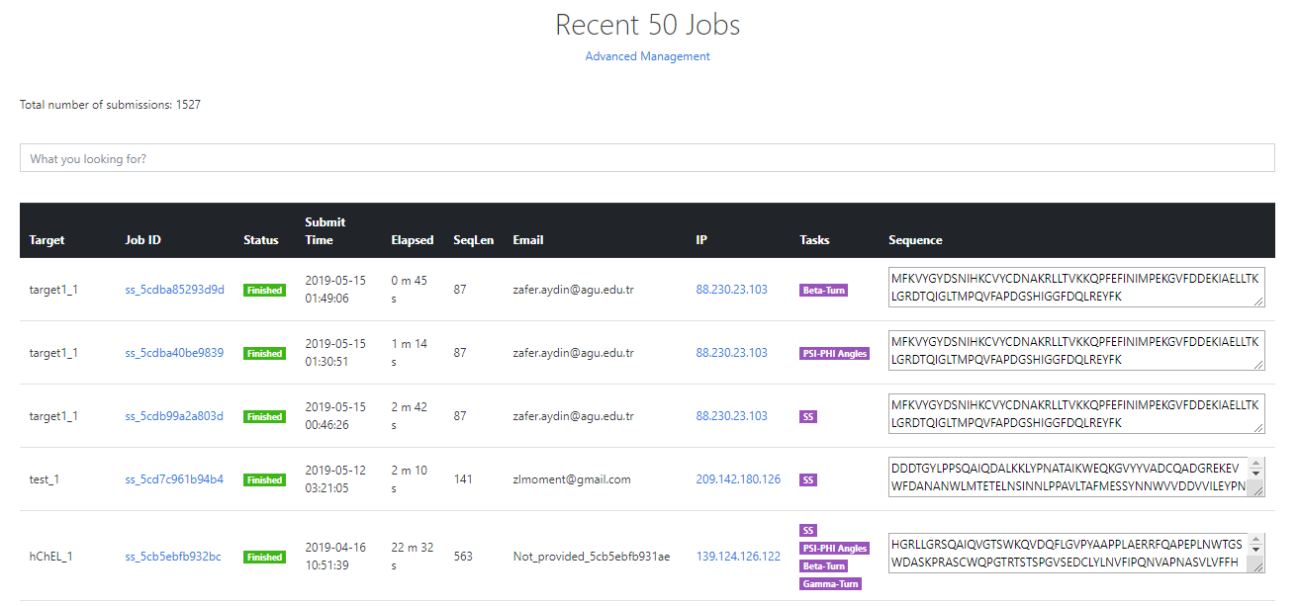
Frontend and Job Scheduler/Management
User friendly frontend
Real time status tracking
Job Management
PhD Defense, May 11, 2020

Slide 62
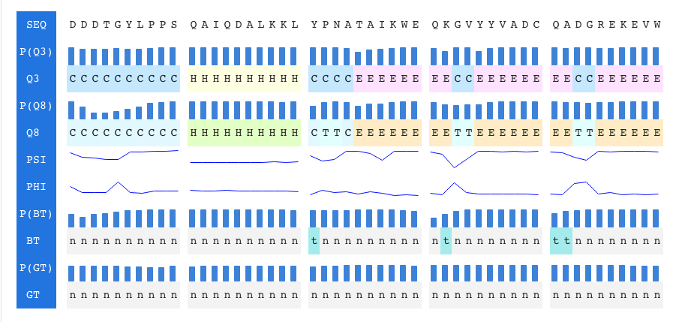
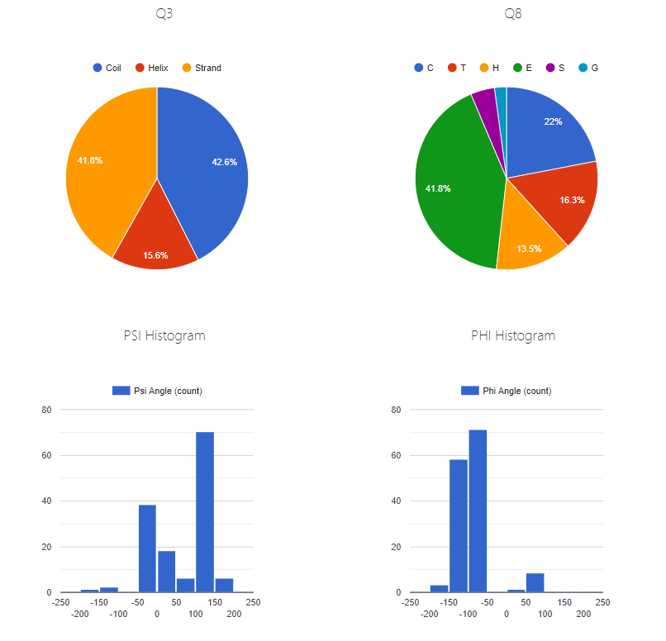
Interactive Results
Interactive Visualization
PhD Defense, May 11, 2020

Slide 63
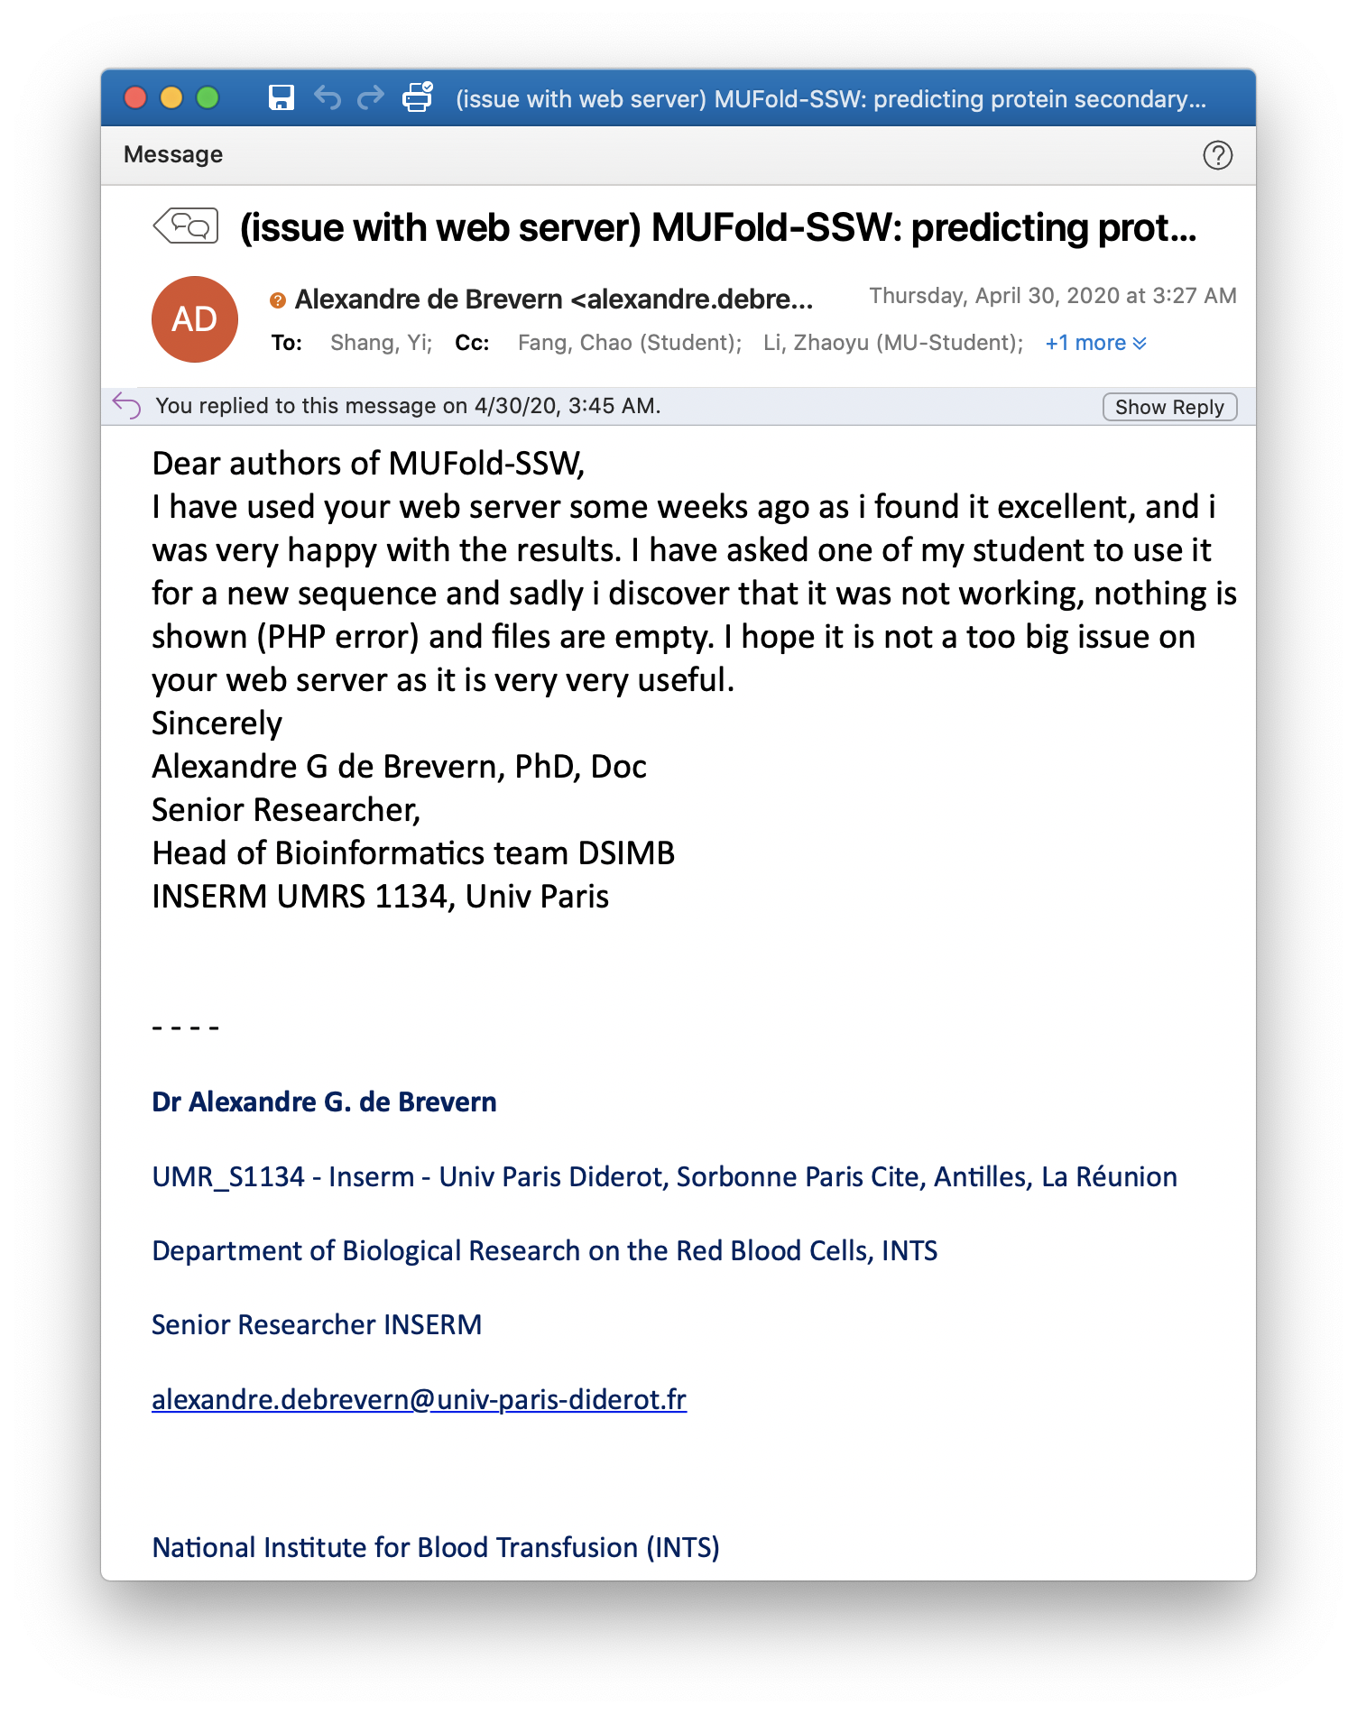
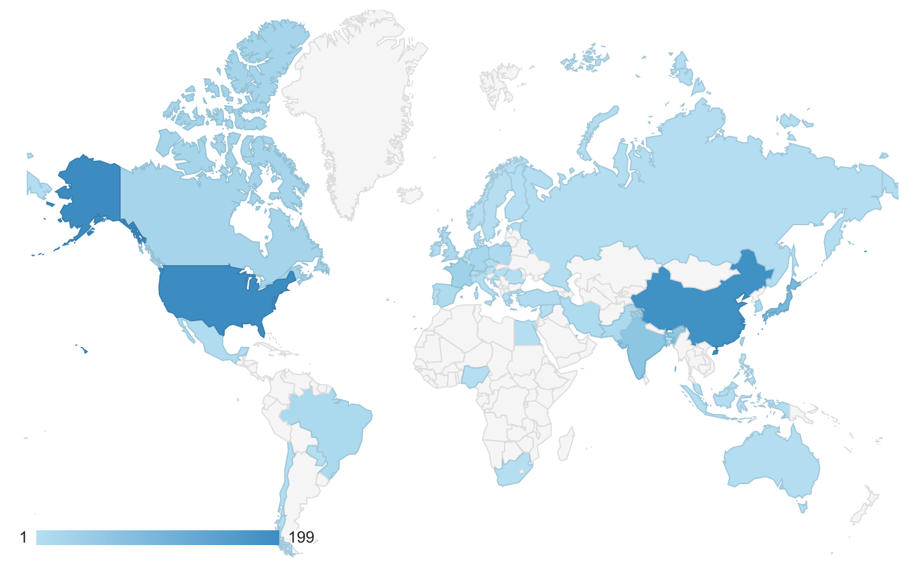
Usage and Usefulness
Since October 2018
1,521 users from all over the world
8,435 submitted jobs (each has up to 4 tasks)
PhD Defense, May 11, 2020

Slide 64
Outline
Introduction and Overview
New Methods Developed
MUFOLD-LM: Protein Loop Modeling
MUFOLD-Contact: Protein Contact Map Prediction
TPCref: Contact Map Prediction Refinement
New Software System Development
MUFOLD Improvements: A Protein Prediction Platform with Web Services
Summary and Future Work
PhD Defense, May 11, 2020

Slide 65
My Contributions
Methods | Techniques | Problem Solved | Performance
MUFOLD_LM | Context Encoder, Generative Adversarial Network (GAN) | Protein Loop Modeling | 43.9% and 4.13% improvements on 8-Res and 12-Res First successful GAN application in protein structure prediction
MUFOLD_Contact | Fully Convolutional Network (FCN), Dilated Residual Network | Protein Contact Map Prediction | 17.5% improvements compared to metaPSICOV2 in Long L/5 on CASP13 New features, new network structures
TPCref | Templates Based Refinement, Collaborative Filtering | Predicted Contact Map Refinement | Significantly improved existing contact predictors (5.0%, 12.8%, and 37.2% for MUFOLD_Contact, MetaPSICOV, CCMPred) Collaborative filtering
MUFOLD Dev | Objected Oriented Design, Modularized Design | Structure Modeling, Unified Online Portal | OOP design Web services for the community User friendly experience, interactive visualizations
PhD Defense, May 11, 2020

Slide 66
Future Work
Loop Modeling
GAN can be further fine-tuned and more variations can be tried
Training could be stabilized
Cross target training
Contact Map Prediction
Usage of GAN
Usage of raw co-evolution scores
Contact Map Refinement
Utilizing a greater number of templates
A more sophisticated template weighting methods
Modern web design of web portals (Angular, HTML5, etc)
PhD Defense, May 11, 2020

Slide 67
List of Publications
Zhaoyu Li, Jeffrey Ruffolo, Yi Shang, "New Deep Learning and Collaborative Filtering Methods for Protein Structure Contact Prediction” (to be submitted)
Chao Fang*, Zhaoyu Li* (co-first author), Dong Xu, Yi Shang. "MUFold-SSW: A New Webserver for Predicting Protein Secondary Structures, Torsion Angles, and Turns." Bioinformatics 36, no. 4 (2020): 1293-1295.
Jeffrey Ruffolo, Zhaoyu Li, Yi Shang. "MUFold-Contact and TPCref: New Methods for Protein Structure Contact Prediction and Refinement." In 2019 IEEE International Conference on Bioinformatics and Biomedicine (BIBM), pp. 90-93. IEEE, 2019.
Wenbo Wang, Zhaoyu Li, Junlin Wang, Dong Xu, and Yi Shang. "PSICA: a fast and accurate web service for protein model quality analysis." Nucleic acids research 47, no. W1 (2019): W443-W450.
Zhaoyu Li, Son Nguyen, Dong Xu, Yi Shang. "Protein Loop Modeling Using Deep Generative Adversarial Network." In Tools with Artificial Intelligence (ICTAI), 2017 IEEE 29th International Conference IEEE, 2017
Junlin Wang, Zhaoyu Li, and Yi Shang. "New Deep Neural Networks for Protein Model Evaluation." In 2017 IEEE 29th International Conference on Tools with Artificial Intelligence (ICTAI), pp. 309-313. IEEE, 2017.
Son Nguyen, Zhaoyu Li, Yi Shang. "Deep Networks and Continuous Distributed Representation of Protein Sequences for Protein Quality Assessment." In Tools with Artificial Intelligence (ICTAI), 2017 IEEE 29th International Conference IEEE, 2017.
Son Nguyen, Zhaoyu Li, Dong Xu, and Yi Shang. "New Deep Learning Methods for Protein Loop Modeling." IEEE/ACM Transactions on Computational Biology and Bioinformatics (2017).
PhD Defense, May 11, 2020

Slide 68
Acknowledgement
This work was supported in part by National Institutes of Health grant R01GM100701.
The high-performance computing infrastructure is supported by the National Science Foundation under grant number CNS-1429294.
Some images were taken from the public domain.
PhD Defense, May 11, 2020

Slide 69
Thank you!
Speaker: Zhaoyu Li
Department of Electrical Engineering and Computer Science (EECS)
University of Missouri - Columbia
PhD Defense, May 11, 2020

Slide 70
Backup Slides

Slide 71
MUFOLD-Contact_GAN
Prediction
GENERATOR
MUFOLD-Contact_C
Conv
PatchGAN
Get patches by sliding window
DISCRIMINATOR
Discriminator Network
True Contact
PhD Defense, May 11, 2020

Slide 72
MUFOLD_LM Loss Functions
Define $z$ the input to the Generator ($G$), Discriminator ($D$), $x$ the ground truth:
Overlap region
Missing region
-
$$Loss_{recon} ={\left\|G(z) – x\right\|}_{2}^{2}$$
$$Loss_{adv_G} = log\left(1 – D\left(\left.G(z\right)\right)\right)$$
-
$$Loss_{all_G} ={Loss_{recon}+}Loss_{adv}$$
-
-
$$Loss_{adv_D} =−log\left(G(x)\right)$$

Slide 73
MUFOLD_LM Adversarial Loss
The adversarial loss is to pick the best distribution according to the training set.
During the training, we train the Adversarial Discriminator Network (D) to maximize log(D(x)), where x is the ground truth, i.e. the probability of correct distinction between the generated result and the ground truth.
In the meantime, we train the Generator Network (G) to minimize log(1-D(G(z))) where z is the input to G:

Slide 74
How to train MUFOLD_LM
Loss of real and recon generated by G.
The gradients provided by this loss will make G generate better fake results with smaller MSE.
Loss_G = 0.5 * Loss(recon) + 0.5 * Loss(adv_G)
Loss_D = 0.5 * Loss(adv_D)
Loss of D predicts recon is real.
The gradients provided by this loss will make G generate better fake results to fool D.
Loss of D predicts recon is fake, and real is real.
The gradients provided by this loss will make D be able to better identify fake from real.

Slide 75
How to train MUFOLD_LM
Fix G’s weights, train D
For real data, D is optimized to output 1
For generated data, D is optimized to output 0
Fix D’s weights, train G
G is optimized to generate data that D gives high probability to be real.
D provides gradients to update G’s weights

Slide 76
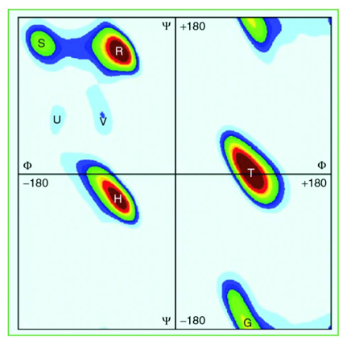
ShapeString
This is a predicted eight states features based on the discrete state of dihedral angles (Zhou, Shu, & Hovmoller, 2010)
The eight-state Shape Strings are defined as shown in the figure and it is generated by tool Frag1D

Slide 77
MUFOLD_LM Method Overview
Target:
Length $L$ with missing region in the middle (e.g. $L=50$)
CDWEEISVKGPNGESSVIHDRKSGKKFSIEEALQSGRLTPAHYDRYVNKD
PSI-BLAST
HHSearch
Template Pool Generation:
Templates that can cover the whole query target
Template Pool
Neural Network Training:
Use the templates’ distance maps with loop region removed to train
Neural Network (GAN)
NN Model
NN Model
Prediction:
Input the target’s distance map with missing region
Prediction

Slide 78
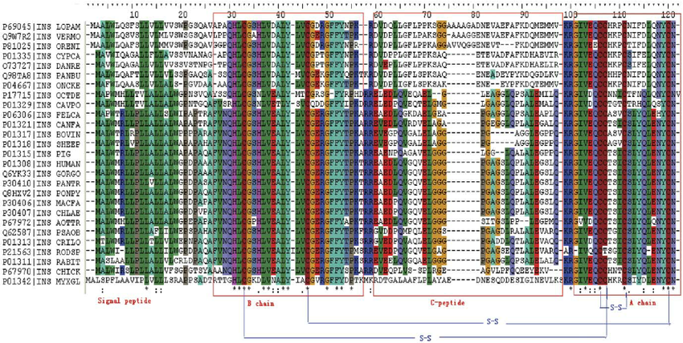
Raw Scores
Position $i$
Position $j$
A
A
C
C
Raw co-evolution statistics (for each residue pair at position 𝑖 and 𝑗)
It can be considered as the $21∙21$ weights of bipartite graph $K_{21,21}$
First vertices set: the 21 amino acid types at position $i$
Second vertices set: the 21 amino acid types at position $j$
Edge weights: co-evolution of the respective variants
D
D
E
E
F
F
G
G
H
H
Direct coupling analysis
I
I
Multiple Sequence Alignment
K
K
L
L
M
M
N
N
P
P
Q
Q
R
R
S
S
T
T
V
V
W
W
Y
Y
-
-
Co-evolution statistics

Slide 79
Feature Calculation: Covariance
Calculate weight
Calculate single frequencies
Calculate pair frequencies
Calculate covariance
This step is from source code: https://github.com/psipred/DeepCov/blob/master/src/cov21stats.c

Slide 80
Related Work using Neural Networks Details
Tool | Year | Methods
MetaPSICOV | 2015 | Two-layer NN, 9-residue window
MetaPSICOV2 | 2017 | Deeper and wider network, 15-residue window
RaptorX | 2017 | 60 layers Resnet, basic sequence and pairwise features
PconsC4 | 2018 | U-net
DNCON2 | 2018 | Two-level CNN, different nets for different contact threshold
ResPRE | 2019 | Deep residual CNN, precision matrix based features
MUFOLD-Contact | Mine | Two-stages, dilated Resnet, distance maps for different ranges, combined for final binary prediction
PhD Defense, May 11, 2020

Slide 81
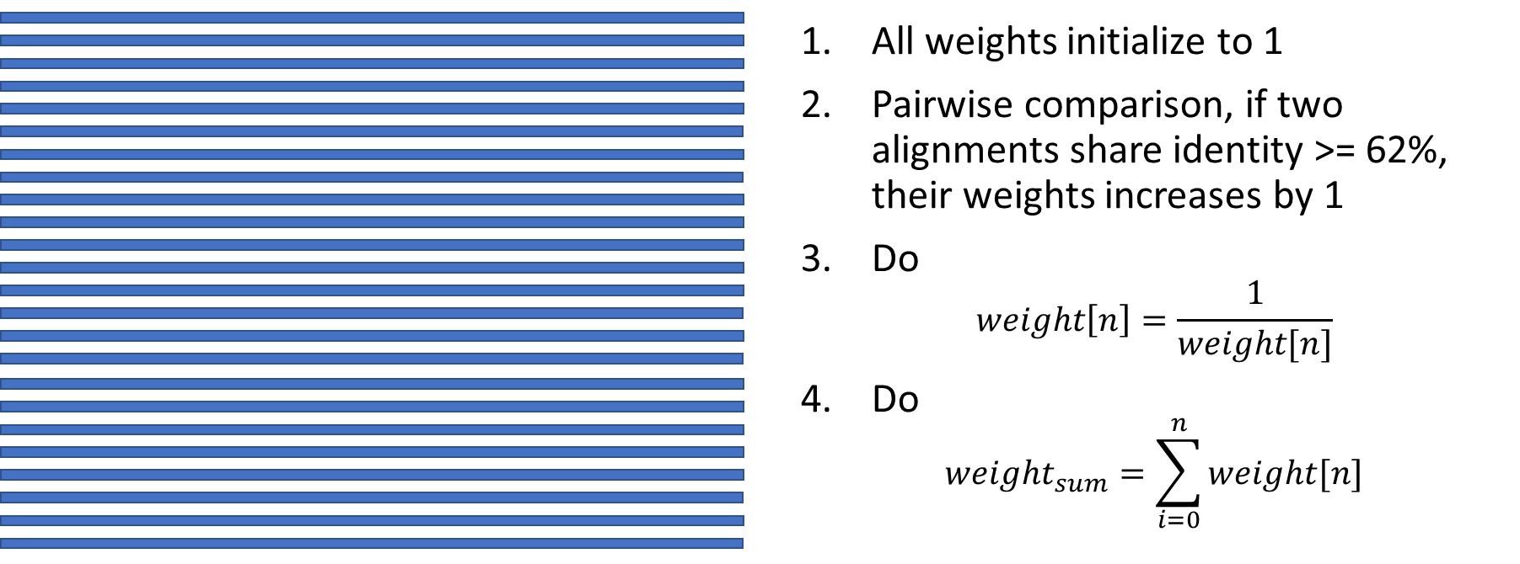
1. Calculate Weight

Slide 82
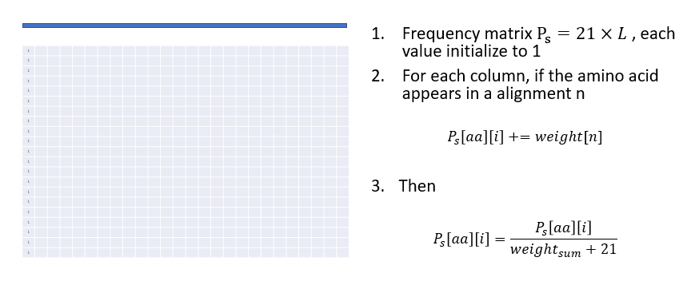
2. Calculate Single Frequencies

Slide 83
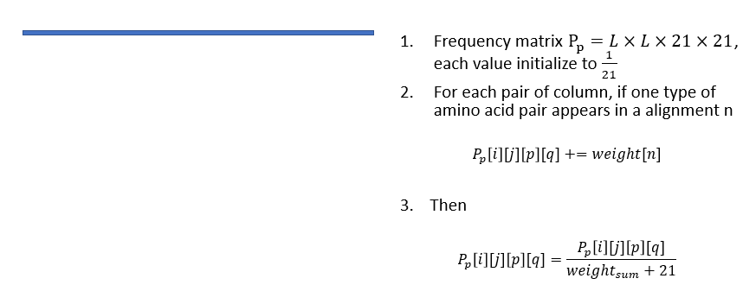
3. Calculate Pairwise Frequencies

Slide 84
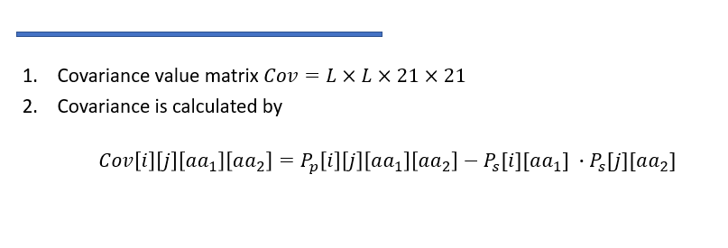
4. Calculate Covariance

