Slide 1
Multi-Dimensional Scaling and MODELLER based Evolutionary Algorithms for Protein Model Refinement
Yan Chen
Advisor: Yi Shang
12.06.2013
Notes:
Good morning everyone, Thank you for coming. This is my thesis project----multi dimensional scaling and MODELLER evolutionary algorithms for protein model refinement.

Slide 2
Motivation
To obtain an accurate protein structure is important in bioinformatics
Refinement is a step in the prediction process
Refinement category added since CASP8(2008), the category is drawing increasing attention
In CASP10, 7 out of 50 groups improved the quality of the starting models (though only 2 or 3 are significantly better)
Notes:
We all known that protein is essential in our life.
To computationally obtain an accurate protein structure is one of the most important problems in bioinformatics and it has been actively researches for many years.
Model refinement is a step in the prediction process.
Since the refinement category being added to the Critical Assessment of Structure Prediction (CASP) competition in 2008, the refinement problem is drawing increasing attention.
In last CASP competition, 7 groups improved the quality of the starting models, though only 2 or 3 are significantly better. I will talk more about in the existing work part.

Slide 3
Motivation
Most groups degrade the starting model more often than they improve it
Improvements are still small even for the best groups
The goal of the project: Exploring new ways to improve existing refinement techniques
Notes:
the performance of most groups are not very well. Rather than improve it, most time they degrade the starting model.
Overall, the improvements are still small even for the best groups.
So my goal of this project is to explore new ways to improve existing refinement techniques.

Slide 4
Methods Developed in the Project
Three evolutionary algorithms for protein model refinement
MDS-based: takes a purely geometrical approach and generates model by combining the contact maps.
MODELLER-based: takes a statistical and energy minimization approach and uses the remodeling module in MODELLER program.
Hybrid: first generates models using the MDS-based method and then run them through the MODELLER-based method, aiming at combining the strength of both.
Notes:
I focused on the evolutionary algorithm for protein model refinement.
Three methods are developed in this project. Multi dimensional scaling (MDS), MODELLER and a hybrid of both are used as crossover operators.
The MDS-based method takes a purely geometrical approach and generates a child model by combining the contact maps of multiple parents.
The MODELLER-based method takes a statistical and energy minimization approach and uses the remodeling module in MODELLER program to generate new models from multiple parents.
The hybrid method first generates models using the MDS-based method and then run them through the MODELLER-based method, aiming at combining the strength of both.

Slide 5
Outline
Existing work
Foundations
Proposed Methods
Experimental Results
Conclusions
Notes:
Here is the outline of my presentation.
First of all, I will introduce the current existing work in CASP10 refinement along with some background information required to understand the proposed methods we will talk about. Next go into methods we developed to refine models.
Then I will show the experimental results.
At the last part, I will talk about the conclusions and future works.

Slide 6
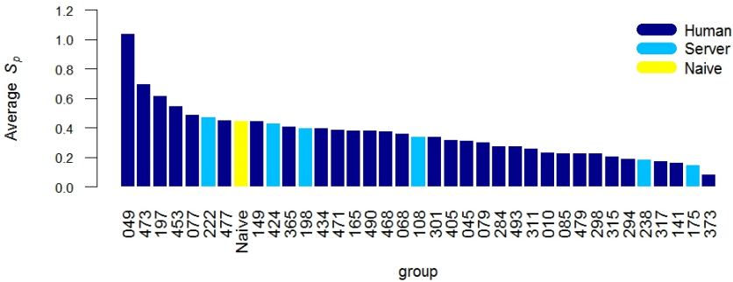
Existing Work
Notes:
The biggest challenge in CASP8 and CASP9 refinement is that only a few groups were able to improve the protein model quality consistently.
In CSAP10, the leading groups demonstrated they could consistently improve the model quality both backbone and side-chain positioning.
they also could improve the local quality of the predicted models.
More over, using different assessment tools to evaluate their performance, the positions of top-ranked groups are stable.

Slide 7
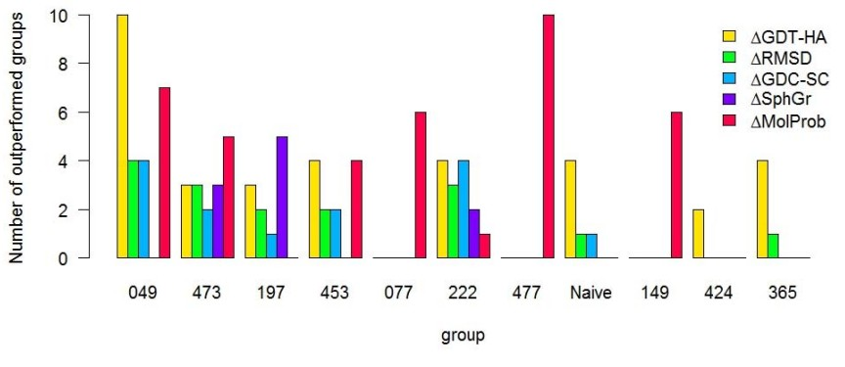
Existing Work
Notes:
This is the performance of the top groups in different methods.
The top group 049 is from Michigan State University. They made largest improvement in GDTHA.
They succeeded in improving the backbone in almost 90% targets. This is the first time in CASP refinement is successful in a clear majority of cases.

Slide 8
Outline
Existing work
Foundations of the proposed methods
Evolutionary Algorithm (EA)
Protein Quality Evaluation
MDS
MODELLER
Proposed methods
Experimental Results
Conclusions
Notes:
Now, I will give you some background information about my project.

Slide 9
Evolutionary Algorithm
Start
Initial population
Generation Cycle
Evaluation
Y
End
terminate?
N
Selection
Crossover
Notes:
What’s the EA? Evolutionary Algorithms simulate the natural evolution progress.
The first step is generate the initial population, then evaluate each individual of the population, next select parents from it, breed new generation by crossover.
Repeat generation until termination

Slide 10
Models Quality Assessment—CGDTTS
Measure the correct positioning of amino acid sequences between two protein models
Widely accepted as a QA tool in CASP
where S_{i} and S_{j} are 3D structures, P_{d} is the percentage of Ca from S_{i} that can be superimposed from S_{j} within a defined distance cutoff d, d$ε$ {1,2,4,8}
Notes:
Picking the best suitable candidates from the template is essential to model refinement.
GDT-TS is a global quality measure of the correct positioning of amino acid sequences between two protein models.
It is the most commonly parameter used to evaluate the quality of a predicted protein models with the experimentally determined structure. It is also widely accepted as a quality assessment of protein models prediction tool in CASP competition.
The GDT is defined as follow:
However, in the refinement procedure, the knowledge of native structure didn’t exposure. For predicted model’s evaluation, most groups used consensus GDT-TS (CGDT-TS) ，which is consider the similarity between each pairs of model. Given a set of prediction structures set S and a reference structure set R, the CGDT-TS score for each prediction structure S_{i} is defined as

Slide 11
Correlation with true GDTTS—Consensus
Notes:
This picture shows the correlative between most commonly used Consensus methods with the naïve GDTTS. From the figure, we could see for the CSAP data set, the Consensus GDTTS has very high correlative values with the naïve.

Slide 12
Models Quality Assessment—ProQ2
Developed by B Wallner from Sweden in 2012
Best single-model method in CASP10
Uses support vector machines to validate local and global quality of protein models
Notes:
Another method used for QA problem is using energy or scoring functions.
ProQ2 program is developed by Dr. Wallner from Sweden in 2012, which is the best single model method in CASP10.
This method uses support vector machines to validate local and global quality of protein models.
It can evaluate both the global and local quality of a predicted model.

Slide 13
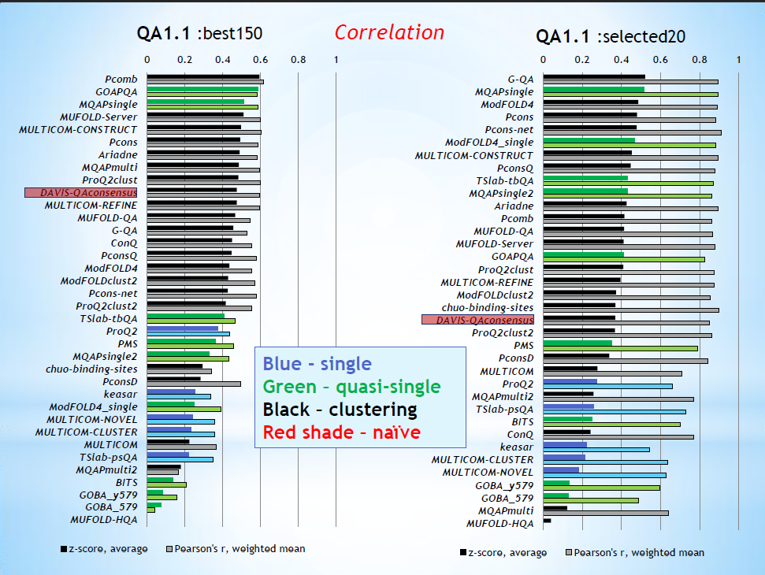
ProQ2
Notes:
Lets look at its performance in CASP10. The blue bar means the single score methods. ProQ2 is the top method for single model.

Slide 14
Correlation with true GDTTS—Score functions
Notes:
I run ProQ2 program and get the correlation value between those scoring functions and true GDTTS . The ProQ2 evaluation methods are better than OpusCA,Ddfire and CalRW.

Slide 15
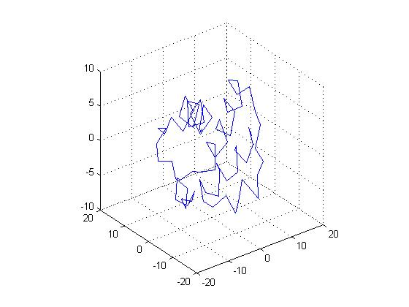
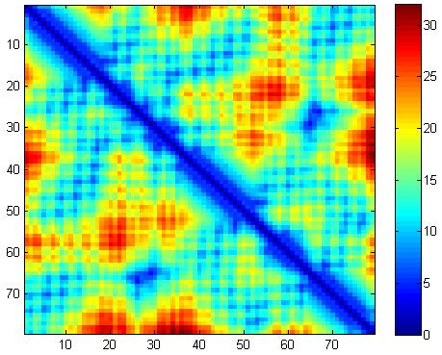
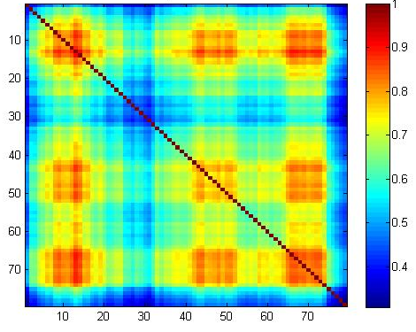
Weighted Multi-Dimensional Scaling (WMDS)
Dimensional reduction technology
Find the low dimensional space to represent the distances
Contact Map
Weights Matrix
3D Coordinates
Notes:
MDS is short for Multi Dimensional Scaling, actually is a dimensional reduction technology.
The aim of MDS is trying to find the low dimensional space to represent the distances.
Weighted MDS named as WMDS.
For example, here is a contact map, which is represent the distance matrix of a predicted model.
Correspondingly here is a weights matrix. Based on them, using WMDS methods we could get a 3D coordinates of a protein model.

Slide 16
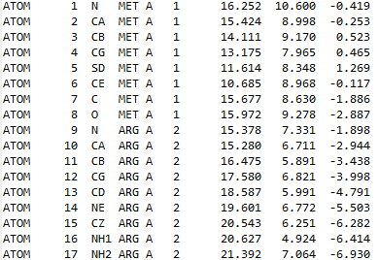
MODELLER
Written by Andrej Sali at the University of California, San Francisco in 1993
Used for homology or comparative modeling of protein three-dimensional structures
Script file
Sequence file
<5 models
3D model
Notes:
MODELLER program is written by Andrej Sali at the university of California, San Francisco in 1993.
This program could used for homology or comparative modeling of protein three dimensional structures.
Commonly, the input includes a sequence file of all models, less than 5 models and a script file to tell Modeller how to run the program.
The output is a full-atom model.

Slide 17
Outline
Existing Work
Foundations
Proposed Methods
Flow Chart
Generate Initial Population
Roulette Wheel Selection
Three Crossover Methods
Experimental Results
Conclusions
Notes:
Now, I will talk about the methods I used.

Slide 18
Focus: different crossover operators in EA
MDS-based
geometrical approach
combining the contact maps
MODELLER-based
statistical and energy minimization approach
remodeling module in MODELLER
Hybrid
first using the MDS-based
then run them through the MODELLER-based
combining the strength of both
Notes:
In this project, I am focus on different crossover operations in EA

Slide 19
Start
Initial Pool
Generate initial population
Generation Cycle
Evaluation
CGDT-TS
ProQ2
Remove Redundancy
Best 200 Models
Best 200 Models
End
Y
100 new models
Terminate?
N
Selection
Roulette Wheel Selection
Crossover
WMDS-based
MODELLER-based
Hybrid
Contact
Map
Weights Matrix
WMDS-
based
Sequence
Model
WMDS
MODELLER-
based
MODELLER
XYZ2PDB
Notes:
This is the flow chart of the EA. First, it will generate initial population, then using ProQ2 or CGDTTS as evaluation methods to choose the best 200 models.
Then using Roulette wheel selection method to pick the parents. In the crossover part, three methods are developed. Put the new 100 models into the last population, then evaluate their quality and choose the best 200 models. Repeat this until the termination.
We will see more details in each part.
First, let’s look at how to gain the initial population.

Slide 20
Generate Initial Population
Remove one of similar models
$$GDTTS(S_{i},S_{j})=1$$
Remove model $S_{i }$whose sequence length is too short or too long
$$Length(S_{i})≠Length(S_{native})$$
Choose the best 200 models by CGDTTS
Notes:
In this project, I used models form CASP competition. There are many groups, each group could submit at most 5 predicted models. If models from the same group or used similar methods, their quality may be similar, so for maintain the diversity of the population, first, compute the GDTTS value between each pair, if GDTTS equals to 1, means one of them is redundant. Then I only keep models which length is the same with the native sequence. At the end, using CGDTTS method to choose the best 200 models as the initial population.

Slide 21
Start
Generate initial population
Evaluation
CGDTTS
ProQ2
Remove Redundancy
Best 200 Models
Best 200 Models
End
Y
100 new models
Terminate?
N
Selection
Roulette Wheel Selection
Crossover
WMDS-based
MODELLER-based
Hybrid
Contact
Map
Weights Matrix
WMDS-
based
Sequence
Model
WMDS
MODELLER-
based
MODELLER
XYZ2PDB
Notes:
We already discussed about the evaluation methods.
For the selection part, I used roulette wheel selection method.

Slide 22
Roulette Wheel Selection
The most wildly used selection method
Based on the probability of individual
The selection probability Pi for individual i
where f₁, f₂,…, f_{n} are the fitness values of individual 1, 2,…, n
$$P_{i}=\frac{f_{i}}{\sum_{j=1}^{n}{f_{j}}}$$
Notes:
Because this method is the most wildly used selection method in EAs. This method based on the probability of individual.
It use this formula to get the probability of each individual. The higher the probability, the higher chance to be chosen.

Slide 23
Start
Generate initial population
CGDT-TS
ProQ2
Remove Redundancy
Best 200 Models
Best 200 Models
End
Y
100 new models
Terminate?
N
Roulette Wheel Selection
Crossover
WMDS-based
MODELLER-based
Hybrid
Contact
Map
Weights Matrix
WMDS-
based
Sequence
Model
WMDS
MODELLER-
based
MODELLER
XYZ2PDB
Notes:
Three methods are developed in the crossover section.

Slide 24
WMDS-based Crossover
Function WMDS-C(Models, PrQ2S) returns a model
inputs: Models, a set of individuals
ProQ2S, ProQ2 score for each individuals
K SIZE(Models)
for $i=1$ to K do
${CM}_{i}$ Contact-Map(${Models}_{i}$)
${ WM}_{i}$ Weights-Matrix(${Models}_{i}$, ${ProQ2S}_{i}$)
end for
then $XYZ$WMDS($\sum_{i=1}^{K}{\frac{{CM}_{i}}{K}}$, $\sum_{i=1}^{K}{\frac{{wM}_{i}}{K}}$)
$PDB$XYZ2PDB($XYZ$)
return PDB file of individual model
${WM}_{i}\text{= }\left[\begin{matrix}1 & q_{1}×q_{2} ⋯ & q_{1}×q_{n} \\ ⋮ & ⋱ & ⋮ \\ q_{n}×q_{1} & q_{n}×q_{2 }⋯ & 1\end{matrix}\right]$
where q₁, q₂,… are the ProQ2 values of residue 1, 2,…, n for model i
Notes:
Now, I will introduce the WMDS-based crossover method first. This method used some models and their ProQ2 scores as input.
At the beginning, compute the contact map and weights matrix for each individual, then average the contact maps and weights mttrixes, respectively.
Based on the new contact map and weights matrix, using the WMDS method to get the 3D coordinates of a model, convert it into the 3D models and output it.
The weights matrix is constructed in this way: multiply the ProQ2 score for each residue pairs.
Except this weights matrix, I also tried other three weights matrix

Slide 25
Other Weights Matrix
${WM}_{i}\text{= }\left[\begin{matrix}1 & q_{1}+q_{2} ⋯ & q_{1}+q_{n} \\ ⋮ & ⋱ & ⋮ \\ q_{n}+q_{1} & q_{n}+q_{2 }⋯ & 1\end{matrix}\right]$
where q₁, q₂,… are the ProQ2 values of each residue 1, 2,…, n for model i
${sum}_{i}=\sum_{j=1,j≠i}^{n}{(q_{i}×q_{j})}$
${WM}_{i}$= $\left[\begin{matrix}1 & \frac{q_{1}×q_{2}}{{sum}_{1}} ⋯ & \frac{q_{1}×q_{n}}{{sum}_{1}} \\ ⋮ & ⋱ & ⋮ \\ \frac{{q_{n}×q}_{1}}{{sum}_{n}} & \frac{{q_{n}×q}_{2}}{{sum}_{n}} ⋯ & 1\end{matrix}\right]$
where q₁, q₂,… are the ProQ2 values of each residue 1, 2,…, n for model i
${sum}_{i}=\sum_{j=1,j≠i}^{n}{(q_{i}+q_{j})}$
${WM}_{i}$= $\left[\begin{matrix}1 & \frac{q_{1}+q_{2}}{{sum}_{1}} ⋯ & \frac{q_{1}+q_{n}}{{sum}_{1}} \\ ⋮ & ⋱ & ⋮ \\ \frac{{q_{n}+q}_{1}}{{sum}_{n}} & \frac{{q_{n}+q}_{2}}{{sum}_{n}} ⋯ & 1\end{matrix}\right]$
where q₁, q₂,… are the ProQ2 values of each residue 1, 2,…, n for model i
Notes:
This one is sum up the ProQ2 score for each residue pairs.
This weights matrix firstly added up the multiplication values of the ProQ2 score for each residue pairs. Then use this as a dividends for the first matrix.
Last one is added up the sum of the ProQ2 score for each residue pairs. Then use this as a dividends for the second matrix.
I did some experiment by using those three weights matrixes in EA framework. But the results didn’t show much improvement, even get worse. So in this project, I only used the first weights matrix.

Slide 26
MODELLER-based Crossover
Function MODELLER-C(Models, SeqF, ScriptsF) returns a model
inputs: Models, a set of individuals
SeqF, Sequences file
ScriptF, Script file for MODELLER
do run MODELLER(Models, SeqF, ScriptsF)
return the best model generate by MODELLER
Notes:
Modeller based crossover method using some models and their sequence file, along with a script file to tell modeller how to run it. Then modeller will remodeling those models and output the best 1.

Slide 27
Hybrid MDS and MODELLER-based Crossover
Function Hybrid-C(Models, ProQ2S, SeqF, ScriptsF) returns a model
NK SIZE(Models)
N Number of Parents run MODELLER-C
for $i=1$ to N do
K Number of Parents run WMDS-C
${ M}_{i}$ WMDS-C(${Models}_{k}$, ${ProQ2S}_{k}$)
end for
Nmodels set of M generate by WMDS-C
then run MODELLER-C(NModels, SeqF, ScriptsF)
return the best model generate by MODELLER
Notes:
To simplify, the hybrid method, run WMDS-based crossover method several times at first, then use the new models generated by WMDS-based crossover as the input for MODELLER-based crossover, finally, get the best model.

Slide 28
Example: P-2P-WMDS-MODELLER
Function Hybrid-C(Models, ProQ2S, SeqF, ScriptsF) returns a model
for $i=1$ to 3 do
K =2 Number of Parents run WMDS-C
${ M}_{i}$ WMDS-C(${Models}_{2}$, ${ProQ2S}_{2}$)
end for
Nmodels 3 new models generate by WMDS-C
then run MODELLER-C(NModels, SeqF, ScriptsF)
return the best model generate by MODELLER
Notes:
For example. P-2P-MODELLER method first choosing 2 parents for WMDS method, repeat it 3 times and get 3 new models for Modeller, then based on this, generate 1 model by Modeller.

Slide 29
Outline
Existing Work
Foundations
Proposed Methods
Experimental Results
Data Set
Computation time
Results using ProQ2 as QA
Results using CGDT-TS as QA
Conclusions
Notes:
The forth section is the experimental results.

Slide 30
Data Set
16 targets in CASP10
Residues | 33~166
Average CGDTTS | 0.240~0.747
Best GDTTS | 0.417~0.995
Notes:
In this project, I chose 16 targets from CASP10, the number of their residues is between 33 to 166.
According to the average CGDTTS, this dataset includes hard, medium and easy cases.

Slide 31
Abbreviated Name of Different Algorithms
Name | QA method | Number of Parent | Crossover Method
P-2P-WMDS | ProQ2 | 2 | WMDS-based
C-2P-WMDS | CGDTTS | 2 | WMDS-based
P-3P-WMDS | ProQ2 | 3 | WMDS-based
C-3P-WMDS | CGDTTS | 3 | WMDS-based
P-3P-MODELLER | ProQ2 | 3 | MODELLER-based
P-3P-MODELLER | CGDTTS | 3 | MODELLER-based
P-2P-WMDS-MODELLER | ProQ2 | First 2,then 3 | Hybrid
P-2P-WMDS-MODELLER | CGDTTS | First 2,then 3 | Hybrid
Notes:
This is the abbreviated name of different algorithms. Those symbol divided by dash line. The first symbol indicate the QA methods. ProQ2 or CGDTTS. The second part means the number of parents, the last partition is the crossover method.

Slide 32
Computation Time for Different Algorithms
MODELLER-based over WMDS-based is 5.9 (ProQ2 as QA)
MODELLER-based over WMDS-based is 2.5 (CGDTTS as QA)
Notes:
This picture shows the average computation time for different algorithms.
WMDS-based method is fast than MODELLER-based method.
Compare P-3P-WMDS and P-3P-MODELLER,both of them are using ProQ2 as QA, MODELLER-based over WMDS-based is 5.9.
If CGDTS as QA, MODELLER-based over WMDS-based is 2.5.

Slide 33
Average Iteration Time for Different Algorithms
Selection spend just in seconds
ProQ2 spend <2 m to evaluate 100 new models.

Slide 34
Computation Time for Steps of Each Iteration
CGDTTS as QA spend most time in Evaluation
Notes:
In WMDS-based method, compare the computation time for steps in each iteration, we will see the using CGDTS as QA method, it spend most time in evaluation.
Run WMDS function by MATLAB program is more than 1 minutes to get 100 new models on average.

Slide 35
Refinement Results using ProQ2 as QA—top 1
9 improved, 5 preserved for P-2P-WMDS
T0680, GDTTS increased from 0.763 to 0.833
Notes:
Now, firstly, we study the results by using ProQ2 as QA methods.
This figure shows the refinement results for top 1 model. The blue line stands for the initial best model in the population.
The red square on behalf of P-2P-WMDS method, 9 out of 16 targets improved their GDTTS of the top1
Biggest improvement occurred on target T0680, GDTTS increased from0.763 to 0.833

Slide 36
Refinement Results using ProQ2 as QA—top 10
13 improved for P-2P-WMDS
T0698, P-2P-WMDS(0.043), P-3P-MODELLER(0.050), P-2P-WMDS-MODELLER(0.036)
Notes:
Consider the average improvement of GDTTS for top10 models, using P-2P-WMDS method 13 targets improved.
Except 3 parents, target T0698, WMDS-based, MODELLER-based and Hybrid method improve the GDTTS for top10 models are 0.043,0.05,0.036 respectively.

Slide 37
Refinement Results using ProQ2 as QA—all
T0657, P-2P-WMDS(0.147), P-3P-MODELLER(0.165), P-3P-WMDS-MODELLER(0.153)
Notes:
For all population, except the 3 parents, the GDTTS of other methods improved a lot.

Slide 38
Refinement Results using CGDTTS as QA—top 1
All of them can’t achieve better predicted top 1 model
Notes:
Now, let’s look at the refinement results by using CGDTS as QA method.
Almost all of them couldn’t obtain better predicted top1 model, especially WMDS-based method choosing three parents

Slide 39
Refinement Results using CGDTTS as QA—top 10
Notes:
Very similar results shows for the top10 models

Slide 40
Refinement Results using CGDTTS as QA—all
Notes:
But for the whole population, except the WMDS-based with 3 parents method, all other methods could get a higher GDTTS for the all population.

Slide 41
Improved GDTTS for Different Algorithms
P-2P-WMDS method can improve average GDT-TS for top1, top10 and all models
Notes:
Put all those methods into one figure. This figure shows the average improvement in GDTTS for different algorithms.
Only P-2P-WMDS method can improve average GDT-TS for top1, top10 and all models.
WMDS-based with 3 parents get very worse results in each subset.
The improvement of MODELLER-based method with Hybrid method on different subset is very similar.

Slide 42
Summary of the Experimental Results
The computation time for MODELLER-based over WMDS-based is 5.9 using ProQ2 as QA, CGDTTS as QA the ratio is 2.5
P-2P-WMDS EA improved GDT-TS of 9 models and 5 preserved out of 16 models for top1 model;
The true GDT-TS of best model for T0680 is changed from 0.763 to 0.833 by using P-2P-WMDS method;
Notes:
To sum up, The computation time for MODELLER-based over WMDS-based is 5.9 using ProQ2 as QA, CGDTTS as QA the ratio is 2.5
P-2P-WMDS EA perform well and it improved GDT-TS of 9 models and 5 preserved out of 16 models for top1 model
Using this method, target T0680 has biggest improvement in GDTTS, it form 0.763 to 0.833

Slide 43
Summary of the Experimental Results
3 parents for WMDS-based EAs is failed in most cases;
Using CGDT-TS as QA method can’t achieve better top 1 model and top 10 models.

Slide 44
Outline
Existing Work
Foundations
Proposed Methods
Experimental Results
Conclusions
Notes:
At right, we look at the conclusion part.

Slide 45
Conclusions
This project applied EA framework and tested three algorithms:
WMDS-based method
MODELLER-based method
Hybrid method
WMDS-based method:
3 parents
CGDTTS as QA
2 parents, ProQ2 as QA

Slide 46
Conclusions
MODELLER-based method:
The average computation time for each target is more than 3.5 hours;
could achieve better models in some cases;
Hybrid method:
could attain few better models sometimes;
Can’t improve the average GDTTS for each target on top1 and top10

Slide 47
Conclusions
Compare three EAs
The computation time for MODELLER-based method are slow than WMDS-based method;
ProQ2 evaluation method fast than CGDTTS;
Except 3 parents, all methods could improve the overall quality of the population;
Only P-2P-WMDS could improve the average GDTTS of each target on top1,top10 and all models.

Slide 48
Future Works
Multi-parents for WMDS-based refinement needs more research;
Known the best starting model, then refine it.
Notes:
In this project, choosing three parents is unhelpful in WMDS-based crossover EA, the reason is still not clear. So Multi-parents for WMDS-based refinement may needs more research
For the refinement problem in CASP competition, participant should focus on the starting model, which is the best model in the population. Further refinement work should be done with known the best starting models.

Slide 49
Acknowledgements
Prof. Shang, Prof. Xu, Prof. Kosztin
All group members and friends
Husband and Relatives
Notes:
Thanks for every one.

