Slide 1
TEMPLATE-BASED METHODS
FOR PROTEIN MODEL QA
Master’s Thesis Defense
Wenbo Wang
Advisor: Dr. Yi Shang

Slide 2
Contents
Introduction
Related Work
Algorithm
Implementation
Experiment Results

Slide 3
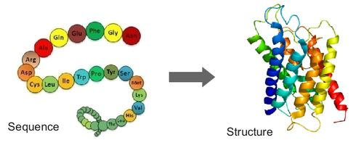
The Problem
Protein structure prediction is one of the most popular problem in bioinformatics

Slide 4
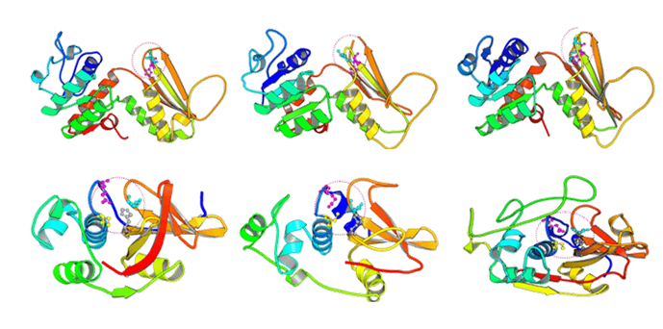
The Problem
In CASP 12 150-200 predicted models (decoys) are submitted for each target
How do we know which one is the best?

Slide 5
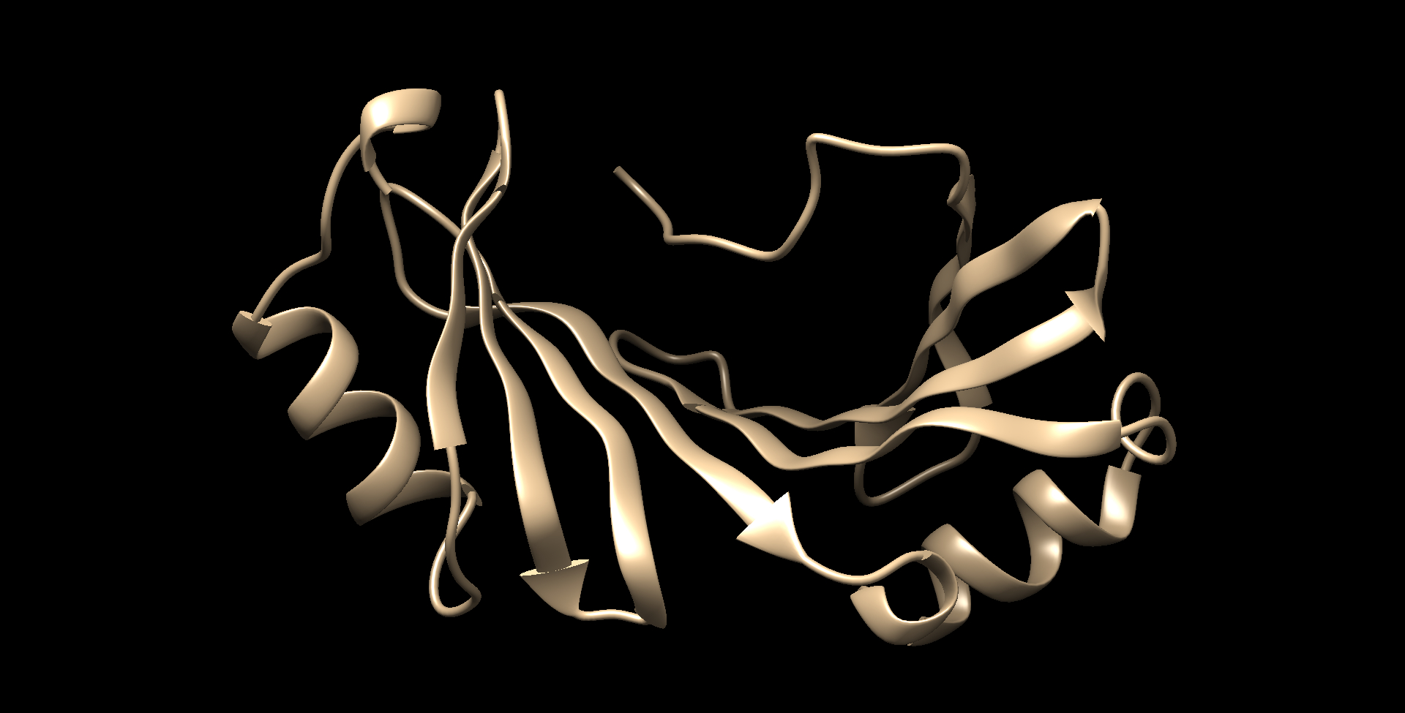
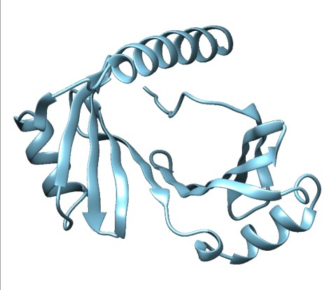
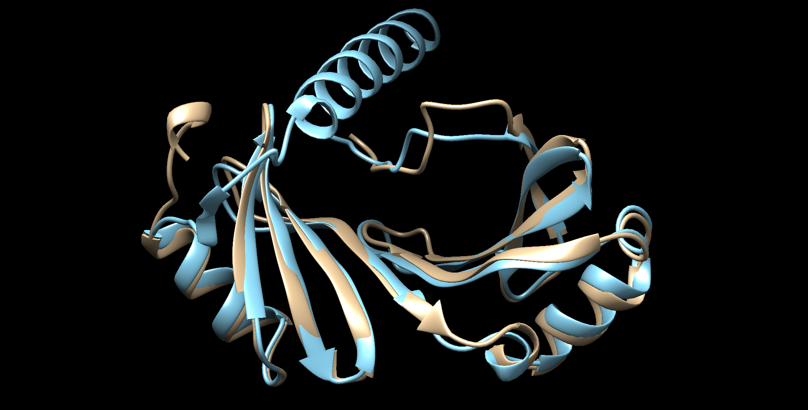
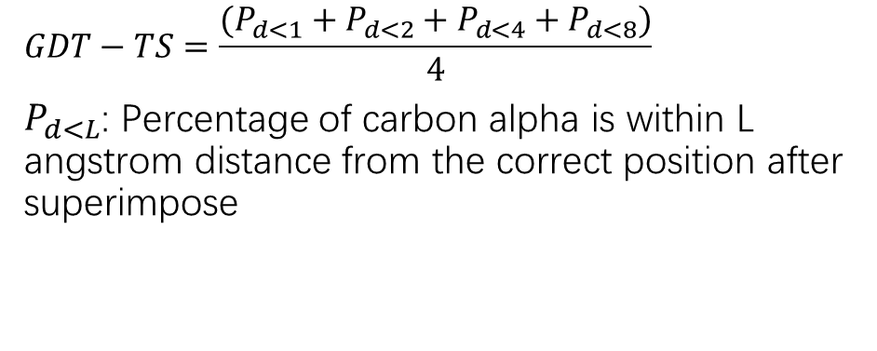
The Problem
Real Structure (Native)
Prediction (Decoy)
$$GDT−TS=\frac{(P_{d<1}+P_{d<2}+P_{d<4}+P_{d<8})}{4}$$
$P_{d<L}$: Percentage of carbon alpha is within L angstrom distance from the correct position after superimpose

Slide 6
The Problem
Real Structure (Native)
Prediction (Decoy)
X
?

Slide 7
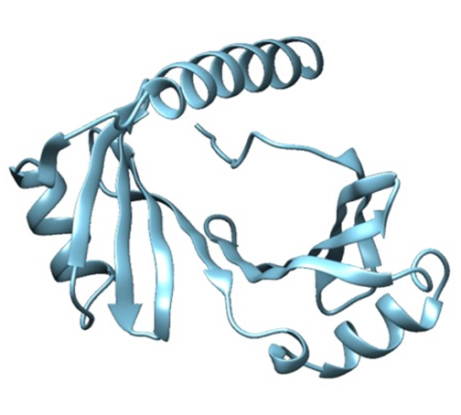
The Task-Model Quality Assessment
Design an algorithm
  Input:
    Target sequence
    Pool of decoys
  Output:
    A score for each decoy
    Range [0,1], 0 is worst, 1 is best
  Performance:
    Pearson Correlation with GDT-TS

Slide 8
Contribution and Achievements
9 major versions of algorithms iterated through 39 builds
2 fully automatic new QA algorithms: MUfoldQA_C, MUfoldQA_S
MUfoldQA_C:
  No. 1 in CASP 11 stage 1
  No. 3 in CASP 11 stage 2
  No. 1 in CASP 11 average ranking
MUfoldQA_S:
  No. 2 in CASP 11 stage 1
  No. 3 in CASP 11 stage 2 among single and Quasi-single
  No. 1 in CASP 11 average ranking among single and Quasi-single
*DAVIS-QAconsensus remove from ranking due to using internal competition information

Slide 9
Contents
Introduction
Related Work
Algorithm
Implementation
Experiment Results

Slide 10
QA method classification
QA | Single model QA
 | Quasi-single model QA
 | Multi-model QA

Slide 11
QA method classification
QA | Single model QA | Only uses one decoy to calculate score
 | Quasi-single model QA | Only uses one decoy from the pool, but might also use its own predicted model
 | Multi-model QA | Uses multiple decoys from the pool

Slide 12
Single model QA
Method: Physical statistics + Machine Learning
Example:
  Group: MUfold2
  Method:
    Features:
      Score Function Results: Ddfire, Dfire, Dope, Opus, Rapdf, RW, Proq2
      Secondary structure features: Percentage of Helix, Percentage of Sheet, Percentage of Coil, Percentage of all matching Secondary Structure, Consistence Score of Secondary Structure
      Solvent Accessibility features: Matching of Bury Amino Acid, Matching of expose Amino Acid, Percentage of matching Solvent Accessibility
    Machine Learning:
      Linear Regression
      Decision Tree
      Neural Network
      Boosting
      Random Forest

Slide 13
Quasi-single model QA
Method: Generate its own model and use these model to score the decoy+single model QA Score
Example 1:
  Group: MQAPsingleA
  Method:
    Submits the target sequence to the GeneSilico Fold prediction metaserver to collect approximately one hundred of 3D models
    scores a model by average GDT_TS distance of the model to the reference models
Example 2:
  Group: MQAPsingleB
  Method:
    0.8*MQAPsingleA+0.2*MQAPsingleC
    (MQAPsingleC is a sinlge model QA: Feature+linear regression)

Slide 14
Multi-model QA
Method: Using other models in the pool to score the decoy+single model QA Score
Example 1:
  Group: DAVIS-QAconsensus
  Method:
    Naïve consensus: average of GDT-TS score from other models in the pool
Example 2:
  Group: Wallner
  Method:
    0.2*ProQ2(single)+0.8*Pcons(consensus)

Slide 15
Multi-model QA
Method: Using other models in the pool to score the decoy+single model QA Score
Example 3:
  Group: FDUBio
  Method:
  Use SVM to rank
    linear kernel and the parameters are optimized with five-fold cross validation on the 3DRobot dataset
    Feature Vector:
      Knowledge based: Boltzmann-based potentials, the DFIRE potential, the DOPE potential, the GOAP potential and the RWplus potential
      Other feature: Frst, ProQ, RFMQA, SIFT and SELECTpro
  Use Top 5 to calculate consensus

Slide 16
Early attempts on template-based method
TASSER-QA
  RMSD VS GDT-TS
  Sliding window VS direct comparison
  Linear VS non-linear score combination
  Different technology set

Slide 17
Contents
Introduction
Related Work
Algorithm
Implementation
Experiment Results

Slide 18

Basic Idea

Slide 19
Basic Idea
Consensus
0.97
0.98
0.99
0.95
0.91

Slide 20
Basic Idea
Weighted
Consensus
0.97
X0.89
0.98
X0.95
0.99
X0.93
0.95
X0.80
0.91
X0.70

Slide 21
Basic Idea – MUfoldQA_S
GDT-TS
0.97
X0.89
BLOSUM45 Inspired weight
Templates

Slide 22
Basic Idea – MUfoldQA_C
GDT-TS
0.97
X0.89
MUfoldQA_S Local Score
Reference Models

Slide 23
Basic Idea – MUfoldQA_C
Decoy
Reference Models
Templates

Slide 24
Overview MUfoldQA_S

Slide 25
Overview MUfoldQA_C

Slide 26
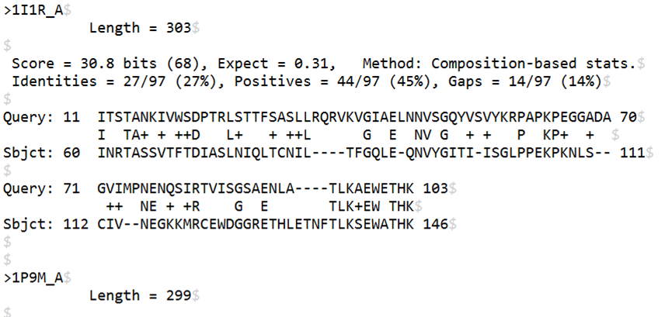
Step 1: Generate Templates
Run Blast and HHsearch to find templates

Slide 27
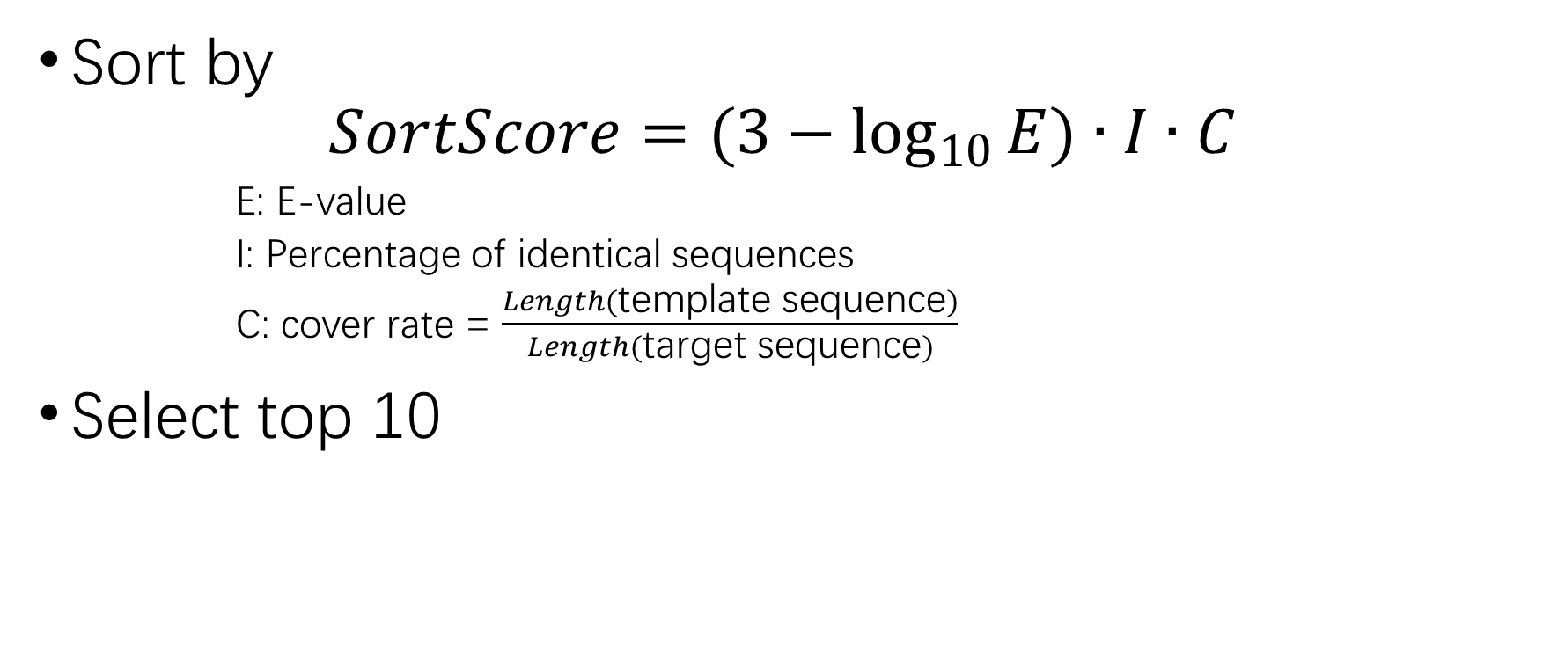
Step 2: Select Top templates
Sort by
$$SortScore=(3−\log_{10}{E})∙I∙C$$
      E: E-value
      I: Percentage of identical sequences
      C: cover rate = $\frac{Length(\text{template} \text{sequence})}{Length(\text{target} \text{sequence})}$
Select top 10

Slide 28
Step 3: Calculate GDT-TS
GDT-TS between decoy and multiple Template
Templates

Slide 29
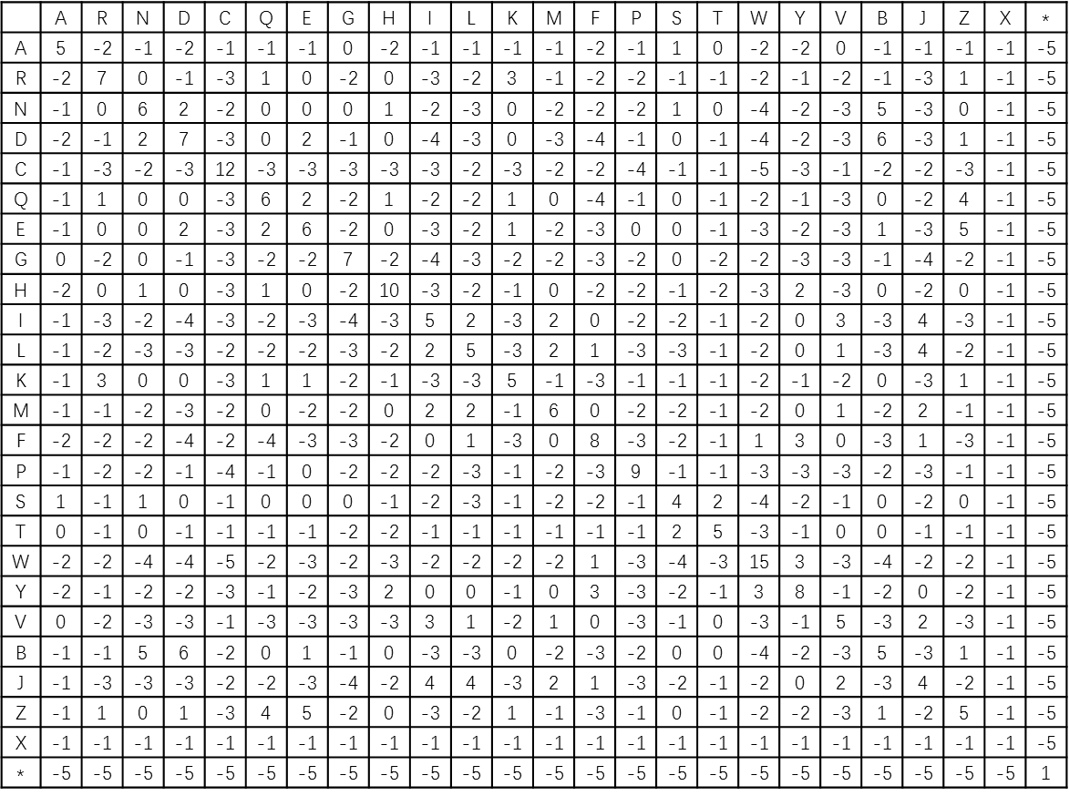

Step 4: Calculate Sequence-Based Weight
Extract template sequence
Compare with Target sequence
BLOSUM45
$$W_{i,j}=2^{B+6}$$
Template 1 | L | Q | E | R | E | Y | H | L | K | E | L | R | E
Target | I | Q | A | K | E | Y | - | L | E | N | L | N | K
Weight | 256 | 4096 | 32 | 512 | 4096 | 16384 | 2 | 2048 | 128 | 64 | 2048 | 64 | 128

Slide 30
Step 5: Calculate Local and Global Weighted Score
CA position | 1 | 2 | 3 | 4 | 5 | 6 | 7
Template 1 | 0.72 | 0.72 | 0.72 | NaN | 0.72 | 0.72 | 0.72
Weight 1 | 2048 | 2048 | 2048 | NaN | 2048 | 8 | 64
Template 2 | 0.61 | 0.61 | NaN | NaN | 0.61 | 0.61 | 0.61
Weight 2 | 256 | 2048 | NaN | NaN | 64 | 16 | 32
Template 3 | 0.63 | 0.63 | 0.63 | NaN | 0.63 | 0.63 | 0.63
Weight 3 | 32 | 32.00 | 128 | NaN | 32 | 512 | 32
Local Score | 0.70 | 0.66 | 0.71 | 0.00 | 0.71 | 0.63 | 0.67
Global Score | 0.58

Slide 31
Step 5: Calculate Local and Global Weighted Score
CA position | 1 | 2 | 3 | 4 | 5 | 6 | 7
Template 1 | 0.72 | 0.72 | 0.72 | NaN | 0.72 | 0.72 | 0.72
Weight 1 | 2048 | 2048 | 2048 | NaN | 2048 | 8 | 64
Template 2 | 0.61 | 0.61 | NaN | NaN | 0.61 | 0.61 | 0.61
Weight 2 | 256 | 2048 | NaN | NaN | 64 | 16 | 32
Template 3 | 0.63 | 0.63 | 0.63 | NaN | 0.63 | 0.63 | 0.63
Weight 3 | 32 | 32.00 | 128 | NaN | 32 | 512 | 32
Local Score | 0.70 | 0.66 | 0.71 | 0.00 | 0.71 | 0.63 | 0.67
Global Score | 0.58
Output as MUfoldQA_S Final Score

Slide 32
Step 5: Calculate Local and Global Weighted Score
CA position | 1 | 2 | 3 | 4 | 5 | 6 | 7
Template 1 | 0.72 | 0.72 | 0.72 | NaN | 0.72 | 0.72 | 0.72
Weight 1 | 2048 | 2048 | 2048 | NaN | 2048 | 8 | 64
Template 2 | 0.61 | 0.61 | NaN | NaN | 0.61 | 0.61 | 0.61
Weight 2 | 256 | 2048 | NaN | NaN | 64 | 16 | 32
Template 3 | 0.63 | 0.63 | 0.63 | NaN | 0.63 | 0.63 | 0.63
Weight 3 | 32 | 32.00 | 128 | NaN | 32 | 512 | 32
Local Score | 0.70 | 0.66 | 0.71 | 0.00 | 0.71 | 0.63 | 0.67
Global Score | 0.58
Stored as weight in MUfoldQA_C

Slide 33
Step 6: Select Top Reference Models
Sort all decoys in pool by MUfoldQA_S global score
Select up to top 100 as reference model

Slide 34
Step 7: Calculate Pair-wise GDT-TS
GDT-TS between decoy and reference models
Reference Models

Slide 35
Step 6: Calculate Weighted Consensus
CA position | 1 | 2 | 3 | 4 | 5 | 6
Reference 1 | NaN | 0.63 | 0.63 | 0.63 | 0.63 | 0.63
Weight 1 | NaN | 0.90 | 0.91 | 0.96 | 0.87 | 0.96
Reference 2 | NaN | 0.66 | 0.66 | 0.66 | 0.66 | 0.66
Weight 2 | NaN | 0.82 | 0.79 | 0.76 | 0.80 | 0.82
Reference 3 | NaN | 1.00 | 1.00 | 1.00 | 1.00 | 1.00
Weight 3 | NaN | 0.80 | 0.77 | 0.73 | 0.77 | 0.77
Local Socre | 0.00 | 0.76 | 0.76 | 0.75 | 0.76 | 0.75
Global Score | 0.63
Output as MUfoldQA_C Final Score

Slide 36
Contents
Introduction
Related Work
Algorithm
Implementation
Experiment Results

Slide 37
Primary Modules
Web interface
Alignment generator
Helper Program
Core Program
GDT-TS calculator

Slide 38
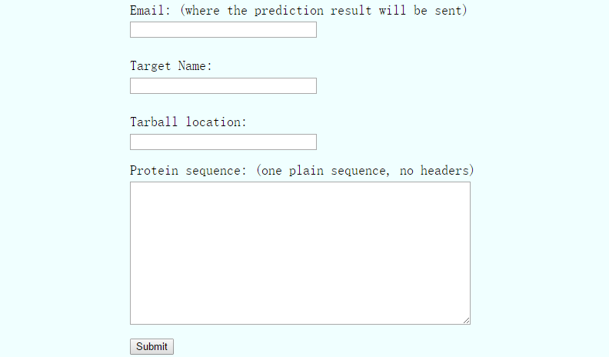
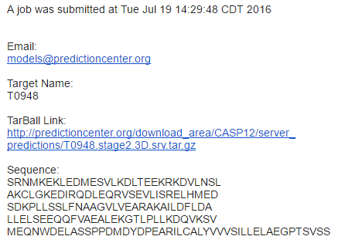



Implementation: Web interface

Slide 39
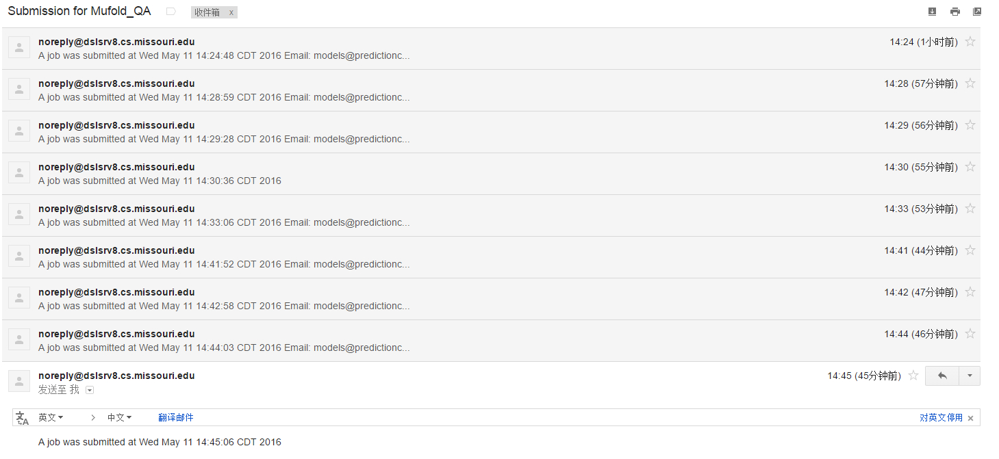
Implementation: Web interface
T0866_set20 | May 11 14:24:48 CDT
T0867_set20 | May 11 14:28:59 CDT
T0861_set150 | May 11 14:29:28 CDT
T0861_set150 | May 11 14:30:36 CDT
T0863_set150 | May 11 14:33:06 CDT
T0862_set150 | May 11 14:41:52 CDT
T0863_set150 | May 11 14:42:58 CDT
T0866_set20 | May 11 14:44:03 CDT
T0867_set20 | May 11 14:45:06 CDT
T0868_set20 | May 14 14:24:56 CDT
T0869_set20 | May 14 14:28:31 CDT
T0869_ser20 | May 14 18:56:44 CDT

Slide 40
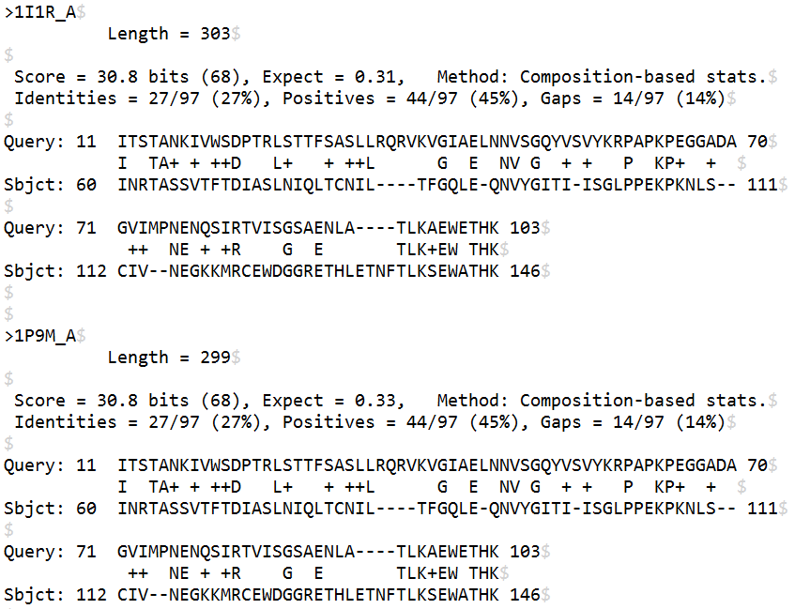
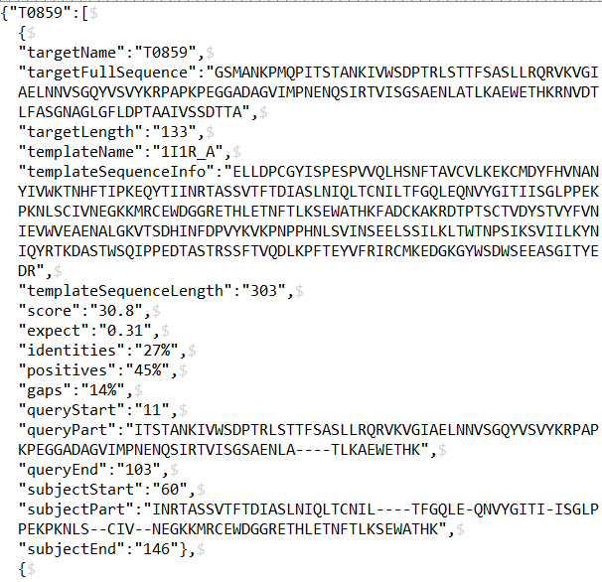
Implementation: Alignment generator
Raw
JSON

Slide 41
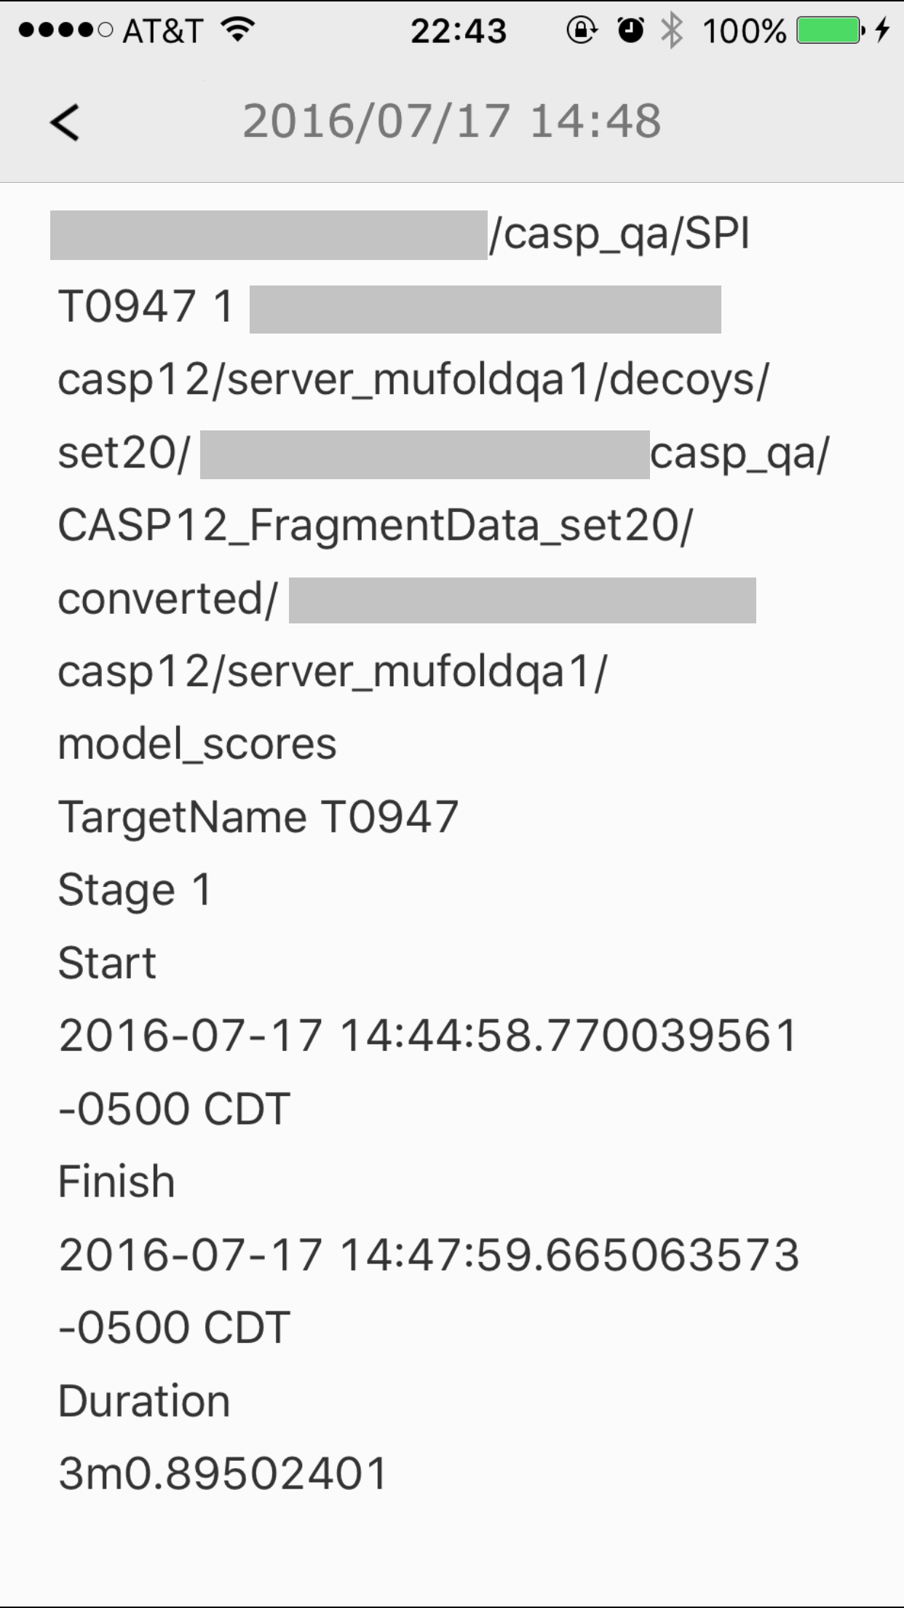
Implementation: Helper Program
Check environment
Monitor core program and send report

Slide 42
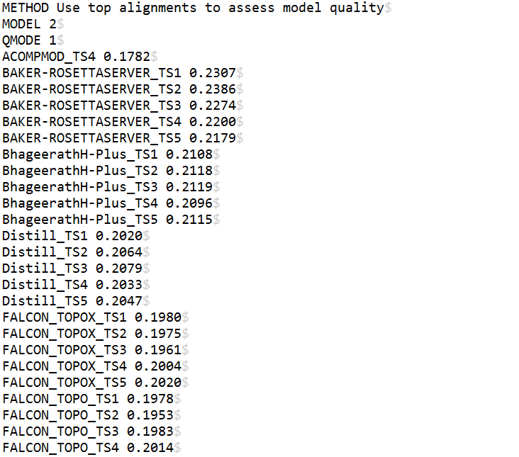
Implementation: Core Program
Handle the most calculation

Slide 43
Implementation: GDT-TS calculator

Slide 44
Contents
Introduction
Related Work
Algorithm
Implementation
Experiment Results

Slide 45
Experiment Setup – CASP 11
Dataset:
  77 targets in CASP 11
  Stage 1 and Stage 2 decoys
Database Version
  April 2014
Results of other group downloaded from CASP official website
  http://www.predictioncenter.org/casp11/qa_analysis.cgi

Slide 46
Ranking | Group Name | Target Count | Avg .Pearson Correlation |  | 21 | ProQ2 | 77 | 0.6589
1 | MUfoldQA_C | 77 | 0.8458 |  | 22 | myprotein-me | 76 | 0.6547
2 | MUfoldQA_S | 77 | 0.8157 |  | 23 | MULTICOM-CLUSTER | 77 | 0.6530
3 | MULTICOM-REFINE | 77 | 0.8139 |  | 24 | Wang_deep_2 | 77 | 0.6484
4 | Pcons-net | 77 | 0.8106 |  | 25 | MULTICOM-NOVEL | 77 | 0.6467
5 | DAVIS-QAconsensus | 77 | 0.8083 |  | 26 | Wang_deep_3 | 77 | 0.6425
6 | MUFOLD-QA | 77 | 0.8076 |  | 27 | PconsD | 75 | 0.6411
7 | MUFOLD-Server | 77 | 0.8055 |  | 28 | Wang_deep_1 | 77 | 0.6313
8 | nns | 77 | 0.7854 |  | 29 | BITS | 77 | 0.6271
9 | MQAPsingleA | 71 | 0.7793 |  | 30 | RFMQA | 77 | 0.6189
10 | Wallner | 77 | 0.7764 |  | 31 | VoroMQA | 77 | 0.5681
11 | MQAPmulti | 71 | 0.7522 |  | 32 | keasar | 77 | 0.5598
12 | ModFOLDclust2 | 77 | 0.7426 |  | 33 | raghavagps-qaspro | 77 | 0.3624
13 | MQAPsingle | 71 | 0.7418 |  | 34 | Qpotclust | 31 | 0.2831
14 | ModFOLD5 | 77 | 0.7406 |  | 35 | LNCCUnB | 54 | 0.2790
15 | ModFOLD5_single | 77 | 0.7389 |  | 36 | Qpotfilt | 31 | 0.2712
16 | ConsMQAPsingle | 71 | 0.7198 |  | 37 | Qpot | 31 | 0.2274
17 | MULTICOM-CONSTRUCT | 77 | 0.6811 |  | 38 | MUFOLD-DQA | 17 | 0.1866
18 | MQAPsingleB | 71 | 0.6797 |  | 39 | FUSION | 77 | 0.0784
19 | Wang_SVM | 77 | 0.6722 |  | 40 | OccuScore | 77 | 0.0000
20 | ProQ2-refine | 77 | 0.6698 |  | 41 | DandekarLab | 26 | -0.0033
CASP 11 Stage 1

Slide 47
Ranking | Group Name | Target Count | Avg. Pearson Correlation |  | 21 | MULTICOM-NOVEL | 77 | 0.4056
1 | Pcons-net | 77 | 0.6484 |  | 22 | ModFOLD5_single | 77 | 0.4040
2 | Wallner | 77 | 0.6417 |  | 23 | ProQ2-refine | 77 | 0.3835
3 | MUfoldQA_C | 77 | 0.5819 |  | 24 | ProQ2 | 77 | 0.3827
4 | MUFOLD-Server | 77 | 0.5681 |  | 25 | Wang_SVM | 77 | 0.3779
5 | DAVIS-QAconsensus | 77 | 0.5550 |  | 26 | MQAPsingleB | 67 | 0.3692
6 | MULTICOM-REFINE | 77 | 0.5538 |  | 27 | RFMQA | 76 | 0.3645
7 | ModFOLDclust2 | 77 | 0.5488 |  | 28 | BITS | 77 | 0.3172
8 | MUFOLD-QA | 76 | 0.5463 |  | 29 | Wang_deep_2 | 77 | 0.3157
9 | MULTICOM-CONSTRUCT | 77 | 0.5404 |  | 30 | Wang_deep_3 | 77 | 0.3098
10 | nns | 77 | 0.5305 |  | 31 | Wang_deep_1 | 77 | 0.3091
11 | MQAPsingleA | 66 | 0.5019 |  | 32 | keasar | 72 | 0.2983
12 | PconsD | 75 | 0.4899 |  | 33 | Qpotclust | 30 | 0.2926
13 | ModFOLD5 | 77 | 0.4852 |  | 34 | raghavagps-qaspro | 77 | 0.2393
14 | MUfoldQA_S | 77 | 0.4758 |  | 35 | Qpotfilt | 26 | 0.2039
15 | MQAPmulti | 67 | 0.4556 |  | 36 | Qpot | 30 | 0.1681
16 | ConsMQAPsingle | 67 | 0.4429 |  | 37 | LNCCUnB | 58 | 0.0890
17 | MQAPsingle | 67 | 0.4237 |  | 38 | MUFOLD-DQA | 14 | 0.0810
18 | MULTICOM-CLUSTER | 77 | 0.4170 |  | 39 | DandekarLab | 27 | 0.0590
19 | VoroMQA | 77 | 0.4142 |  | 40 | FUSION | 77 | 0.0521
20 | myprotein-me | 76 | 0.4100 |  | 41 | OccuScore | 77 | 0.0000
CASP 11 Stage 2

Slide 48
Ranking | Group Name | Target Count | Avg. Pearson Correlation |  | 21 | MULTICOM-NOVEL | 77 | 0.4056
1 | Pcons-net | 77 | 0.6484 |  | 22 | ModFOLD5_single | 77 | 0.4040
2 | Wallner | 77 | 0.6417 |  | 23 | ProQ2-refine | 77 | 0.3835
3 | MUfoldQA_C | 77 | 0.5819 |  | 24 | ProQ2 | 77 | 0.3827
4 | MUFOLD-Server | 77 | 0.5681 |  | 25 | Wang_SVM | 77 | 0.3779
5 | DAVIS-QAconsensus | 77 | 0.5550 |  | 26 | MQAPsingleB | 67 | 0.3692
6 | MULTICOM-REFINE | 77 | 0.5538 |  | 27 | RFMQA | 76 | 0.3645
7 | ModFOLDclust2 | 77 | 0.5488 |  | 28 | BITS | 77 | 0.3172
8 | MUFOLD-QA | 76 | 0.5463 |  | 29 | Wang_deep_2 | 77 | 0.3157
9 | MULTICOM-CONSTRUCT | 77 | 0.5404 |  | 30 | Wang_deep_3 | 77 | 0.3098
10 | nns | 77 | 0.5305 |  | 31 | Wang_deep_1 | 77 | 0.3091
11 | MQAPsingleA | 66 | 0.5019 |  | 32 | keasar | 72 | 0.2983
12 | PconsD | 75 | 0.4899 |  | 33 | Qpotclust | 30 | 0.2926
13 | ModFOLD5 | 77 | 0.4852 |  | 34 | raghavagps-qaspro | 77 | 0.2393
14 | MUfoldQA_S | 77 | 0.4758 |  | 35 | Qpotfilt | 26 | 0.2039
15 | MQAPmulti | 67 | 0.4556 |  | 36 | Qpot | 30 | 0.1681
16 | ConsMQAPsingle | 67 | 0.4429 |  | 37 | LNCCUnB | 58 | 0.0890
17 | MQAPsingle | 67 | 0.4237 |  | 38 | MUFOLD-DQA | 14 | 0.0810
18 | MULTICOM-CLUSTER | 77 | 0.4170 |  | 39 | DandekarLab | 27 | 0.0590
19 | VoroMQA | 77 | 0.4142 |  | 40 | FUSION | 77 | 0.0521
20 | myprotein-me | 76 | 0.4100 |  | 41 | OccuScore | 77 | 0.0000
CASP 11 Stage 2

Slide 49
Overall performance
MUfoldQA_C: Best of all QA methods
MUfoldQA_S: Best of Quasi-single and single

Slide 50
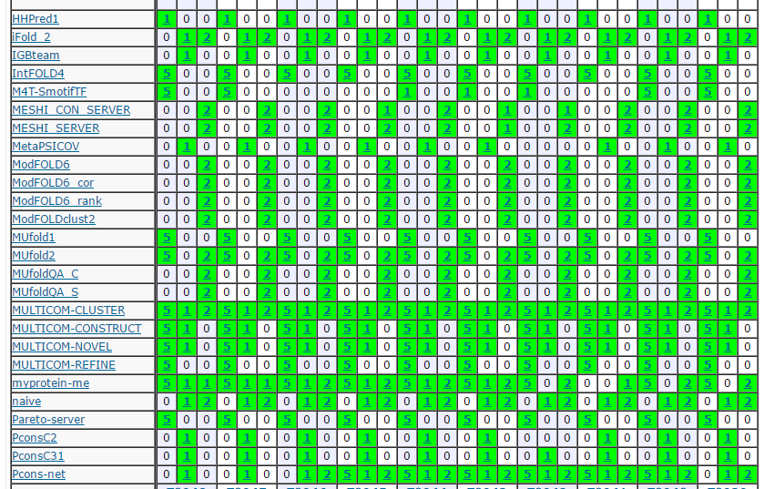
Experiment Setup – CASP 12
Submitted the result to CASP 12 under the method name

Slide 51
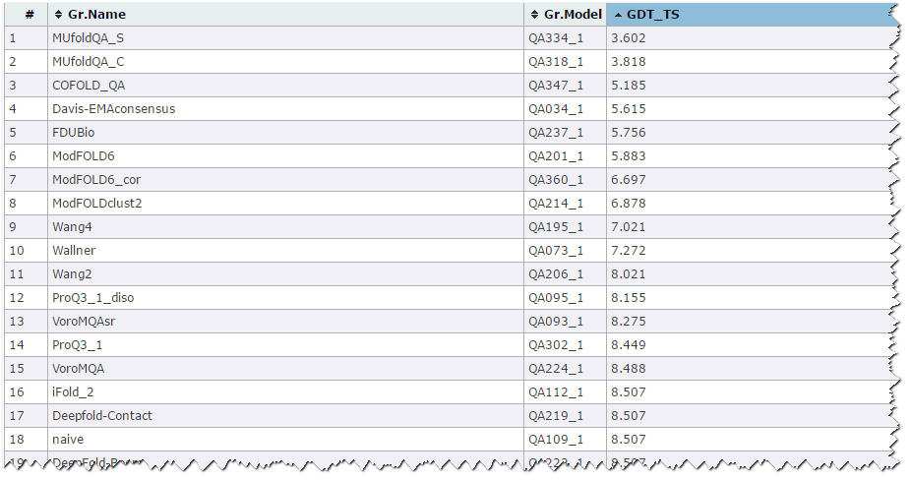
CASP 12 Score Differences (predicted vs observed)
Stage 1
…
27 more teams omitted

Slide 52
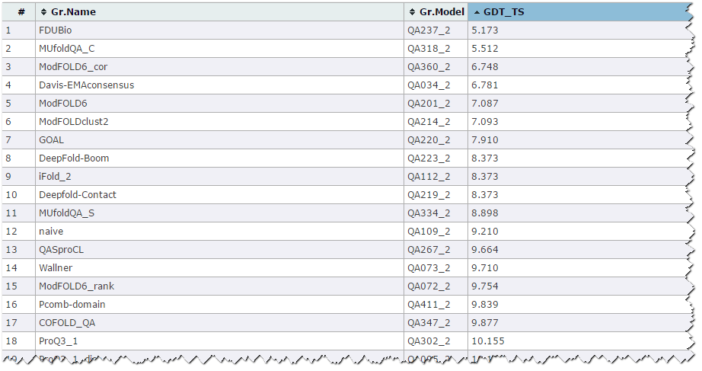
CASP 12 Score Differences (predicted vs observed)
Stage 2
…
27 more teams omitted

Slide 53
Future Work
Add local score feature for MUfoldQA_C
Port the algorithm to find good alignment
Better gap handling

Slide 54
Thank you!

