Slide 1

TigerAware Android-An Improved
Mobile Survey and Notification System
Department of Electrical Engineering and Computer Science
Advisor: Professor Yi Shang
Speaker: Weiliang Xia
Notes:
答辩准备
正装
M3
Ppt打印
关空调

Slide 2

Contents
Introduction
Related Work
System Improvement
Performance Evaluation
Conclusion

Slide 3
Contents
Introduction
Related Work
System Improvement
Performance Evaluation
Conclusion

Slide 4
Motivation
What is Mobile Data Collection?
  Mobile Data Collection is the method of gathering any type of information using a mobile device, such as a smartphone or tablet.
Smart phones have quickly become predominant in the United States, with 77% of Americans owning smart phones.
  Up to 92% people in younger populations use smart phones.
Smart phones are cheap and an easy way to collect information without a major learning curve.
Notes:
thus a corss platform system called TigerAware is developed

Slide 5
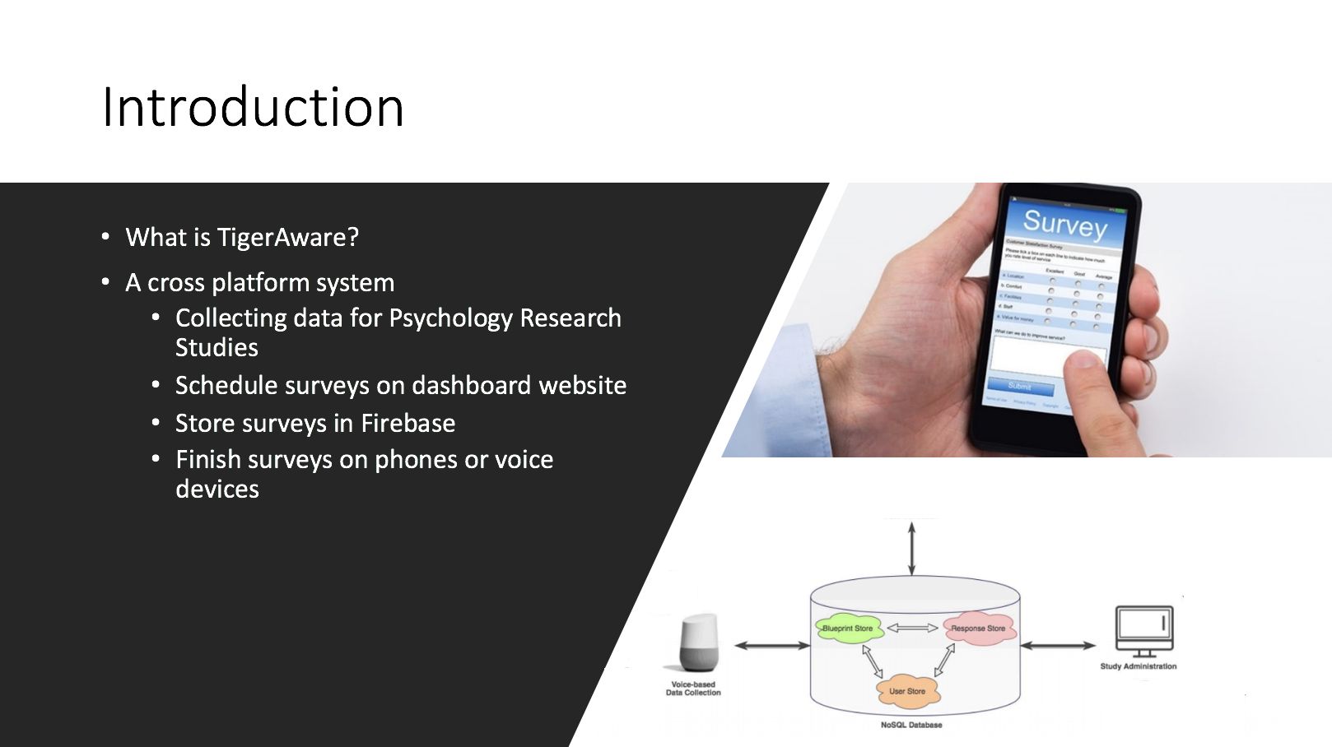
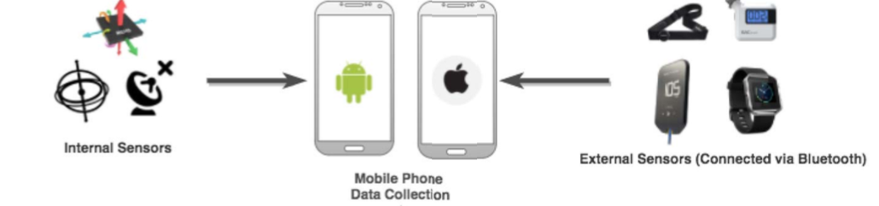

Introduction (cont’d)
TigerAware
A cross platform system
  Collecting data for Psychology Research Studies
  Schedule surveys on dashboard website
  Store surveys in Firebase
  Finish surveys on phones or voice devices
A mobile system TigerAware Android based on surveys
  A mobile data collecting system
  Sending notifications and surveys to participants
  Collecting data from surveys and mobile phone sensors
Notes:
title to tigeraware

Slide 6
TigerAware Android
A mobile system TigerAware Android based on surveys
  A mobile data collecting system
  Sending notifications and surveys to participants
  Collecting data from surveys and mobile phone sensors
Notes:
tigeraware android

Slide 7



Previous System
ResearchStack Modules
TigerAware Android
Multiple Choice Question
Questions
Date and Time Question
Time of Day question
Database
Notifications
Scale Question
Continuous Scale Question
Suspension
TigerAware
Web Server
….
Notes:
介绍功能
However, there are a few problems occurring while using the previous system

Slide 8
Problems
  Insufficient custom questions
    It needs more questions to meet the requirements of specific study goals
  Uncertain interval for notifications
    Original random notifications might be scheduled too close to each other or even at the same time
  Repeating suspension period
    Some user may forget to reset suspend window and it will repeat over and over again then they won’t get any notification during that time in the future
Notes:
ResearchStack can only support 10 question types while research studies needs more and more,
insufic support of custom
inapporavire

Slide 9
Enhanced System
ResearchStack Modules
TigerAware Android
Multiple Choice Question
Combined with multiple
Selection question
Questions
Date and Time Question
Added time, past day, multiple day option
Custom Questions
Time of Day question
Changed the time format from 24 hours to AP/PM
Database
Notifications
Random notifications with 15 mins break
Scale Question
Dynamically change the value of string
Continuous Scale Question
Added the min, max text display and the index
TigerAware
Web Server
Suspension
Image question
One time suspension
…….
Notes:
in researchstack ,we have two different format, single selection and mult selection.
[]First check if we can combine two questions into a new question
[]Then check if we can add more function to existing questions
[]Finally, if above does not work, create a new question from scratch

Slide 10
Contribution
Improvements on existing application
  Custom questions
  - add kinds of questions, such as image question, continuous scale question and so on
  Truly randomized notifications
  - notifications with 15 mins break
  One time suspension
  - suspend window which will only occur one time
  Others
  - UI improvements: text color, icon, bar color and so on
  - Testing: debug and so on

Slide 11
Contents
Introduction
Related Work
  TigerAware System
  Firebase
  ResearchStack
System Improvement
Performance Evaluation
Conclusion

Slide 12
Related Research
William Morrison; Luke Guerdan; Jayanth Kanugo; Timothy Trull; Yi Shang, “TigerAware: An Innovative Mobile Survey and Sensor Data Collection and Analytics System,” in 2018 IEEE Third International Conference on Data Science in Cyberspace (DSC), 2018
Introduced the system architecture of TigerAware, including the TigerAware DashBoard, survey structure in Firebase Database and TigerAware Mobile developement.

Slide 13
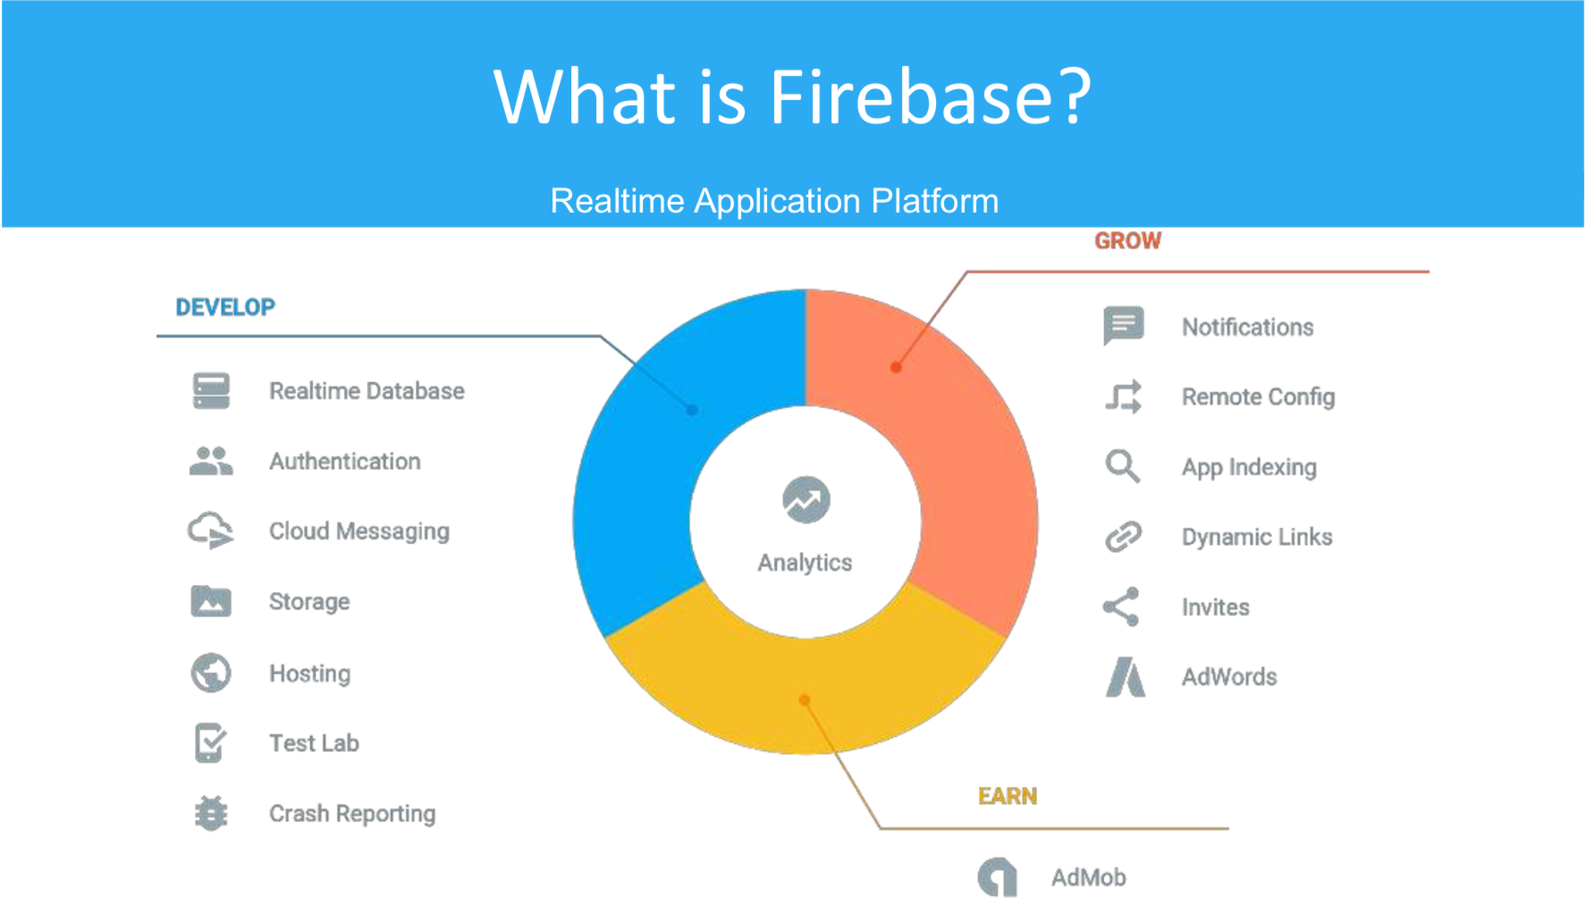
Database
Notes:
https://firebase.google.com/products

Slide 14
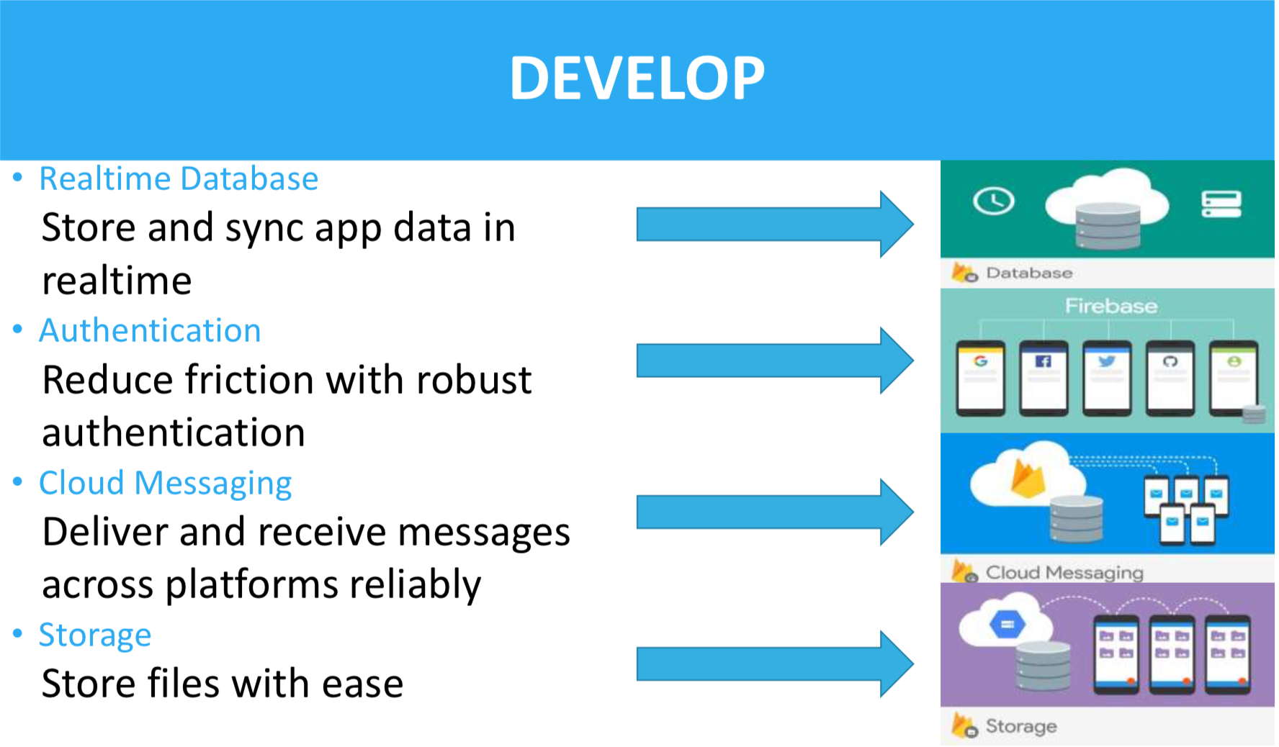
Database

Slide 15
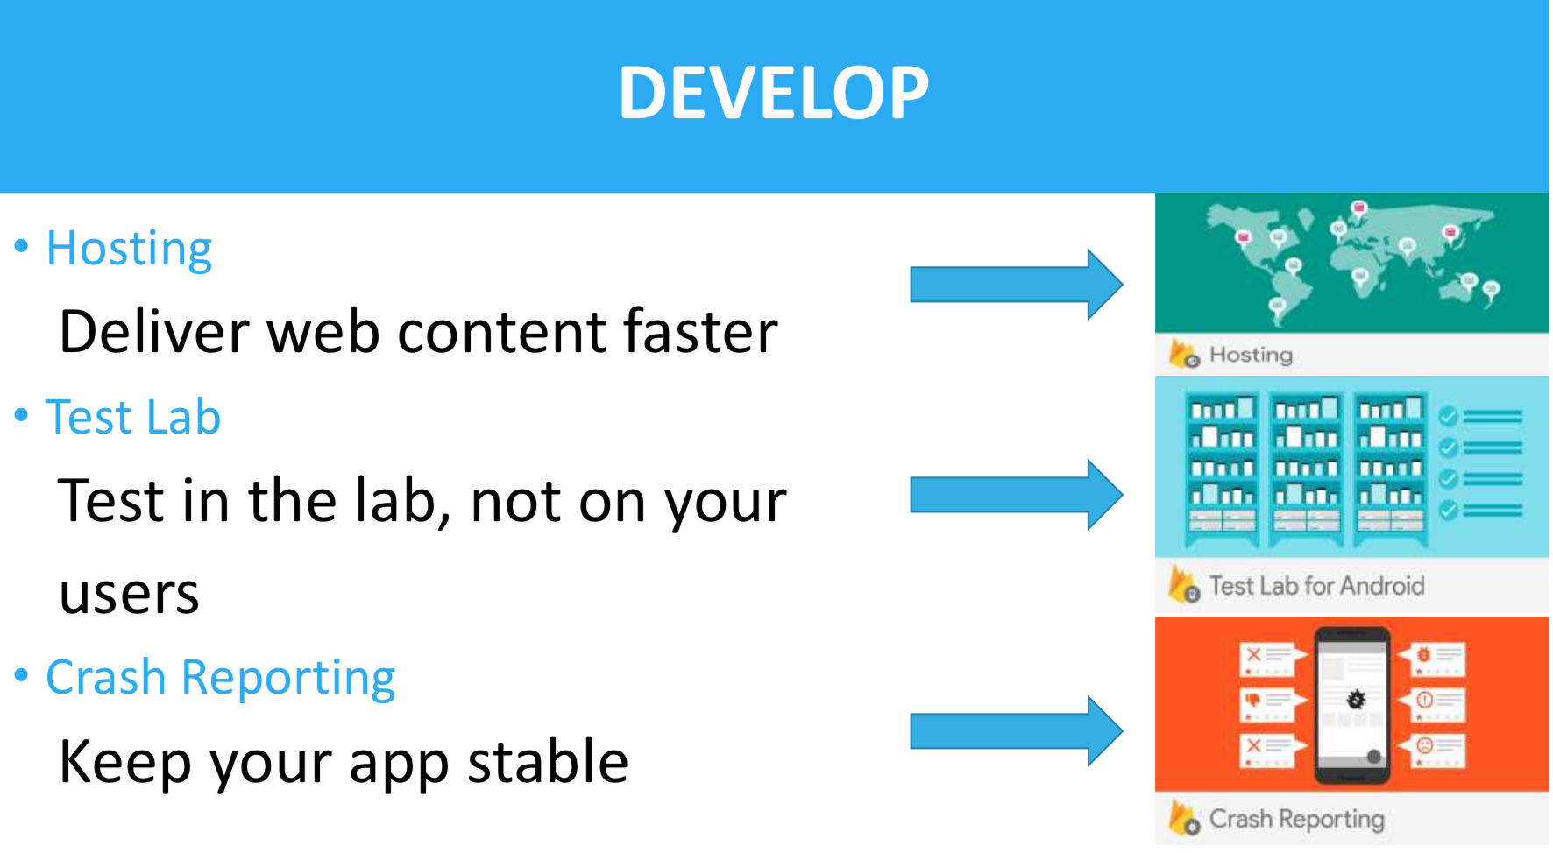
Database

Slide 16

ResearchStack

Slide 17
Contents
Introduction
Related Work
System Improvement
  Custom Questions
  Random Notifications with 15 minutes break
  One time suspension
Performance Evaluation
Conclusion

Slide 18
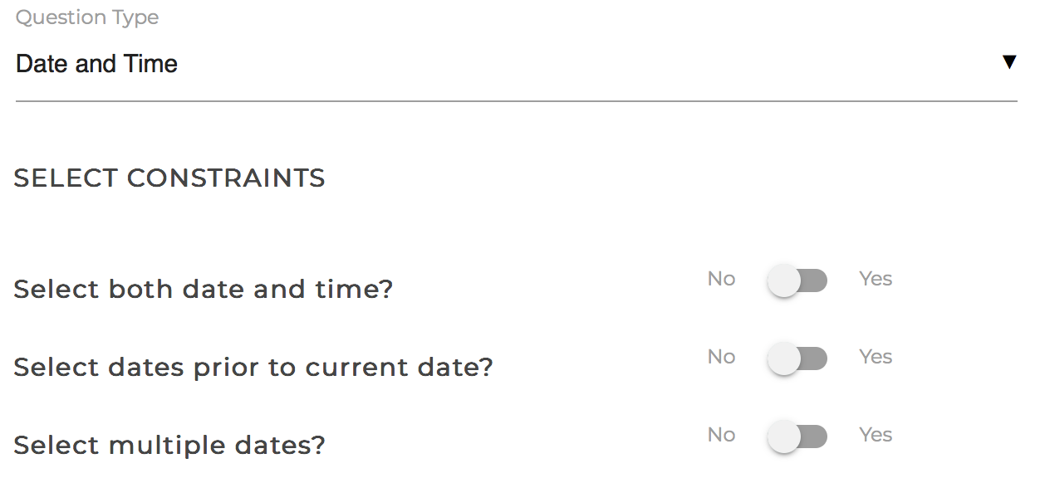
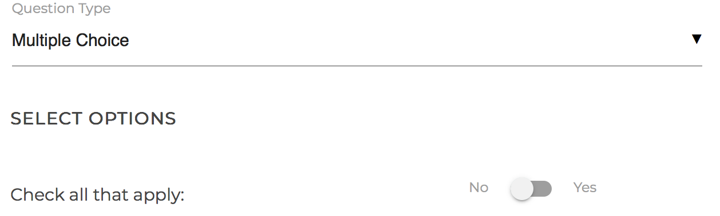
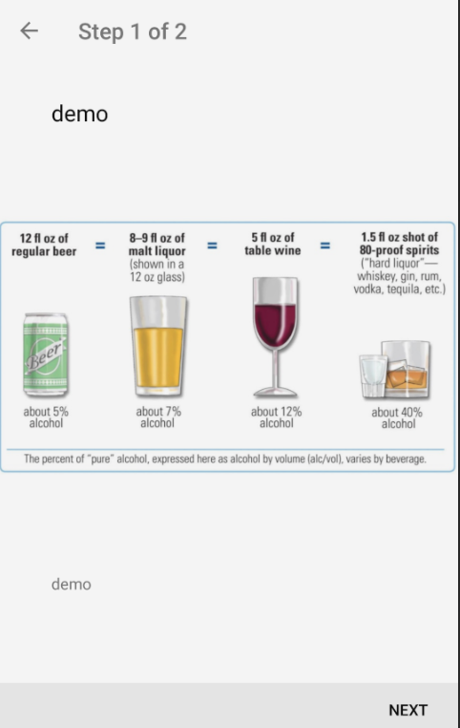
Questions
Custom Questions
  Requirement
  Implements
    First check if we can combine two questions into a new question
    Then check if we can add more function to existing questions
    Finally, if above does not work, create a new question from scratch
    Create custom questions to
    meet the specific study goals
Notes:
3 steps to implement this

Slide 19
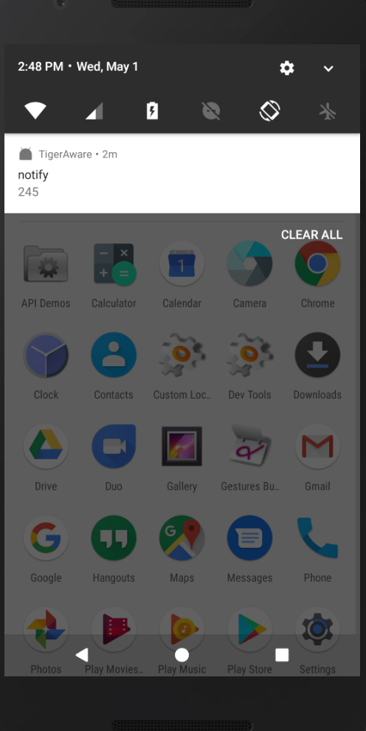
Notifications
Random Notifications
  Requirement
  Algorithms
    Algorithm1-Original algorithm
    Algorithm2-The latest start time algorithm
    Algorithm3-The conditional random selection algorithm
Random notifications need to
be scheduled with 15 minutes break
Notes:
for random notifications , we need to schedule them with 15 mins break

Slide 20

Algorithm-1
Original algorithm
  Requirement
  Implementations
Random notifications need to
be scheduled between start hour and end hour
Input1 midnight
Notification: 0:33 AM
Input2 1AM
Notes:
but the problem is
notifications might be scheduled too close to each other

Slide 21
Algorithm-2
The latest start time algorithm
  Requirement
  Implementations:
Random notifications need to
be scheduled between start time and end time
and with 15 minutes break
  Eg: 3 notifications from midnight to 1AM
Input1 midnight
The latest start time: 0:30 AM
0:45
Input2 1AM
  First notification can be scheduled here
Notes:
then in order to make sure the 15 mins break,we
developed algorithm2
For example, from midnight to 1am, we want to schedule 3 random notification
so whats the lastest start time for the first notification
and imagine we scheduled the fitst notif at 18mins,

Slide 22
Algorithm-2
The latest start time algorithm
  Requirement
  Implementations:
Random notifications need to
be scheduled between start time and end time
and with 15 minutes break
  Eg: 3 notifications from midnight to 1AM
Input1 midnight
Notification: 0:18AM
New Input1:0:33AM
Input2 1AM
  Plus 15 mins break time
Notes:
but the problem is, notiifcatiions are not even distributed, for example, the late time, alwasys have chance to be scheduled with notificaitons

Slide 23
    Algorithm-3
The conditional selection algorithm
  Requirement
  Implementations
Random notifications need to
be scheduled between start time and end time
and with 15 minutes break
  Eg: 3 notifications from midnight to 1AM
Input1 midnight
0:20
Notification: 0:35 AM
0:50
Input2: 1 AM
Remove 15 mins break
Notes:
The conditional random selection
(click twice)

Slide 24
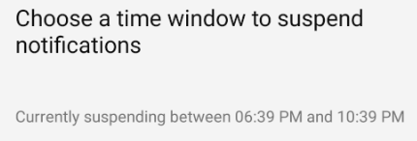
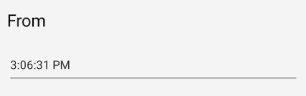
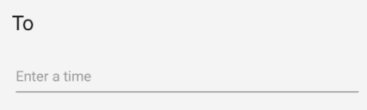
Suspension
One time suspension
  Requirement
  Algorithms
    Algorithm-1: Original algorithm
    Algorithm-2: Based on end date
    Algorithm-3: Based on both start and end time
Suspend window will block notifications
during that time
Notes:
for suspension, this is how our suspend window looks like
and the requirement is

Slide 25
Algorithm-1
-original algorithm
Suspension
  Requirement
  Implementations
1.Suspend window will block notifications during that time
2.Set up a suspend window by choosing two timestamps between 0 to 24 hours
3.The end time should be after the start time
4.It will repeat over and over again
timeline
notifications
0:00
8:00 AM
0:00
8:00 AM
suspension
now
Eg: suspend from 0 to 8AM
Notes:
to handle the repeating issue
i developed algorithm 2

Slide 26
Algorithm-2(case 1)
-based on end time
Suspension
  Requirement
  Implementations
1.Suspend window will block notifications during that time
2.Set up a suspend window by choosing two timestamps between 0 to 24 hours
3.The end time could be set before the start time
4.Suspend date is added automatically from back end based on the end time
5.It will only occur once
timeline
notifications
0:00
8:00 AM
0:00
8:00 AM
suspension
now
Eg: suspend from 0 to 8AM
May 3rd from the back end
It is not May 3rd
Notes:
normal case from midnight to 8am
it works fine and it is a quick fix for current system
but lets look at a more complex situation

Slide 27
Algorithm-2(case 2)
-based on end time
Suspension
  Requirement
  Implementations
1.Suspend window will block notifications during that time
2.Set up a suspend window by choosing two timestamps between 0 to 24 hours
3.The end time could be set before the start time
4.Suspend date is added automatically from back end based on the end time
5.It will only occur once
timeline
notifications
11:00PM
8:00 AM
11:00PM
8:00 AM
suspension
Suspend from 11PM to 8AM
now
It is not May 3rd
May 3rd from the back end
It is not May 3rd
Notes:
algorithm2 solved the repeating problem by adding suspend date
but the problem is, if we want to suspend over midnight, it always start from midnight to end time,and ignored the time before midnight

Slide 28
Algorithm-3
-for both start time and end time
Suspension
  Requirement
  Implementations
1.Suspend window will block notifications during that time
2.Set up a suspend window by choosing two timestamps between 0 to 24 hours
3.The end time could be set before the start time
4.Suspend start date and end date are added based on both time
5.It will only occur once
timeline
notifications
11:00PM
8:00 AM
11:00PM
8:00 AM
suspension
now
May 2nd
May 3rd
May 4th

Slide 29
Contents
Introduction
Related Work
System Improvement
Performance Evaluation
  Test matrix
  Notification
  Suspension
Conclusion

Slide 30
Test matrix
 | Aspect1 | Aspect2 | Aspect3
Notifications | Basic Random notifications | Interval | Distribution
Suspension | Basic suspension | Frequency | Overnight suspension
Notes:
after first notification is scheduled, the second notification cannot be scheduled before first notification.

Slide 31
Performance Evaluation - Notification
Algorithm1
Random notification
  Uncertain interval
Algorithm2
Random notification
Certain interval
  Uneven distribution
Algorithm3
Random notification
Certain interval
  Even distribution
Notes:
algorithm1 the basic notification
algorithm2 the latest start time
algorithm3 the conditional selection
after first notification is scheduled, the second notification cannot be scheduled before first notification.

Slide 32

Performance Evaluation - Suspension
Algorithm1
Basic suspension
  Repeating suspension period
Algorithm2
Basic suspension
  Occurring only once
  Unsupported over midnight suspension
Algorithm3
Basic suspension
  Occurring only once
  Supported over midnight suspension
Notes:
format table
use verb

Slide 33
Contents
Introduction
Related Work
System Improvement
Performance Evaluation
Conclusion

Slide 34
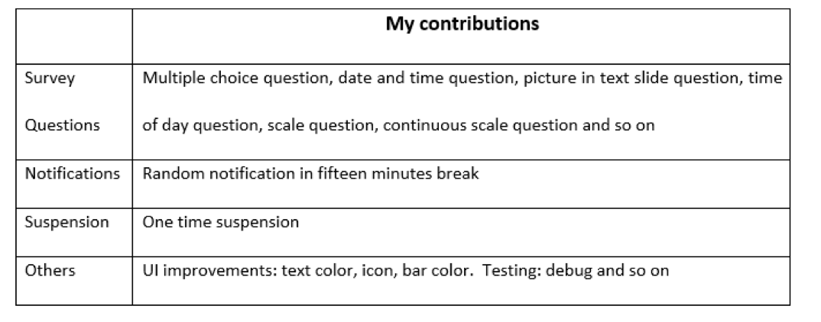
Conclusion
Notes:
For custom questions, I use a three steps, first check if we can combine two questions into one, then check if we can add new features into existing questions, finally consider building a new question from scratch
For random notifications, eventually I chose the conditional random selection algorithm because it is more random based on the time sequence.
For suspend window, first I chose the end time algorithm because it’s a quick fix, then switched to date detection algorithm based on start time and end time, because it has more compatibility to deal with different situations.

Slide 35


Thank You!
Last but not least, I hope TigerAware will be better and better in the future!
Question?

