Slide 1
Deep Learning Methods for Protein Predictions
Master’s Thesis Defense – Comprehensive Defense
Son P. Nguyen
Advisor: Yi Shang

Slide 2
Agenda
Master Thesis
Introduction
Background and Related Work
Methods
Experiments
Summary
PhD Comprehensive
Framework
Preliminary Works
Research Plan

Slide 3
Agenda
Master Thesis
Introduction
Background and Related Work
Methods
Experiments
Summary
PhD Comprehensive
Framework
Preliminary Works
Research Plan

Slide 4
Protein Prediction Problem
Protein 3D structures is critical for biology applications
Protein predictions using computational prediction methods
Modeller, HHpred, I-TASSER, Mufold
Protein Model Quality Asssessment (QA) methods
Single model QA
Opus-CA, DOPE, DFIRE, RW, etc.
Consensus QA
Mufold-WQA, QmeanClust, Multicom, etc.
Critical Assessment of Structure Prediction (CASP)

Slide 5
Problem Formulation
Problem formulation
Input: a set of predicted models of a protein
Output: classify into two classes:
Good (near-native)
Bad
Goal
Improve the accuracy of single model QA classification
Proposed Solution
Single model QA
Deep Learning techniques for feature extraction
Distance matrix (DM) to represent protein 3D model

Slide 6
Main Contributions
Theoretically
Developed 3 new algorithms for single model QA classification
DL-Pro, a deep learning based method on DM
SVM-Pro, a SVM based method on DM
FFNN-Pro, a FFNN based method on DM
Experimentally
Implement and test DL-Pro, SVM-Pro, FFNN-Pro on practical data
DL-Pro shows better accuracy
Publication
IEEE World Congress on Computational Intelligence Conference (WCCI) – 2014
“DL-Pro: A Novel Deep Learning Method for Protein Model Quality Assessment “ by Son Nguyen, Yi Shang and Dong Xu

Slide 7
Agenda
Master Thesis
Introduction
Background and Related Work
Methods
Experiments
Summary
PhD Comprehensive
Framework
Preliminary Works
Research Plan

Slide 8
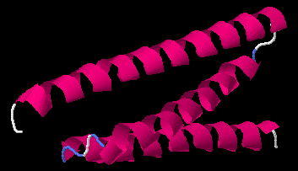
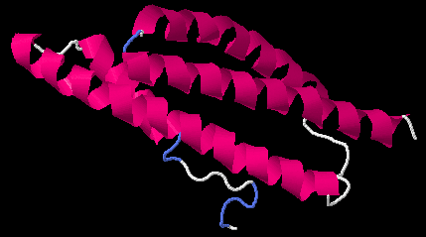
Structures Similarity
Measure the similarity between two 3D structures
Common Metrics: RMSD, TM-Score, GDT_TS
$GDT_TS(U_{i},U_{j})=(P_{1}+P_{2}+P_{3}+P_{4})/4$
U_{i} and U_{j} are two 3D models
P_{d} is the percentage that the C-α atoms in U_{i} is within a defined cutoff distance d, $d∈ \left\{1,2,4,8\right\}$
$GDT_TS$ $∈$ [0,1]
GDTTS = 0.52

Slide 9
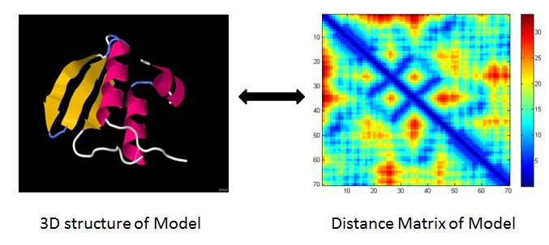
Distance Matrix
Convert protein 3D model into nxn matrix with :
$$A_{ij}= \sqrt{{\left(U_{x}^{i}−U_{x}^{j}\right)}^{2}+{\left(U_{y}^{i}−U_{y}^{j}\right)}^{2}+{(U_{z}^{i}−U_{z}^{j})}^{2}}$$
where $U_{x,y,z}^{i}$ , $U_{x,y,z}^{j}$ are the 3D coordinates of points i and j, respectively.

Slide 10
Protein Model Quality Assessment
Consensus methods
Structures more similar to others are better
Naive Consensus
Similar methods
QMEANclust, United3D, MULTICOM, ModFOLDclust, etc.
Pros
The accuracy is very good
Cons
Need a diversify pool of models
Can’t do QA for single model

Slide 11
Protein Model Quality Assessment
Energy or Scoring functions
Based on physical properties at molecule levels or statistics based properties from known structures
Common methods:
Opus-CA, DFIRE, DOPE, RW
Pros
Good theoretical foundations
Can do single QA
Cons
The accuracy is as good as consensus method
Sensitive to small structure errors

Slide 12
Deep Learning
Autoencoder (AE)
FFNN, trained by optimizing Input equals Output
Output from hidden layer can be used as “Abstracted features”
Can be used for feature reduction or input reconstruction
Sparsity: limits number of active hidden nodes
Stacked AE by adding other AEs on top of it

Slide 13
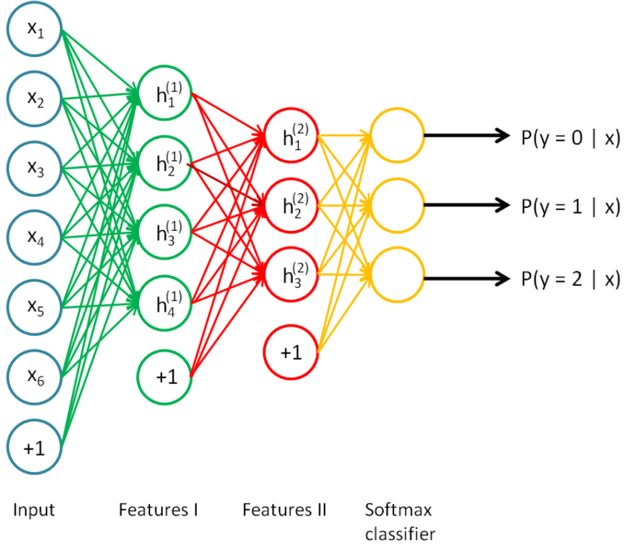
Deep Learning
Stacked AE Classification
Unsupervised training
Supervised training
Softmax classifier
Train whole network using backpropagation
Picture taken from WWW, “http://deeplearning.stanford.edu/wiki/index.php/Stacked_Autoencoders”.

Slide 14
Agenda
Master Thesis
Introduction
Background and Related Work
Methods
Experiments
Summary
PhD Comprehensive
Framework
Preliminary Works
Research Plan

Slide 15
Classification using scoring functions
Energy function based Classifications (ECReg)
Learn separated classifier for each score
OPUS-CA, DOPE, DFIRE, and RW
Use Linear Regression to fit scores
Derive thresholds for classification
Input:
True GDTTS
GDTTS >= 0.7: Good Prediction
GDTTS < 0.4: Bad Prediction
Energy scores
Output:
Threshold for Energy score
Classified sample

Slide 16
ECReg Algorithm
Training
Map GDTTS 0.4
S₁
Energy Scores
Linear Regression Model
Train Data
S₀ = (S₁ + S₂)/2
True Scores
Preprocessing
S₂
Map GDTTS 0.7
Testing
Score >= S₀
Good Model
Energy Scores
Test Data
Score < S₀
Bad Model
Preprocessing

Slide 17
Classification using Distance Matrix
Deep learning (DL-Pro) classifier
Uses DM as features
Stacked AE followed by a softmax classifier (SAE)
Unsupervised training with proteins of PDB
Input
Model structures
Labels of models
Output
Trained DL-Pro classifier
Classified samples

Slide 18
DL-Pro Algorithm
Training
Convert DM
Norm
Structures
DMs
Normalized DMs
PCA
Labels
Train Data
Train
Stacked Autoencoder
Testing
Convert DM
Norm
Structures
DMs
Normalized DMs
PCA
Classify
Stacked Autoencoder
Train
Predicted Labels
Train Data

Slide 19
Classification using Distance Matrix
Support Vector Machine (SVM-Pro) classifier
Uses DM as features
Support Vector Machine
Input
Model structures
Labels of models
Output
Trained SVM classifier
Classified samples

Slide 20
Classification using Distance Matrix
Feedforward Neural Network (FFNN-Pro) classifier
Uses DM as features
Feedforward Neural Network
Input
Model structures
Labels of models
Output
Trained FFNN classifier
Classified samples

Slide 21
Agenda
Master Thesis
Introduction
Background and Related Work
Methods
Experiments
Summary
PhD Comprehensive
Framework
Preliminary Works
Research Plan

Slide 22
Dataset
CASP 10
20 proteins (targets) with 1117 models
Experiments with 4 folds cross-validation
Sequence lengths from 93 – 115
Protein Native Structure database
Protein Data Bank’s website
Sequence lengths from 93 – 115
Remove proteins similar to CASP targets (>80%)
972 proteins used

Slide 23
ECReg Classification Result
Classification performances of energy functions with different energy scores obtained from OPUS-CA, DOPE, DFIRE, and RW, respectively.
Classifier using DFIRE scores achieves best accuracy

Slide 24
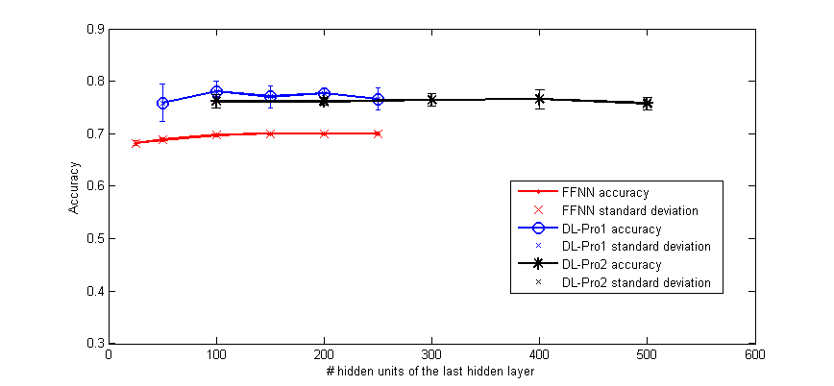
DL-Pro & FFNN-Pro Classification Results
Classification performance of DL-Pro1 (one hidden-layer configurations), DL-Pro2 (two hidden-layer configurations), and FFNN-Pro with various hidden units
DL-Pro with one hidden-layer and 100 hidden units achieves best accuracy

Slide 25
Summary Classifiers
Classification performances of EC-DFIRE, SVM-Pro, FFNN-Pro, DL-Pro1 (DL-Pro with one-hidden-layer configuration), DL-Pro2 (DL-Pro with two-hidden-layer configuration)

Slide 26
Agenda
Master Thesis
Introduction
Background and Related Work
Methods
Experiments
Summary
PhD Comprehensive
Framework
Preliminary Works
Research Plan

Slide 27
Summary
Novel approach of using purely geometric information of a model and deep learning for single-model QA
Promising results has been shown
The information required is far less than other single-model QA methods
Can combine additional information for further QA improvement

Slide 28
Agenda
Master Thesis
Introduction
Background and Related Work
Methods
Experiments
Summary
PhD Comprehensive
Framework
Preliminary Works
Research Plan

Slide 29
Main Contributions
Theory
Developed DL-Recon algorithm, a Deep learning method for protein structure predictions
Developed DL-Pro algorithm, a Deep learning method for protein QA
Experiment
Implement and test DL-Recon, DL-Pro on practical data
DL-Pro shows better accuracy

Slide 30
Agenda
Master Thesis
Introduction
Background and Related Work
Methods
Experiments
Summary
PhD Comprehensive
Framework
Preliminary Works
Research Plan

Slide 31
Framework
Protein Prediction Pipeline
Target Sequence
2. Model Prediction
Pool of predicted structures
Model Refinement
MS Thesis
1. Model QA
Predicted Structure

Slide 32
Agenda
Master Thesis
Introduction
Background and Related Work
Methods
Experiments
Summary
PhD Comprehensive
Framework
Preliminary Work
Model QA
Model Prediction
Research Plan

Slide 33
Accomplished Works
Model Quality Assessment
Single model QA
Literature Review and Problem Formulation
Proposed, implement and test successfully DL-Pro algorithm for single model QA classification
Local QA
Literature Review and Problem Formulation

Slide 34
Future Works
Model Quality Assessment
Single model QA
Test DL-Pro with bigger data set
Combine Deep Learning with Energy functions
Use evolutionary information
Local QA
Use Deep Learning to learn common local positions of model and use that for local QA

Slide 35
Agenda
Master Thesis
Introduction
Background and Related Work
Methods
Experiments
Summary
PhD Comprehensive
Framework
Preliminary Work
Model QA
Model Prediction
Accomplished works
Future works
Research Plan

Slide 36
Background
Distance Matrices comparison
R-Score$=\frac{\sqrt{∑\left(Aij−Bij\right)2}}{m2}$
with A,B: DM matrix size (m,m)

Slide 37
Background
Deep Belief Network (DBN)
Restricted Boltzman Machine as building blocks
Unsupervised training
Supervised training
Hiddent Layer 3
W3
Hiddent Layer 2
W2
Hiddent Layer 1
W1
Data

Slide 38
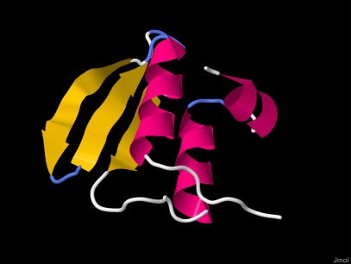
Problem formulation
Input: a protein sequence
Ex: >T0738 BA0019A, , 249 residues
MNLVQDKVTIITGGTRGIGFAAAKIFIDNGAKVSIFGETQEE…
Output: pool of predicted models
Proposed Solution
Evolutionary information: Alignments, Scores
Deep Belief Network
Distance matrix to represent protein 3D model
Use CASP data & Proteins from Protein Data Bank

Slide 39
DL-Recon: Working Flow
Training
Target Sequence
Find Alignment
Alignments & Scores
Extract Data
Distance Matrices (DM)
Train
DBN

Slide 40
DL-Recon: Working Flow
Testing
Target Sequence
Pool of Predicted Models
Find Alignment
Convert 3D
Alignments & Scores
Refined DMs
Extract Data
Deep Learning
Create Initial DMs
Distance Matrices(DM)
& Scores
Initial DMs

Slide 41
Experiment 1
Data set
CASP10 targets
Select 100 aligned proteins per target
Create DMs for the first 60 residues of aligned proteins
Normalize data from [0, 35] to [0,1]
Training
600 Distance Matrices
6 targets with 100 aligned proteins for each
Test
Input: Native Distance Matrix
Output: Refined Distance Matrix
Objective
Check if we can reconstruct well from an ideal case
Configuration
[<input: 1770> 2000 1000 500 70]
RBM Epoch number: 20
DBN Epoch number: 15

Slide 42
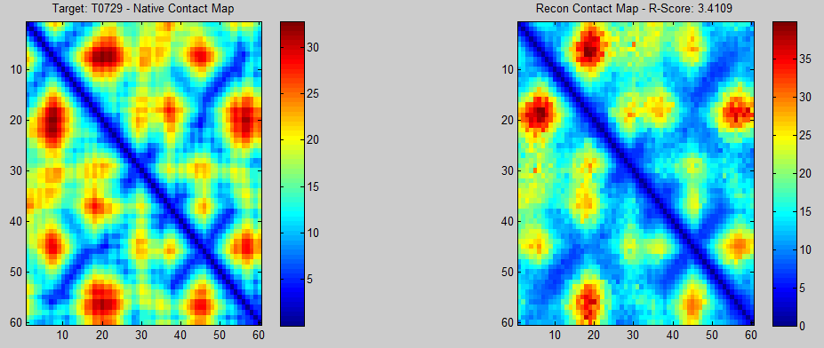
Experiment 1
DL-Recon can reconstruct native structure of target T0729 quite well. All patterns are kept in the reconstruction.

Slide 43
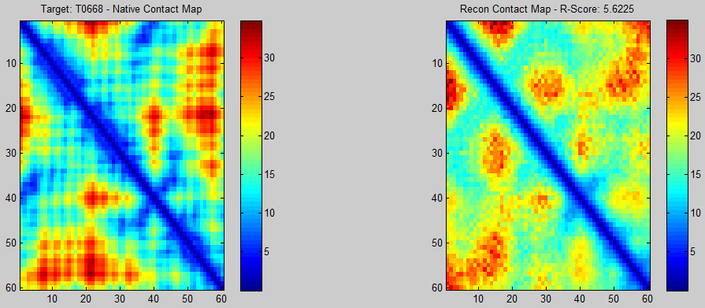
Experiment 1
Many details in the native map are not kept in reconstruction. The result is not as good as previous T0729 target.

Slide 44
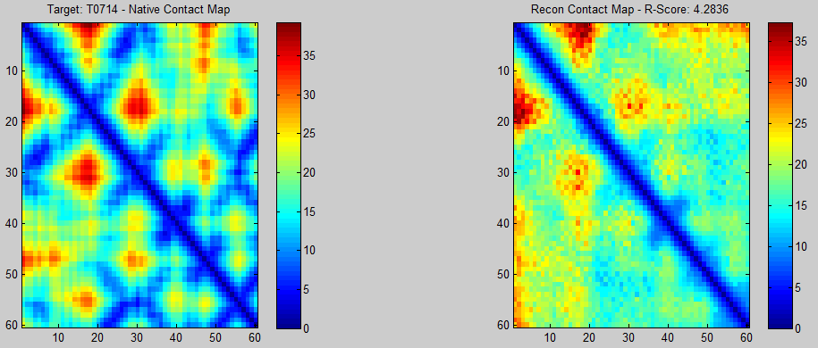
Experiment 1
Reconstruction can’t keep most of native’s patterns. The result is significantly worse than targets T0729. The R-Score of this target T0714 is better than T0668: 4.2 vs. 5.6

Slide 45
Experiment 2
DBN Experiment
Data & Training
Target: T0668
mTrain: 189 samples of aligned proteins
mTrainSamples(151x3655)
mValSamples(38x3655)
Input:
Combined DM
Output
Refined DM
Configuration
[<input: 1770> 2000 1000 500 70]
RBM Epoch number: 20
DBN Epoch number: 15

Slide 46
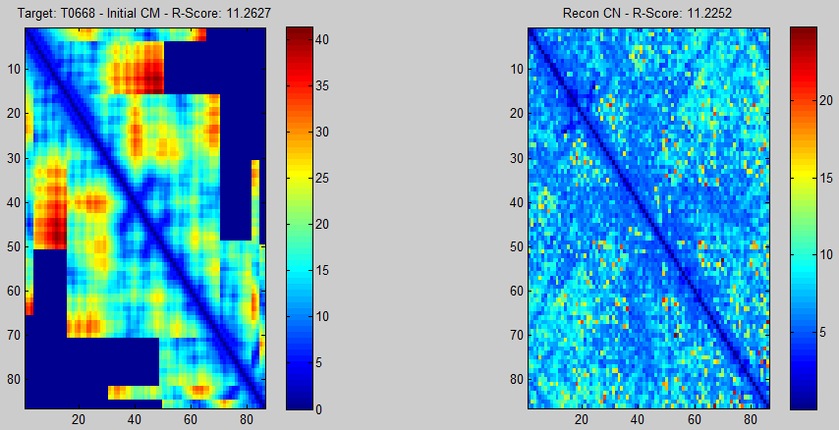
Experiment 2
Input map is created by combining segments of alignments. It has a big missing parts with value 0.
The reconstruction destroys all patterns from input.

Slide 47
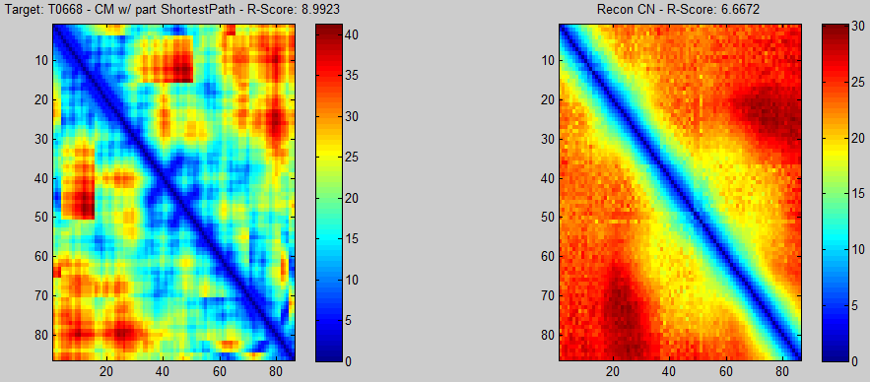
Experiment 2
Input map is created by filling missing parts with Shortest Path. The map now looks more complete and has significantly better R-Score: 8.9 vs. 11.2
There’s no pattern found in the reconstruction.

Slide 48
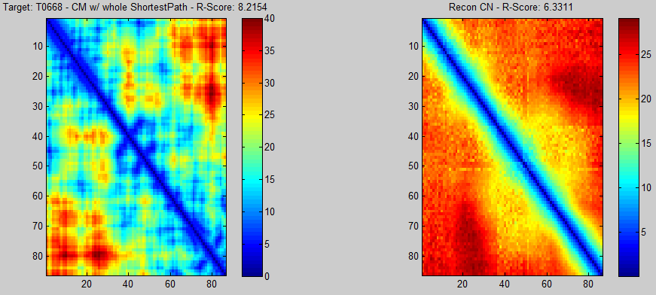
Experiment 2
Input map is created by filling the whole map with Shortest Path.
There’s no pattern found in the reconstruction.

Slide 49
Summary
Having a bigger, more diversify data set helps improving the reconstruction accuracy
Reconstruction results are not good
DL-Recon is limited with input size
Shortest Path can help fill in the gaps

Slide 50
Future Work
Test with bigger data set
Use Stacked Autoencoder for reconstruction
Try other methods for creation of combined DM
Use other evolutionary information
Secondary Structure
Solvent Accessibility

Slide 51
Agenda
Master Thesis
Introduction
Background and Related Work
Methods
Experiments
Summary
PhD Comprehensive
Framework
Preliminary Works
Research Plan

Slide 52
Research Plan
 | Literature Review & Problem Formulation | Algorithm Proposal | Experiments
Single model QA classification (Output labels) | Done | Proposed DL-Pro for single model QA classification | Done on a subset of CASP data.
Single model QA (Output values) | Done | Ongoing | To do
Local QA | Done | Ongoing | To do
Model Prediction | Done | Proposed DL-Recon for model based on deep learning and distance matrix | Done on some targets of CASP data. Need bigger experiment.

Slide 53
THANK YOU!

