Slide 1
ACTIVITY IDENTIFICATION
FROM ANIMAL GPS TRACKS
With Spatial Temporal Clustering Method
DDB-SMoT
Master’s Thesis Defense
Simiao Sun
Advisor: Dr. Yi Shang

Slide 2
Overview
Introduction
Related Work
Methodology
Experiment
Summary and Future Work

Slide 3
Animal GPS Tracks

Slide 4
Infer Animal Activity from GPS Tracks
Current Condition:
Lots of GPS devices provide us with huge amount of wildlife GPS data
GPS data does not directly improve semantic richness
Still have no information about the meaning of the GPS data
Need to associate GPS data with the real world
Problem:
How to solve the semantic gap between raw GPS data and the real world

Slide 5
Motivation
Wildlife semantic data is more useful than raw GPS data
Better control the animal population
Better protection for animal
Better understanding of animals
Find a way to fill the semantic gaps
Large amount of GPS tracks
Lack of wildlife semantic data

Slide 6
Problem Definition
Data Source: Missouri Black Bear/Deer GPS data
T = [P₁,P₂,…P_{n}]
P_{i} = [lon, lat, timestamp]
Method:
POI(Point of Interest)
Stop Detection Algorithm: Direction and Distance Based- Stop and Move of Trajectory (DDB-SMoT)
Probability Model: Inverse-square Laws
Purpose: predict the activities that animals performed in the trajectory
Bear1001: mating → drinking → …

Slide 7
Thesis Achievements
DDB-SMoT
A new stops detection algorithm based on DB-SMoT
Semantic Analysis Software
A software to predict a list of activities performed given an input of animal trajectory and POI dataset
Semantic Analysis Web Application
A web application to display the semantic enrichment result
Animal Trajectory Generator
A software to generate trajectories that are similar to real animal trajectory

Slide 8
Overview
Introduction
Related Work
Methodology
Experiment
Summary and Future Work

Slide 9
Semantic Analysis Related Work
Previously, more related works have been done for analyzing human GPS tracks
Two main trends for related works:
Trend 1: Concentrate on transportation means identification
Yu Zheng, Like Liu, Longhao Wang, and Xing Xie. “Learning transportation mode from raw GPS data for geographic applications on the web.” In WWW, pages 247–256, 2008.
Trend 2: Focus on inferring human activities
Arbara Furletti, Paolo Cintia, and Chiara Renso. “Inferring human activities from GPS tracks.” Chicago, USA, 2013. ACM.

Slide 10
Semantic Analysis Related Work
Previous works provide us with two approaches:
Approach 1:
Use Spatial Temporal POI’s Attractiveness (STPA) to identify activity-locations and durations
Use POI to match trajectories
Very detailed geographic information needed
Fame, Size of each POI
Approach 2:
Use stops in the trajectories to match visited POIs and then infer the corresponding activities
Use stops to match POIs

Slide 11
Stops Detection Related Work
There are mainly three types of GPS stops detection algorithms :
IB-SMoT: Intersection Based – Stop and Move of Trajectory
CB-SMoT: Clustering Based – Stop and Move of Trajectory
DB-SMoT: Direction Based – Stop and Move of Trajectory
IB-SMoT and CB-SMoT:
Choose stops matches important places in application
Trajectory should stay in a fixed area
DB-SMoT better fits our condition

Slide 12
Overview
Introduction
Related Work
Methodology
Experiment
Summary and Future Work

Slide 13
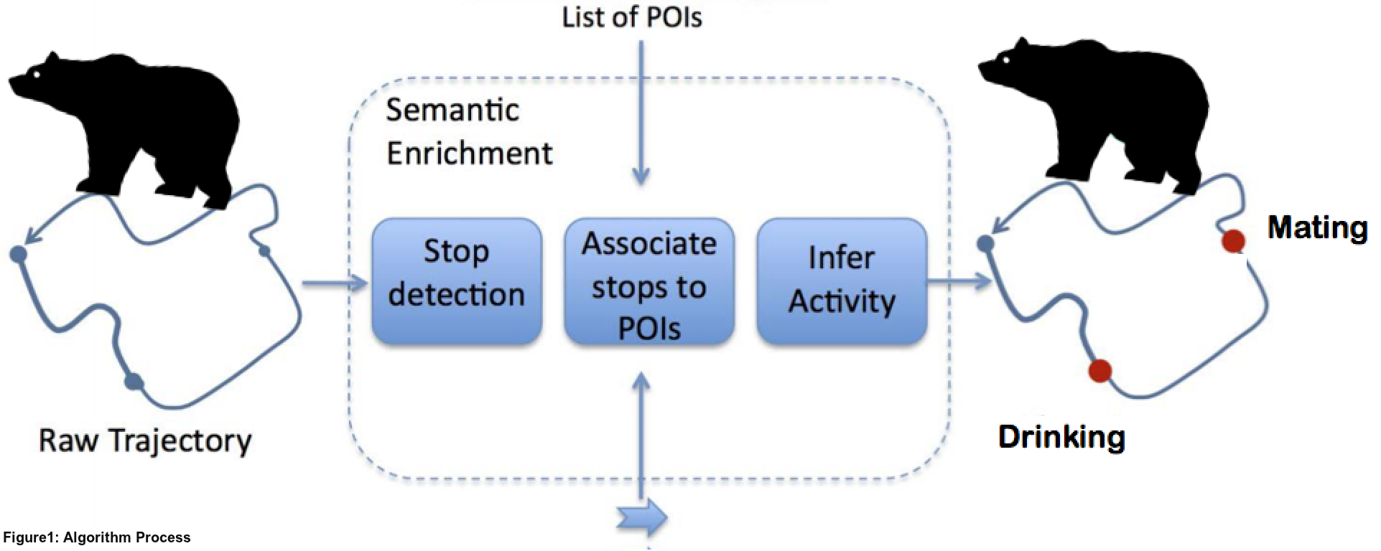
Semantic Enrichment Process

Slide 14
1. Stops Detection
Stops detection algorithm DDB-SMoT
Input: T[P₁,P₂…P_{n}], MinDirChange, MaxDisChange, MaxTimeChange, MinTime, MaxTol
Output: a list of stops and moves
DB-SMoT
DDB-SMoT
O(n) Time Complexity
Require very dense GPS data
Use only direction change between each two points
O(n) Time Complexity
Can apply to both dense and sparse GPS data
Consider direction change, distance and timestamp between each two points

Slide 15
1. Stops Detection Definitions
Basic definitions for DDB-SMoT in trajectory T[P₁,P₂…P_{n}]
Direction Change: Angle of direction P_{i-1}P_{i} and direction P_{i}P_{i+1}
MinDirChange
Distance Change: Distance between P_{i-1} and P_{i}
MaxDisChange
Time Change (Optional): Time difference between P_{i-1} and P_{i}
MaxTimeChange
Time Duration: The time that the animal stays at the stop
MinTime
Tolerance: The number of trajectory points with
Dirchange < MinDirChange that can be found
consecutively in a stop cluster
MaxTol
P_{i}
DirChange
DisChange
P_{i+1}
P_{i-1}

Slide 16
1. Stops Detection Example
P₂, P₃ : DirChange>MinDirChange
MaxTol: 1
P₄ : DirChange<MinDirChange
MinDirChange:90º
P₅, P₆ : DirChange>MinDirChange
MaxDisChange:500m
P_{7,} P₈, : DirChange<MinDirChange
MinTime:2 hours
MaxTimeChange: 24 hours
P₅
P₄
P₂
75
240
P₇
P₉
400
375
450
400
P₁
350
600
P₈
P₆
P₃
Result: Stop cluster [P1,P2,P3,P4,P5]
Result: Stop cluster [P1,P2,P3,P4,P5,P6]

Slide 17
2. Associate Stops with POIs
Stops can be detected by DDB-SMoT
Stop should be associated with POIs
POI(Lon, Lat, Category)
The Category above will map to an Activity, eg. River→Drinking. (An Activity will have multiple Categories)
Select POI that satisfies these two requirements
If POI is reachable
dis(POI, Stop) < MaxReachDistance
If the available time of POI intersects the stop time duration
We don’t have this information yet

Slide 18
3. Infer Activity from POIs
Use probability model(derived from Inverse-square Law) to determine the probability(P) of an activity(act) for a stop(s):
Inverse-square Law: mass1*mass2/(distance²)
(mass1 will always be 1, mass2 will be the number of POIs from selected POIs related to the same activity)
Choose the Max(P(s,act)) to infer the activity

Slide 19
3. Infer Activity from POIs
POI₁
POI₂
60
70
POI₃
110
Act₁: POI₁, POI₂, POI₃
S
Act₂: POI₄, POI₆
75
POI₄
Act₃: POI₅
50
75
POI₆
POI₅
P(S,Act₁) = 1×3/60²×Φ = 0.36
P(S,Act₂) = 1×2/50²×Φ = 0.52
→ Perform Act₂ at S
P(S,Act₃) = 1×1/75²×Φ = 0.12

Slide 20
Animal Trajectory Generator
Stops detection affects the accuracy of the result
Need a platform to verify the stops detection algorithm
Trajectory Generator provides with labeled trajectories that are similar to the real animal trajectory
Has more POI left
Start
Prepare POIs
Generate points towards or around a POI
Terminate
No more POI left
Stop Model
Movement Model

Slide 21
State Transition Model
P(p.n=m | p=s)
P(p.n=s | p=s)
Stop
Move
Dis(p,POI)>POI.radius
Dis(p,POI)<=POI.radius
p: current point’s label
s: stop label
p.n: next point’s label
m: move label

Slide 22
Movement Model
Assumption: Purpose of Movement is to get closer to the POI and get into the Stop Model
Parameters for the model:
Distance Change (dis)
Direction Change (dirchange)
Choose from P_{next} and P_{next}’
Make sure dis(P_{next},POI)<dis(P_{cur},POI)
P_{pre}
P_{next}
P_{cur}
d₁
d₂
θ
θ
d₁
P_{next}’
POI
d₁ = dis θ = dirchange

Slide 23
Movement Model
Generate the next point:
Based on the formula of angle between directions:
Based on the distance between
current and next point:
Choose from P_{next} and P_{next}’
Make sure dis(P_{next},POI)<dis(P_{cur},POI)
P_{pre}(x_{p},y_{p})
P_{pre}
P_{next}
P_{cur}(x_{c},y_{c})
P_{cur}
d₁
d₂
θ
P_{next}(x_{n},y_{n})
θ
d₁
P_{next}’
POI
d₁ = dis θ = dirchange

Slide 24
Stop Model
Assumption: Purpose of Stop is to stay inside the POI range to perform activity
Parameters for the model:
Distance Change (dis)
Direction Change (dirchange)
Choose from P_{next} and P_{next}’
Make sure dis(P_{next},POI)<POI.radius
P_{next}
d₁
P_{pre}
P_{cur}
d₂
θ
d₁
θ
P_{next}’
POI
POI.radius
d₁ = dis θ = dirchange

Slide 25
Overview
Introduction
Related Work
Methodology
Experiment
Summary and Future Work

Slide 26
Experiment Dataset
Missouri Black Bear GPS Data
Total num of bear: 78
110000 GPS points
Missouri Deer GPS Data
Total num of deer: 114
150000 GPS points
Trajectories similar to Missouri black bear trajectory
Generated by Animal Trajectory Generator
Features extracted from Missouri black bear GPS data

Slide 27
Experiments
Performance evaluation for DDB-SMoT
Use trajectories provided by Animal Trajectory Generator
Features extracted from black bear trajectory
Compare accuracy with DB-SMoT
Semantic Analysis Experiments
Use Missouri black bear and deer GPS data

Slide 28
DDB-SMoT Performance Evaluation
Use labeled trajectory
Apply DDB-SMoT
Label each point with prediction result
Evaluate the accuracy of the stops detection algorithm from three bench marks:
Stop points accuracy
Move points accuracy
Overall accuracy

Slide 29
DDB-SMoT Performance Evaluation

Slide 30
DDB-SMoT Performance Evaluation

Slide 31
DDB-SMoT Performance Evaluation
Compare with DB-SMoT:
Better overall accuracy
Largely improved move points accuracy
Stop points accuracy around the same

Slide 32
Semantic Analysis Experiments
Currently, no accuracy of semantic analysis can be calculated
POI dataset not available
No ground truth labeled with the GPS points
Semantic analysis web application
Visualize the whole semantic enrichment process
Semantic analysis for black bear and deer GPS data

Slide 33
Semantic Analysis Experiments

Slide 34
Semantic Analysis Experiments
Before Stops Detection
After Stops Detection

Slide 35
Semantic Analysis Experiments

Slide 36
Overview
Introduction
Related Work
Methodology
Experiment
Summary and Future Work

Slide 37
Summary
New stops detection algorithm DDB-SMoT
More accurate than DB-SMoT
Semantic Analysis Software
Lack of rich POI data, cannot provide real prediction
Lack of ground truth from observation, cannot calculate accuracy
Semantic Analysis Web Application
Available for visualizing the semantic enrichment process
Animal Trajectory Generator
Can be used for generating trajectories similar to animal GPS tracks

Slide 38
Future Work
Revise semantic analysis model
The network of animals can be taken into consideration
Multiple activities may happen in the same place
Build the POI dataset:
Use stops detection result as a reference to find POIs near stops
Evaluate semantic enrichment process

Slide 39
Thanks For Presences
Questions ?

