Slide 1
An Evolutionary Method for Training Autoencoders for Deep Learning Networks
Master’s Thesis Defense
Sean Lander
Advisor: Yi Shang

Slide 2
Agenda
Overview
Background and Related Work
Methods
Performance and Testing
Results
Conclusion and Future Work

Slide 3
Agenda
Overview
Background and Related Work
Methods
Performance and Testing
Results
Conclusion and Future Work

Slide 4
Overview Deep Learning classification/reconstruction
Since 2006, Deep Learning Networks (DLNs) have changed the landscape of classification problems
Strong ability to create and utilize abstract features
Easily lends itself to GPU and distributed systems
Does not require labeled data – VERY IMPORTANT
Can be used for feature reduction and classification

Slide 5
Overview Problem and proposed solution
Problems with DLNs:
Costly to train with large data sets or high feature spaces
Local minima systemic with Artificial Neural Networks
Hyper-parameters must be hand selected
Proposed Solutions:
Evolutionary based approach with local search phase
Increased chance of global minimum
Optimizes structure based on abstracted features
Data partitions based on population size (large data only)
Reduced training time
Reduced chances of overfitting

Slide 6
Agenda
Overview
Background and Related Work
Methods
Performance and Testing
Results
Conclusion and Future Work

Slide 7
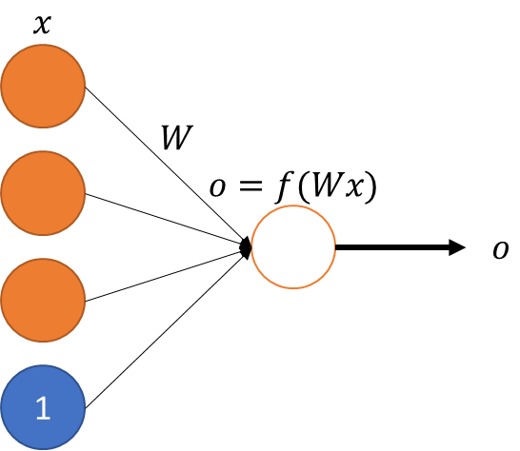
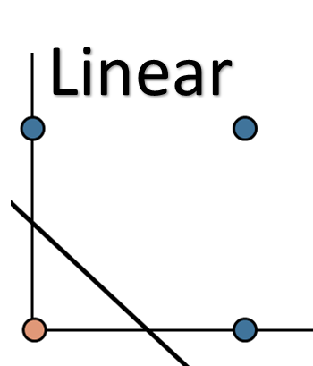
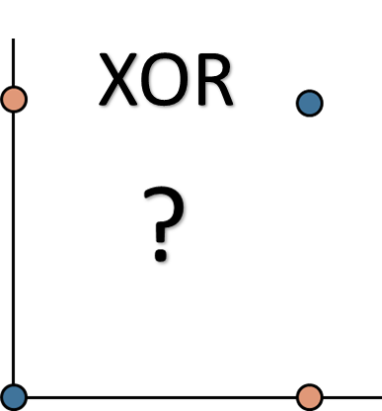
Background Perceptrons
Started with Perceptron in 1950
Only capable of linear separability
Failed on XOR

Slide 8
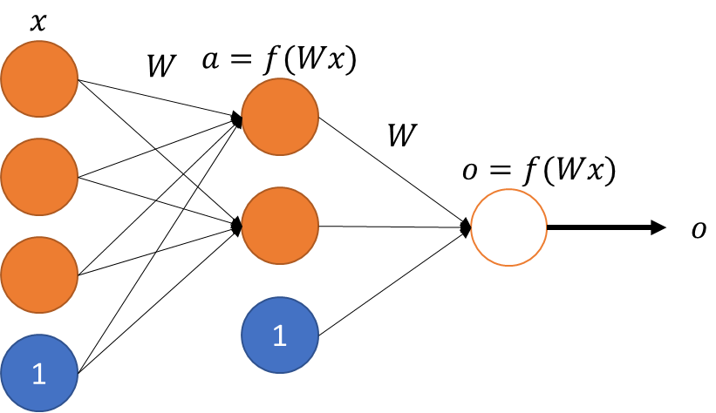
Background Artificial Neural Networks (ANNs)
ANNs went out of favor until the Multilayer Perceptron (MLP) introduced
Pro: Non-linear classification
Con: Time consuming
Advance in training: Backpropagation
Increased training speeds
Limited to shallow networks
Error propagation diminishes a number of layers increase

Slide 9
Background Backpropagation using Gradient Descent
Proposed in 1988, based on classification error
Given m training samples:
$\{\left(x_{1},x_{M}\right),…,\left(y_{1},y_{M}\right)\}$
For each sample $(x,y)$ where $x,y ∈\left[0,1\right]$ calculate its error:
$E\left(W,b;x,y\right)=\frac{1}{2}{\left\|h_{W,b}\left(x\right)−y\right\|}^{2}$
For all m training samples the total error can be calculated as:
$J\left(W,b\right)= \frac{1}{M}\sum_{m=1}^{M}{E(W,b;x_{m},y_{m})}$

Slide 10
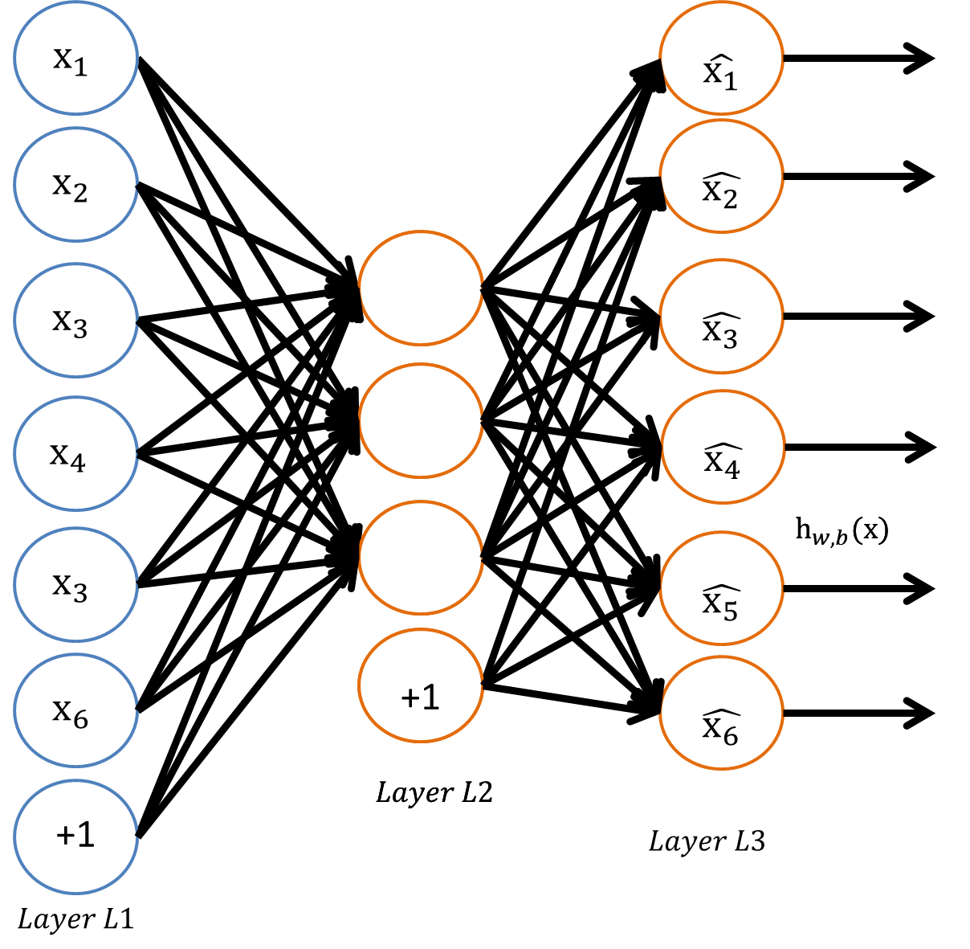
Background Deep Learning Networks (DLNs)
Allows for deep networks with multiple layers
Layers pre-trained using unlabeled data
Layers are “stacked” and fine tuned
Minimizes error degradation for deep neural networks (many layers)
Still costly to train
Manual selection of hyper-parameters
Local, not global, minimum

Slide 11
Background Autoencoders for reconstruction
Autoencoders can be used for feature reduction and clustering
“Classification error” is the ability to reconstruct the sample input
Abstracted features – output from the hidden layer – can be used to replace raw input for other techniques

Slide 12
Related Work Evolutionary and genetic ANNs
First use of Genetic Algorithms (GAs) in 1989
Two layer ANN on a small data set
Tested multiple types of chromosomal encodings and mutation types
Late 1990s and early 2000s introduced other techniques
Multi-level mutations and mutation priority
Addition of local search in each generation
Inclusion of hyper-parameters as part of the mutation
Issue of competing conventions starts to appear
Two ANNs produce the same results by sharing the same nodes but in a permuted order

Slide 13
Related Work Hyper-parameter selection for DLNs
Majority of the work explored using newer technologies and methods such as GPU and distributed (MapReduce) training
Improved versions of Backpropagation, such as Conjugated Gradient or Limited Memory BFGS were tested under different conditions
Most conclusions pointed toward manual parameter selection via trial-and-error

Slide 14
Agenda
Overview
Background and Related Work
Methods
Performance and Testing
Results
Conclusion and Future Work

Slide 15
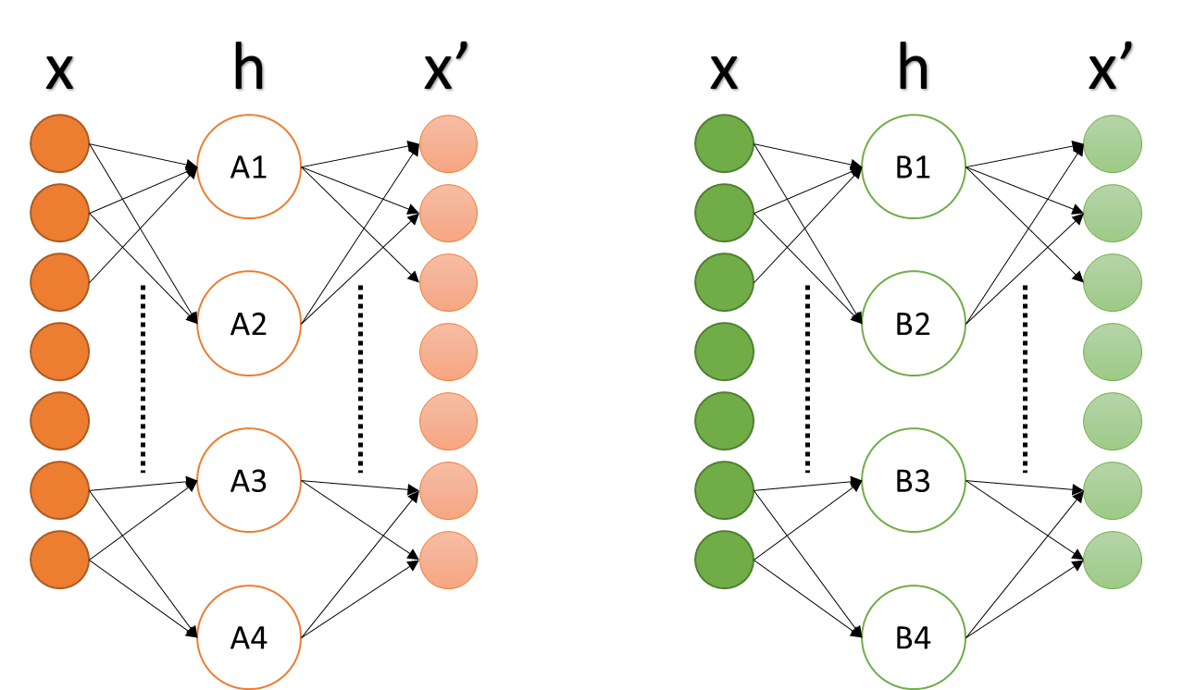
Method 1 Evolutionary Autoencoder (EvoAE)
IDEA: Autoencoders’ power are in their feature abstraction, the hidden node output
Training many AEs will make more potential abstracted features
Best AEs will contain the best features
Joining these features should create a better AE

Slide 16
Method 1 Evolutionary Autoencoder (EvoAE)
A population of autoencoders (AEs) is initialized with a semi-random number of hidden nodes
Each AE is trained for a small number of epochs using Backpropagation
The AEs are ranked based on reconstruction error
The top AEs are selected for crossover
New AEs are mutated based on mutation rate, with an even chance at gaining or losing a node
New nodes are selected randomly from the population, not randomly initialized
Continue until convergence criteria is met

Slide 17
Method 1 Evolutionary Autoencoder (EvoAE)
x
h
x’
x
h
x’
A1
B1
A2
B2
Local Search
Initialization
Crossover
Mutation
A3
B3
A4
C2

Slide 18
Method 1A Distributed learning and Mini-batches
Training of generic EvoAE increases in time linearly to the size of the population
ANN training time increases drastically with data size
To combat this, mini-batches can be used where each AE is trained against a batch and updated
Batch size << total data

Slide 19
Method 1A Distributed learning and Mini-batches
EvoAE lends itself to distributed system
Data duplication and storage now an issue due to data duplication
Batch 1
Train
Forward propagation
Backpropagation
Batch 2
Rank
Calculate error
Sort
…
GA
Crossover
Mutate
Batch N

Slide 20
Method 2 EvoAE Evo-batches
IDEA: When data is large, small batches can be representative
Prevents overfitting as nodes being trained are almost always introduced to new data
Scales well with large amounts of data even when parallel training is not possible
Works well on limited memory systems by increasing size of the population, thus reducing data per batch
Quick training of large populations, equivalent to training a single autoencoder using traditional methods

Slide 21
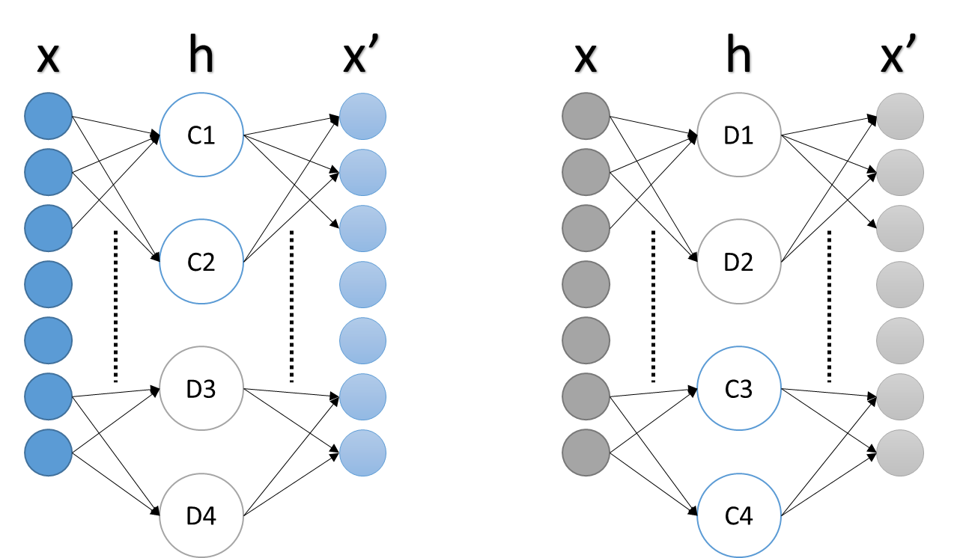
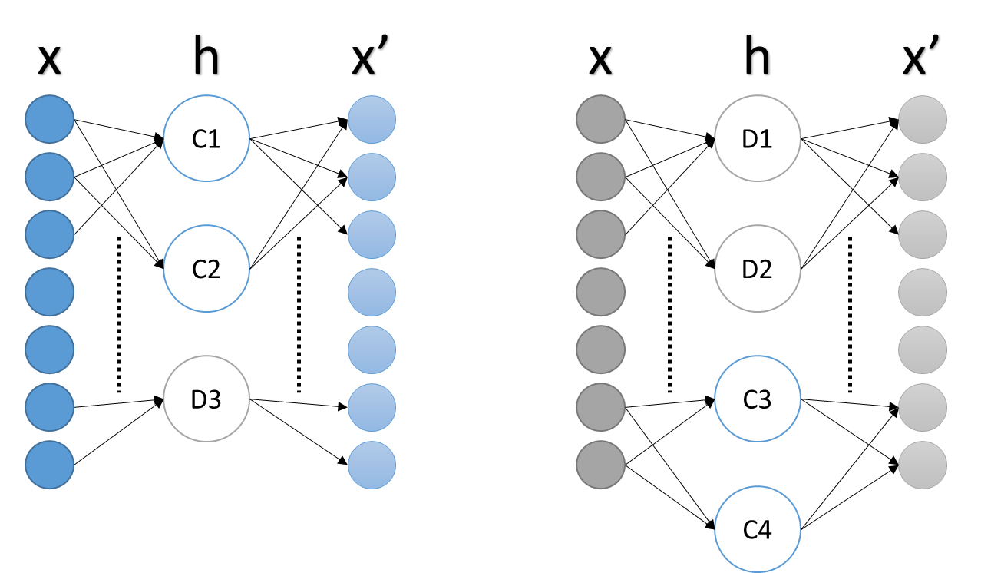
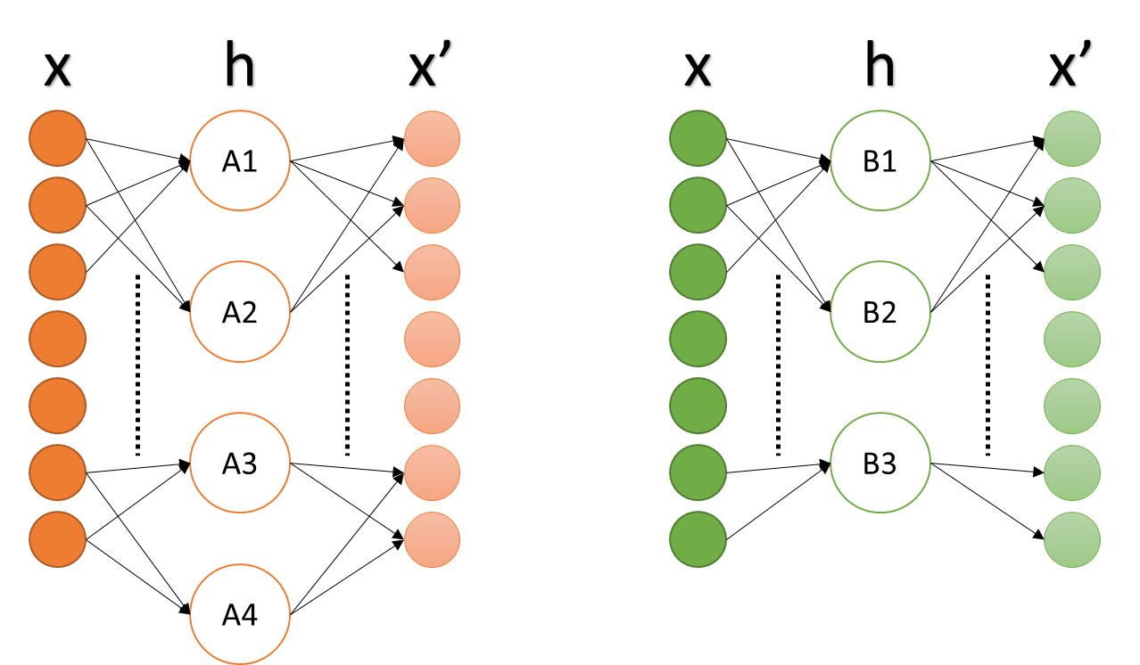
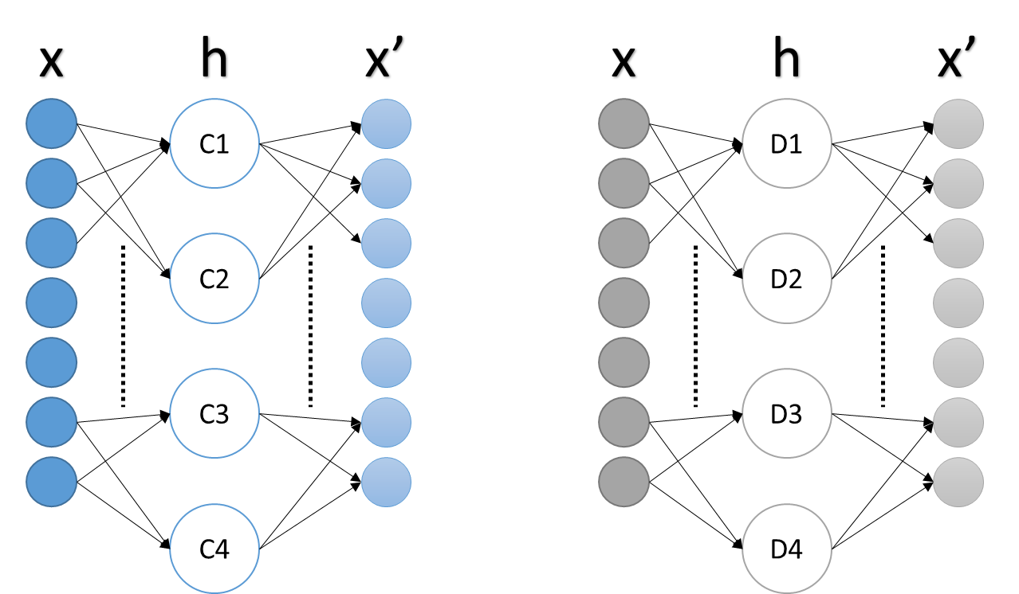
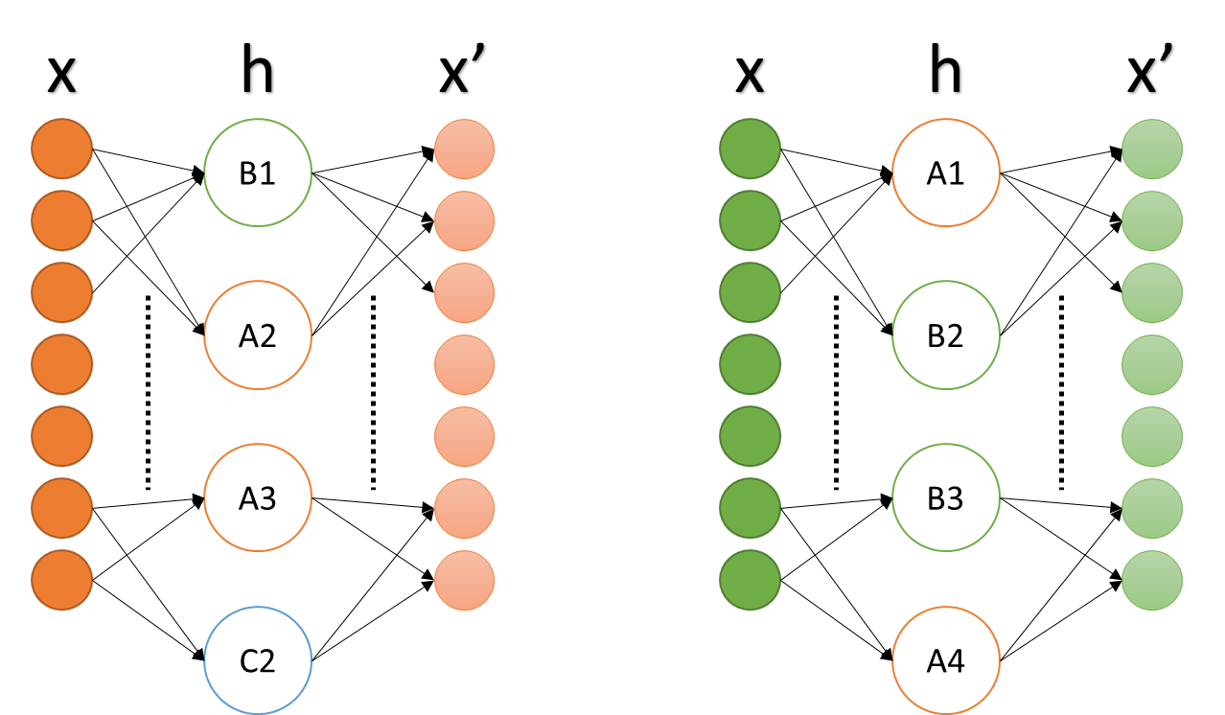
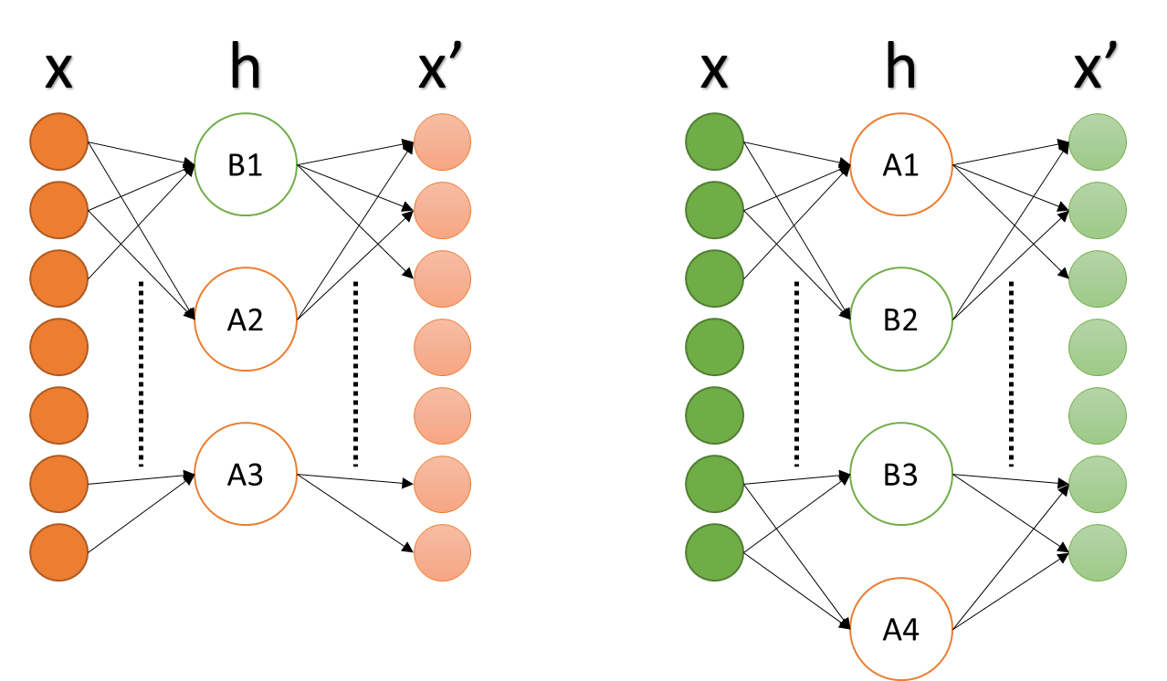
Method 2 EvoAE Evo-batches
Original Data
Data A
Data B
Data A
Data B
Data C
Data D
Data C
Data D
Local Search
Crossover
Mutate

Slide 22
Agenda
Overview
Background and Related Work
Methods
Performance and Testing
Results
Conclusion and Future Work

Slide 23
Performance and Testing Hardware and testing parameters
Lenovo Y500 laptop
Intel i7 3rd generation 2.4GHz
12 GB RAM
All weights randomly initialized to N(0,0.5)
Parameter | Defaults
Learning Rate | 0.1
Momentum | 2
Weight Decay | 0.003
Population Size | 30
Generations | 50
Epochs/Gen | 20
Train/Validate | 80/20
Parameter | Wine | Iris | Heart Disease | MNIST
Hidden Size | 32 | 32 | 12 | 200
Hidden Std Dev | NULL | NULL | NULL | 80
Hidden +/- | 16 | 16 | 6 | NULL
Mutation Rate | 0.1 | 0.1 | 0.1 | 0.1

Slide 24
Performance and Testing Baseline
Baseline is a single AE with 30 random initializations
Two learning rates to create two baseline measurements
Base learning rate
Learning rate * 0.1
Learning rate
Learning rate * 0.1

Slide 25
Performance and Testing Data partitioning
Three data partitioning methods were used
Full data
Mini-batch
Evo-batch
Full data
Mini-batch
Evo-batch

Slide 26
Performance and Testing Post-training configurations
Post-training run in the following ways
Full data (All)
Batch data (Batch)
None
All sets below are using the Evo-batch configuration
Full data
Batch data
None

Slide 27
Agenda
Overview
Background and Related Work
Methods
Performance and Testing
Results
Conclusion and Future Work

Slide 28
Results Parameters Review
Parameter | Wine | MNIST
Hidden Size | 32 | 200
Hidden Std Dev | NULL | 80
Hidden +/- | 16 | NULL
Mutation Rate | 0.1 | 0.1
Parameter | Defaults
Learning Rate | 0.1
Momentum | 2
Weight Decay | 0.003
Population Size | 30
Generations | 50
Epochs/Gen | 20
Train/Validate | 80/20

Slide 29
Results Datasets
UCI wine dataset
178 samples
13 features
3 classes
Reduced MNIST dataset
6000/1000 and 24k/6k training/testing samples
784 features
10 classes (0-9)

Slide 30
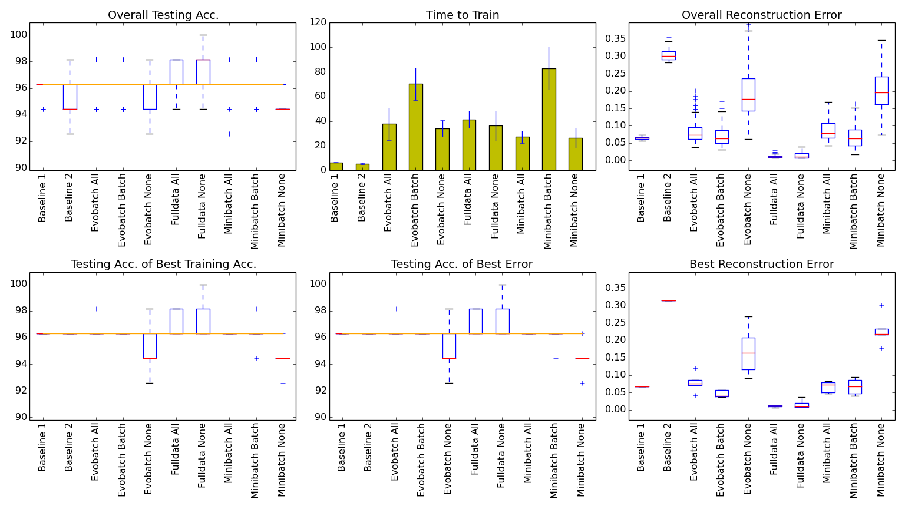
Results Small datasets - UCI Wine
Parameter | Wine
Hidden Size | 32
Hidden Std Dev | NULL
Hidden +/- | 16
Mutation Rate | 0.1

Slide 31
Results Small datasets - UCI Wine
Parameter | Wine
Hidden Size | 32
Hidden Std Dev | NULL
Hidden +/- | 16
Mutation Rate | 0.1
Best error-to-speed:
Baseline 1
Best overall error:
Full data All
Full data is fast on small scale data
Evo- and mini-batch not good on small scale data

Slide 32
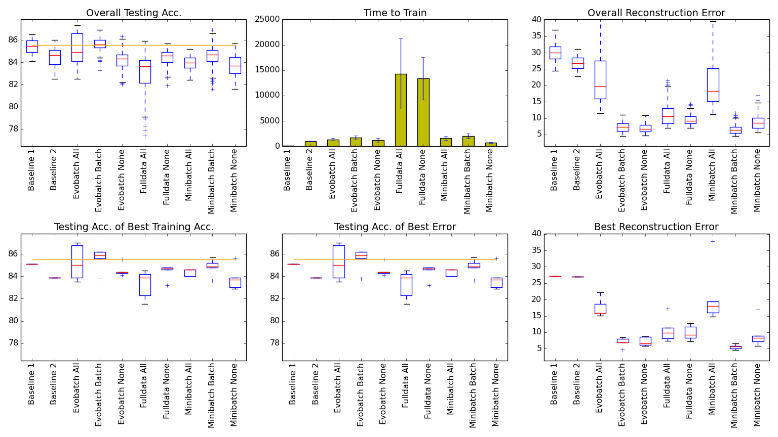
Results Small datasets – MNIST 6k/1k
Parameter | MNIST
Hidden Size | 200
Hidden Std Dev | 80
Hidden +/- | NULL
Mutation Rate | 0.1

Slide 33
Results Small datasets – MNIST 6k/1k
Parameter | MNIST
Hidden Size | 200
Hidden Std Dev | 80
Hidden +/- | NULL
Mutation Rate | 0.1
Best error-to-time:
Mini-batch None
Best overall error:
Mini-batch Batch
Full data slows exponentially on large scale data
Evo- and mini-batch close to baseline speed

Slide 34
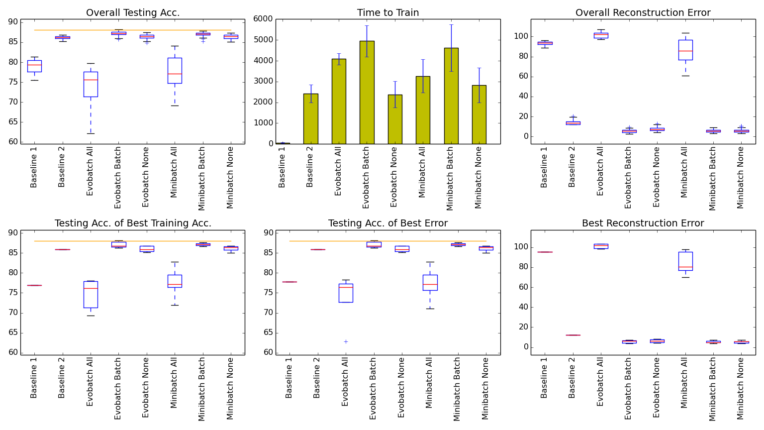
Results Medium datasets – MNIST 24k/6k
Parameter | MNIST
Hidden Size | 200
Hidden Std Dev | 80
Hidden +/- | NULL
Mutation Rate | 0.1

Slide 35
Results Medium datasets – MNIST 24k/6k
Parameter | MNIST
Hidden Size | 200
Hidden Std Dev | 80
Hidden +/- | NULL
Mutation Rate | 0.1
Best error-to-time:
Evo-batch None
Best overall error:
Evo-batch Batch OR
Mini-batch Batch
Full data too slow to run on dataset
EvoAE w/ population 30 trains as quickly as a single baseline AE when using Evo-batch

Slide 36
Agenda
Overview
Background and Related Work
Methods
Performance and Testing
Results
Conclusion and Future Work

Slide 37
Conclusions Good for large problems
Traditional methods are still preferred choice for small problems and toy problems
EvoAE with Evo-batch produces effective and efficient feature reduction given a large volume of data
EvoAE is robust against poorly-chosen hyper-parameters, specifically learning rate

Slide 38
Future Work
Immediate goals:
Transition to distributed system, MapReduce based or otherwise
Harness GPU technology for increased speeds (~50% in some cases)
Long term goals:
Open the system for use by novices and non-programmers
Make the system easy to use and transparent to the user for both modification and training purposes

Slide 39
Thank you

Slide 40
Background Backpropagation with weight decay
We use this new cost to update weights and biases given some learning rate α:
$W_{ij}^{(l)}=W_{ij}^{(l)}−α\frac{∂J\left(W,b\right)}{∂W_{ij}^{(l)}}$
$b_{i}^{\left(l\right)}=b_{i}^{\left(l\right)}−α\frac{∂J\left(W,b\right)}{∂b_{i}^{\left(l\right)}}$
Cost is prone to overfitting - weight decay variable λ is added
$J\left(W,b\right)= \left[\frac{1}{M}\sum_{m=1}^{M}{E(W,b;x_{m},y_{m})}\right]+\frac{λ}{2}\sum_{l=1}^{L−1}{\sum_{i=1}^{s_{l}}{\sum_{j=1}^{s_{l+1}}{{(W_{ji}^{(l)})}^{2}}}}$

Slide 41
Background Conjugated Gradient Descent
This can become stuck in a loop, however, so we add a momentum term β
$ΔW_{ij}^{(l)t}= \left(\frac{∂J\left(W,b\right)}{∂W_{ij}^{(l)}}\right)+βΔW_{ij}^{\left(l\right)t−1}$
$Δb_{i}^{\left(l\right)t}= \left(\frac{∂J\left(W,b\right)}{∂b_{i}^{\left(l\right)}}\right)+βΔb_{i}^{\left(l\right)t−1}$
$W_{ij}^{(l)}=W_{ij}^{(l)}−α(ΔW_{ij}^{\left(l\right)t})$
$b_{i}^{\left(l\right)}=b_{i}^{\left(l\right)}−α(Δb_{i}^{\left(l\right)t})$
This adds memory to the equation, as we use previous updates

Slide 42
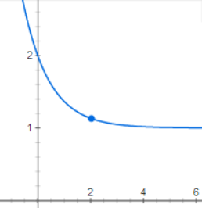
Background Architecture and hyper-parameters
Architecture and hyper-parameter selection usually done through trial-and-error
Manually optimized and updated by hand
Dynamic learning rates can be implemented to correct for sub-optimal learning rate selection
$α^{′}= a∗\left(1+\exp\left(−epoch\right)\right)$
$W^{′}=W− α^{′}∗∆W$

Slide 43
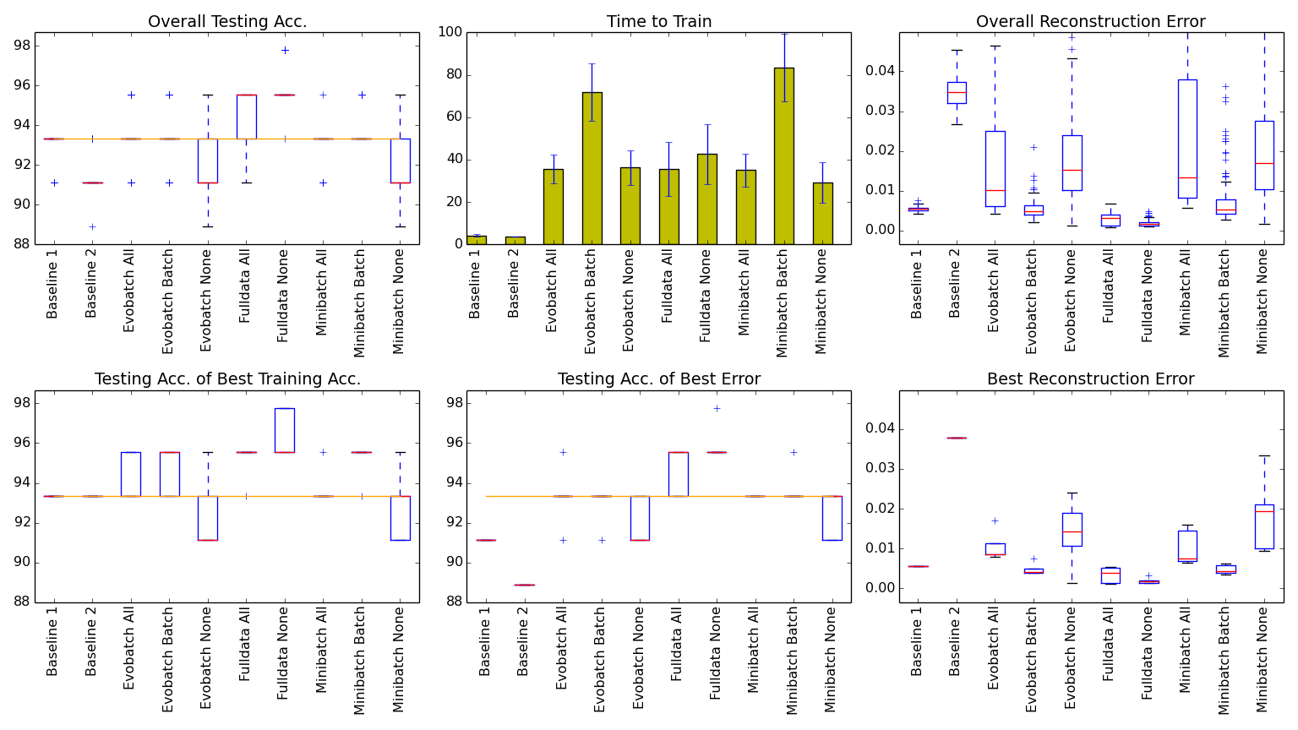
Results Small datasets – UCI Iris
Parameter | Iris
Hidden Size | 32
Hidden Std Dev | NULL
Hidden +/- | 16
Mutation Rate | 0.1
The UCI Iris dataset has 150 samples with 4 features and 3 classes
Best error-to-speed:
Baseline 1
Best overall error:
Full data None

Slide 44
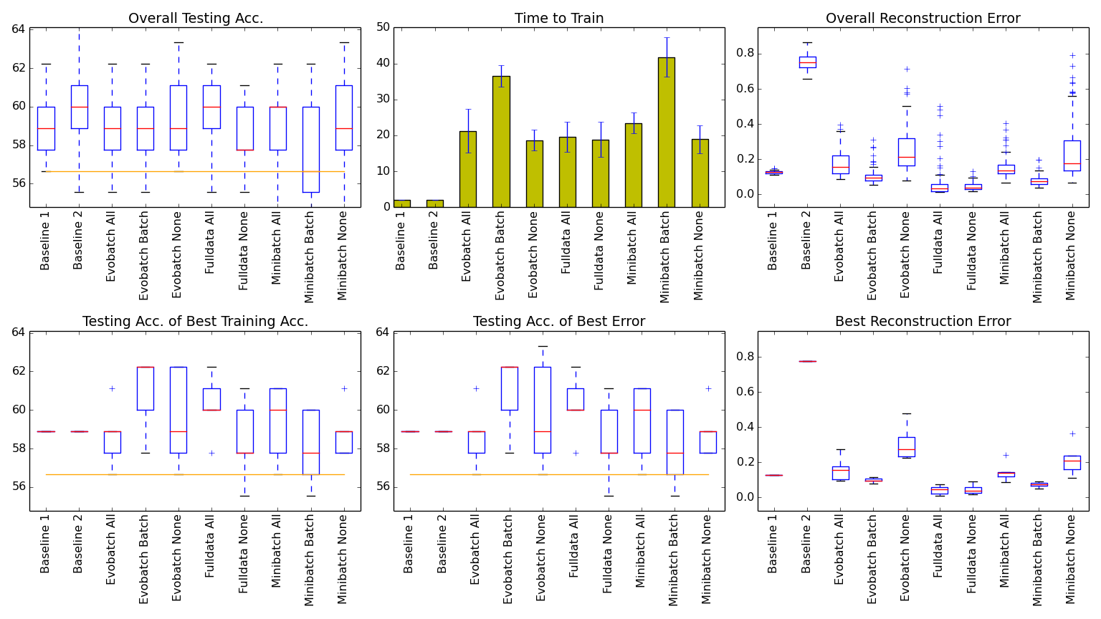
Results Small datasets – UCI Heart Disease
Parameter | Heart Disease
Hidden Size | 12
Hidden Std Dev | NULL
Hidden +/- | 6
Mutation Rate | 0.1
The UCI Heart Disease dataset has 297 samples with 13 features and 5 classes
Best error-to-time:
Baseline 1
Best overall error:
Full data None

