Slide 1
AN ENHANCED MOBILE AMBULATORY ASSESSMENT SYSTEM FOR ALCOHOL CRAVING STUDIES
Master’s Thesis Defense
Ruiqi Shi
Advisor: Dr.Yi Shang

Slide 2
Overview
Introduction
Related Work
System Architecture and Implementation
Preliminary Result
Summary and Future Work

Slide 3
Motivation
What is Alcohol Craving ?
Thoughts, physical sensations, or emotions that tempt subject to drink, even though the subject have at least some desire not to.
NIAAA: 18 million - alcohol use disorder or alcohol dependence.
NIDA: $30 - billion health care costs
Not Much Reliable Ambulatory Assessment System for Alcohol Craving Studies
No Accurate Methods for Alcohol Craving Episodes Prediction Reported in Ambulatory Alcohol Craving studies
Notes:
"craving" refer to a broad range of thoughts, physical sensations, or emotions that tempt you to drink, even though you have at least some desire not to.

Slide 4
Laboratory Assessment

Slide 5
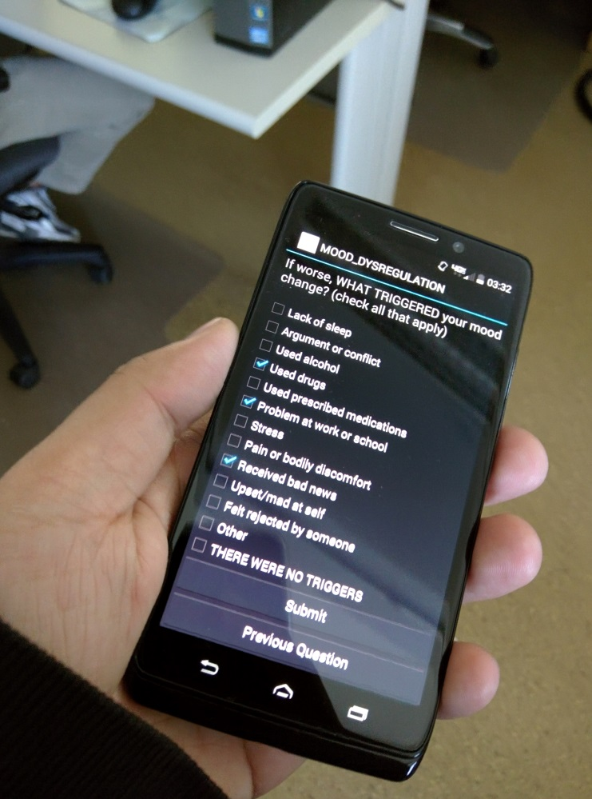
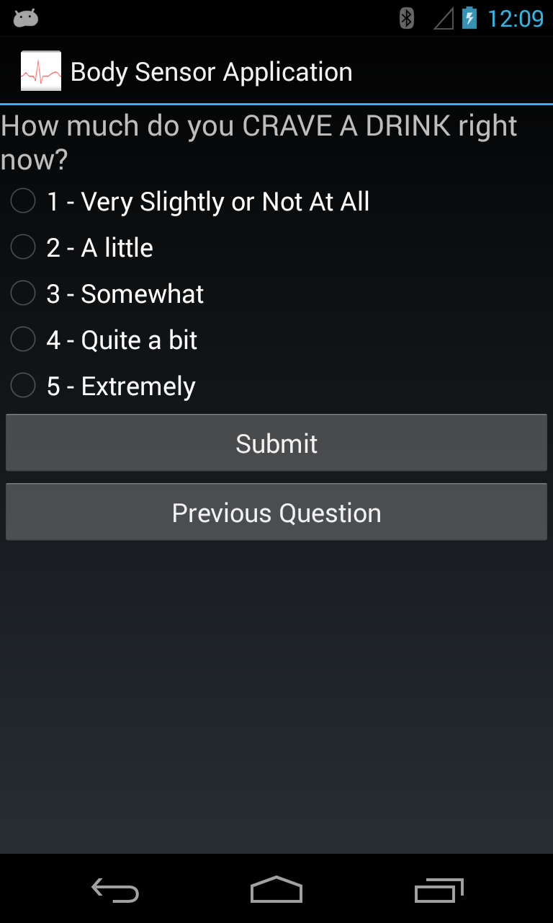
Ambulatory Assessment

Slide 6
Comparison between Laboratory Assessment and Ambulatory Assessment
 | Data Precision | Time Consuming | Daily Data Collection | Real-time Data Monitoring
Laboratory Assessment | Higher |  |  | 
Ambulatory Assessment | Lower |  |  | 

Slide 7
Thesis Goals
System to monitor/collect real-time factors and predict drink craving episodes.
Goals: (more details)
Implement and Enhance a Drinking Craving Android Application (aCraving) based on a prototype.
Implement a Server Program to provide interaction with the mobile and monitoring on the real-time data.
Implement an automated data analysis system to predict drink craving episode.

Slide 8
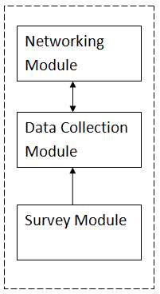
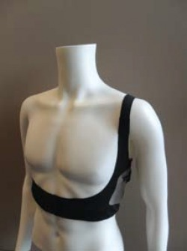
Prototype System
External Sensors
Smart Phone
Networking Module
Accelerometer Collection
Equivital EQ02 Life monitor
Server Program

Slide 9
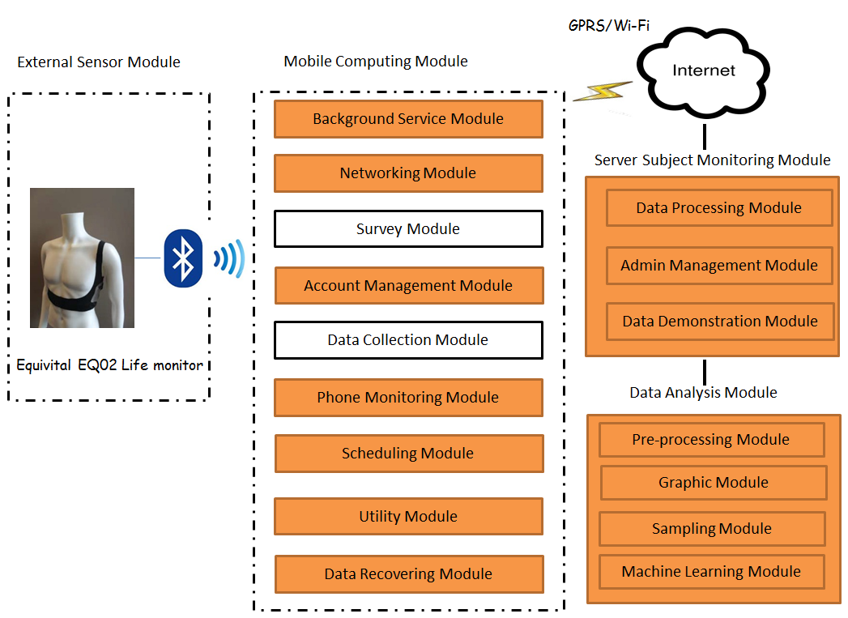
Enhanced System (aCraving)

Slide 10
New Features
Smart Phone
Automated Survey Scheduling
Survey Suspension/Break Suspension
Subject Behavior/Phone Performance Monitoring
System Restoring
Data Recovering
Data Encryption/Decryption
Server
Administration Management
Data Processing and Generating
Data Visualization
Notes:
4 system-triggered surveys based on previous survey results and subjects preference
Avoid interruption during the expension period meeting

Slide 11
New Features(cont’d)
Data Analysis
Data Cleaning and Refining
Data Smoothing(extract global trend) and Visualization
Feature Selection and Calculation for Generating Training Data
Supervised Learning

Slide 12
Enhancement
System Architecture Refactor
Organized/Reusable Structure
Responsiveness
Multi-thread framework
Security
HTTPS
Power Consumption
Data Buffering
System Component Optimization
Survey Data Reliability
Subject Identification
Report Preciseness

Slide 13
Overview
Introduction
Related Work
System Architecture and Implementation
Preliminary Result
Summary and Future Work

Slide 14
Related Work
“IPainRelief - A pain assessment and management app for a smart phone implementing sensors and soft computing tools”, by Rajesh and Joan, SRM University, India, ICICES,2013.
A Pain Assessment and Management App “IPainRelief” for a Smart phone
Uses Fuzzy Expert Systems
No experimental results
Notes:
identifying intensity of pain
Model trained by neural network

Slide 15
Related Work(cont’d)
E.W. Boyer, R. Fletcher, R.J. Fay, D. Smelson, D. Ziedonis, and R.W. Picard, “Preliminary efforts directed toward the detection of craving of illicit substances: the iHeal project,” J Med Toxicol. 8(1):5-9, March 2012.
A Drug Craving System and Management App for a phone
Sensor Data Detection, Random Assessment and self-report
No Real-time Data Collection

Slide 16
Related Work(cont’d)
 | Real-time Data Monitoring | Real-time Sensor Data Collection | System-triggered Report | Target | Experiment Result
IPainRelief |  |  |  | Pain intensity | No Result
iHeal |  |  |  | Drug Craving Episode | Not Shown
aCraving |  |  |  | Drink Craving Episode | Preliminary Result

Slide 17
Overview
Introduction
Related Work
System Architecture and Implementation
Preliminary Result
Summary and Future Work

Slide 18
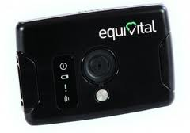
System Environment
External Sensor:
EQ02 Life Monitor
Deployed Phone:
MOTO DROID
Samsung Nexus
Nexus 4.
Android OS: 4.4, 5.0.
Server OS: Linux

Slide 19
EQ02 Life Monitor
Bluetooth RFCOMM Protocol
Heart Rate derived from ECG , Impedance
Breathing Rate derived from ECG, Impedance
Body Position and Body Movement
Core Temperature and Skin Temperature
Requires Equivital SDK for parsing the raw data from the SEM

Slide 20
Enhanced System Architecture
Notes:
rules

Slide 21
System Implementation
External Sensor Module
Mobile Computing Module
Server Subject Monitoring Module
Machine Learning Module

Slide 22
Mobile Computing Module
Networking Module
Data Collection
Phone Monitoring Module
Data Recovering Module
Background Service Module
Utility Module
Survey Module
Scheduling Module
Account Management Module

Slide 23
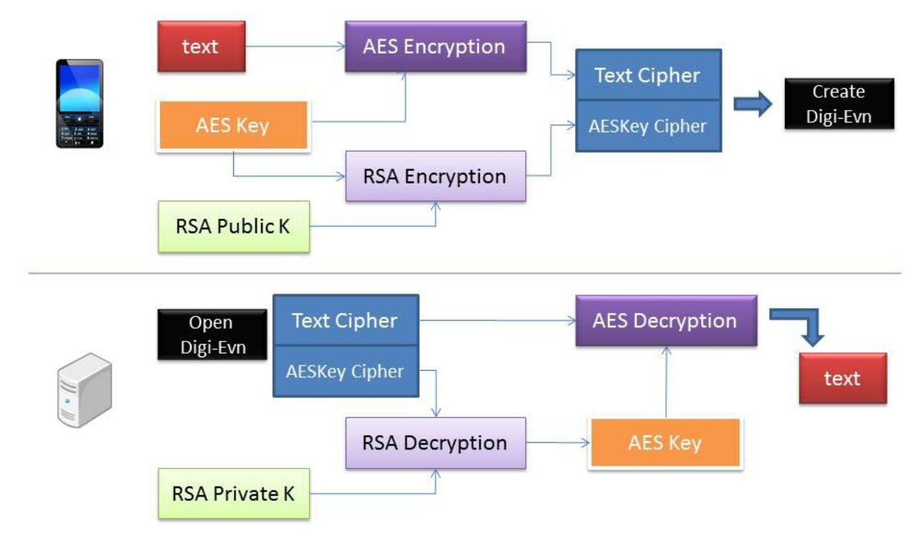
Mobile Computing Module Enhancement
Security
Hypertext Transfer Protocol Secure (HTTPS) Protocol
Hybrid Cryptosystem

Slide 24
Http Vs. Https
Test Data Size: 4.2 MB
Environment: LTE connection
 | HTTP | HTTPS （Not Verify the Server Certificate） | HTTPS
Average Response Time(second) | 12.1 | 13.7 | 13.8

Slide 25
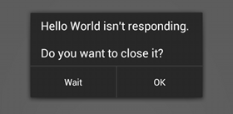
Mobile Computing Module Enhancement
Responsiveness
Multi-thread framework
Previous Design
Enhanced Design
Worker
Thread 1
Activity UI Thread
Activity UI Thread
Task
OnClickEvent
Time-consuming Task
(Network Access)
ANR Window Pop up
New Click Request
OnClick
Event
Worker
Thread 1
Task

Slide 26
Mobile Computing Module Enhancement
Power Consumption
Transmission Data Buffering
Power consumption reduced by 28.6 %

Slide 27
System Implementation
External Sensor Module
Mobile Computing Module
Server Subject Monitoring Module
Machine Learning Module

Slide 28
Sensor Data Chart Example

Slide 29
Location Data Example

Slide 30
System Implementation
External Sensor Module
Mobile Computing Module
Server Subject Monitoring Module
Machine Learning Module

Slide 31
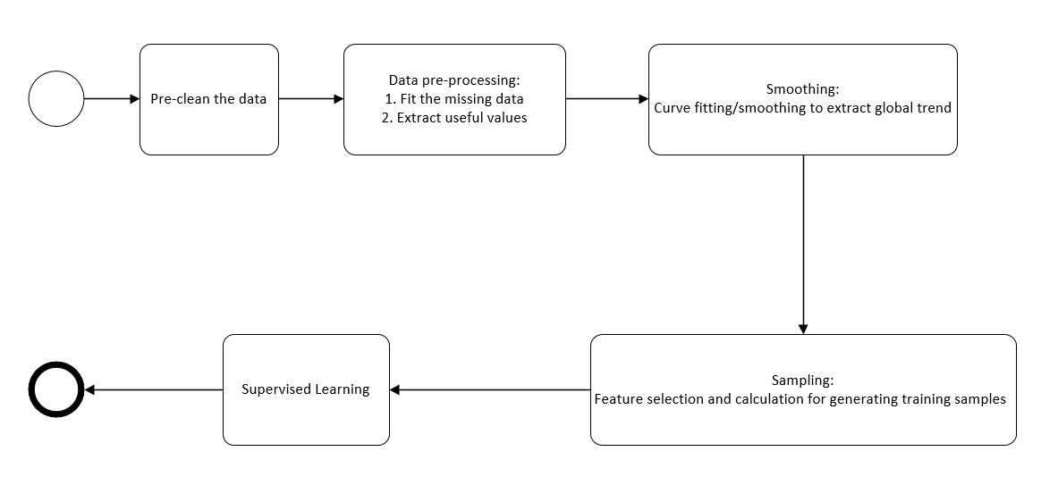
Data Analysis Module
Pre-processing Module
Fit Missing Data: Linear Interpolation; Spline Interpolation
Graphic Module
Smoothing Spline
Sampling Module
Machine Learning Module

Slide 32
Pre-processing Module
Pre-clean the Data
Discard unreliable sensor data based on the data confidence
Fit Missing Data
Linear Interpolation
Piecewise Polynomial Interpolation: Spline Interpolation
$P\left(x\right)= \frac{3hs^{2}−2s^{3}}{h^{3}}y_{k+1}+\frac{h^{3}−3hs^{2}+2s^{3}}{h^{3}}y_{k}+\frac{s^{2}(s−h)}{h^{2}}d_{k+1}+ \frac{s^{2}(s−h)}{h^{2}}d_{k}$
$Y={ y}_{i}+\left({ y}_{i+1}−{ y}_{i}\right)\frac{ X −{ x}_{i}}{x_{i+1}− x_{i}}$
$s=x−x_{k}$
$$h=h_{k}$$
$d_{k} = P^{′}(x_{k} )$

Slide 33
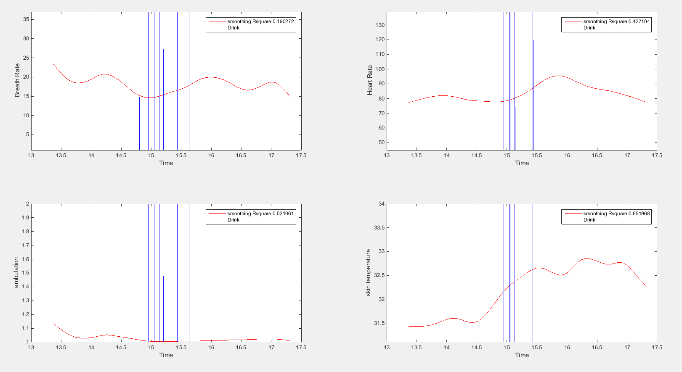
Graphic Module
Responsible for Curve fitting/smoothing to extract global trend

Slide 34
Supervised Learning

Slide 35
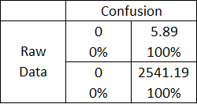
Collected Dataset
Dataset
Data are sorted by the timestamp
Data Size around 2540 * 5
Proportion of the Drink Craving Episode Data is low
around 6/2540 (0.23%)
Drink Craving Episode Data is collected with deviation
System-trigger survey
Self-report survey
Result of Directly Applying Machine Learning Method

Slide 36
“Expansion” Method-Expansion Step
Generating Drink Period by increasing the drink range around the drink report time.

Slide 37
“Expansion” Method-Conversion Step
Using Moving window to convert the drink period prediction to drink craving
episode prediction by calculating the proportion of drink-data in the window

Slide 38
“Shrink” Methods – Shrink Step
A Moving Window is utilized to compress the training dataset

Slide 39
“Shrink” Methods – Conversion Step

Slide 40
Evaluation
Test Drink Craving Episode Data Entry
Accepted Range
Predicted Drink Craving Episode Data Entry


Deviation
Notes:
Accepted Range equals to window size or expansion range

Slide 41
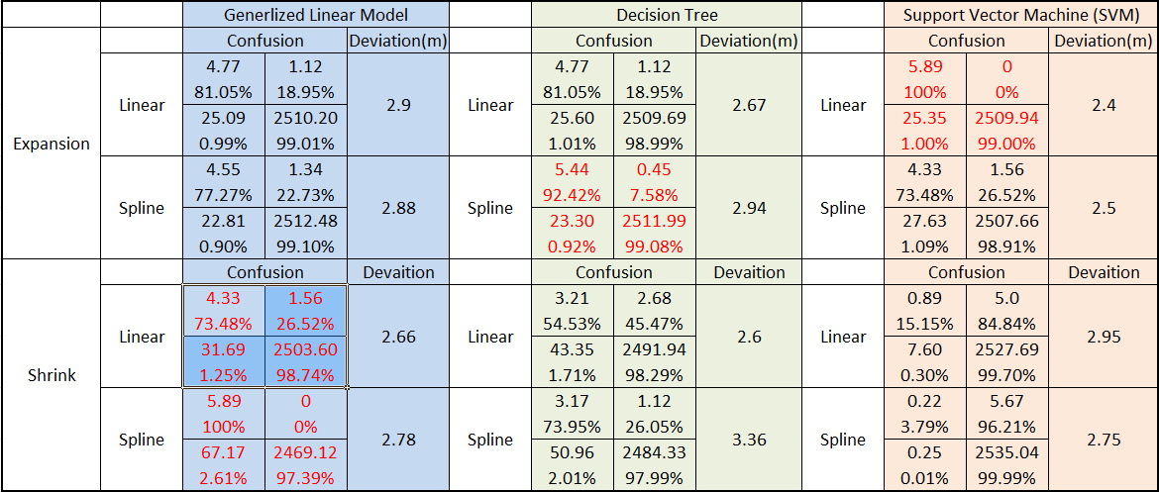
Preliminary Result

Slide 42
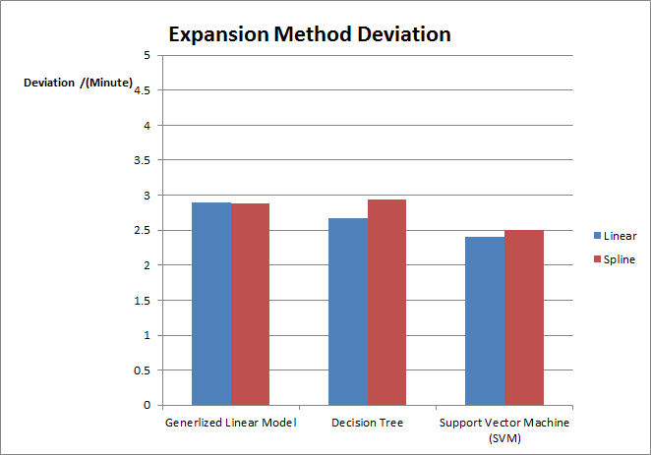
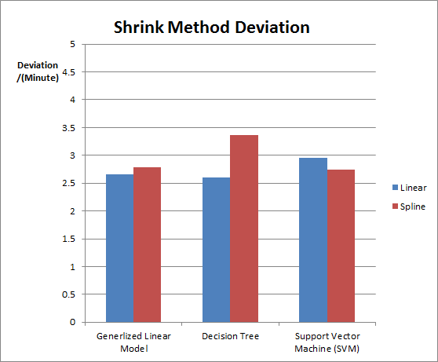
Preliminary Result (cont.)

Slide 43
Overview
Introduction
Related Work
System Architecture and Implementation
Preliminary Result
Summary and Future Work

Slide 44
Summary
Mobile Computing Module
provides reliable long-term real-time data collection.
provides reliable real-time survey assessment.
provides reliable survey scheduling functions.
provides secure data storage and transmission.
Server Monitoring Module
provides reliable real-time monitoring and visualization.
Promising automated data analysis module is deployed.
“aCraving” System has been used in real subjects for several months.

Slide 45
Future Work
Mobile Computing Module:
Data for Communication between Server and Phone
Alternative Module for New External Sensors
Bluetooth 4.0 Support
Data Analysis Module:
More supervised Learning Methods
Unsupervised Learning Methods
Survival Analysis Model

Slide 46
Thanks For Presences
Questions ?

Slide 47
Flow Chart of HTTPS Implementation in Android

Slide 48
Smoothing Spline
. The smoothing spline function s minimizes the following Eq. (4.2):
$$p\sum_{i}{w_{i}(y_{i}−s(x_{i})})^{2}+(1−p)\int{(\frac{d^{2}s}{dx^{2}}})^{2}dx$$
where p is the smoothing parameter between 0 and 1, ${ w}_{i}$ is the weight, ${ x}_{i}$and ${ y}_{i}$ is a training example. p = 0 produces a least-squares straight-line fit to the data, while p = 1 produces a cubic spline interpolant.

