Slide 1

DESIGN AND IMPLEMENTATION
OF
CREEL SURVEY DATA MANAGEMENT APPLICATION
(CSDMA)
A Mobile Data Collection and Web Based Data Verification Application
Master’s Project Defense
By: Nishant Chettri
Advisor: Dr. Yi Shang
Notes:
Good morning and thank you for attending my project defense
The title of my project is “…” and involves a mobile data collection app and an accompanying web based data verification application

Slide 2
OUTLINE
Introduction
Related Works
Design & Implementation
Results
Conclusion & Future Work
Notes:
In this presentation, I will be going through the following topics.
Firstly, I will introduce what the project involves, the problem with the current process and the proposed solution
Secondly, I’ll talk about some applications, which were used as inspiration for this project
I will then go through the design and implementation of the mobile app followed by the web application
Finally, I will conclude the presentation and talk about some potential future works for this project

Slide 3
OUTLINE
Introduction
Related Works
Design & Implementation
Results
Conclusion & Future Work
Problem Background
Proposed Solution
Notes:
So first of all, I will introduce what a creel survey is, who conducts these surveys, the purpose of these surveys and the current process
Then I will highlight some of the problems in the current process
And finally talk about the solution proposed in this project

Slide 4
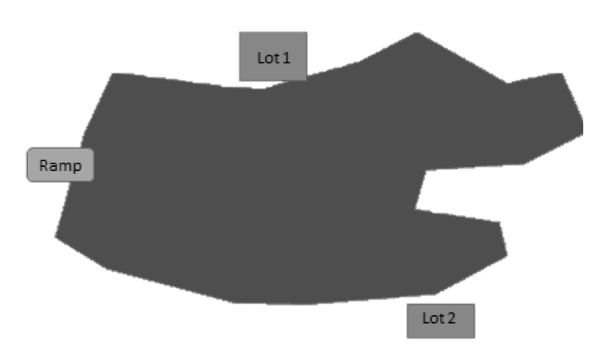
Introduction
Creel Surveys: Missouri Department of Conservation (MDC) conducts angler (fishermen and fisherwomen) interviews in Missouri lakes
Data collected improves fishing environment, fishing regulations, and helps monitor fishing activities
Survey process:
  Clerks interview angler(s) using data sheet(s)
  Data sheets are returned to MDC
  Survey responses are manually verified and entered to database
Notes:
Creel Surveys are conducted by MDC to get fishing details from anglers by asking questions and noting down their responses
The purpose of collecting all these data is to improve the fishing in the lakes: fishing activities; monitor the fishing trends, assess success, etc.
Clerks wait at specific locations in the lakes or move around the lake depending on the size, number of anglers, etc. Ask questions and note down responses in data sheets; They then take the data sheets back to MDC and have someone manually verify and enter into database
Uses of creel survey
Evaluation of fishing regulations
Fishing regulation development
Monitoring trends in fishing activity
Evaluate fishery management action (e.g., habitat improvement for improved fishing)
Refine fish stocking programs
Assess fishing success
Access creel: Access creels are normally conducted at exit points from the fishery.
Bus route or Stream: A bus route/stream creel is ideal for situations where there are many accesses that are lightly to moderately used; The clerk travels among accesses and is assigned times
Roving: Roving creel surveys are good for larger lakes with numerous accesses, especially when many of these accesses are located on private property, and where fishing is done mostly from boats.

Slide 5
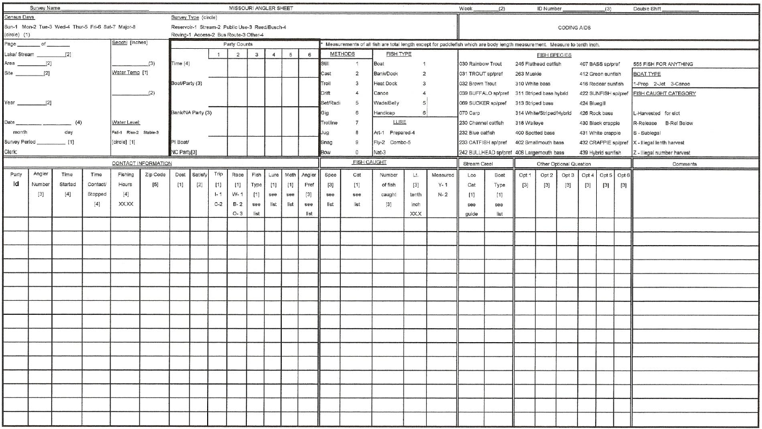
Problem Background
Slow, inefficient and error-prone
  Database entry can take 15-20 hours each month
  Human error – Incorrect data can be entered to database
  Possibility of misplaced or damaged data sheets
No real-time access to survey data
  Access to real-time data can expedite overall process
  Can help in identification of potential flaws in workflow
Lack of any interactive interface to collect and verify survey data
Data Sheet
Notes:
As you can imagine, this poses a lot of issues
Responses are noted down in a large data sheet, which requires clerks to write in a lot of information before taking interview of any angler party, i.e. a group of anglers being interviewed at the same time. Each party has a single data sheet, which could pile up.
Takes too long to collect, bring back data sheet, and enter data to a database
Human factor: error-prone
Lacks real time access to survey data, which can be helpful in improving not only how the staff view data but the entire workflow. Any changes to the workflow can be identified quickly when data is accessible earlier
No automation anywhere in the workflow

Slide 6
Proposed Solution
CSDMA
Creel Survey Mobile App
Hybrid Mobile Development with Phonegap
Fast, efficient and user-friendly interface
Process of collecting and entering data to database can be significantly improved
Creel Survey Web Dashboard
LAMP Stack development
Interactive, and modularized interface for a simplified data verification process
Modularized development framework with object-oriented programming
Both these implementations can also introduce new features in the workflow
Notes:
CSDMA: Mobile app and Web dashboard
Mobile app
User interface can be just as smooth as using a website
Portable data collection, reduces having to carry data sheets back and forth = no need for manual data entry
Web dashboard
Globally accessible data verification portal
Makes the process more simpler, and early access to data
PLUS both these applications can add new features to the workflow

Slide 7
OUTLINE
Introduction
Related Works
Design & Implementation
Results
Conclusion & Future Work
Notes:
We will talk about 3 other applications, which focused on similar data collection approaches

Slide 8
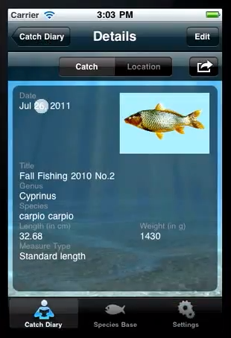
iFishWatcher and AnglersBase
iOS and Android applications for anglers developed by Fishbase
Self-reporting of fishing activities
Collects information in “Catch diary” entries: images, fish weight and length, etc.
However, MDC not inclined towards self-reporting
B. Ueberschär, M. Bourimi, D. Kesdogan, C. Neumann, O. Dreisbach, J. Dachs, W. Schwittek, "Mobile Applications for the Angling Community," in 6th World Recreational Fishing Conference, Berlin, 2011.
Notes:
Presented at a Fishing Conference in Berlin in 2011
An iOS and android implementation of data collection for anglers
Self reporting app but no accompanying web dashboard discussed
MDC prefers clerks taking surveys and does not want a self-reporting (outward facing) application, i.e. put on app stores
But features such as image capture taken as inspiration

Slide 9
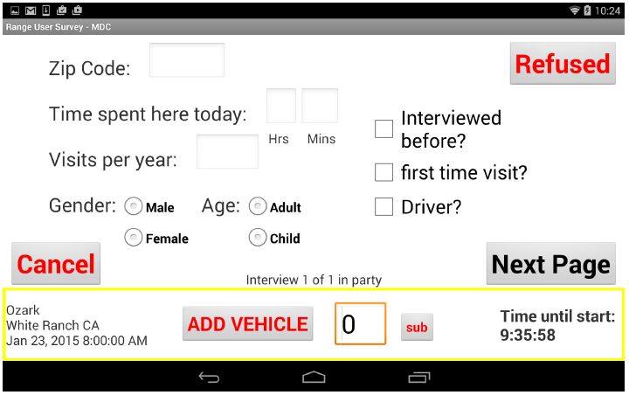
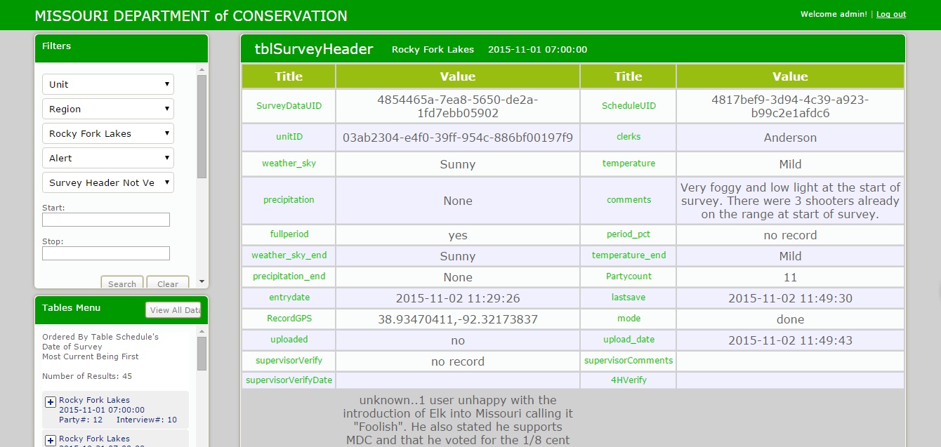
Range User Survey
Shooting Range survey application developed by MU’s Distributed and Intelligent Computing Lab
Focus on mobile app, data storage and a web interface for reporting
Android mobile application but with limited design considerations
Web app is slow, non-modularized, and design’s responsiveness not implemented properly
Z. Peng, N. Wergeles and Y. Shang, "Development of The Missouri Department of Conservation Application: A Mobile Data Collection Platform For Natural Resource Management," Computer Science Department, University of Missouri, Columbia, 2015.
Notes:
Collaboration between MDC and MU
Similar solution as our proposed one
Android OS as compared to our hybrid approach: MDC requested iOS but were talking about running it on their existing Android tablets as well
Slow, non-modularized web application, does not adjust as well as bootstrap does for mobile devices
Useful: treeview for displaying data was taken as inspiration and even improved upon

Slide 10
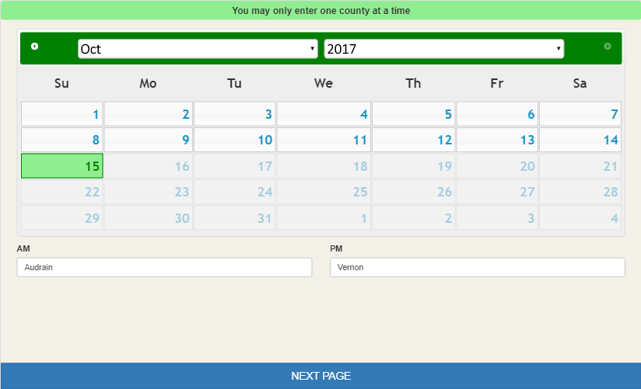
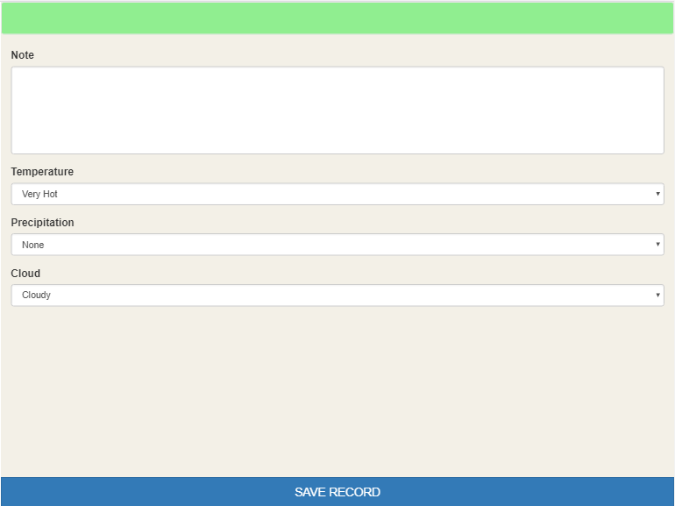
Bow Hunting Observation
Bow Hunting survey application for MDC developed by MU’s Distributed and Intelligent Computing Lab
A mobile application prototype
Hybrid mobile application with responsive design using Phonegap for both Android and iOS
Implementation of HTML5’s Web Storage as a persistent storage options, but had no server implementation
Computational complexity was low
Notes:
Finally, the bow hunting obs was a prototype developed for MDC by MU
Hybrid approach for both android and iOS devices. Easy to develop and run on both platforms
Useful for applications which don’t require too much computation or graphics processing. Our proposed solution is similar in that respect
HTML5 web storage is useful to store values prior to storing it in database

Slide 11
OUTLINE
Introduction
Related Works
Design & Implementation
Results
Conclusion & Future Work
Creel Survey Mobile App
Creel Survey Web Dashboard
Notes:
First I will go through design and implementation of the mobile app and then the same for the web dashboard

Slide 12
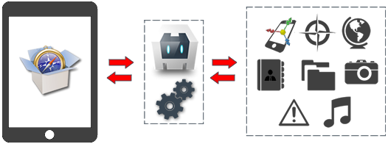
Creel Survey Mobile App
An efficient, and portable data collection application with a responsive and user-friendly interface
Hybrid mobile development for rapid, multi-platform (Android, iOS) development using Phonegap framework powered by Cordova
iPad
Cordova Plugins
Cordova Engine
A. Trice, "PhoneGap Explained Visually," Adobe Phonegap, 2 May 2012. [Online]. Available: https://phonegap.com/blog/2012/05/02/phonegap-explained-visually/
Notes:
Hybrid development
Fast
Multi-platform
Easy to program, native expertise not required on either platform
Web development architecture
Not computationally expensive so preferred over native

Slide 13
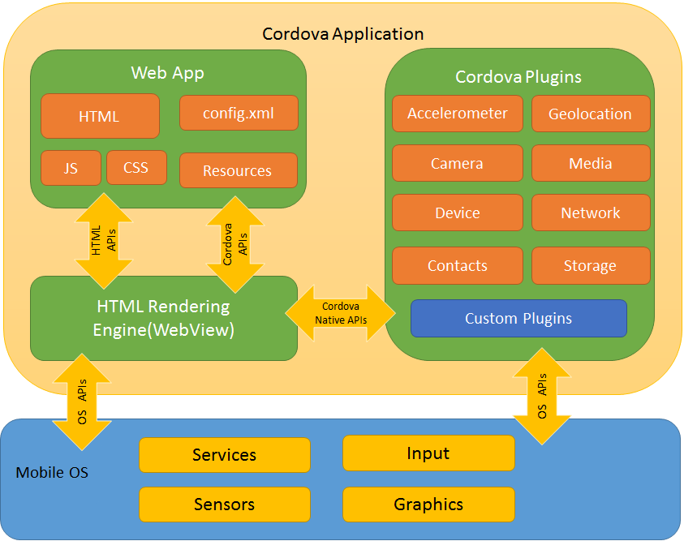
Cordova Architecture
Apache Cordova, "Documentation - Apache Cordova," Apache Cordova, 2017. [Online]. Available: https://cordova.apache.org/docs/en/latest/
Notes:
Hybrid app similar to web app development, but wrapped in a native application container and presented in a native WebView (container that runs web apps like a native app)
Interaction with the native application plugins is done using cordova plugins.
Some useful plugins used:
Cordova-plugin-camera: Provides access to the native camera functionality
Cordova-plugin-network-information: Allows access to the current network setting of the device, i.e. identify whether the device is connected to Wi-Fi, 4G connection, and so on
Cordova-plugin-device: Gets information of the device’s metadata such as the platform (OS), device’s UUID, manufacturer, serial number, etc.
Cordova-plugin-dialogs: Creates custom alert messages dialog boxes. This was especially useful for iOS to edit the alert titles
Cordova-sqlite-storage: Provides access to a persistent data storage option, which can be accessed using SQL queries
Phonegap-plugin-barcodescanner: QR code scanners were included in the initial design and development stages of the application

Slide 14
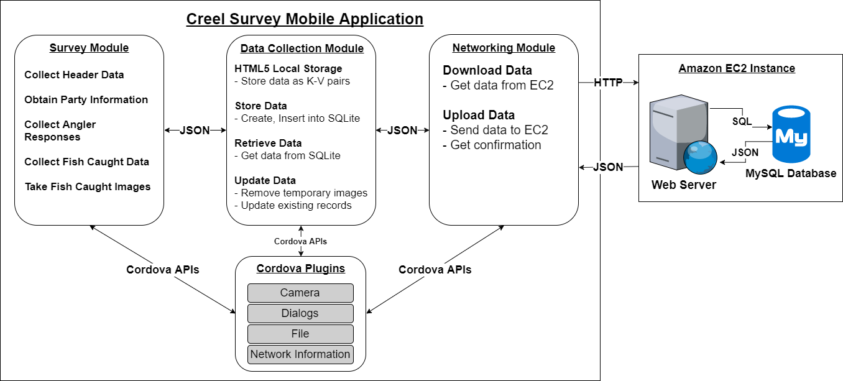
Creel Survey Mobile App Implementation
Notes:
There are 3 main modules in the mobile application:
survey,
data collection and
networking.
These modules interact with one another to create a user-friendly interface to collect data easily, and be able to conveniently upload and download data to and from the remote database. These modules also use the cordova APIs to access native device functions

Slide 15
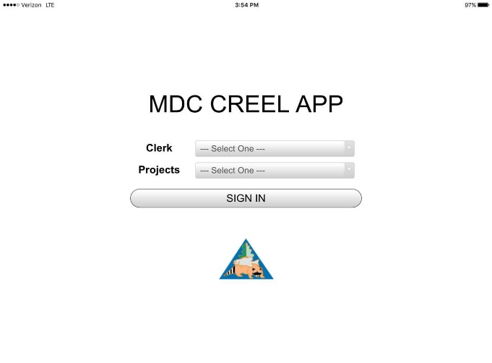
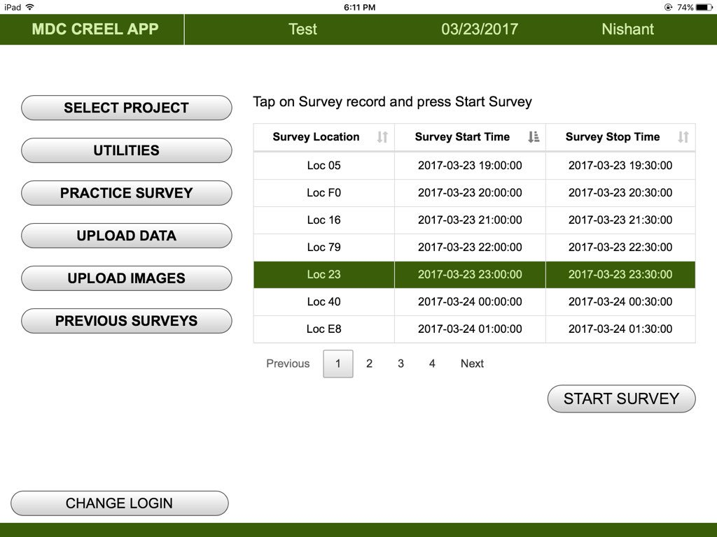
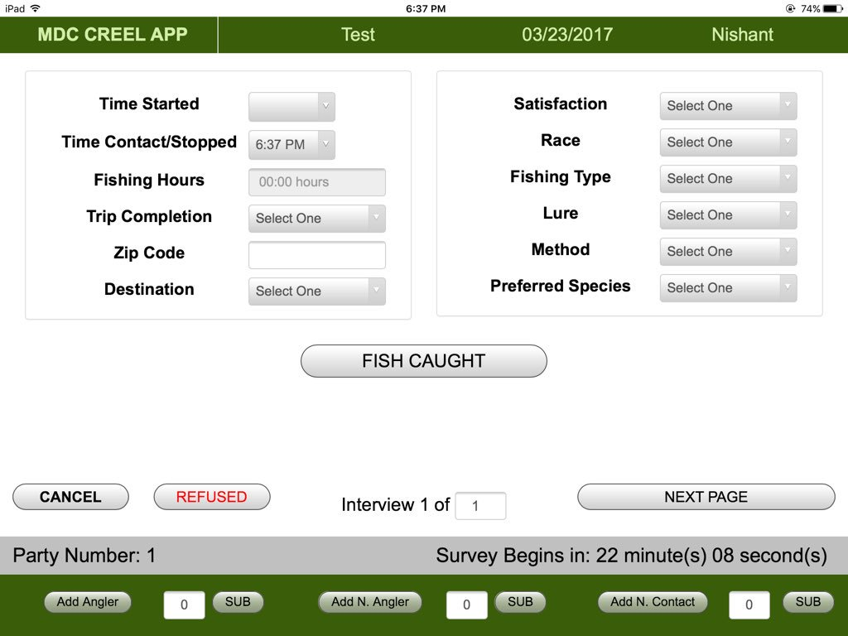
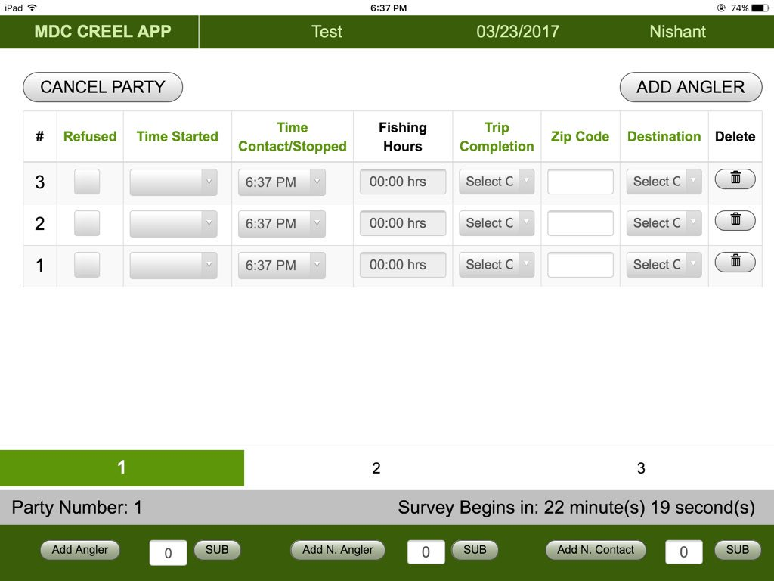
Survey Module
Contains the questions asked:
  Time started/stopped,
  Fishing preferences,
  Fish caught,
  Angler satisfaction, etc.
Communication with Cordova plugins to take images and validate data
Login
Begin Survey
Interview Angler(s)
Save Data
Uploads to Server
Notes:
All the SURVEY LOGIC is handled by the survey module. Contains all the questions and layout flows.
Talk about the process
Cordova API are used to take images and in some instances for validating data
The data collection process also involves these 5 steps, with 3 of these steps being cyclical

Slide 16
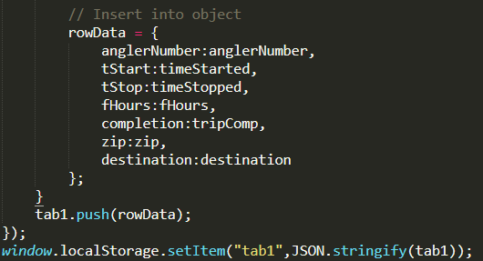


Data Collection Module
HTML5 Localstorage
  Saves data in <Key: Value> pair when transitioning between views, and app closures
  Value: Usually JSON object/array as strings
SQLite
  Create: tables dynamically to store data
  Read: data to display and validate data in the survey module
  Update: data, which have been uploaded
  Delete: all uploaded images to save memory
SQLite
Notes:
This module handles all the data collected using the survey module. There are two main aspects in this module.
HTML5
Store data when transitioning between views, which is then parsed and stored into SQLite when parties and surveys are completed.
Faster than accessing from a database, which is useful when transitioning between views
Also stores data in case of app closure
SQLite
Cordova Plugin
Able to do all the CRUD operations

Slide 17


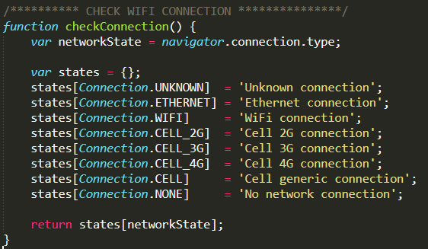
Networking Module
Download data from Server
  Get pre-requisite data (projects, schedules, count times) as JSON Arrays and insert them in the SQLite database
Upload data to Server
  Get survey data from SQLite and send them as a single JSON array to server
But first, cordova plugin verifies WiFi or Cellular connection
Notes:
This module handles all the data transfer between the device and the remote server
The remote server uses PHP files to send data to the device, and parse data received from the device
The application makes use of JSON arrays because:
They are easy to traverse and manipulate data,
and are also the standard when it comes to sending data via jquery ajax
The application makes sure WiFi or 4G is available before sending data. Only WiFi for image data

Slide 18
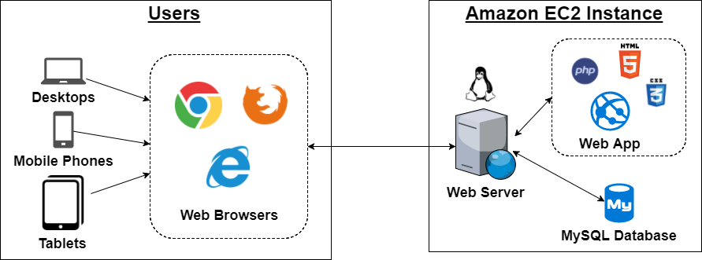
Creel Survey Web Dashboard
An organized and interactive interface for MDC staff to verify real-time data
Developed using the LAMP stack, and hosted on an Amazon EC2 instance making it accessible from anywhere
Notes:
The Creel Survey web dashboard provides an organized interface with modularized processes and responsive interfaces for MDC staff to verify survey data in real-time
This was developed using the LAMP stack (Linux, Apache, MySQL and PHP), and hosted on EC2 instance for ease of accessibility, scalability (if necessary) and convenience
PHP over 82% of programmers use it for web apps
Open-source and FREE
MySQL provides RDBMS features making CRUD operations easy
PHP, the most popular server-side scripting language, provides OOP approach to development and integrates easily with MySQL
Cloud provides scalable, reliable and secure hosting platform
One of the most popular: AWS EC2, provides a suitable platform for development, especially for Mizzou students

Slide 19
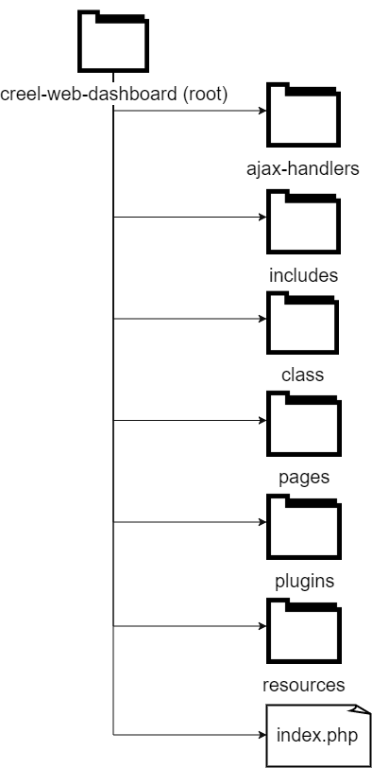
File System Hierarchy
Separated into different directories based on the functionalities
Development process is made easier and rapid with reusable codes = fewer lines of code
PHP classes help access MySQL tables in an object-oriented manner with objects and methods
Ajax-handlers enable front-end and back-end communication via jQuery Ajax improving usability and performance
Notes:
Before developing the application, a manageable and organized structure for programming was necessary.
This framework enables quick development, with modularized codes and implements code reusability. Redundant HTML and database queries are separated into individual files and called whenever necessary
Whenever communication between the front-end and back-end is required without having to reload the entire page, the ajax-handlers are used. This makes the process quicker and less memory intensive

Slide 20
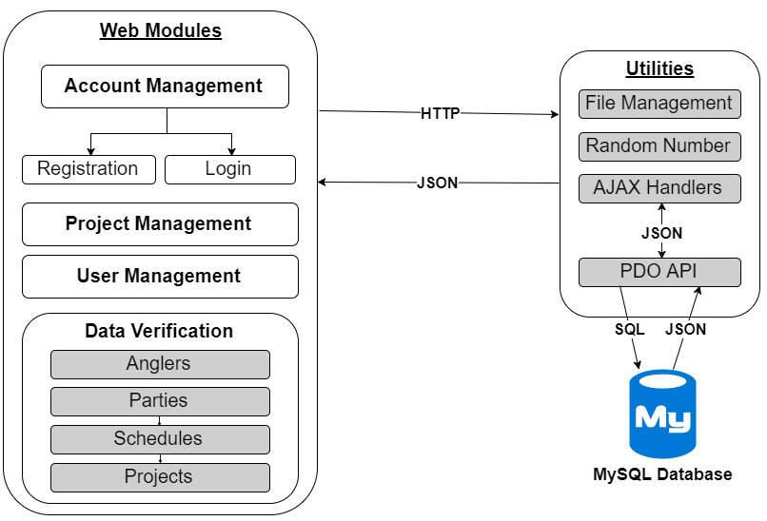
Creel Survey Web Dashboard Implementation
Notes:
There are 4 main modules in the web dashboard, with some assisting utilities.
The web modules communicate with the database using utilities such as the ajax-handlers, and MySQL APIs. We will go over these modules in the next slides.
Account management: that manages registration and login; implemented salted-hashed passwords to add security to login
Project and User management: add and update projects and users. Users when registering are unauthorized and user management assigns them user roles and projects to work on.
Data verification is primary goal: go from a top-down approach to look at data, but verification is then done bottom-up.
Utilities:
File management: download-upload CSV files
Random number: function to create a random globally unique ID
Ajax-handlers: as mentioned before to help in front-end and back-end communication
PDO API: MySQL API for PHP to assist in executing CRUD operations in an OOP manner

Slide 21
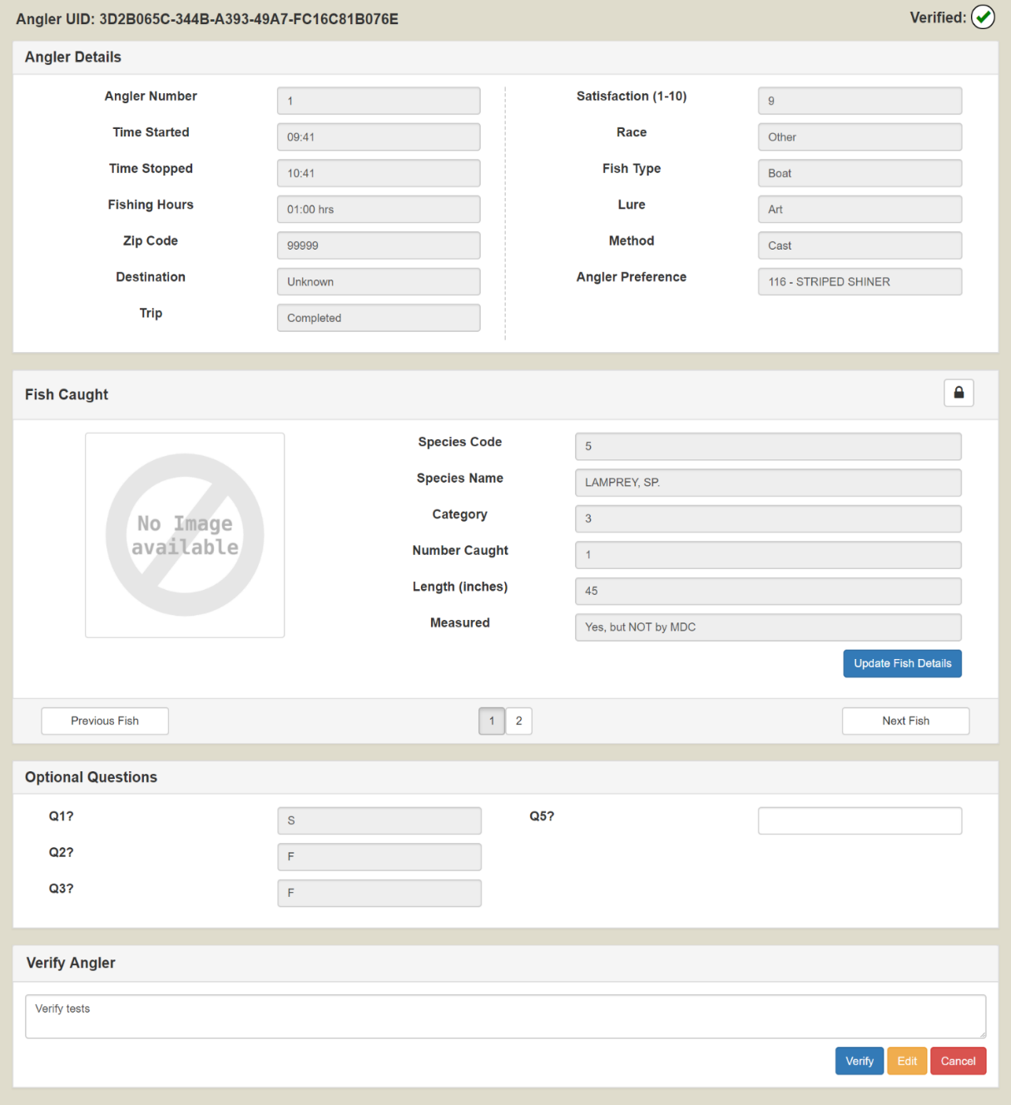
Data Verification Module
Modularization makes verification process structured, and easy to follow
  Angler(s) → Party → Survey → Project
Angler Verification:
  Verify data for each angler in a party
  Verify the fish caught data
  Update any incorrect or missing data
Party Verification:
  Verify all angler in party
Survey and Project auto-verification by bubbling up
Notes:
The most important module, rather the module, which was the driving force behind developing this web interface is the verification module.
This module simplifies the verification process for the MDC staff by providing a structured, hierarchical view of the data. Users are able to navigate through the data in a top-down approach, while being able to verify it in a bottom-up approach.
The angler verification process involves:
checking whether all NECESSARY data has been entered in the survey
Checking whether the fish caught data has valid and legitimate data
Update any incorrect data in the survey
Once all the anglers in a party are verified, the party can then be verified as well. The survey and projects are verified automatically by bubbling up, i.e. reverse cascading

Slide 22
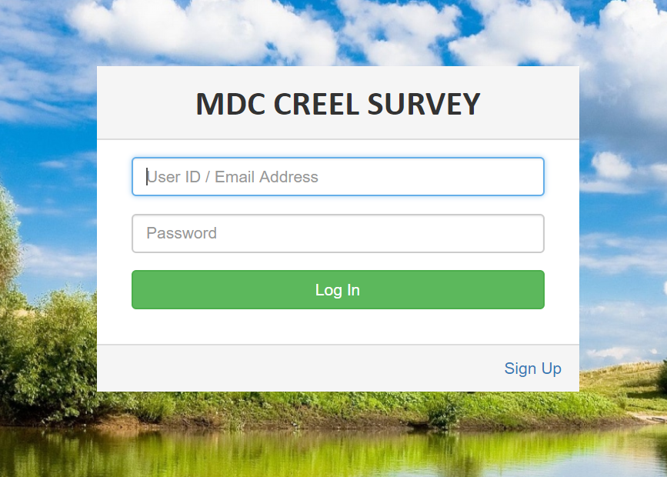
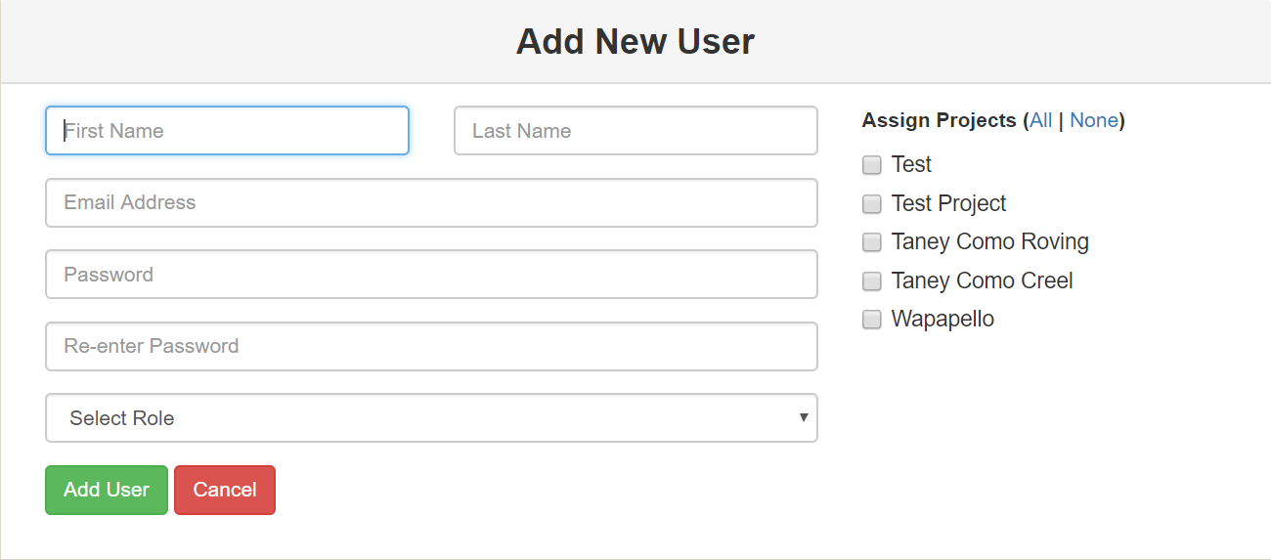
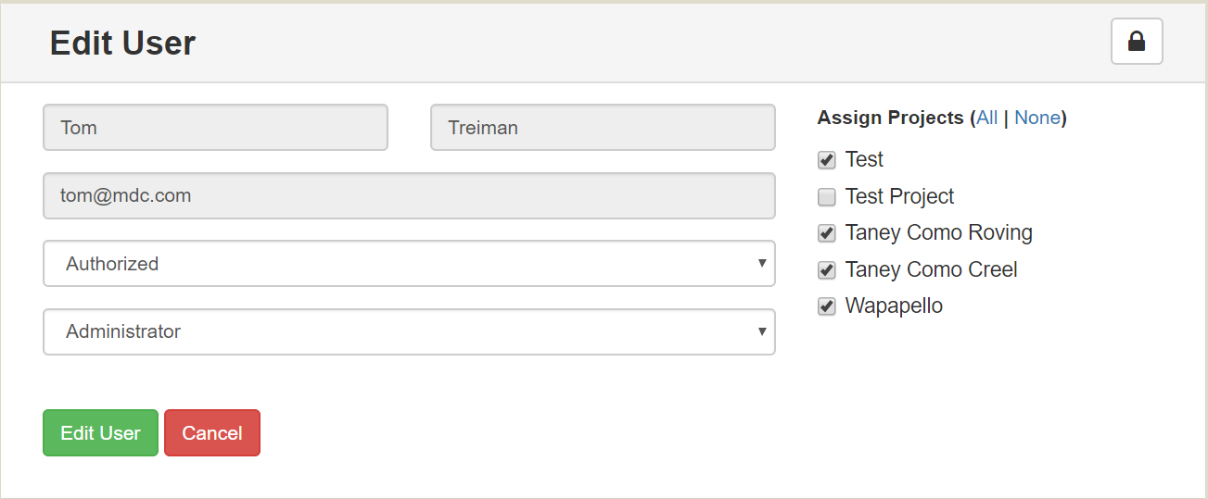
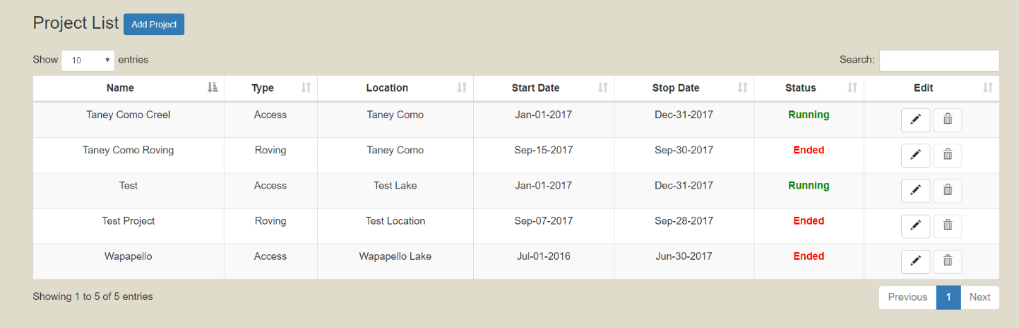
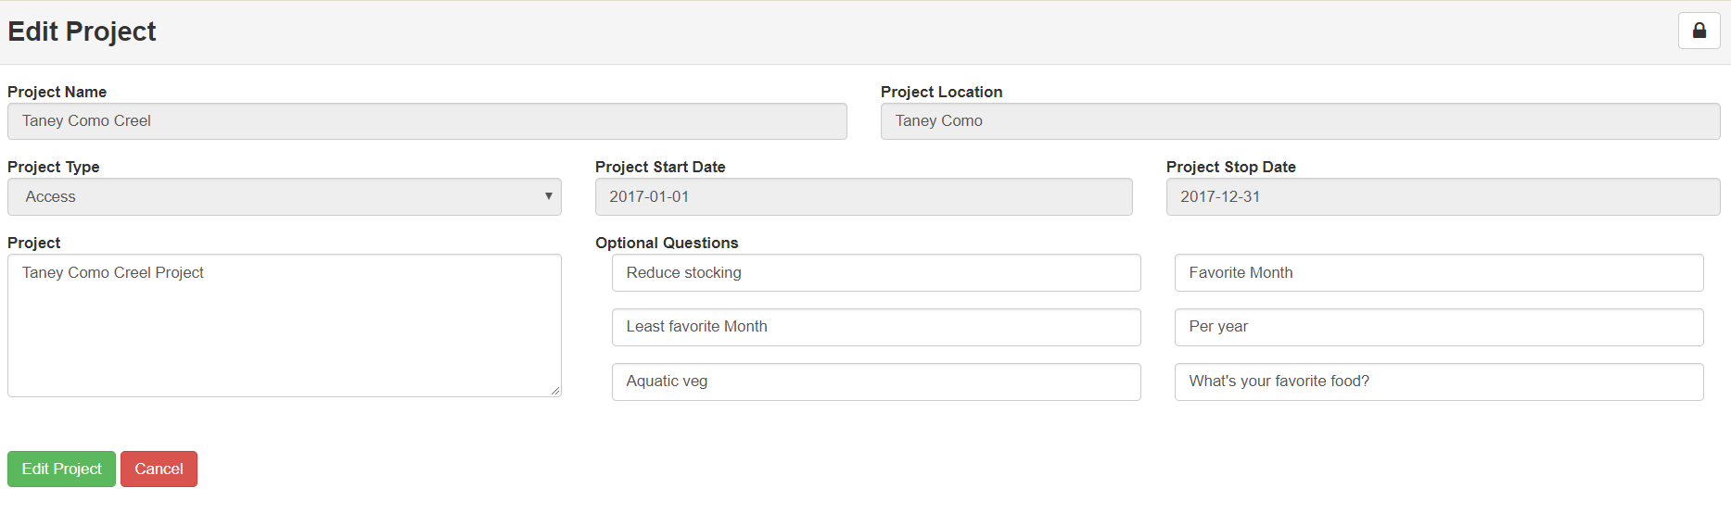
Web Modules
Account Management Module
  Registration, and login management
  Salted (random) and Hashed (SHA-256) password
User Management Module
  Assignment of roles and projects to users
  User authorization
Project Management Module
Notes:
The first web module is the account management module, which is responsible for registration and login process. When a new user account is registered, their data is sent from this module to the database. The user’s password is secured using a salted-hashed password encryption.
Login is restricted for any unauthorized user, and users can be given access for login using the user management module. This module is accessible only by administrators. When an administrator authorizes a user, they also assign the user a “role” and assign projects to those users depending on the role.
Finally, the project management module in the application manages the various projects associated with the creel surveys. When a new project is to be added, or an existing one is to be updated, the users can do it through this interface.

Slide 23
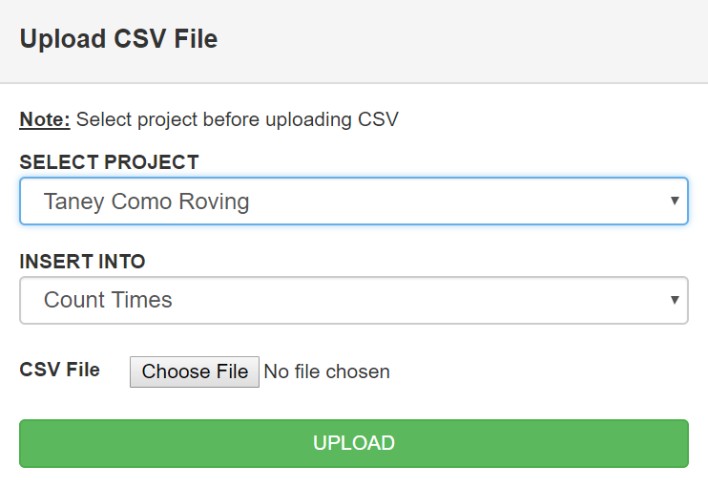
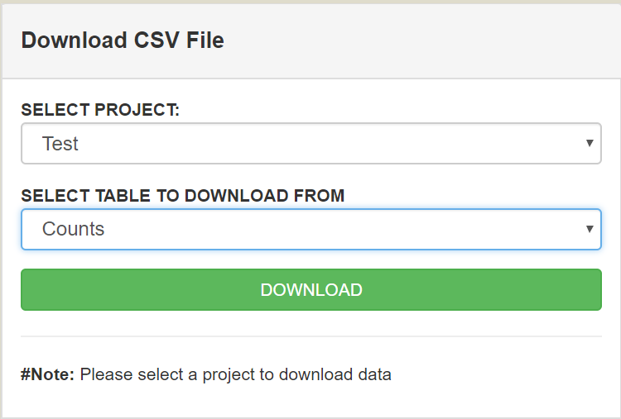
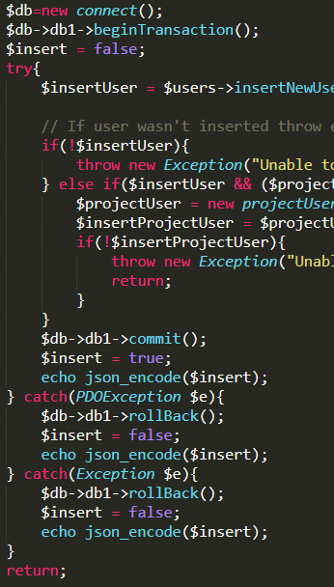
Utilities
File Management
  Upload CSV: Validate CSV with MySQL tables and upload to table
  Download CSV: Download requested MySQL table as CSV file
PHP Data Object (PDO)
  MySQL API for communication between PHP and MySQL tables via objects and methods
  Implementation of transactions and rollbacks, where necessary
Notes:
File management: only admin users
Upload CSV: add new data (survey schedules, counttimes, etc.) to database using CSV files; validated using PHP and inserted.
Download CSV: download individual tables or all in one big table as CSV file. Queries return JSON arrays and JSON converted to CSV file using JS library
PDO helps create classes for each db table and each crud operation is created as a function/method in the class. Class objects are created whenever necessary and used for calling the functions. More manageable and structured.

Slide 24
OUTLINE
Introduction
Related Works
Design & Implementation
Results
Conclusion & Future Work
Creel Survey Mobile App Demo
Creel Survey Web Dashboard Demo

Slide 25
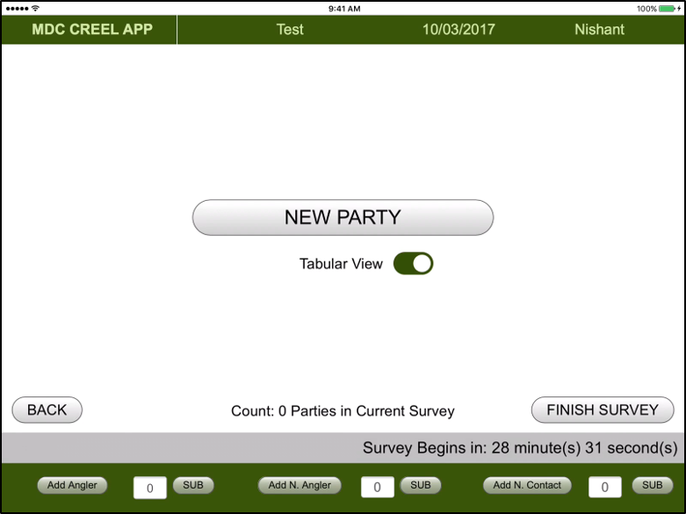
Creel Survey Mobile App Demo
Angler View

Slide 26
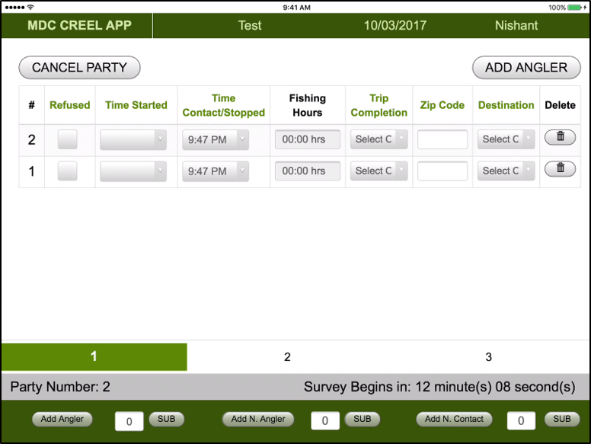
Creel Survey Mobile App Demo
Tabular View

Slide 27
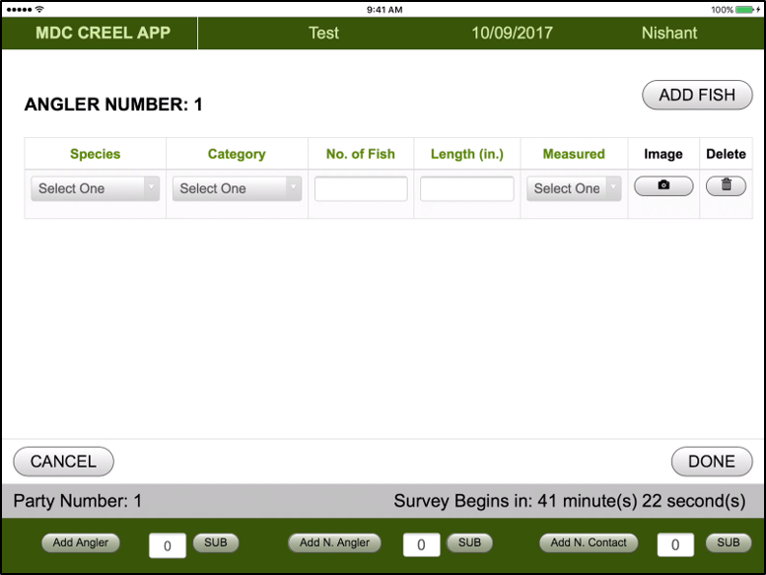
Creel Survey Mobile App Demo
Image Capture

Slide 28
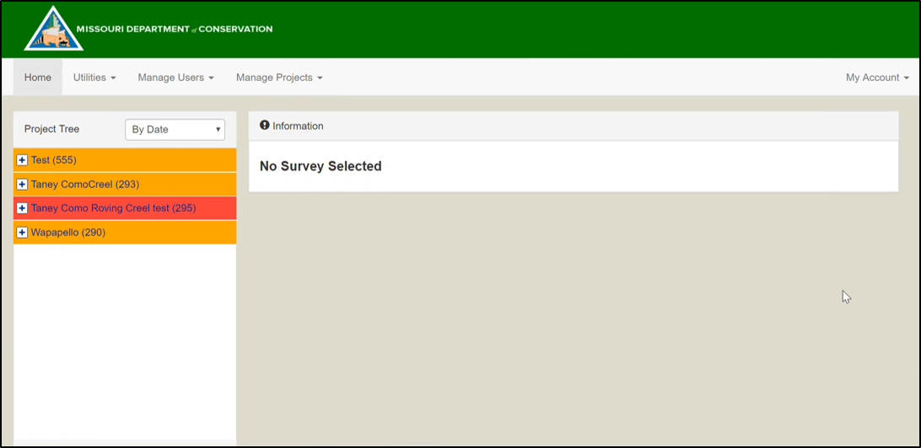
Creel Survey Web Dashboard Demo
Angler Verification

Slide 29
Improvements
 | Paper-Based Logging | CSDMA
Convenience |  | 
Reliability |  | 
Speed | Slow | Fast
Security |  | 
Automated |  | 
Real-Time Data |  | 
Web Accessibility |  | 
Differences between previous system and CSDMA
Notes:
Convenience: easier compared to previous logging process
Reliable due to validation on the front-end and a more thorough verification process
Speed is invariably improved
Security is ensure with password hashing, user authentication on each page
Real-time data access after data upload
Globally accessible
Not to mention: scalable with EC2

Slide 30
OUTLINE
Introduction
Related Works
Design & Implementation
Results
Conclusion & Future Work

Slide 31
Conclusion
CSDMA: An amalgamation of a modern day mobile and web development application improving the process of data collection and verification
Data collection process is made convenient, accurate, efficient, portable, and reliable with the mobile application
Data verification process more robust with the web dashboard, and addition of new functionalities make it more versatile
Notes:
1. This project encapsulates the full stack development methodology in both a mobile and web dashboard developing modular multi page web applications
2. Involved using some of the newest and popular web development technologies

Slide 32
Future Work
Creel Survey Mobile Application could be further improved by implementing Single Page Application (SPA) frameworks like Angular
Adding visualizations (graphs, charts, etc.) to the Creel Survey Web Dashboard can add a new dimension of looking at the survey data

Slide 33

Thank You!
Questions?

