Slide 1
EMPIRICAL STUDY OF DEEP NEURAL NETWORK ARCHITECTURES FOR PROTEIN SECONDARY STRUCTURE PREDICTION
Master’s Thesis defense
Ming Du
Advisor: Dr. Yi Shang

Slide 2
Contents
Introduction
Related Work
Network Architecture
System Implementation
Experiment Results

Slide 3
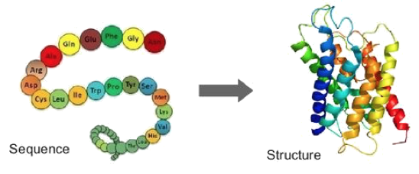
Problem definition

Slide 4
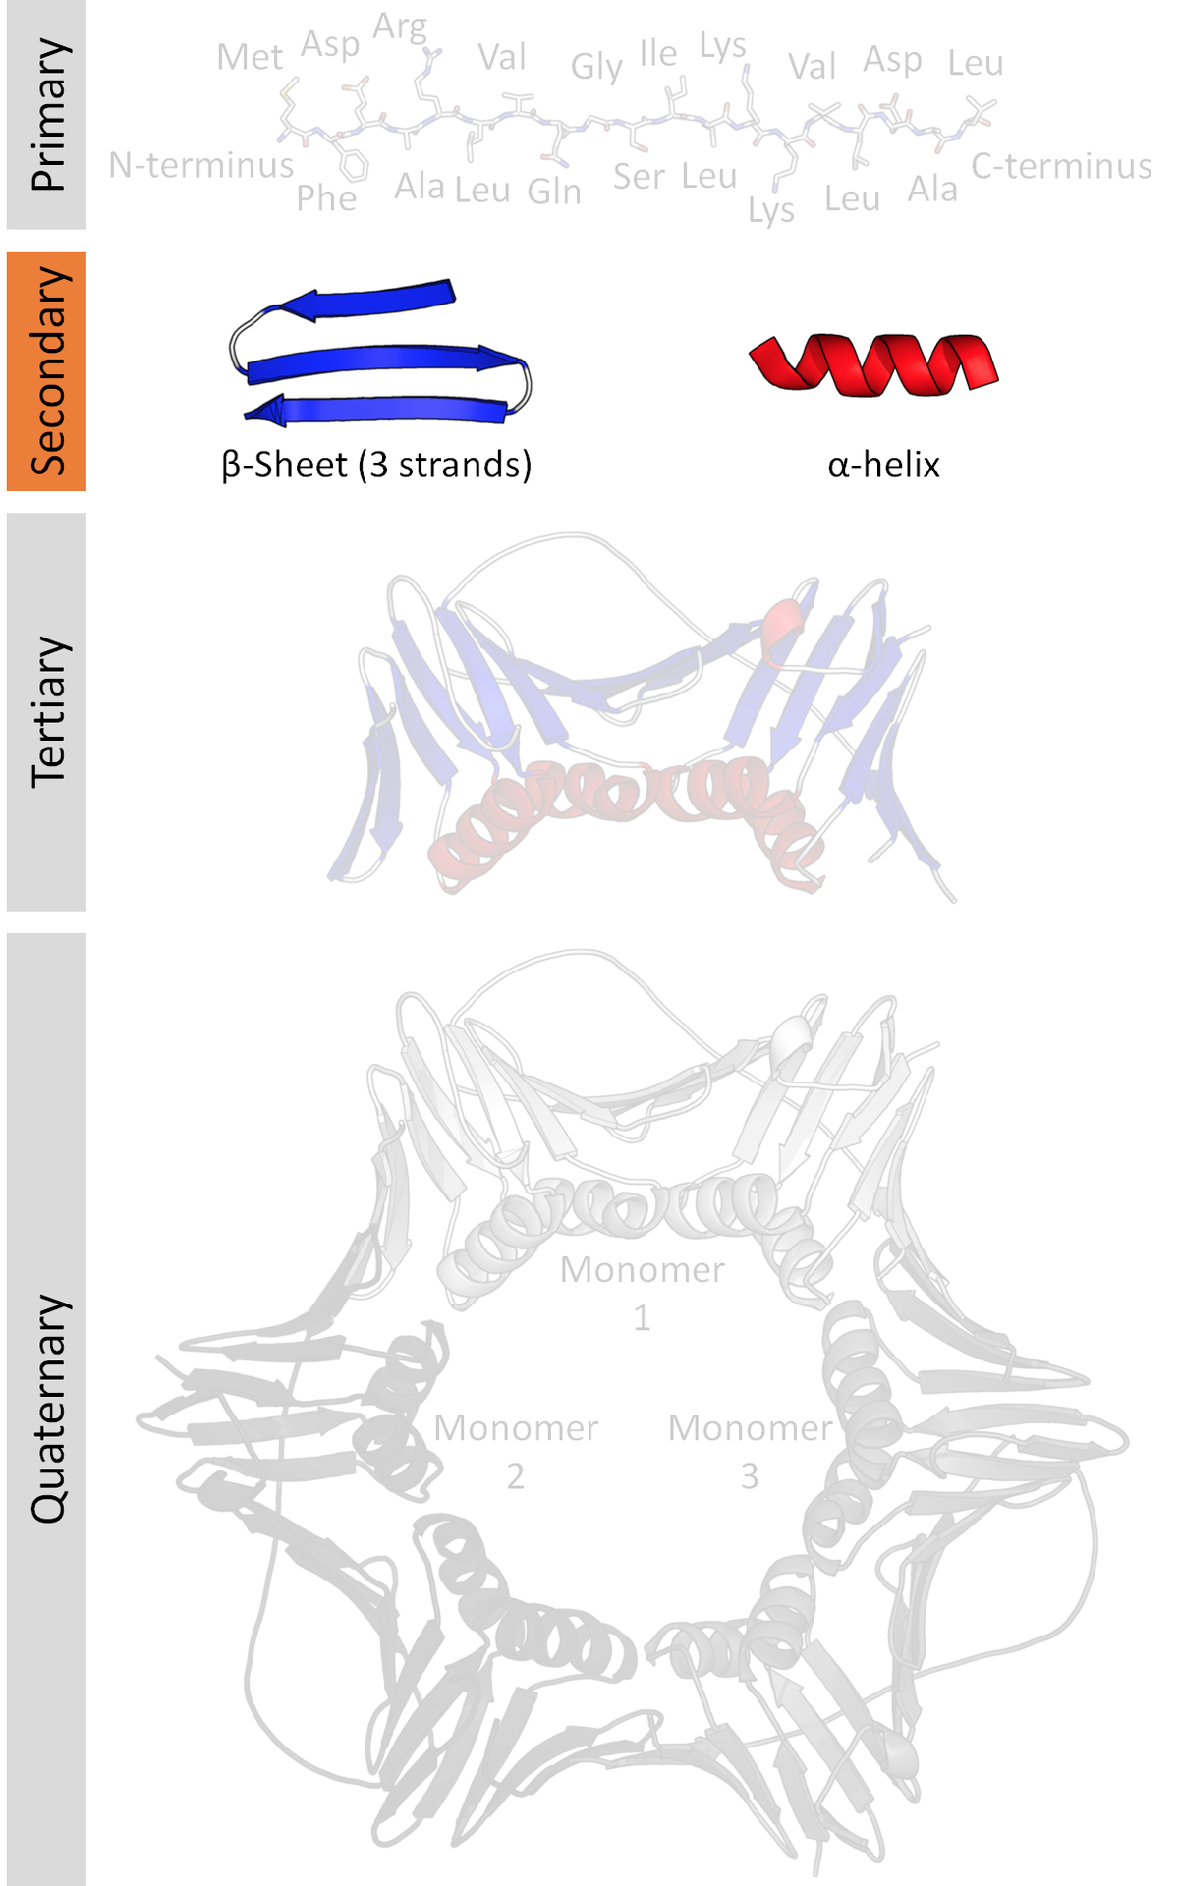
Problem definition
3-class name | 8-class symbol | 8-class name
Helix | G | 3₁₀ helix
 | H | α helix
 | I | π helix
Strand | E | beta bridge
 | B | beta bulges( beta sheet )
Loop | S | bend
 | T | turns
 | C | coil

Slide 5
Problem definition
a₀ | a₁ | a₂ | a₃ | a₄ | a₅ | a₆ | a₇ | a₈ | a₉ | a₁₀ | ... | a_{L}
p₀ | p₁ | p₂ | p₃ | p₄ | p₅ | p₆ | p₇ | p₈ | p₉ | p₁₀ | ... | p_{L}
s₀ | s₁ | s₂ | s₃ | s₄ | s₅ | s₆ | s₇ | s₈ | s₉ | s₁₀ | ... | s_{L}

Slide 6
Evaluation
Q8 Accuracy:
Predicted
s₀ | s₁ | s₂ | s₃ | s₄ | s₅ | s₆ | s₇ | s₈ | s₉ | s₁₀ | ... | s_{L}
True label
s*₀ | s*₁ | s*₂ | s*₃ | s*₄ | s*₅ | s*₆ | s*₇ | s*₈ | s*₉ | s*₁₀ | ... | s*_{L}
true_positive = sum(diag(conf_mat))
Q8 = true_positive / L
Confusion
Matrix

Slide 7
Contribution and Achievements
Design and implement a DNN learning system using TensorFlow for PROTEIN SECONDARY STRUCTURE PREDICTION.
Provide detailed information of how to use RNN correctly.
Test and explore the trade off between speed and accuracy of the RNN.
Achieve 69.5% accuracy on CB513, which is comparable to current state-of-the-art.

Slide 8
Contents
Introduction
Related Work
Network Architecture
System Implementation
Experiment Results

Slide 9
Related works
Architecture | Q8 Accuracy on CB513
Convolutional Generative Stochastic Network | 66.4%
Convolutional recurrent network | 69.7%
Deep Multi-scale Convolutional Neural Networks | 70.6%

Slide 10
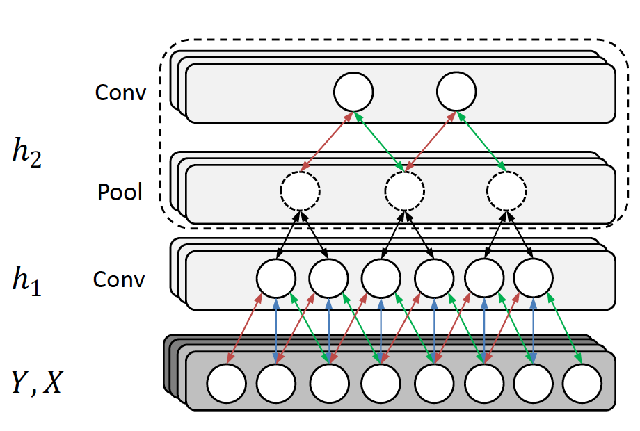
Related works
Convolutional Generative Stochastic Network
Zhou, Jian, and Olga G. Troyanskaya. "Deep Supervised and Convolutional Generative Stochastic Network for Protein Secondary Structure Prediction." ICML. 2014.

Slide 11
Related works
Convolutional recurrent network
Li, Zhen, and Yizhou Yu. "Protein Secondary Structure Prediction Using Cascaded Convolutional and Recurrent Neural Networks." arXiv preprint arXiv:1604.07176 (2016).
Sønderby, Søren Kaae, and Ole Winther. "Protein secondary structure prediction with long short term memory networks." arXiv preprint arXiv:1412.7828 (2014).

Slide 12
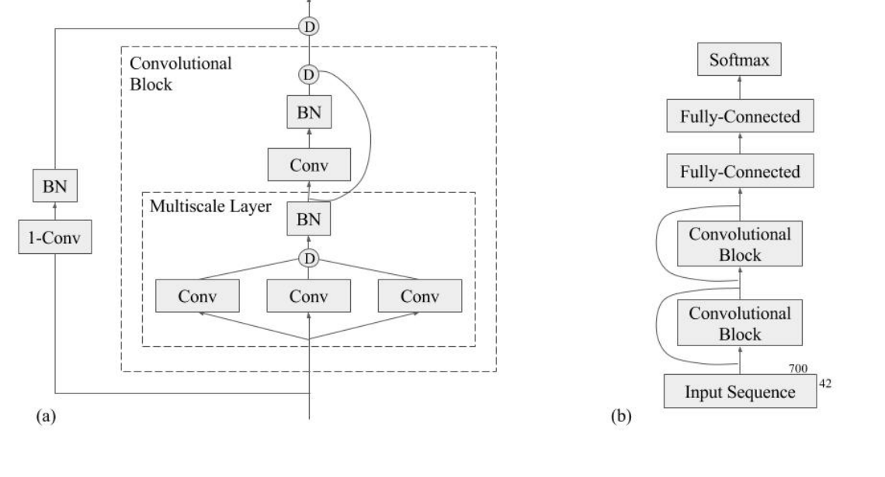
Related work
Busia, Akosua, Jasmine Collins, and Navdeep Jaitly. "Protein Secondary Structure Prediction Using Deep Multi-scale Convolutional Neural Networks and Next-Step Conditioning." arXiv preprint arXiv:1611.01503 (2016).

Slide 13
Contents
Introduction
Related Work
Network Architecture
System Implementation
Experiment Results

Slide 14
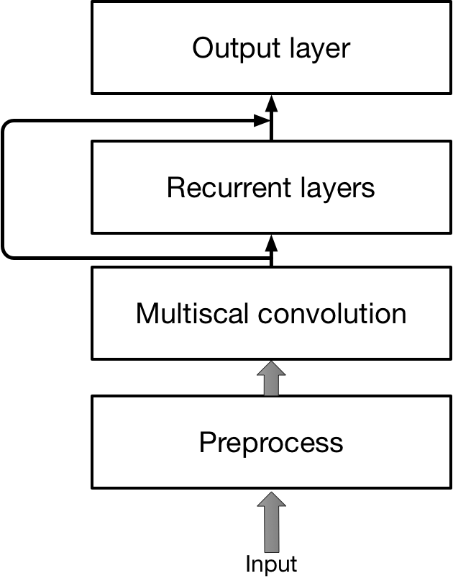
Overall architecture
Basic idea:
Use convolutional layers to extract local dependencies in a fixed range.
Use Recurrent layers to extract long term dependencies.

Slide 15
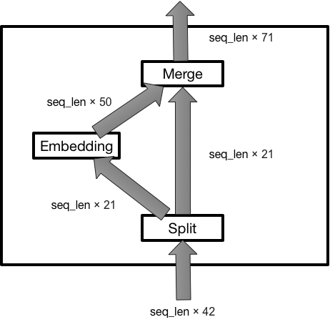
Preprocess layer
To avoid inconsistent input feature.
Embed the one hot encoding to dense encoding.

Slide 16
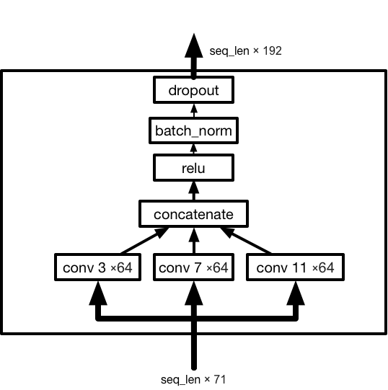
Multi-scale convolutional block
Use 3 different kernels to extract local dependencies information.
Add batch normalization to control the variance shifting during the training.
Add dropout to prevent overfitting.

Slide 17
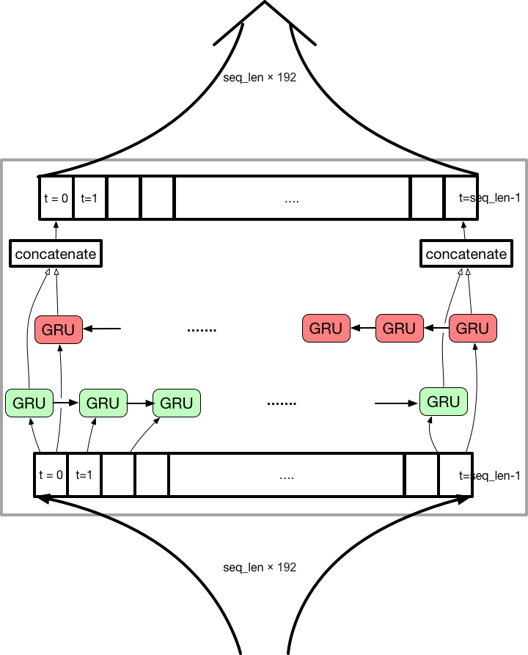
Recurrent layer
A single Bidirectional RNN layer.
Use Gated Recurrent Unit as “cell”.
Have a forward layer and a backward layer.
The output is the concatenation of the output of forward layer and backward layer.

Slide 18
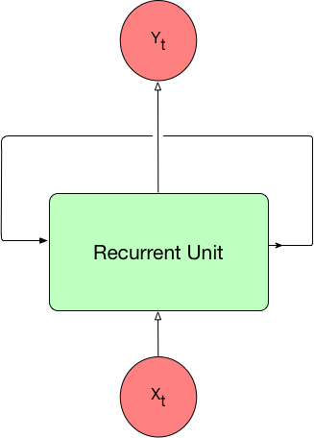
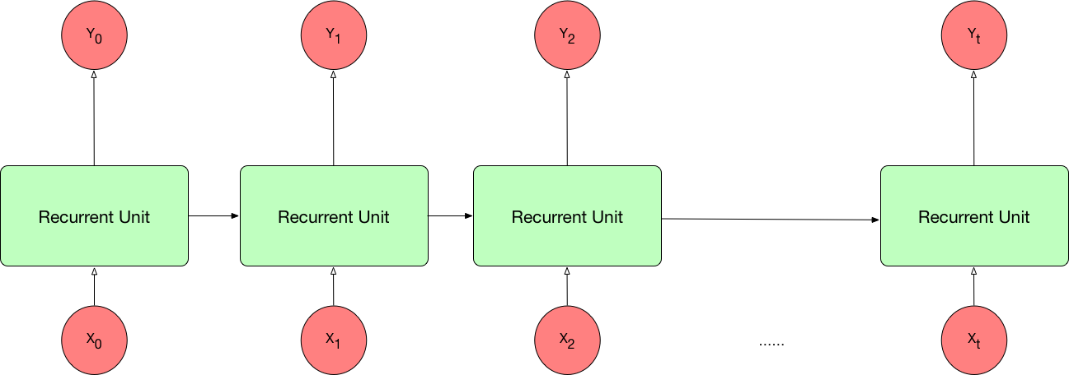
How does GRU/LSTM recurrent network work

Slide 19
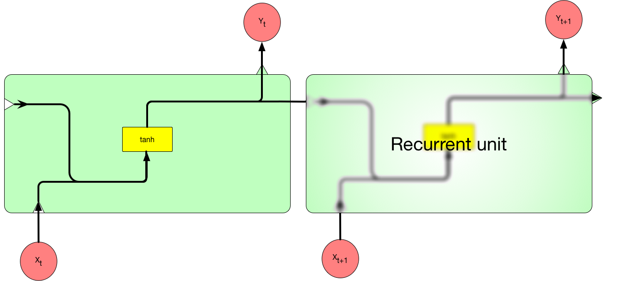
Conventional RNN
Problems:
Difficult to train
Can’t remember long term dependency

Slide 20
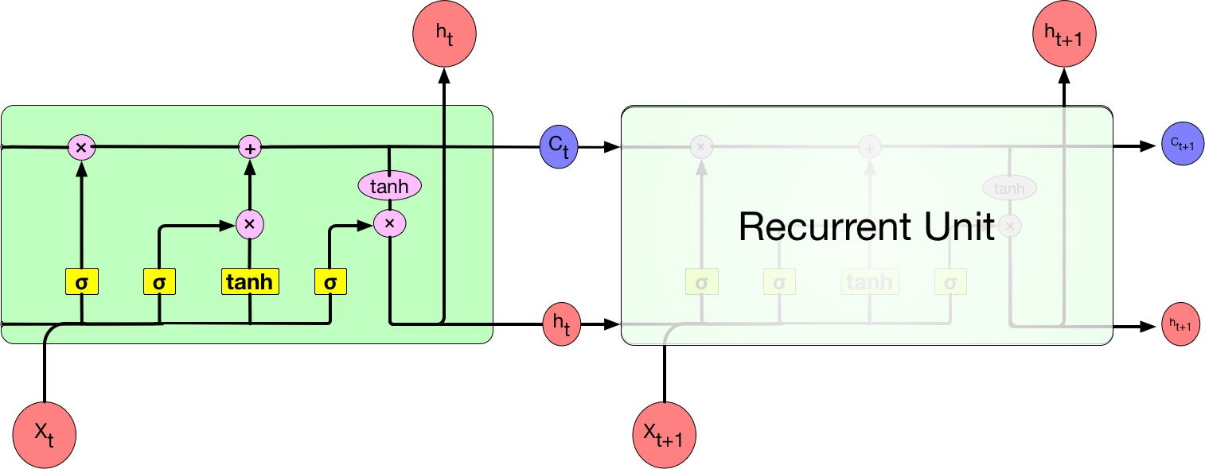
Long Short Term Memory(LSTM)

Slide 21
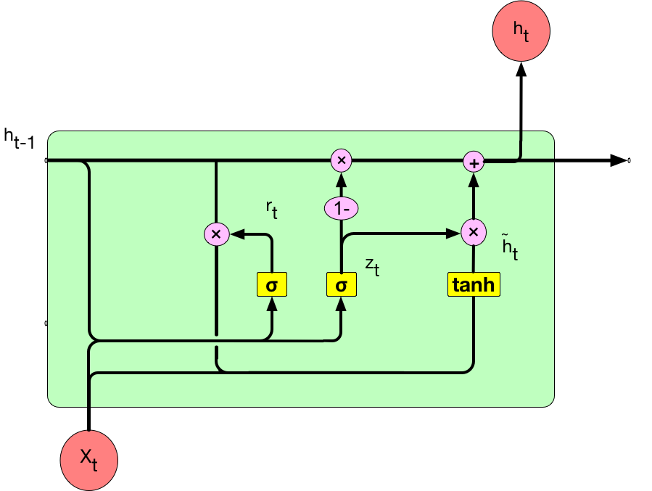
Gated Recurrent Unit(GRU)
Less parameters
Comparable performance

Slide 22
Output layer
Use two convolutional layers
Convert the dimension of the output of recurrent layers to 8.

Slide 23
Loss and optimization
Secondary structure
Solvent accessibility
L2 norm regularization
Choose Adam optimizer to update the parameters.

Slide 24
Contents
Introduction
Related Work
Network Architecture
System Implementation
Experiment Results

Slide 25
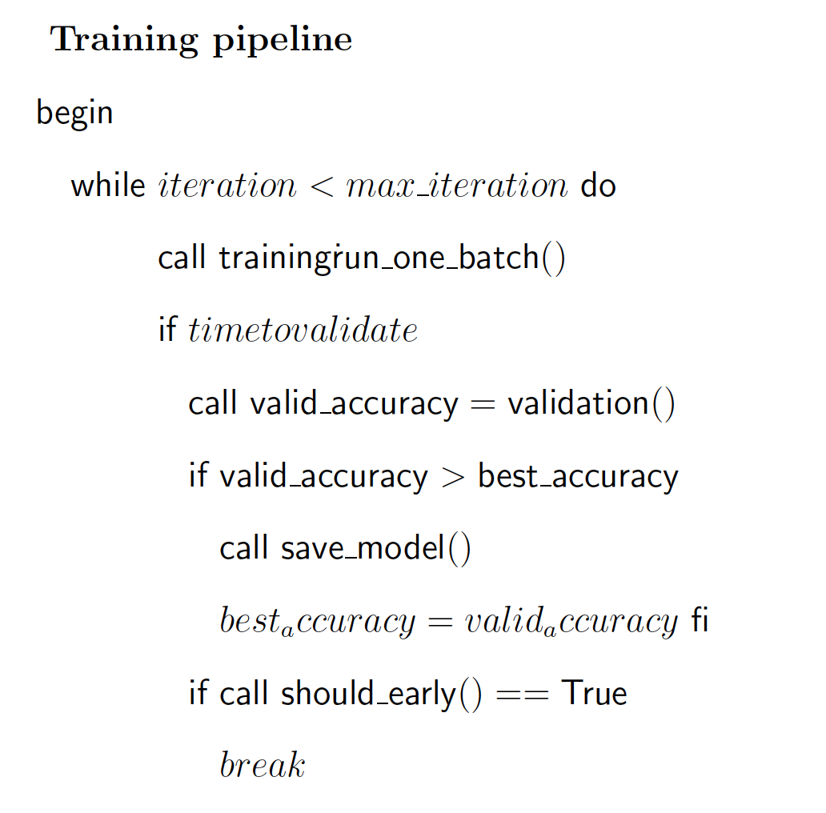
Requirement of the system
Training with validation and early stopping.
Evaluation and Inference.
Save checkpoint file and restore from interruption.
Reusable for different networks.
Monitor the training process.
Training on multi-GPUs or clusters

Slide 26
TensorFlow
Graph: a computational model contains all the operation you want to perform on the dataset.
Session: encapsulates the environment for a graph to be executed.

Slide 27
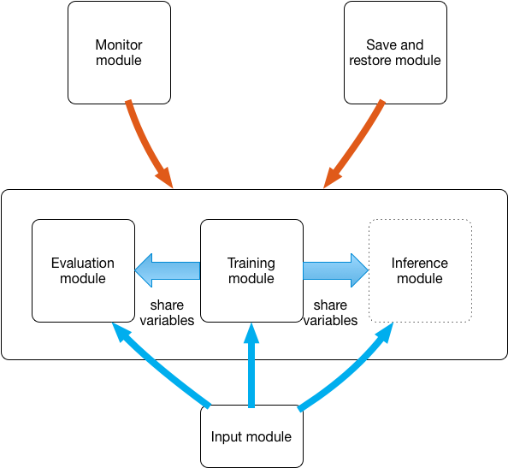
Overall system design
Separate the “network model” from input, monitor and Save/Restore modules.
Use different “network models” for training, evaluation and inference.

Slide 28
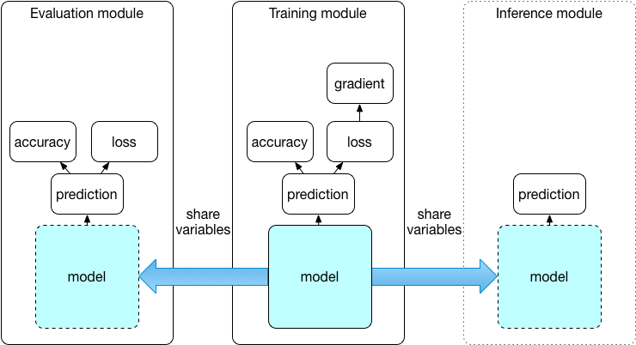
Training, Evaluation and inference modules

Slide 29
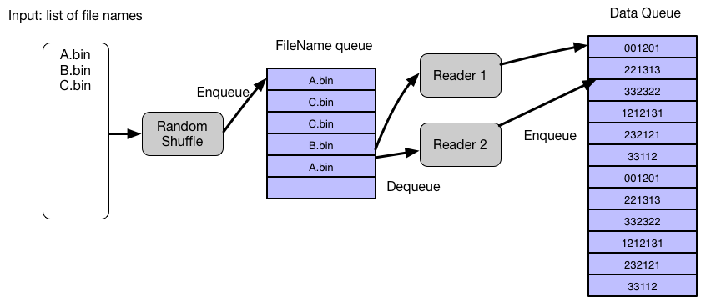
Input module
2 input modes:
From file
From memory

Slide 30
Recurrent layer implementation
Static RNN: unrolls the loop and have a fixed number of computational nodes to process fixed length sequences
Dynamic RNN: use a loop structure to process variable length of sequences

Slide 31
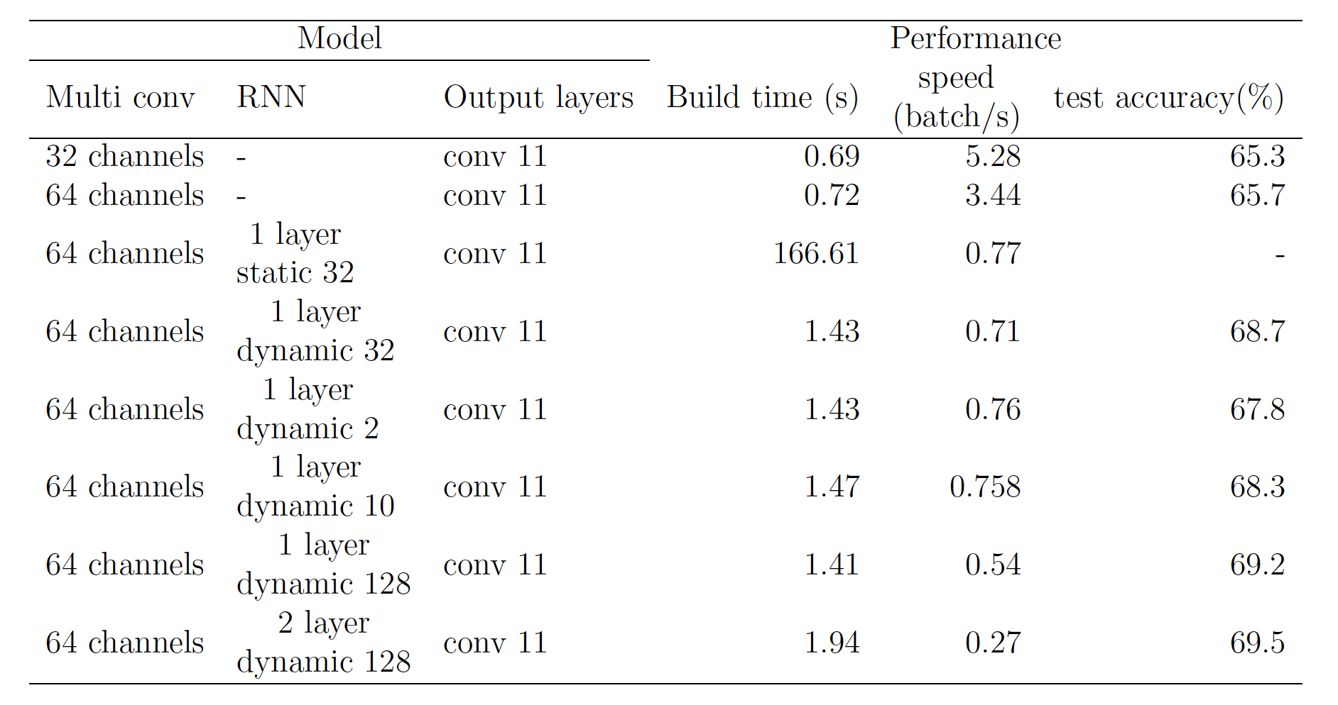
Recurrent layer implementation
RNN is slower than CNN
Dynamic RNN
Low Build time
Slower speed
Small model
Static RNN
High Build time
Faster speed
Huge model

Slide 32
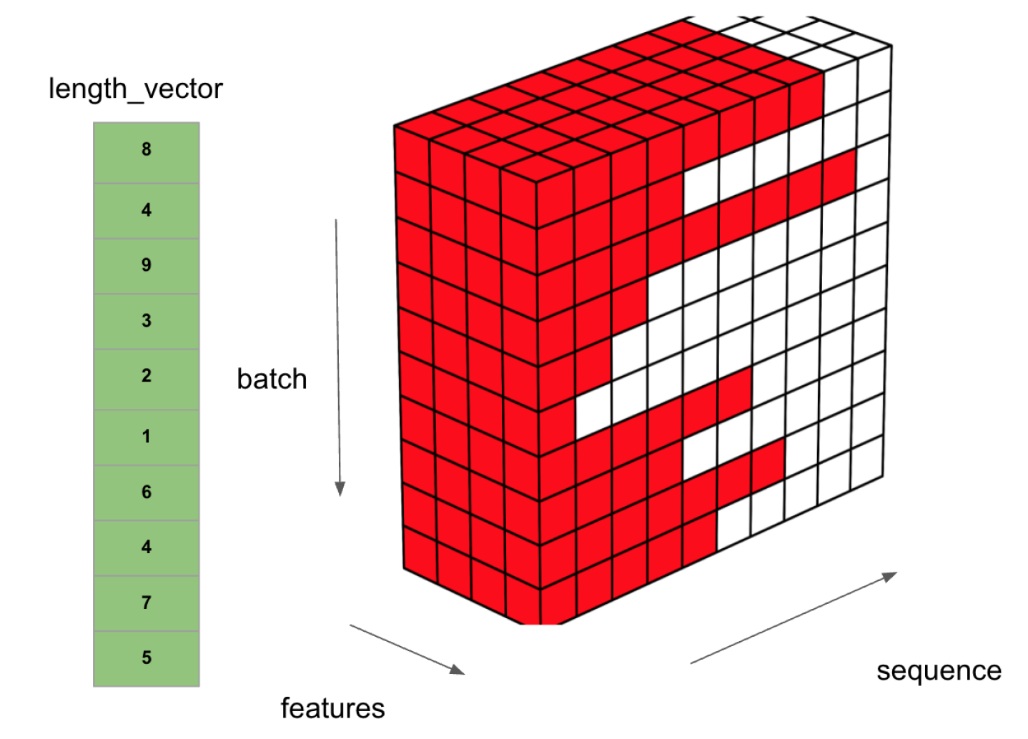
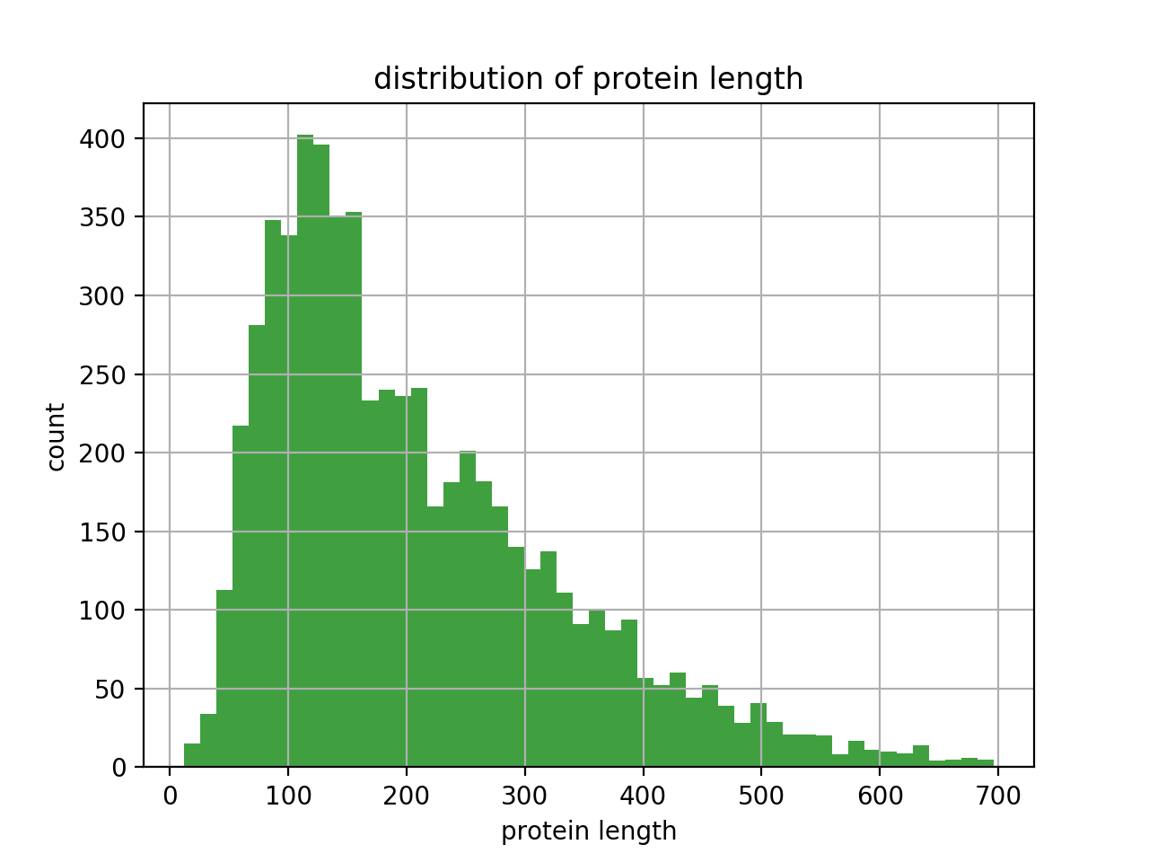
Loss function implementation
sum(LOSS_ARRAY )=sum(length_vector).
Problem: Variable length input in a single batch.

Slide 33
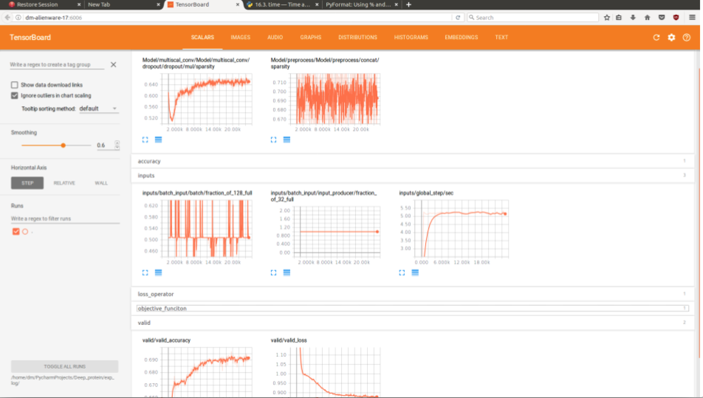
Monitor Implementation using TensorBoard

Slide 34
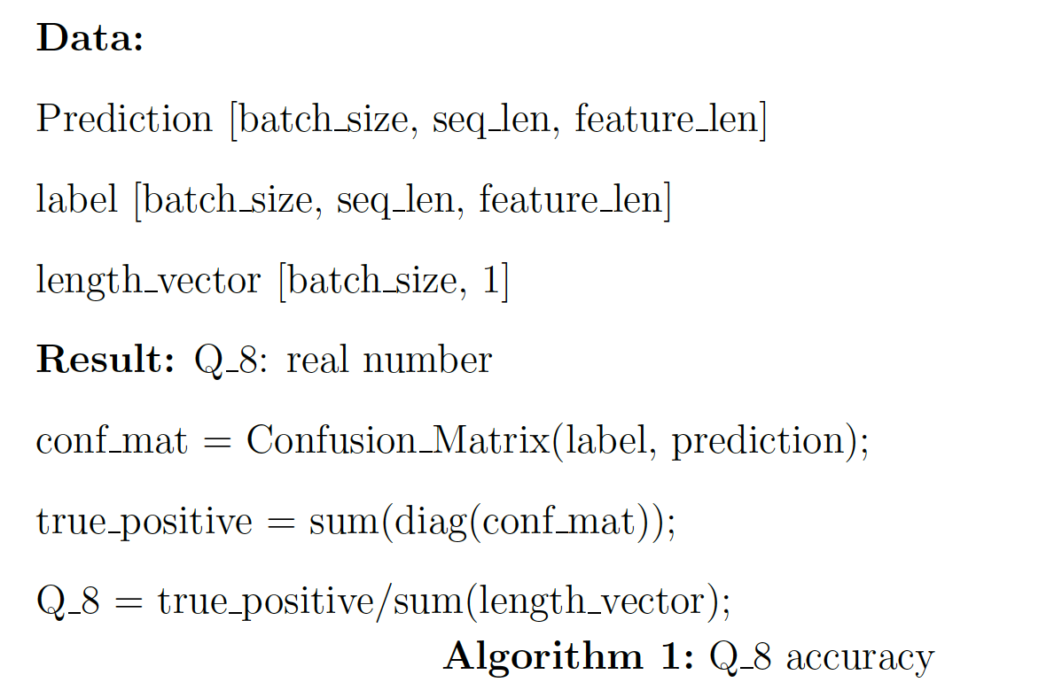
Accuracy operator
In order to monitor the accuracy during training.
Create a Tensorflow operator to calculate the accuracy.

Slide 35
Save/Restore
Save checkpoint file every 5 minutes.
Only keeps the N most recent checkpoints to save disk space.
When find new best model, save the model file.

Slide 36
Contents
Introduction
Related Work
Network Architecture
System Implementation
Experiment Results

Slide 37
Experiment setup
Dataset: CB513, filtered CB6133
Training data: 80% of filtered CB6133
Validation data: 20% of filtered CB6133
Test data: CB513
Evaluation: Q8 accuracy

Slide 38
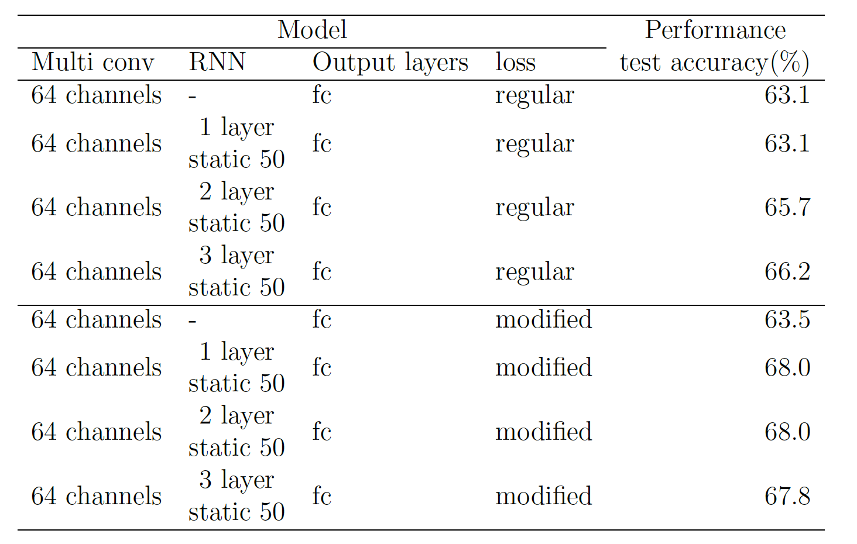
Experiment: Loss function

Slide 39
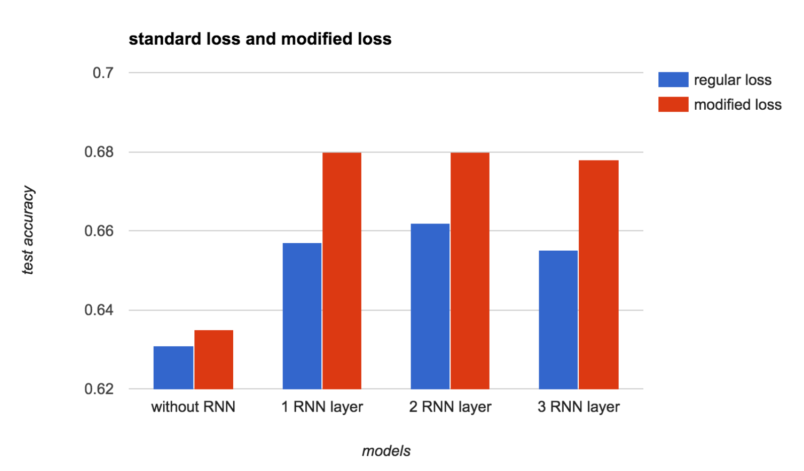
Experiment: Loss function

Slide 40
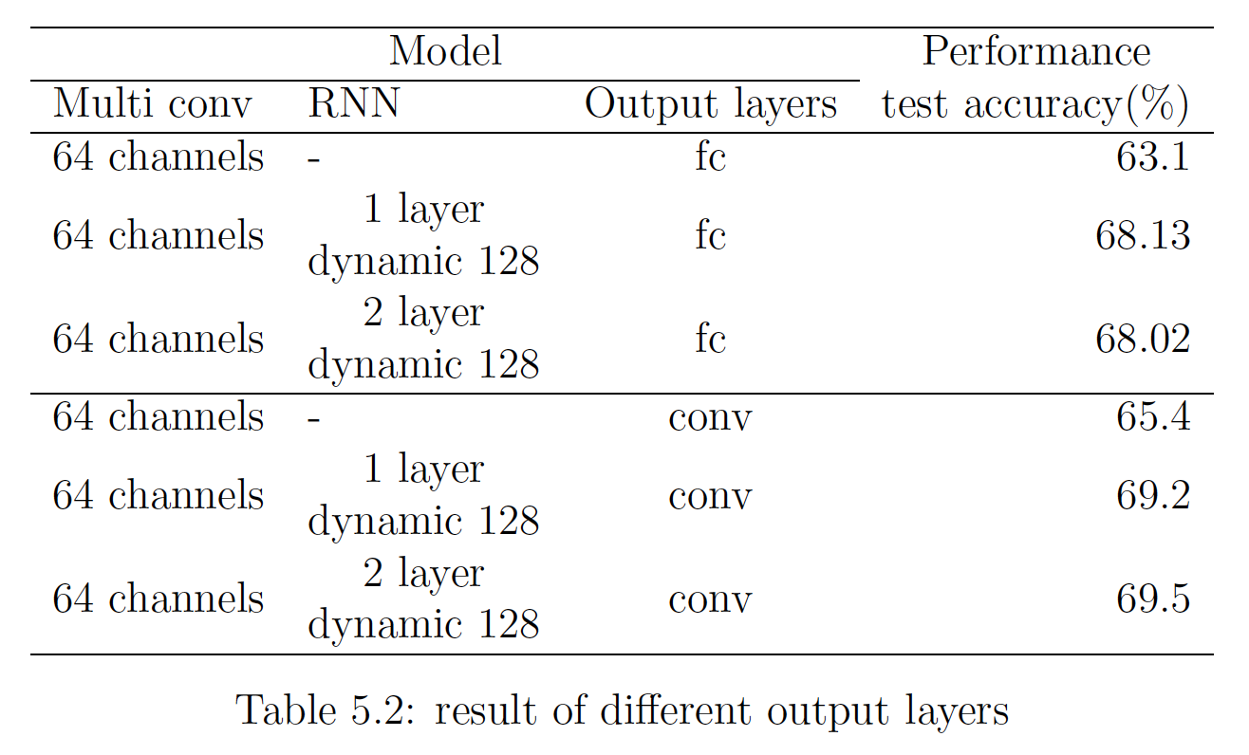
Experiment: different output layers

Slide 41
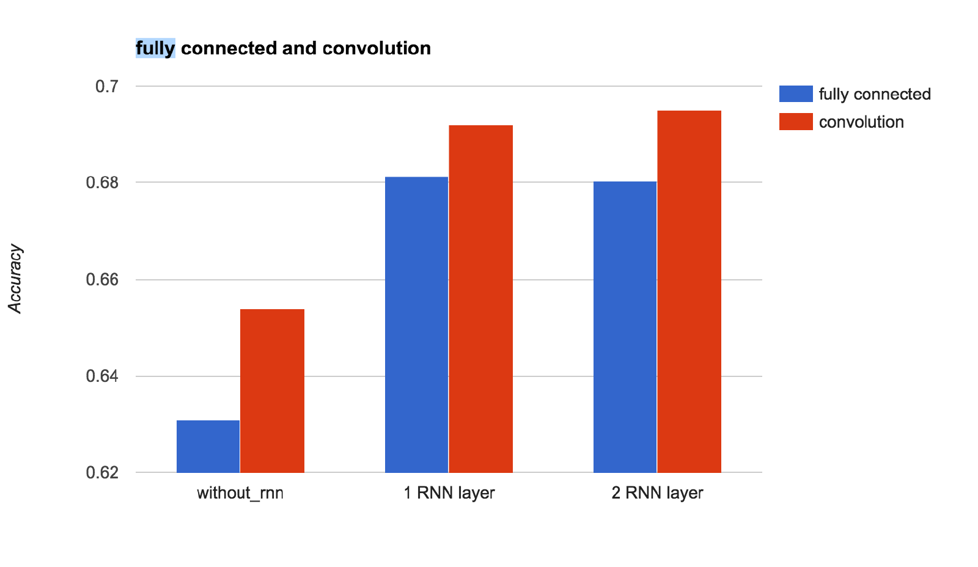
Experiment: different output layers

Slide 42
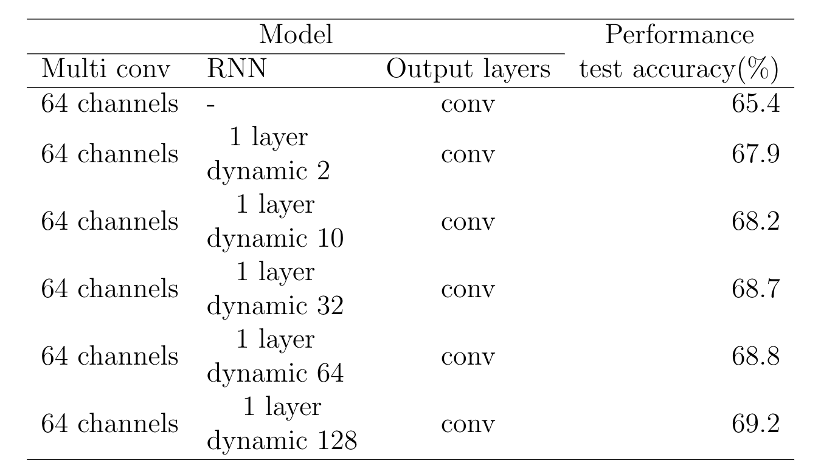
Experiment: different hidden unit in RNN layer

Slide 43
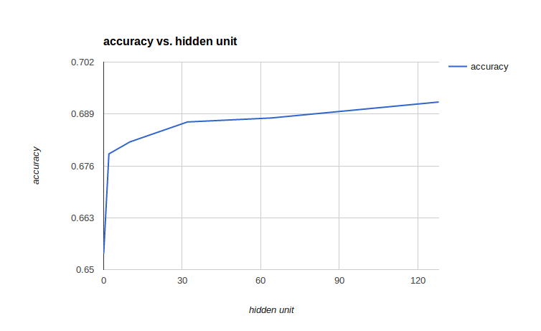
Experiment: different hidden unit in RNN layer

Slide 44
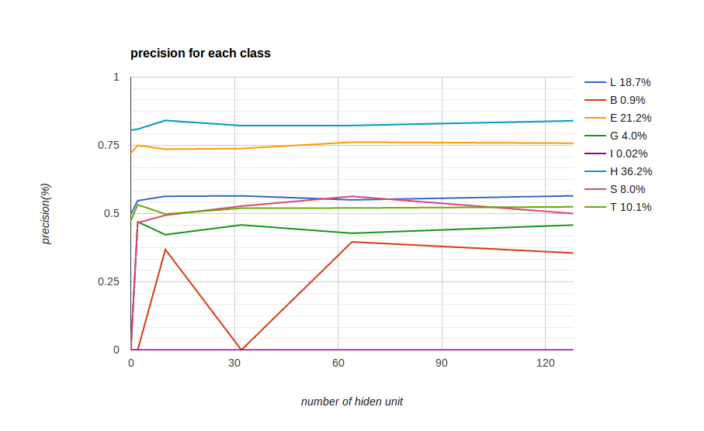
Experiment: different hidden unit in RNN layer

Slide 45
Final result
best model:
2 layers of 128 hidden units bidirectional RNN
with convolutional output layer.
The test accuracy on CB513 is 69.5%

Slide 46
Future works
Apply Batch normalization between each timestep.
Using advanced RNN structure, RNN with attention mechanism.
Make the system can be trained on multi-GPU and clusters.

Slide 47
Thank you

