Slide 1
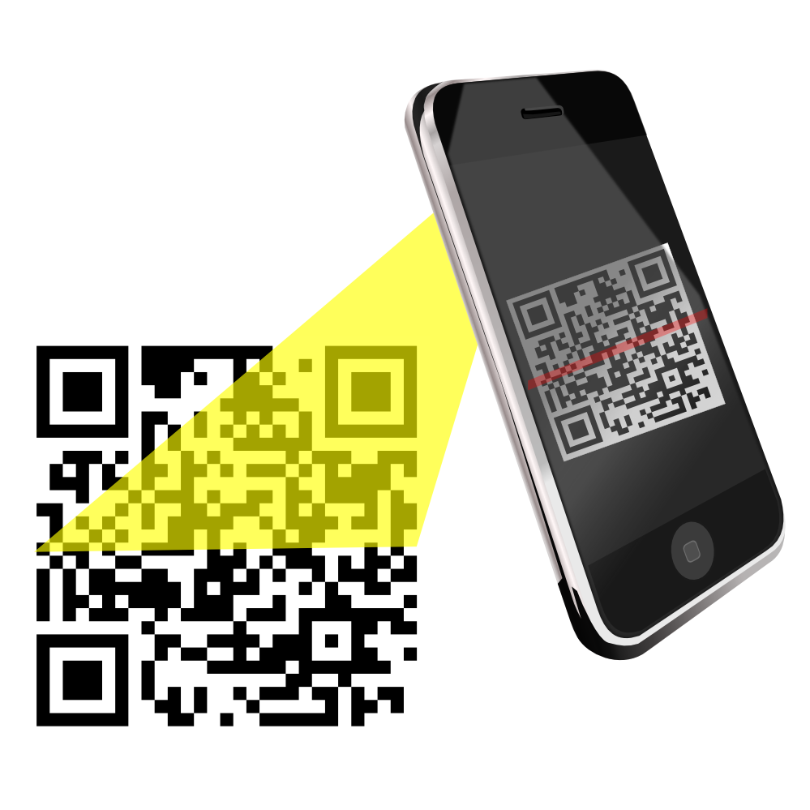
Enhanced Detection of Linearly Distorted Quick Response (QR) Codes in Smart Phones
Master’s Project Defense
Manav Singhal
Advisor - Prof. Yi Shang

Slide 2
Overview
Introduction
Background and Related Work
Algorithm Design
Implementation and System Design
Experimental Results and Analysis
Conclusion

Slide 3
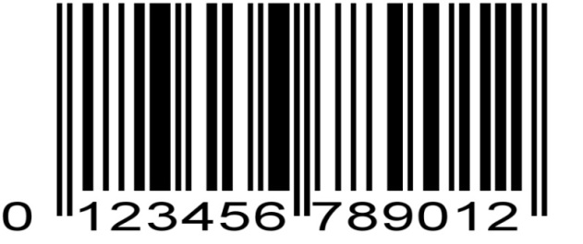
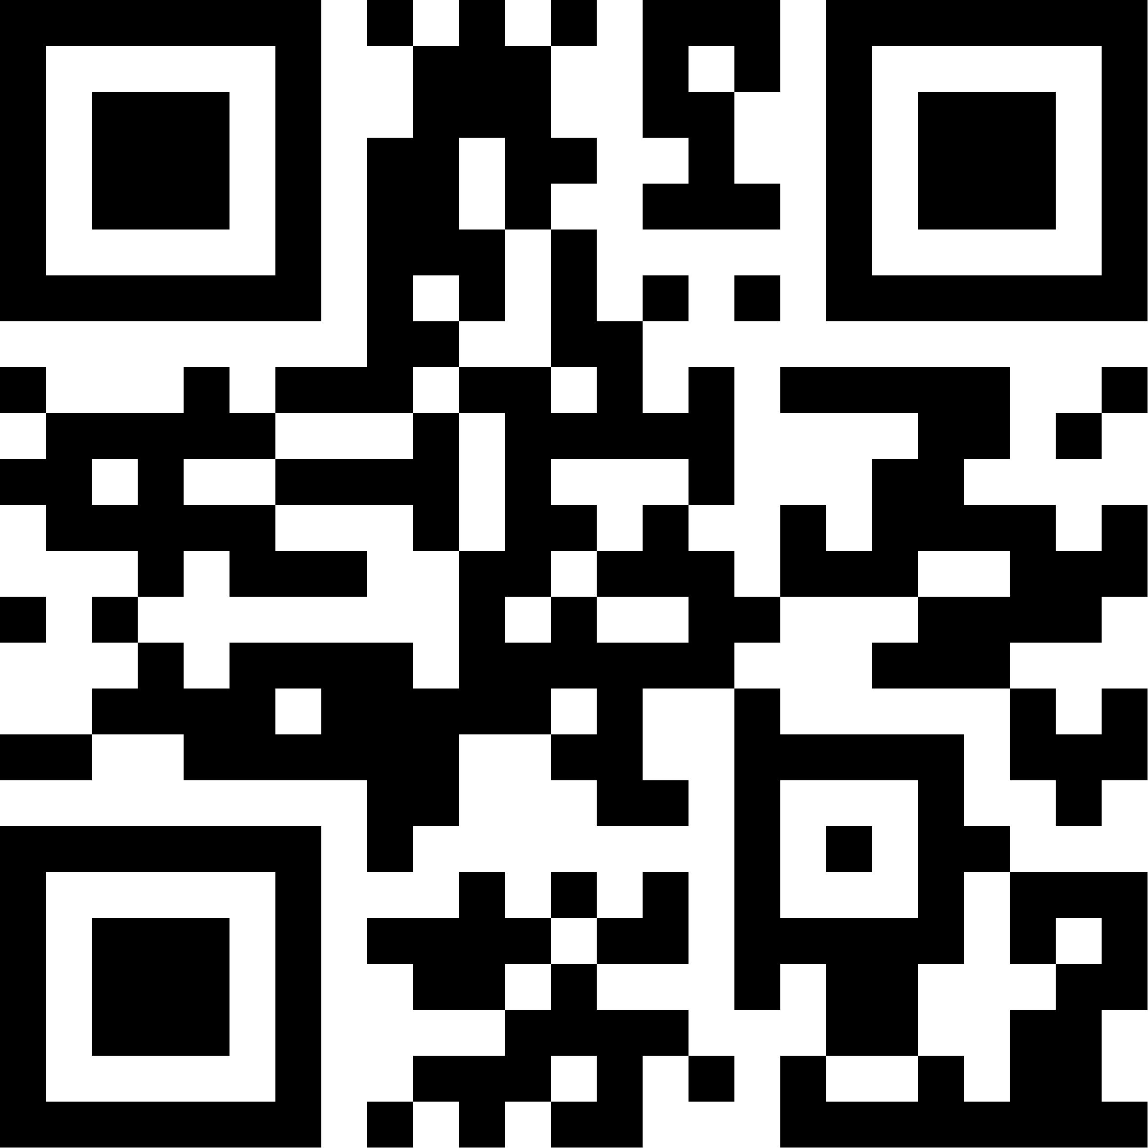
Introduction
Barcode
Optical machine-readable representation of data about the object
Shown by varying the widths and spacing of parallel lines
Linear or one-dimensional (1D)
QR Code
Invented in Japan by DENSO Corp. for Japanese auto-makers to track car parts (1994)
Uses four standardized encoding modes (numeric, alphanumeric, byte / binary, and kanji) to efficiently store data
Matrix two-dimensional (2D)

Slide 4
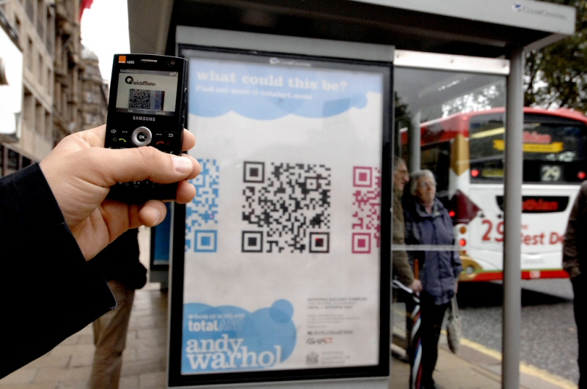
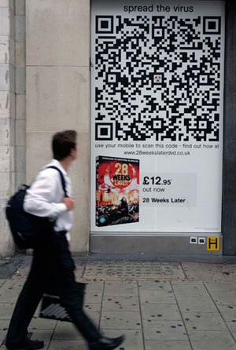
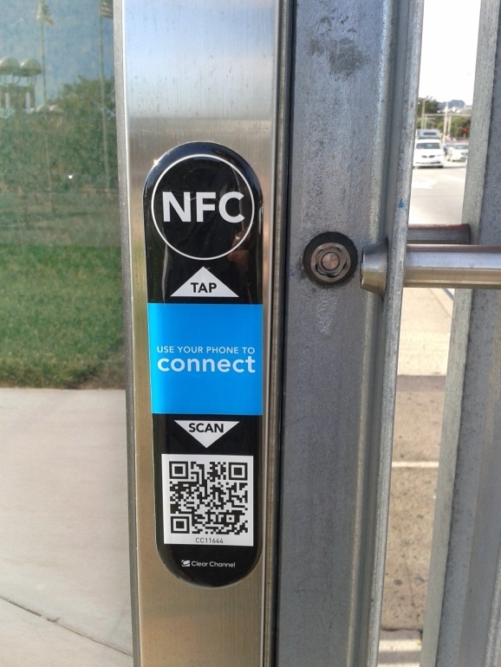
QR Code Applications
Business | Large Inventory Management, Cost Saving, Speed
Healthcare | Dispensing Medication
Customer Relationship Management (CRM) | Customer Data profiling
Event Management | Information Storage

Slide 5
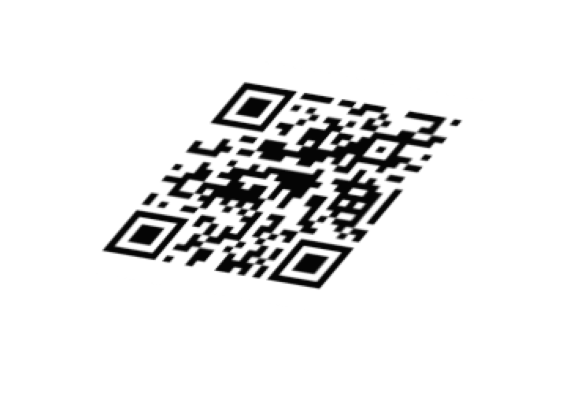
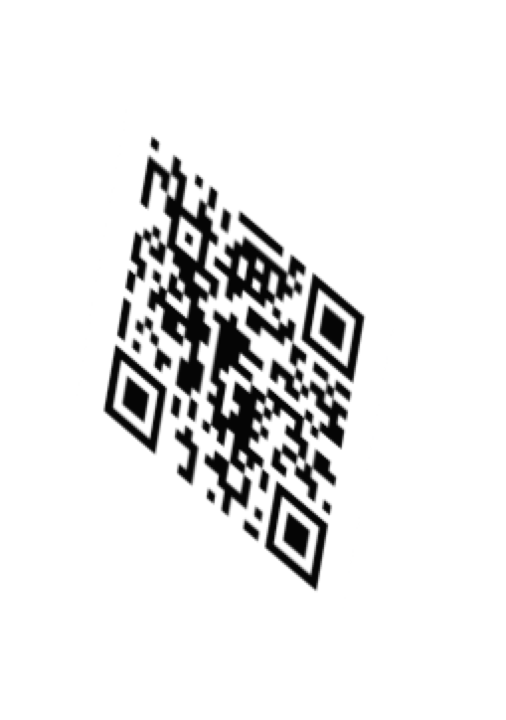
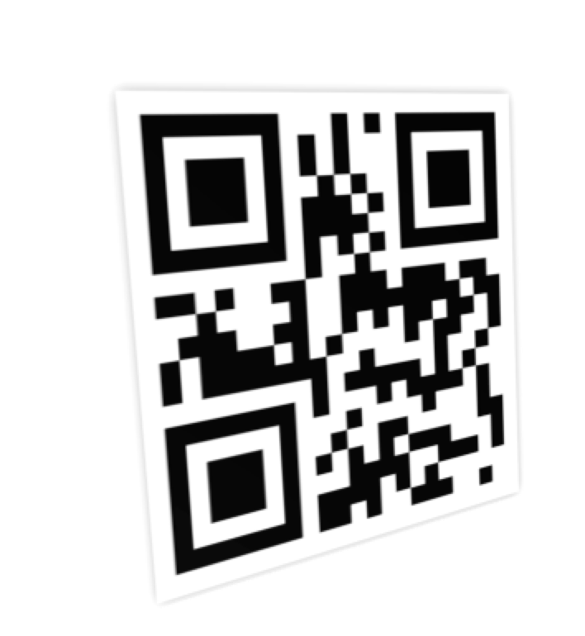
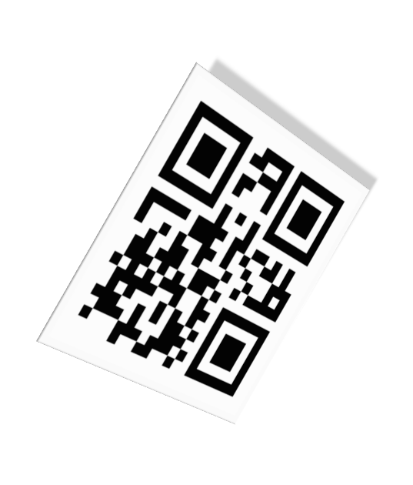
QR Code Scanning
Do not work efficiently with linearly distorted QR codes and various rotations specifically on mobile platforms where we have less resources for image-processing
QR Code Reader
QR Droid Code Scanner
Barcode Scanner
Real problem since a little distortion can easily throw off enough pixels to make the code unreadable

Slide 6
Problem Statement
“Given a linearly distorted input QR code image, the problem is to
efficiently estimate the fourth corner point leveraging finder and
alignment patterns of QR code or other image processing techniques.”
“The processing has to be optimized enough to run on mobile platforms such as Android OS”

Slide 7
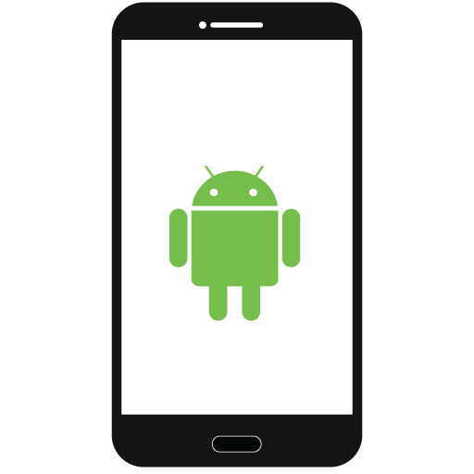
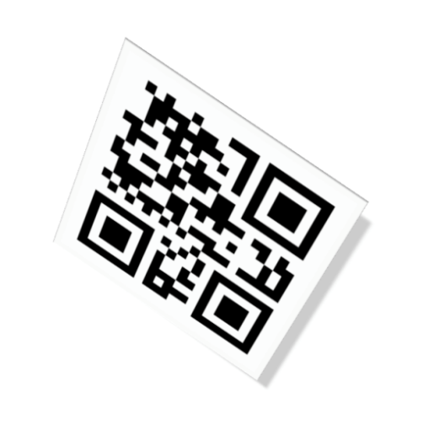
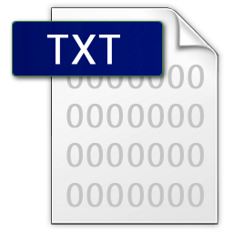
Objective and Goal
To convert the data encoded into linearly distorted QR codes to a human readable form in an efficient and time saving manner
To develop the app leveraging fourth-corner detection algorithm able to work on smart phones (i.e. Android)
To compare the scanning/detection experimental results with current apps
Scan linearly distorted
QR Code
Show Data

Slide 8
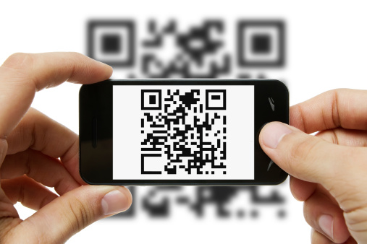
Motivation
18% of retailers believe that the ability to scan QR codes, compare products and pricing is having a significant impact on their business (KPMG July 2013)
60.5% of marketers have adopted scannable QR codes or tags as a mobile marketing tactic (Chief Marketer, 2013)
42.4% of multi-channel merchants used QR codes in 2013 (Multichannel Merchants June 2013)
Source - http://www.marketingcharts.com/online/data-dive-qr-codes-29525

Slide 9
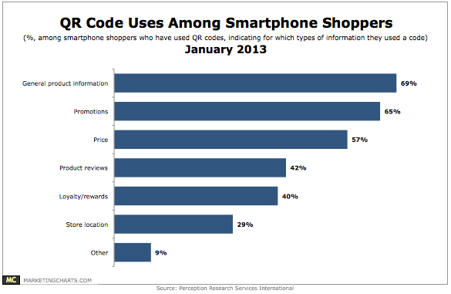
Motivation
Source - http://www.marketingcharts.com/online/data-dive-qr-codes-29525

Slide 10
Overview
Introduction
Background and Related Work
Algorithm Design
Implementation and System Design
Experimental Results and Analysis
Conclusion

Slide 11
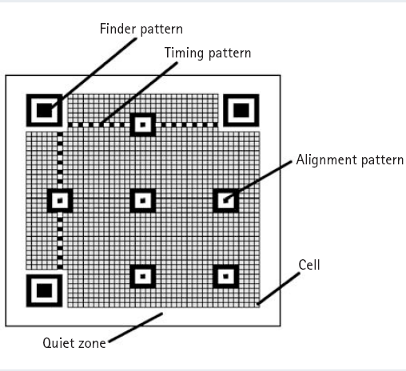
QR Code Structure
Finder pattern
Used for detecting the QR code in scanning area
The position, the size, and the angle of the symbol can be detected
Alignment pattern
Helpful in correcting the distortion of the QR Code
A black isolated cell is placed in the alignment pattern to make it easier to detect the central coordinate

Slide 12
QR Code Structure
Timing pattern
Used for identifying the central coordinate of each cell in the QR Code with black and white patterns arranged alternately
Arranged in both vertical and horizontal directions
Quite zone
Marginal space necessary for reading the QR Code
Data area
Data will be stored (encoded) into the data area

Slide 13
QR Code Characteristics
Small Space, Big Heart
Barcode: 20 numerals
QR codes: 7,089 numerals
Space Requirement: Approximately 1/30th the amount of space in barcode
Double the Capacity
Holds data two-dimensionally in both the horizontal and vertical directions

Slide 14
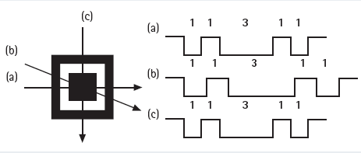
All-Direction (360°) High-Speed Reading
Finder patterns for notifying the position of the symbol arranged in three of its corners to enable high-speed reading in all directions (360°)
Ratio between black and white points that runs of the finder patterns is always 1:1:3:1:1 when seen from any direction

Slide 15
QR Code - Version Types
S.No. | Version | Property
1. | Version 1 | Without Alignment Pattern
2. | Version 2-6 | With Only One Alignment Pattern
3. | Version 7-13 | With 6 Alignment Patterns
4. | Version 14 onwards | With 13 Alignment Patterns

Slide 16
Generic Steps QR Code Detection
Pre-processing
Histogram calculation (Binarization) to define the threshold of black-white boundaries
Global Threshold
Local Threshold
Resizing the original image to reduce calculation cost
Locating the Finder pattern/Corner Marks
Three dark-light dark squares are overlapped in every Finder pattern, and the dark-light ratio is 1:1:3:1:1
Useful for getting knowledge of version, orientation of QR Code

Slide 17
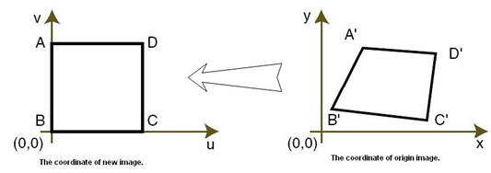
Estimating Fourth Corner point Pattern
Most critical step in QR code detection
Alignment patterns can be used to help in detecting the corner point
Performing Inverse Perspective Transform
Used to normalize the shape of deformed input image shape
Decoding
The binary image is converted to a 2D bit matrix
Mapping between bit 0 and 1 to data is used to extract data

Slide 18
Google Play Apps
QR Code Reader
Scan Inc.
4 out of 5 stars
QR Droid Code Scanner
DroidLa
4.1 out of 5 stars
Barcode Scanner
Zxing Team
4.1 out of 5 stars

Slide 19
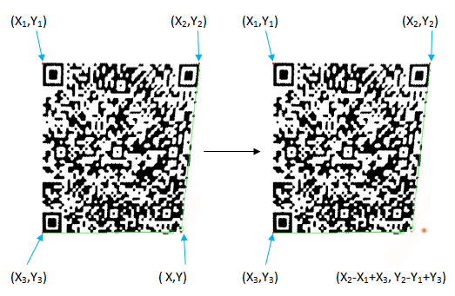
Zxing – QR Code Library
Follows generic steps as described previously at all steps except Fourth Point Detection
‘Fourth Point’ is calculated through geometrical calculations :
X₄ = X₂- X₁ + X₃ and Y₄ = Y₂-Y₁+ Y₃
Decoding is maximal when the QR code is aligned along X-axis and Y-axis with rotations around z-axis at 0°, 90°, 180° or 270° degrees --- easily geometrically computable
Problems with z-axis rotations at other angles like 45°, 135°, 225° degrees
Scheuermann, Constantin, et al. "Evaluation of barcode decoding performance using zxing library." Proceedings of the Second Workshop on Smart Mobile Applications, SmartApps. 2012.

Slide 20
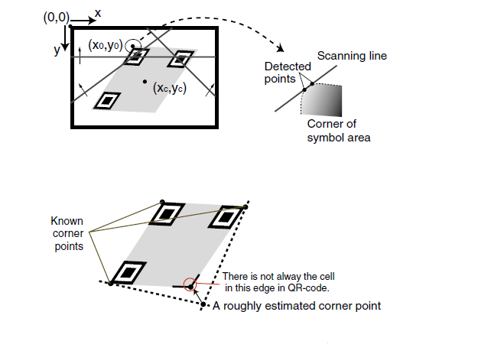
Ohbuchi’s Approach
Three scanning lines are used for Finder pattern
Fourth Corner Detection Method
(Line Attachment Method)
Ohbuchi, Eisaku, Hiroshi Hanaizumi, and Lim Ah Hock. "Barcode readers using the camera device in mobile phones." Cyberworlds, 2004 International Conference on. IEEE, 2004

Slide 21
Limitations
Ohbuchi’s Method
Hand tailored i.e. especially designed for one certain hardware device and certain assumptions are not realistic in usual environment.
Quality performance of this algorithm strongly depends on the accuracy of the symbol corner position.
Assumes that input image is the skewed code symbol but not curved for all edges.

Slide 22
Chen and Yang’s Approach
Finder Pattern
Case 0: the length ratio between black blocks and white blocks is 1:1:3:1:1 in transverse and vertical directions, and is also 1:1:3:1:1 in diagonal directions;
Case 1: the length ratio is 1:1:3:1:1 in transverse and vertical directions, and the ratio between left diagonal line and right diagonal line is 1:1
Case 2: the ratio between transverse line and vertical line is 1:1, and the length ratio is 1:1:3:1:1 in left and right diagonal directions.
Chen, Weibing, Gaobo Yang, and Ganglin Zhang. "A Simple and Efficient Image Pre-processing for QR Decoder." 2nd International Conference on Electronic & Mechanical Engineering and Information Technology. Atlantis Press, 2012.

Slide 23
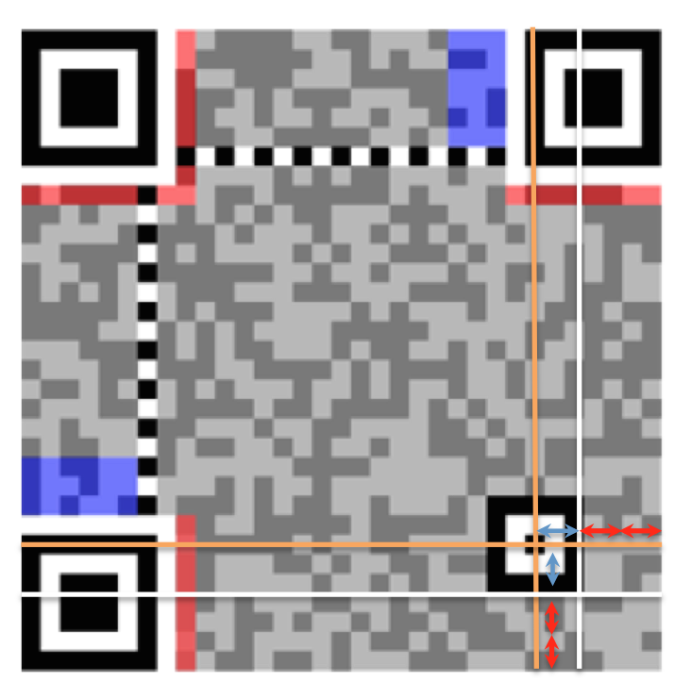
Contd …
Fourth Point Detection
Estimate the approximate position of alignment pattern
Move image pointer near to this point, and search the center coordinate of a alignment pattern
If this center can be found, then return to this point
if not found, then take estimation value as standard
Calculate the width of vertical module and transverse module of the quadrangle comprised of alignment pattern
Move the center point, the width of 3 transverse modules toward right and the width of 3 vertical modules towards bottom
Then the fourth point can be obtained

Slide 24
Limitations
The current approaches are limited at decoding distorted and blurred images
Limited applicability on mobile phones due to intensive calculation during decoding
Chen and Yang’s Approach :
Simulated only for PC and not tested on other embedded devices (No implementation)
Secondly, code optimization is not done
Depends on alignment pattern hence won’t work for all QR codes

Slide 25
Overview
Introduction
Background and Related Work
Algorithm Design
Implementation and System Design
Experimental Results and Analysis
Conclusion

Slide 26
QR Code Fourth Point Detection Method
Critical Step
To find the fourth corner point of a QR code
The location of the fourth pattern is approximated, as a very rough estimate.
The bottom and right edge are found of the bottomLeft and topRight estimated patterns, respectively.
Using the estimated bottom and right edges, real edges are determined.

Slide 27
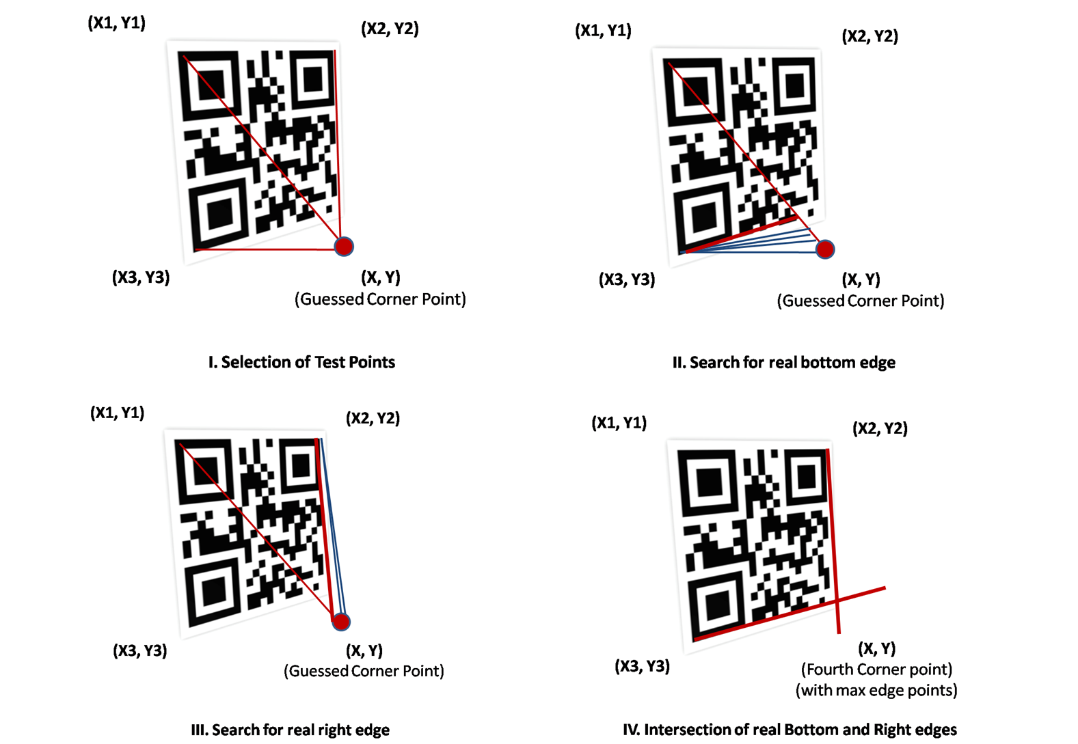
Fourth Corner Point Detection Method

Slide 28
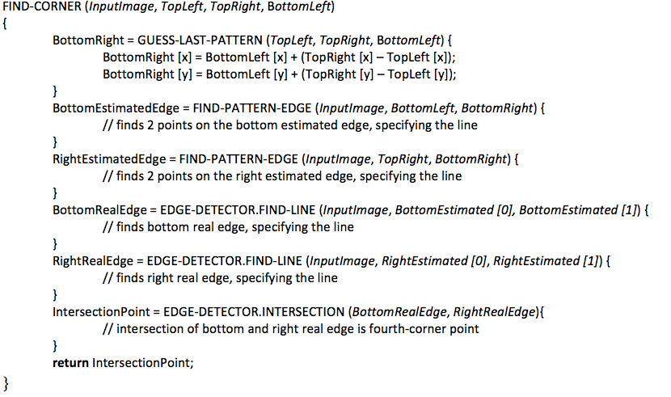
Fourth Corner Point Detection Method
Algorithm 1.1
Objective To determine the bottom-right corner of a QR code
Input Input Image and 3 Finder pattern points
Output Fourth corner point of QR Code
Guessing fourth-corner point geometrically
Estimated bottom and right edges
Real bottom and right edges
Intersection of real bottom and right edges is fourth-corner point

Slide 29
Algorithm 1.2
Objective To determine real bottom and right edge of given QR code
Input Input image, Estimated Bottom and Right edge points
Output Real Bottom and Right edges
Given a line and maximum deviation from the line, we find the line going through the most edge points
Each pair of points on these two lines (one on each) forms a possible line. Each of these lines is part of test under consideration.
For each probable line, we iterate through all the edge points. The distance from the edge point to the line is used to calculate the "cost" for the line.
“The line with the best cost is treated as real edge”
Complexity – O (n.k)
where n = number of possible lines under consideration
k = number of edge points for each line

Slide 30
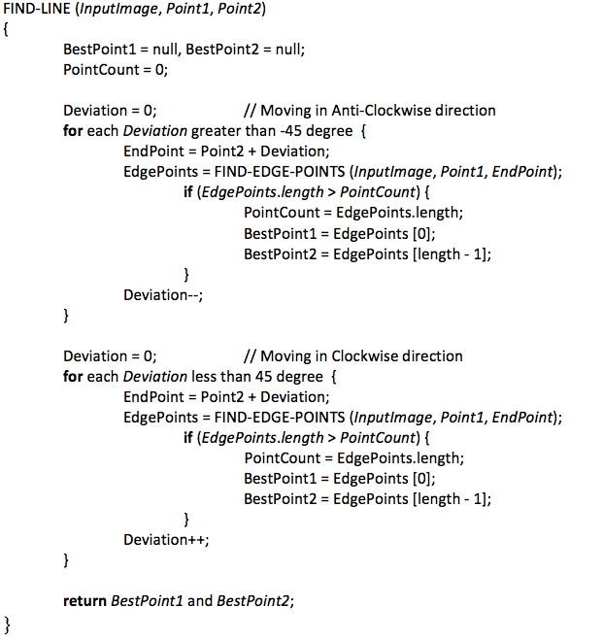
Deviating in Anti-Clockwise direction to find real edge
Deviating in Clockwise direction to find real edge

Slide 31
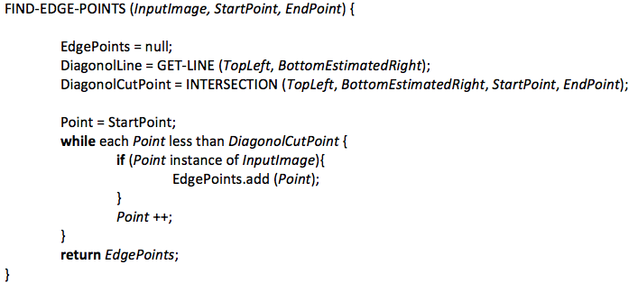
Algorithms 1.3
Objective To find all points that could be part of an edge.
Input Input Image, start Point and end Point
Output List of all edge points
Finding diagonal cut-point with possible line
Finding edge-points for each possible line under consideration

Slide 32
Overview
Introduction
Background and Related Work
Algorithm Design
Implementation and System Design
Experimental Results and Analysis
Conclusion

Slide 33
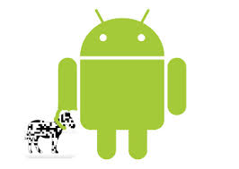
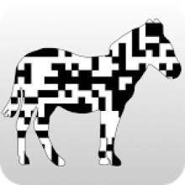
Development Tools and Technology
Tools / SDKs
Eclipse IDE
Programming Language – Java
Zxing QR Code Library
Android SDK
Testing Tools
Google Nexus 4
Samsung Galaxy S III Mini

Slide 34
QR Scanner App - Specifications
android:version Android 1.6 and above
android:minSdkVersion Android 2.1 (API Level 7)
android:targetSdkVersion Android 3.0 (API Level 11)
User Permissions android.hardware.camera
android.permission.CAMERA
android.permission.INTERNET
android.permission.ACCESS_WIFI_STATE
android.permission.ACCESS_NETWORK_STATE
External Library Zxing QR Code Library Source Code

Slide 35
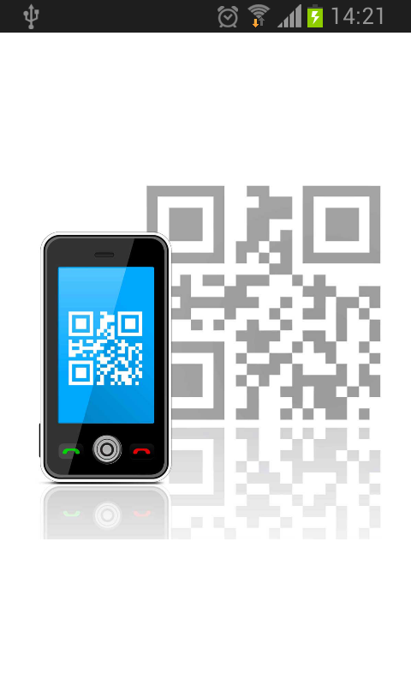
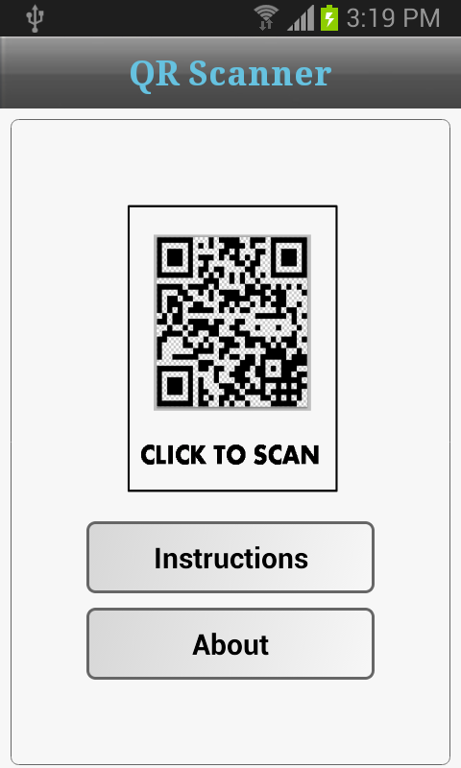
QR Scanner App
Splash Screen
Home Screen

Slide 36
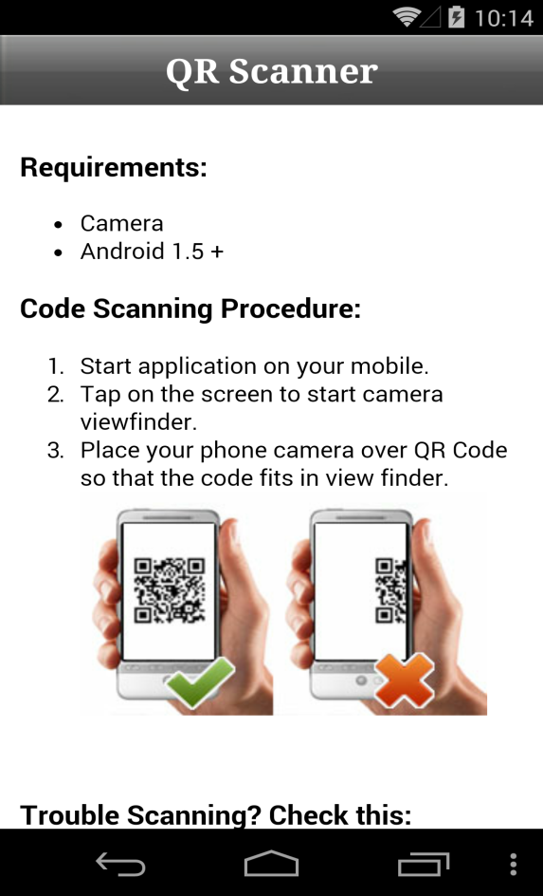
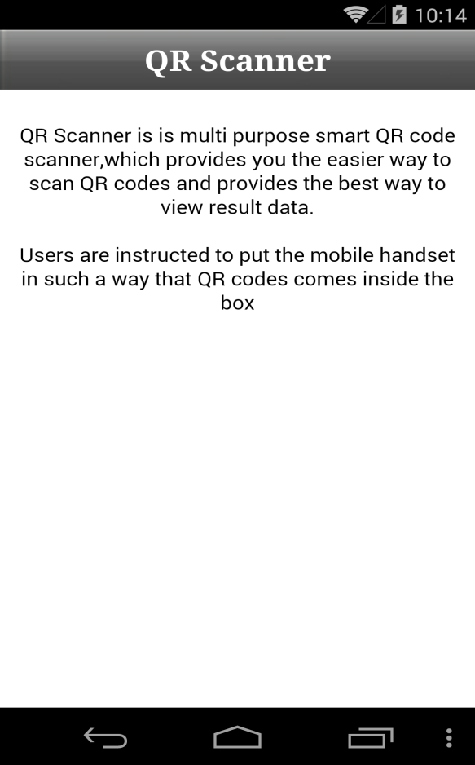
QR Scanner App
Instructions Screen
About Us Screen

Slide 37
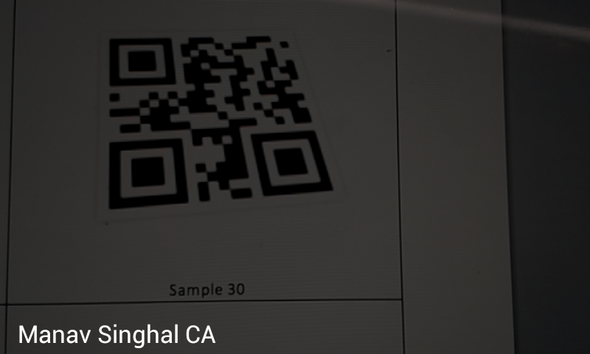
QR Scanner App
Scanning Screen
(Data shown on bottom left)

Slide 38
Overview
Introduction
Background and Related Work
Algorithm Design
Implementation and System Design
Experimental Results and Analysis
Conclusion

Slide 39
Experimental Testing Results
Tested our app ‘QR Scanner’ with sample set of QR codes (linearly distorted and various rotations) and compared the results with scanner apps on Google Play -
QR Code Reader
QR Droid Code Scanner
Barcode Scanner
Out of 32 sample codes under consideration, 19 were detected by QR Scanner app only
For 6 codes, one or the other app scanned code but QR Scanner app read all.
QR Scanner App provides ~75 % more detection rates compared to other apps.
For only 2 sample codes, neither QR Scanner nor other apps were able to scan codes.

Slide 40
Experimental Testing Results
Sample Count | QR Code Reader App | QR Droid Code Scanner App | Barcode Scanner App | QR Scanner App
# 25 | No | No | No | Yes
# 5 | Yes | Yes | Yes | Yes
# 2 | No | No | No | No

Slide 41
Overview
Introduction
Background and Related Work
Algorithm Design
Implementation and System Design
Experimental Results and Analysis
Conclusion

Slide 42
Conclusion
QR codes can be used on various mobile device operating systems e.g. Blackberry, Symbian OS, iOS and Android.
There are many business use-cases where QR codes are being utilized for marketing and promotions.
QR code scanning is a real problem since a little distortion can easily throw off enough pixels to make the code unreadable.

Slide 43
The main contributions of this project are –
Algorithm for estimating the fourth corner point is a significant improvement from the traditional approach
QR Scanner app can read the codes even when the image taken is not parallel to the surface and has various z-axis rotations / linear distortions.
Analysis of experimental scanning results show that QR Scanner app provides ~75 % more detection rate compared to other apps

Slide 44
References
Chen, Weibing, Gaobo Yang, and Ganglin Zhang. "A Simple and Efficient Image Pre-processing for QR Decoder." 2nd International Conference on Electronic & Mechanical Engineering and Information Technology. Atlantis Press, 2012.
Ohbuchi, Eisaku, Hiroshi Hanaizumi, and Lim Ah Hock. "Barcode readers using the camera device in mobile phones." Cyberworlds, 2004 International Conference on. IEEE, 2004.
Scheuermann, Constantin, et al. "Evaluation of barcode decoding performance using zxing library." Proceedings of the Second Workshop on Smart Mobile Applications, SmartApps. 2012.
Berisso, Kevin. "Designer QR Codes: Ensuring the" Beep"(White Paper)." AIDC 100 Archives, Special Collections and University Archives, Stony Brook University Libraries. (2013).
Narayanan, A. Sankara. "QR Codes and Security Solutions." International Journal of Computer Science and Telecommunications 3.7 (2012): 69.
QR Code Reader Android App, https://play.google.com/store/apps/details?id=me.scan.android.client
QR Droid Code Scanner, https://play.google.com/store/apps/details?id=la.droid.qr
Barcode Scanner, https://play.google.com/store/apps/details?id=com.google.zxing.client.android
Zxing – QR Code Decoding Library, https://github.com/zxing/zxing
Android Software Development Kit (SDK), http://developer.android.com/sdk/index.html

Slide 45
Thank You !!
Any Questions ??

