Slide 1

TigerAware Conditional Action Engine:
An extensible framework for providing real-time intervention to EMA surveys
Department of Electrical Engineering and Computer Science
Advisor: Dr. Yi Shang
Logan Harrison

Slide 2

Contents
Introduction
Motivation
System Design
UI Additions
Backend Architecture
Conclusion

Slide 3
Contents
Introduction
Motivation
System Design
UI Additions
Backend Architecture
Conclusion

Slide 4
Ecological Momentary Assessments (EMA)
EMAs differ from typical surveys (Qualtrics, Google Forms)
Attempt to collect data from participants in real time, over time
Goal: detect changes in behaviors and patterns
Environment and time sensitive
  Ideal for mobile-based delivery

Slide 5

TigerAware
Mobile survey platform
Designed specifically for EMA surveys
Functionality of a custom solution in a pre-built solution
Allows researchers to create surveys and deploy those surveys to user devices
  Android
  iOS
  Smart devices*
*in progress

Slide 6
Contents
Introduction
Motivation
System Design
UI Additions
Backend Architecture
Conclusion

Slide 7
Motivation
Main problem: collecting lots of data, but researchers are not involved
  Go to dashboard, download data, manually search
Solution: analyze data as it is recorded
  Allow researchers to configure events they are interested in
  Alert if the event happens
  Involves researcher in data collection
Intervention

Slide 8
Motivation
Example
  Researcher studying alcohol effects
  Participant takes nightly survey
  Interested in “extreme intoxication”
    BAC above 0.2% (0.08% is legal limit for driving)
  If someone goes above 0.2% send email to researcher and lab assistant

Slide 9
Contents
Introduction
Motivation
System Design
UI Additions
Backend Architecture
Conclusion

Slide 10
System Design
Allow researchers to configure actions based on participant responses
Each conditional action has three components
  Target value
    The value that the participant’s response will be compared to
  Operator
    How the values will be compared (==, >, etc.)
  Action
    What to do if the operator evaluates to TRUE
Participant Response
Target Value
Operator
Action

Slide 11
System Design
Challenge: allow flexibility but guarantee reliability
How can conditional actions be defined?
Must define grammar (set of rules)

Slide 12
System Design - Grammar
ConditionalAction:
action → ‘sendSMS’ | ‘sendEmail’ | ‘sendNotification’
aggregationType → ‘1Q’
message → String
operator → ‘eq’ | ‘neq’ | ‘con’ | ‘ncon’ | ‘gt’ | ‘gte’ | ‘lt’ | ‘lte’
questionId → String
value → String | Number
recipients → [String]

Slide 13
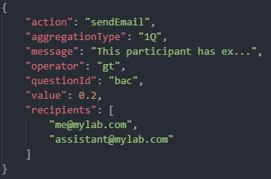
System Design - Grammar
ConditionalAction:
action → ‘sendSMS’ | ‘sendEmail’ | ‘sendNotification’
aggregationType → ‘1Q’
message → String
operator → ‘eq’ | ‘neq’ | ‘con’ | ‘ncon’ | ‘gt’ | ‘gte’ | ‘lt’ | ‘lte’
questionId → String
value → String | Number
recipients → [String]

Slide 14
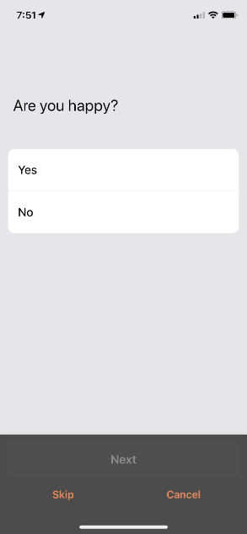
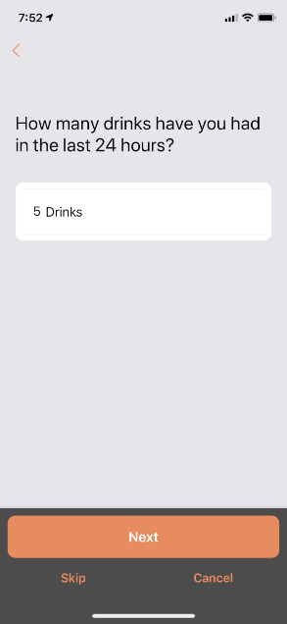
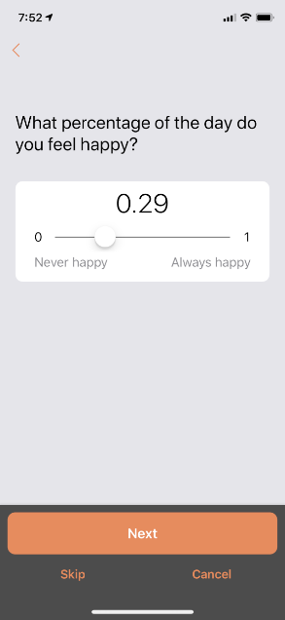
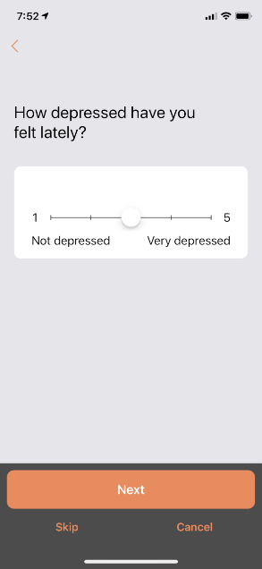
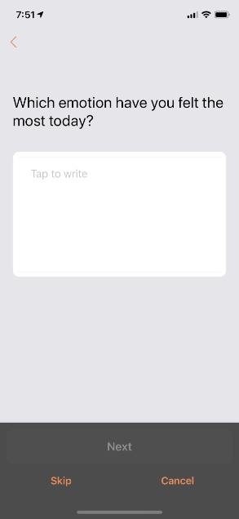
System Design - Configuration
Grammar defines syntactic correctness
  Need to guarantee semantic correctness as well
Different question types have different capabilities

Slide 15
System Design - Configuration
Question Type | Data Type
Yes/No | string
Text Field | string
Scale | number
Continuous Scale | number
Number | number
BAC | number
Question Type | Equals | > or < | ≥ or ≤ | Contains
Yes/No | ✔ | ❌ | ❌ | ❌
Text Field | ✔ | ❌ | ❌ | ✔
Scale | ✔ | ✔ | ✔ | ❌
Continuous Scale | ✔ | ✔ | ✔ | ❌
Number | ✔ | ✔ | ✔ | ❌
BAC | ❌ | ✔ | ✔ | ❌
Supported data types
Supported operators

Slide 16
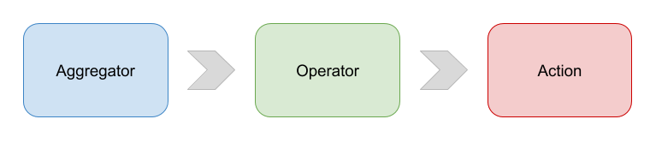
System Design – Conditional Action Pipeline
Need a way to evaluate conditional actions in real-time
Challenge
  “How do we design the system in such a way that allows the system to be expanded upon, but the core fundamentals stay the same from day one?”
Designed with expansion and flexibility in mind

Slide 17
Contents
Introduction
Motivation
System Design
UI Additions
Backend Architecture
Conclusion

Slide 18
UI Considerations
Large, established codebase
  Must be backwards compatible
Will be maintained by new people constantly
  Need to be as simple as possible
Want to reuse as much as possible
  Less code to maintain
  Less place for bugs to be introduced
  Codebase is relatively complex already, try to minimize added complexity

Slide 19
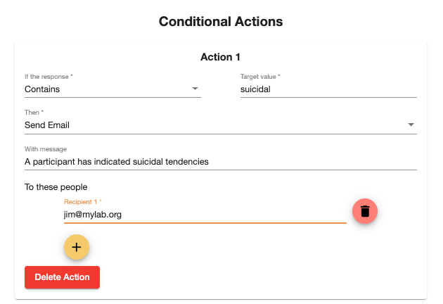
Component Reusability
Operator selection
Action selection

Slide 20

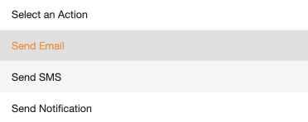
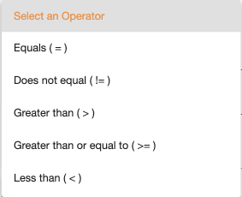
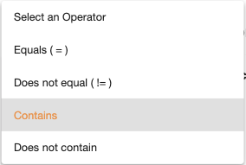
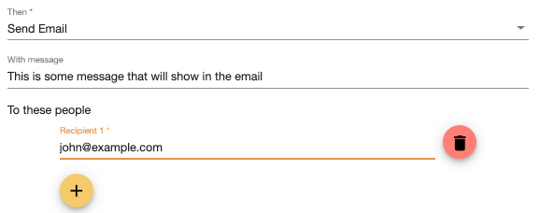
Operator & Action Selection

Slide 21
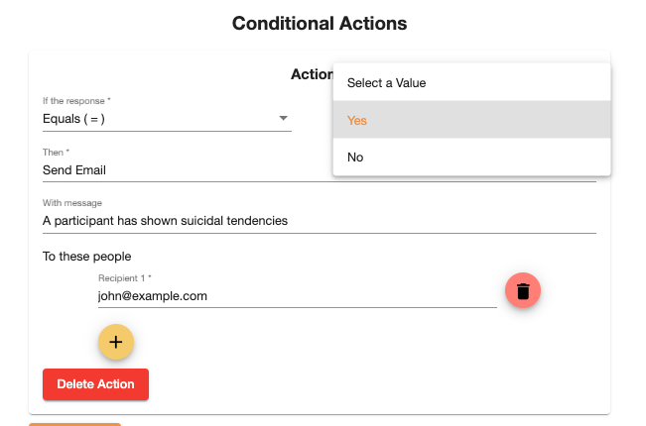
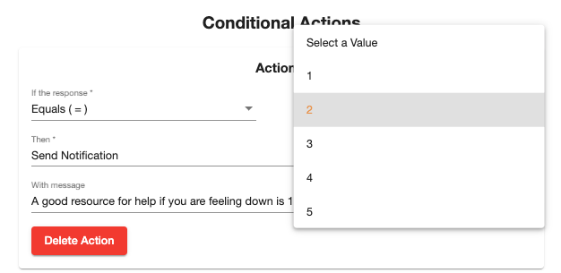
Conditional Action Dropdown
Scale question type
Yes/no question type

Slide 22
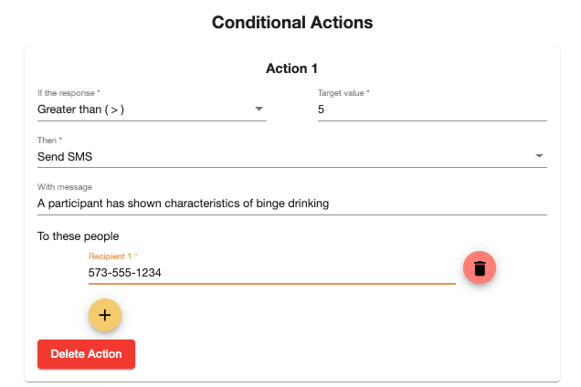
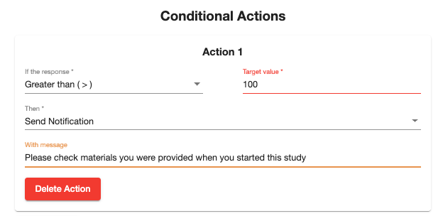
Conditional Action Number Box
Continuous scale question type
Number question type

Slide 23
Conditional Action Text Box
Text field question type

Slide 24
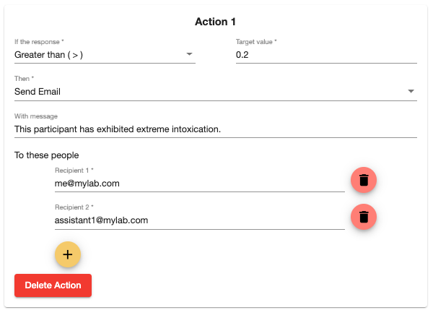
Result of the UI

Slide 25
Contents
Introduction
Motivation
System Design
UI Additions
Backend Architecture
Conclusion

Slide 26
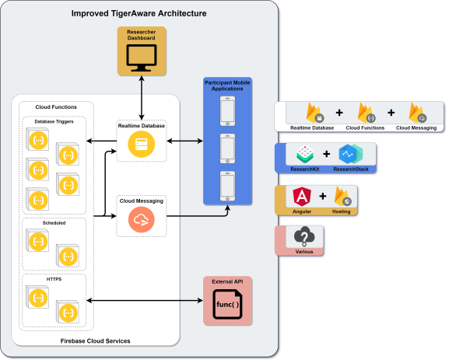
TigerAware Architecture

Slide 27
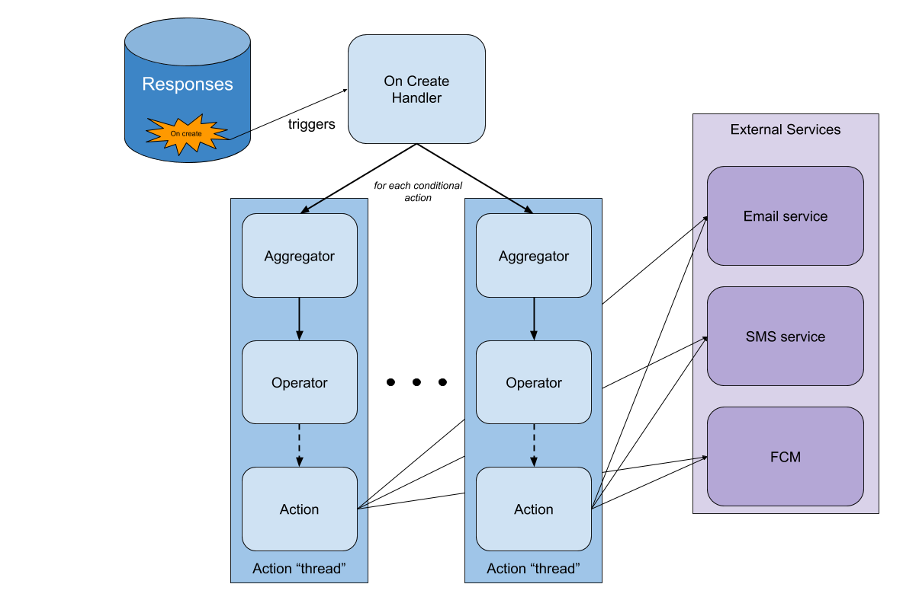

Conditional Action Architecture
1. Response is created
BAC: 0.24

Slide 28
Conditional Action Architecture
2. “OnCreate” trigger runs our cloud function

Slide 29
Conditional Action Architecture
3. Check for conditional actions for that survey

Slide 30
Conditional Action Architecture
0.24
4. Aggregate the data

Slide 31
Conditional Action Architecture
0.24
>
0.2
5. Evaluate using the provided operator

Slide 32
Conditional Action Architecture
6. Route to the proper service for the action

Slide 33
Conditional Action Architecture
7. Perform the action

Slide 34

Email Service
Utilize NodeMailer TypeScript library
  Fully-customizable messages
  Sends via SMTP without having to configure your own SMTP server
  Can be sent from any email address you own
  Widely used and trusted
  Free to use

Slide 35

SMS Service
Utilize Twilio SMS service
  RESTful HTTPS endpoints
    Twilio provides a TypeScript library that wraps these endpoints for easier use
  Pay-for-what-you-use model
    Cost effective
  Great documentation
  Widely used and trusted

Slide 36
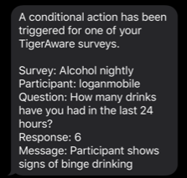
Email/SMS Alert Examples
From: no-reply@tigeraware.com
To: jim@mylab.com
A conditional action has been triggered for one of your TigerAware surveys.
Survey: Alcohol nightly
Participant: loganmobile
Question: How many drinks have you had in the last 24 hours?
Response: 6
Message: Participant shows signs of binge drinking

Slide 37
Contents
Introduction
Motivation
System Design
UI Additions
Backend Architecture
Conclusion

Slide 38
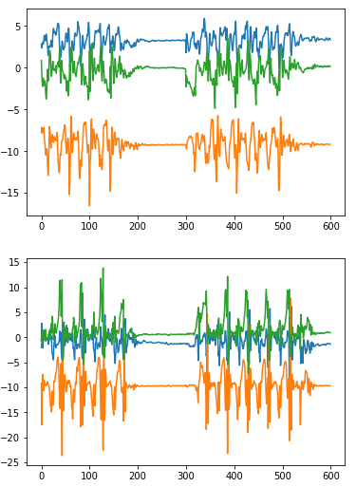
Future Opportunities
Historical aggregators
Sentiment analysis aggregators
ML model aggregators
  Impairment detection – gait and balance

Slide 39
Conclusion
Introduced extensible framework for providing full closed loop feedback
Added UI components to allow configuration of conditional actions
Utilized external services to add email and SMS functionality to TigerAware
Laid groundwork for more advanced features to be added

Slide 40

Questions?
Notes:
7. D. Simmons, M. Shah, J. Rogers, C. Rowland, and Y. Shang, “Deep Learning at Your Fingertips,” IEEE Annual Consumer Communications & Networking Conference, January 2019.

