Slide 1

Design And Implementation Of Web-based Survey Analysis And Management System
By: Gaofei Zhao
Advisor: Dr. Yi Shang
Notes:
Good morning and thank you for attending my project defense, my name is Gaofei. My advisor is Dr. Shang.
My project is “Design And Implementation Of Web-based Survey Analysis And Management System".

Slide 2
Outline
Introduction
Related Work
Design & Implementation
Results
Conclusion & Future Work
Notes:
In this presentation, I will be going through the following topics.
Firstly, I will introduce what the project involves, the problem with the current process and the proposed solution
Secondly, I’ll talk about some applications, which were used as inspiration for this project
I will then go through the design and implementation of the whole system
Finally, I will conclude the presentation, present the demo and talk about some potential future works for this project

Slide 3
Outline
Introduction
1. Problem Description
2. Proposed Solution
Related Work
Design & Implementation
Results
Conclusion & Future Work
Notes:
So first of all, I will introduce the purpose of conducting surveys in research and the current process
Then I will highlight some of the problems in the current process
And talk about the solution proposed in this project

Slide 4
Introduction
1.Define the problem
2.Design the research
3.Design survey questions
4.Specify the participants
5.Collect survey data
6.Analysis survey data
7.Write the research report and present its findings
Researchers across any discipline can follow these seven steps to conduct effective survey.
  Define the problem
  Design the research
  Design survey questions
  Specify the participants
  Collect survey data
  Analysis survey data
  Write the research report and present its findings
Notes:
Every research goes through these general steps when try to get a proper result.
Define the problem
Ideation hypothesis
Design the research
The research design is your “plan of attack.” It outlines what data you are going to gather and from whom, how and when you will collect the data, and how you will analyze it once it’s been obtained.
Design the data collection forms
Information Collection
Specify the sample
Organizing data format.
Collect the data
Information Collection
Analysis the data
Organizing and interpreting the data.
Write the research report and present its findings
So for this system, I want it can perform the data collection and analysis work for the researchers.

Slide 5

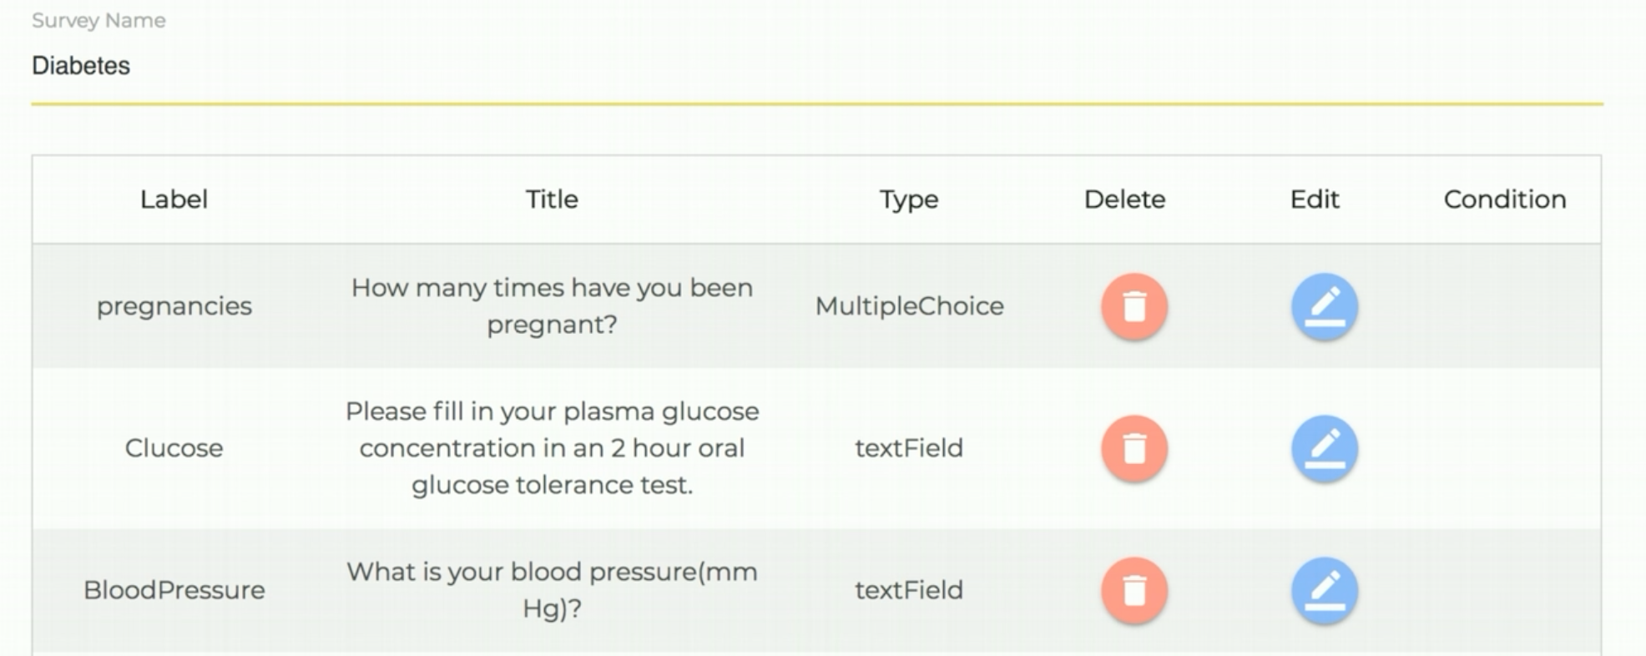
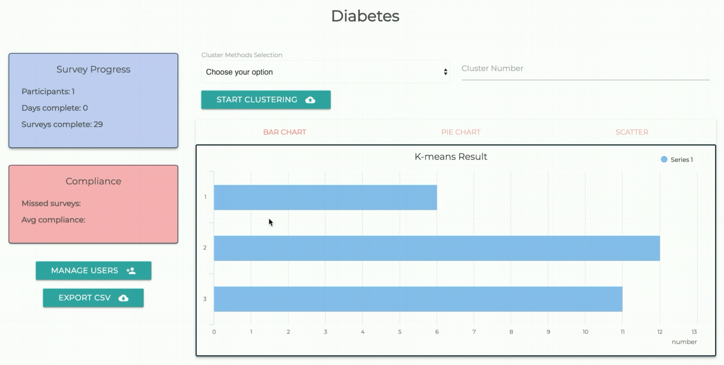
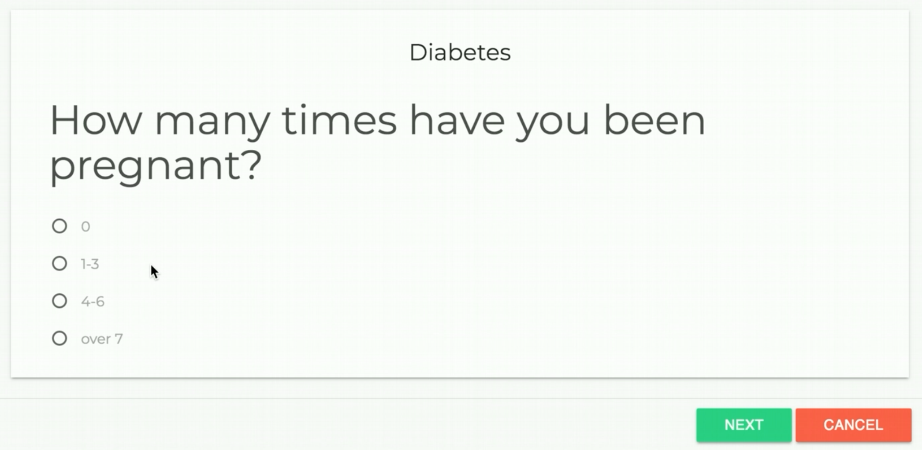
Introduction
Notes:
Every research goes through these general steps when try to get a proper result.
Define the problem
Ideation hypothesis
Design the research
The research design is your “plan of attack.” It outlines what data you are going to gather and from whom, how and when you will collect the data, and how you will analyze it once it’s been obtained.
Design the data collection forms
Information Collection
Specify the sample
Organizing data format.
Collect the data
Information Collection
Analysis the data
Organizing and interpreting the data.
Write the research report and present its findings
So for this system, I want it can perform the data collection and analysis work for the researchers.

Slide 6
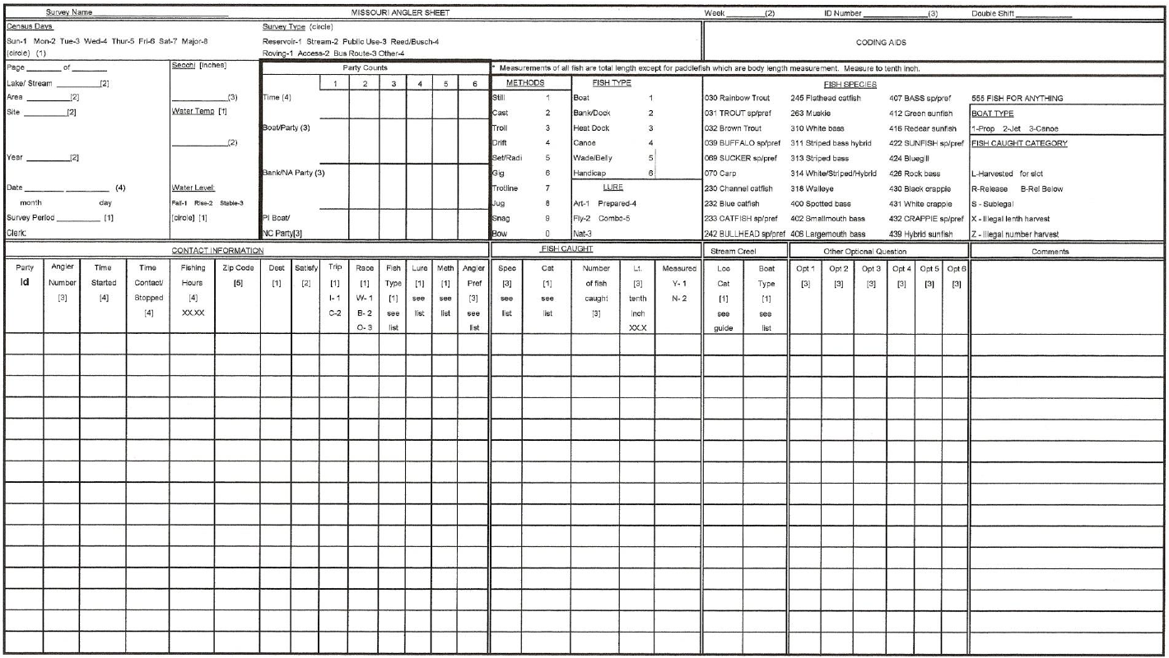
Problem Description
Slow, inefficient and error-prone
  Database entry can take 15-20 hours each month
  Human error – Incorrect data can be entered to database
  Possibility of misplaced or damaged data sheets
No real-time access to survey data
  Access to real-time data can expedite overall process
  Can help in identification of potential flaws in workflow
Lack of any interactive interface to collect, verify and show survey data and get feedback from analysis result.
Data Sheet
Notes:
In the current process, lots of researchers still using paper sheets for collecting the data.
Responses are noted down in a large data sheet, which takes too long to collect, bring back data sheet, and enter data to a database
Human factor: error-prone and damage to the data sheets
Lacks real time access to survey data, which can be helpful in observing current study process and observe potential flaws in the workflow.
Lack of any interactive interface to collect, verify and interpret the data.

Slide 7
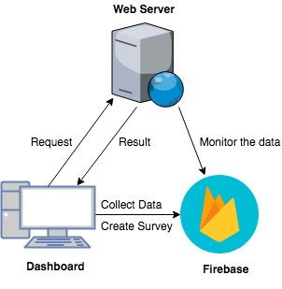
Proposed Solution
Survey Analysis And Management System(SAMS)
Client Side
Interactive, and modularized interface for a simplified data management process
Fast, efficient and user-friendly interface
Process of collecting and entering data to database can be significantly improved
Server Side
REST development
Modularized development framework with object-oriented programming
Rule module run as daemon process
Both these implementations can also introduce new features in the workflow
Notes:
To solve the problems noted above, I proposed this survey analysis and management system. It is a web application to perform the ability to collect data, monitor data and analysis data on a web site.
Client side
The frontend is implement by MVC framework AngularJS, which decrease the difficulties of code changing and reusing for the entire Web Application. Front-end was developed by combining HTML5, Bootstrap, Materialize with CSS3, and JavaScript with jQuery libraries, which make the system powerful and adaptable.
Fast, efficient and user-friendly interface to collects, organizes and displays data for researchers
data collection, reduces having to carry data sheets back and forth and no need for manual data entry
Server side
Restful API provides a great deal of flexibility
Makes the process more simpler
Monitor module run as daemon process
PLUS both these applications can add new features to the workflow

Slide 8
Outline
Introduction
Related Work
Design & Implementation
Results
Conclusion & Future Work
Notes:
We will talk about 4 other applications, which focused on similar data management approaches

Slide 9
Related Work
^{[1]} Blake Camp, “A Cross-Platform System Architecture for Form Design and Data Analytics for Public Health”, in ACM ISBN 978-1-4503-4722-8/17/08. August 20–23, 2017
web-based form designer
NoSQL databases
fast offline/online analytics Server

Slide 10
Related Work
^{[2]} Ruiqi Shi, "An Enhanced Mobile Ambulatory Assessment System for Alcohol Craving Studies“, in University of Missouri, Department of CS in Master’s Thesis , April, 2015
Flat file system
Single Survey – Alcohol Craving Study
Quantitative data collection from sensors
LAMP based server architecture

Slide 11
Related Work
^{[3]} N. Chettri, “Design and Implementation of Creel Survey Data Management Application”, in University of Missouri, Department of CS in Master’s Thesis, 2017
Hybrid mobile and web dashboard.
  Server API’s which can be used for any client
Data exportation
Dashboard based user role control
LAMP based Architecture

Slide 12
Related Work
^{[4]}D. Srivatsav, "MTD: MOOD TOOLKIT DASHBOARD - A Data Analytical Web Application for Psychological Research Studies“, in University of Missouri, Department of CS in Master’s Thesis, 2017.
Web dashboard implementation
  Simple and Intuitive to use
LAMP Based Architecture
Visualization Capabilities

Slide 13
Related Work Summary
Collecting data in form of question accompanied by data from mobile device's internal sensors or external wirelessly connected sensors
Managing multiple participants and their data across time
Visualizing and organizing collected data on a Web dashboard
Data Exportation
Mostly based on LAMP Architecture

Slide 14
OUTLINE
Introduction
Related Work
Design & Implementation
1. Client Side
2. Server Side
Results
Conclusion
Notes:
First I will go through design and implementation of the Client Side and then the same for the Server Side.

Slide 15
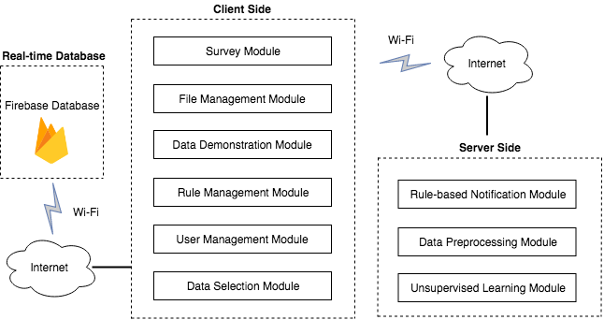
Design & Implementation
Notes:
System Design
The proposed system in this project divided into Client Side and Server Side, shown in this figure.
The Client Side can be further divided into
Survey Module
File Management Module
Data Demonstration Module
Rule Management Module
User Management Module
Data Selection Module.
The Server Side is including
Rule-based Notification Module
Data Preprocessing Module
Unsupervised Learning Module.
These modules will be introduced in the following slides.

Slide 16
Client Side
MVC Architectural Pattern:
Model – View – Controller
Industry Standard for implementing UI
Modular and robust design features as it provides abstraction support
AngularJS Feature:
2-WAY DATA BINDING
Notes:
user interface changes are completely separated from business logic.
Secure as the UI pages will not be having the backend table structures/ other logic involved.
In Two-way data binding, view (UI part) updates automatically when data model changed. Its synchronization processes. In this case, Model is a single source of truth. This feature makes the web front very powerful.

Slide 17
Design & Implementation
Notes:
System Design
The proposed system in this project divided into Client Side and Server Side, shown in this figure.
The Client Side can be further divided into
Survey Module
File Management Module
Data Demonstration Module
Rule Management Module
User Management Module
Data Selection Module.
The Server Side is including
Rule-based Notification Module
Data Preprocessing Module
Unsupervised Learning Module.
These modules will be introduced in the following slides.

Slide 18
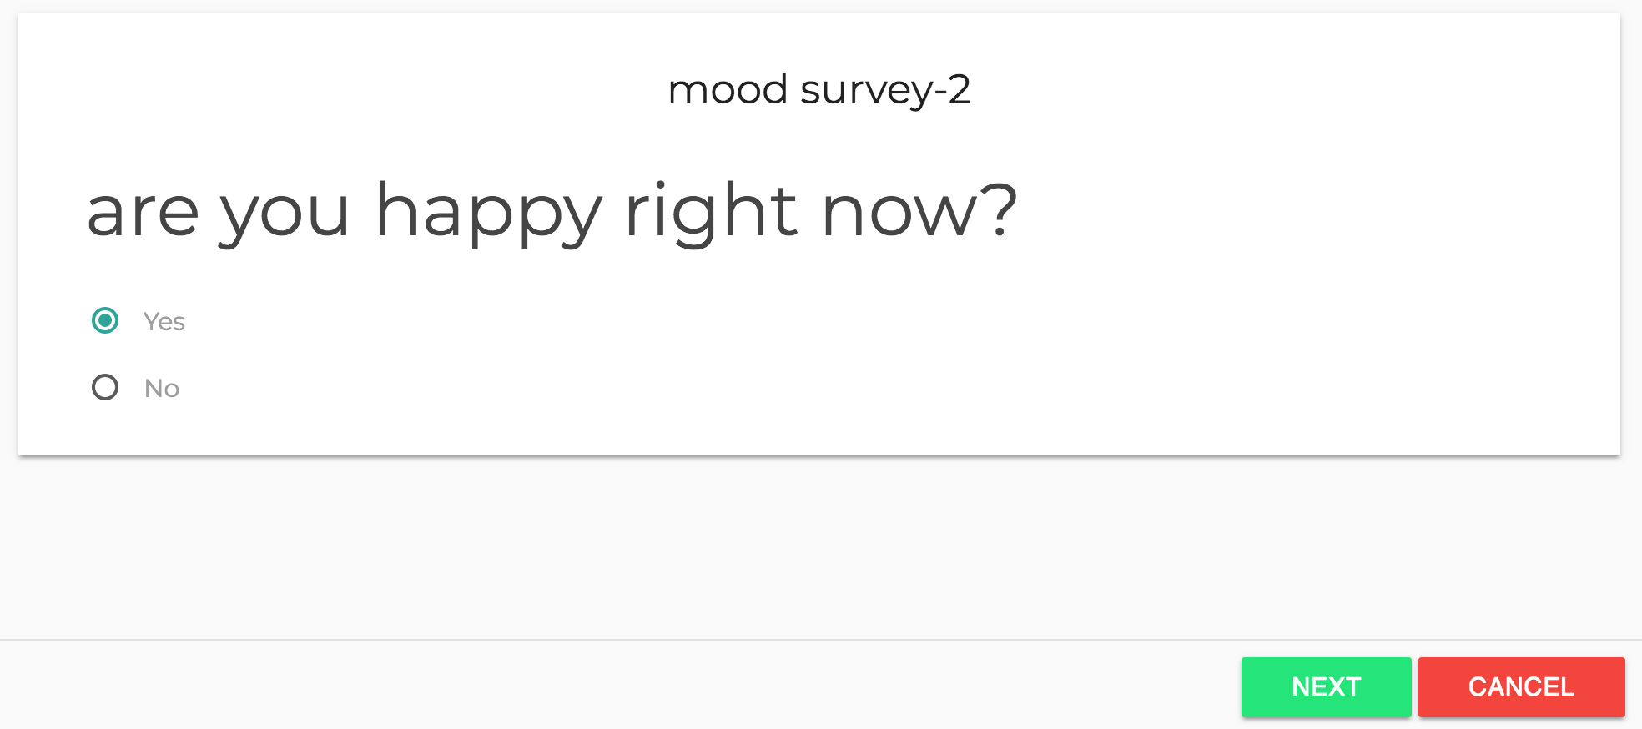
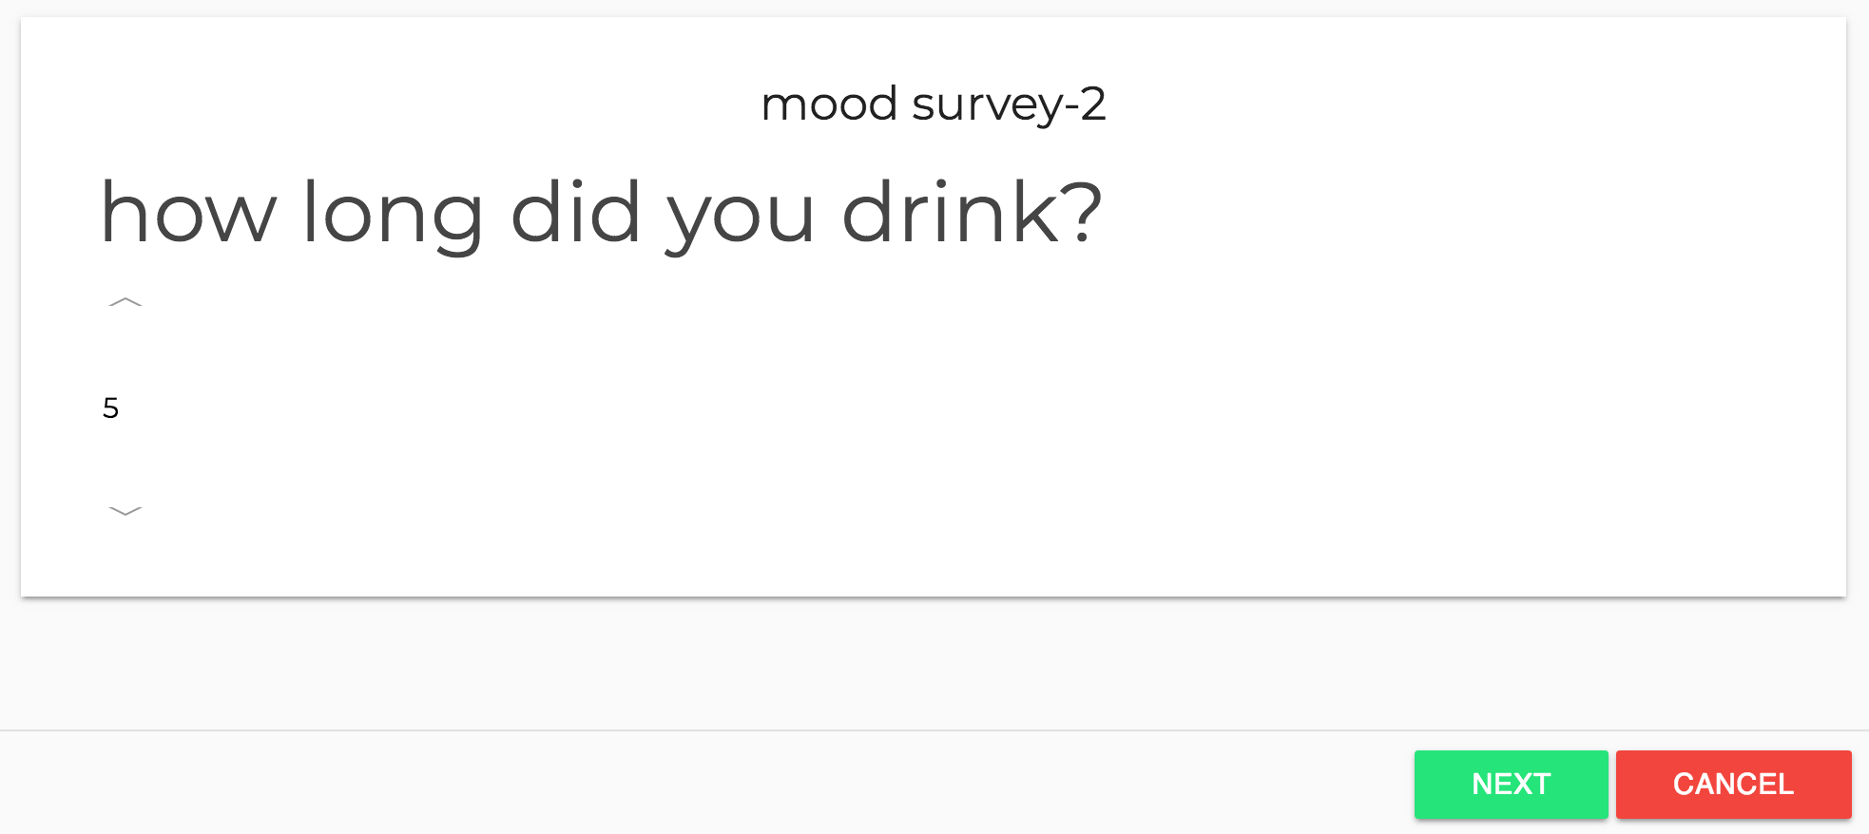
Client Side
Survey Module:
  Implement surveys
  Currently support 7 different question types
  Response validation
  Upload responses to database
Select Survey
Begin Survey
Take Survey
Save Data
Uploads to Server
Notes:
The survey module designed for data collection. Participants can take a public survey or invited survey.
The data collection process involves these 5 steps, with 3 of these steps being cyclical
Factory design to handle different question types in the survey.
Different Materialize components are used for different question types while user taking the survey.

Slide 19
Design & Implementation
Notes:
System Design
The proposed system in this project divided into Client Side and Server Side, shown in this figure.
The Client Side can be further divided into
Survey Module
File Management Module
Data Demonstration Module
Rule Management Module
User Management Module
Data Selection Module.
The Server Side is including
Rule-based Notification Module
Data Preprocessing Module
Unsupervised Learning Module.
These modules will be introduced in the following slides.

Slide 20
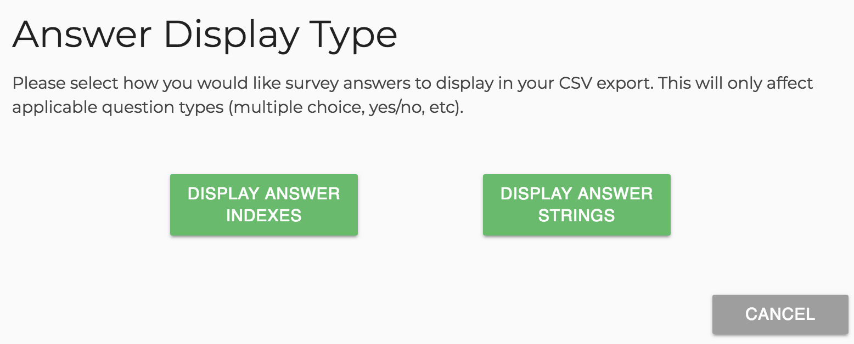
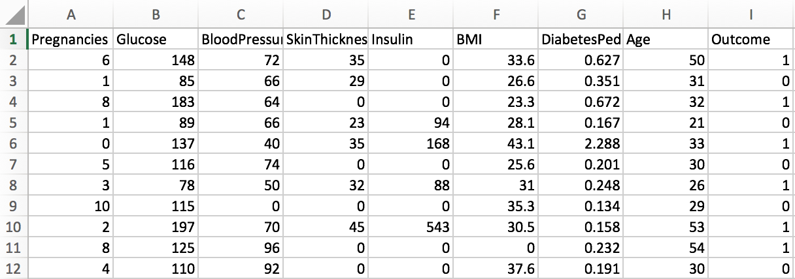
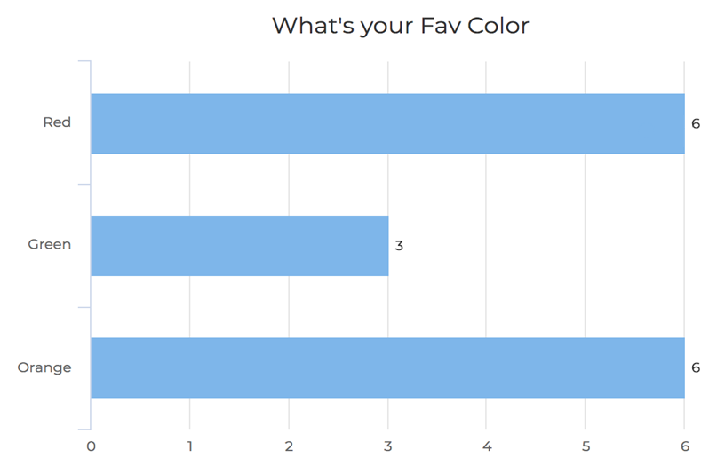
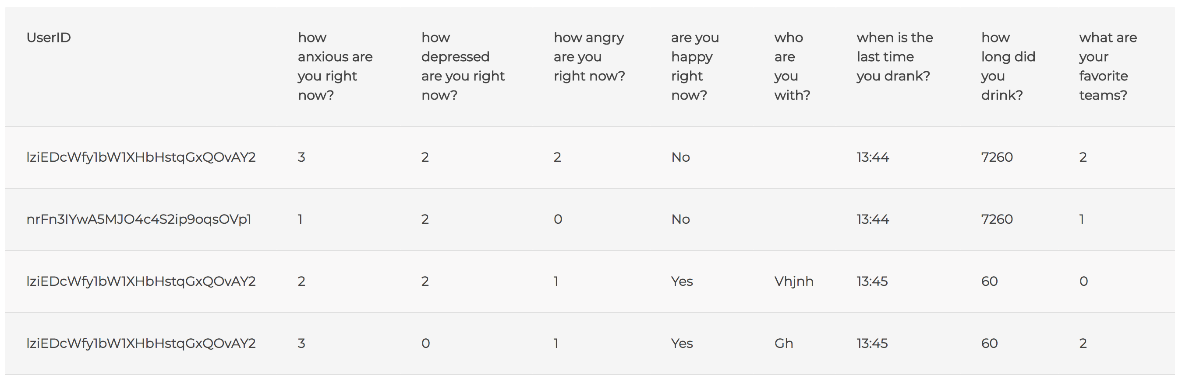
Client Side
File Management Module:
  Export to CSV with two options (text / numeric)
  Import data from local system CSV file
Data Demonstration Module:
  Using factory design pattern to return a JSON response corresponding to each question type in responses
  Data table to show all responses
Notes:
File management: only admin users
Upload CSV: view new data on the dashboard using CSV files; validated using JS and imported.
Download CSV: download individual responses in a big table as CSV file, When the user chooses to download the CSV file, two options will be given. One is to use the index to represent multiple-choice and scale-type answers, and the other is to be represented by text.
File management: only admin users
Responses data table for administrator to observe collected responses.

Slide 21
Design & Implementation
Notes:
System Design
The proposed system in this project divided into Client Side and Server Side, shown in this figure.
The Client Side can be further divided into
Survey Module
File Management Module
Data Demonstration Module
Rule Management Module
User Management Module
Data Selection Module.
The Server Side is including
Rule-based Notification Module
Data Preprocessing Module
Unsupervised Learning Module.
These modules will be introduced in the following slides.

Slide 22
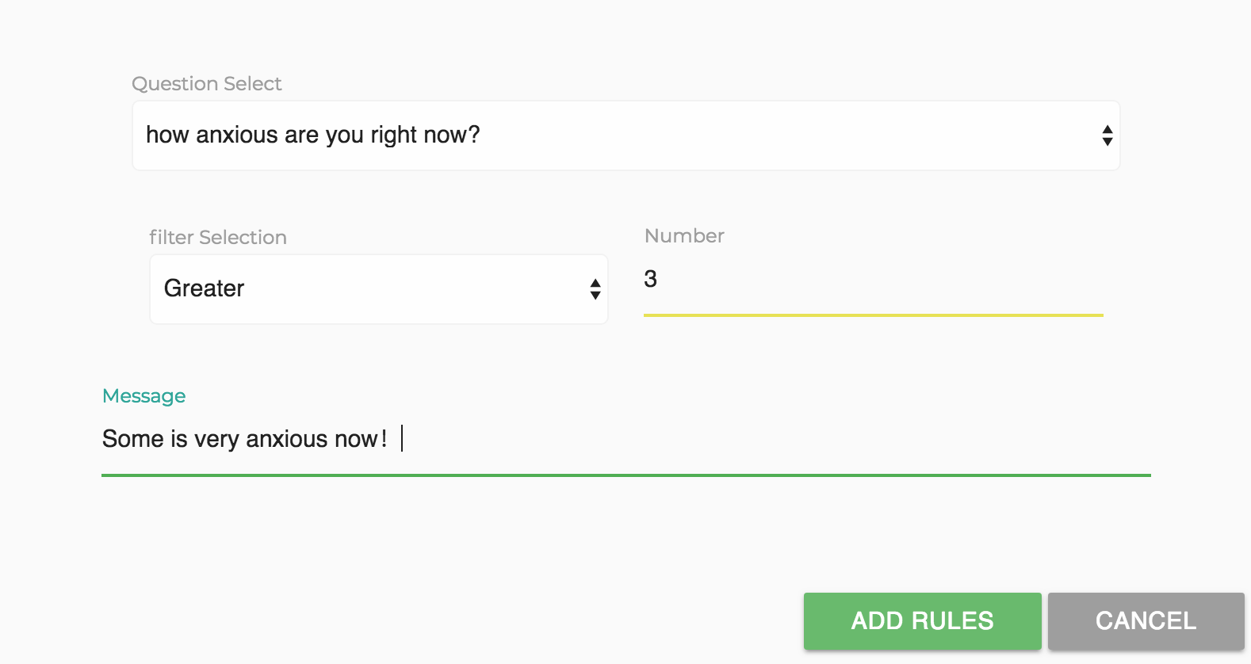
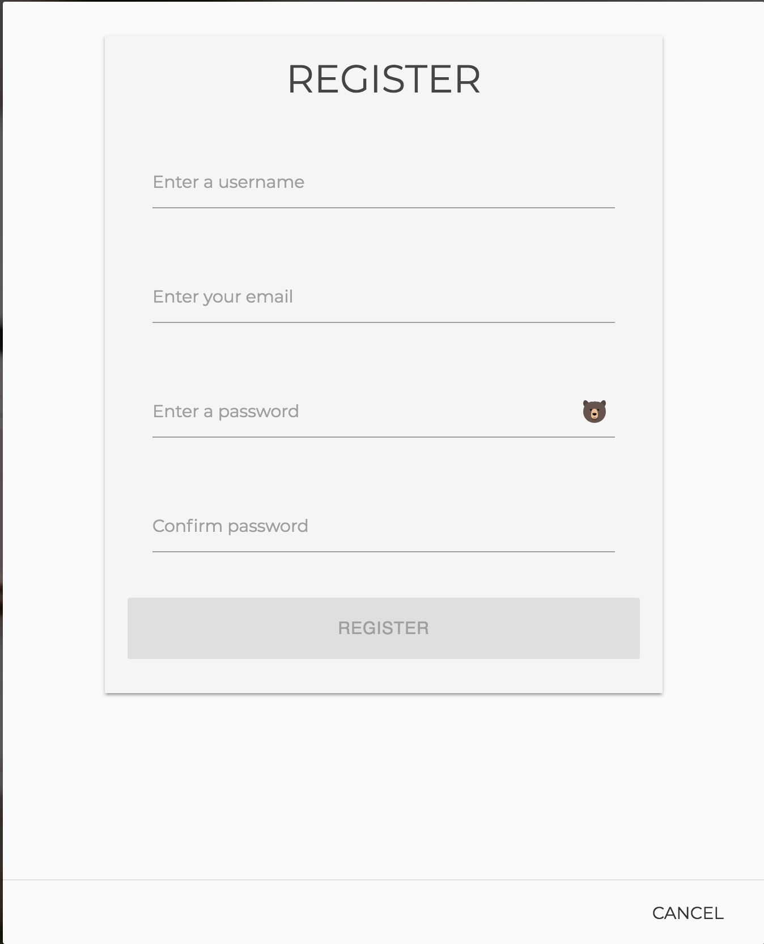
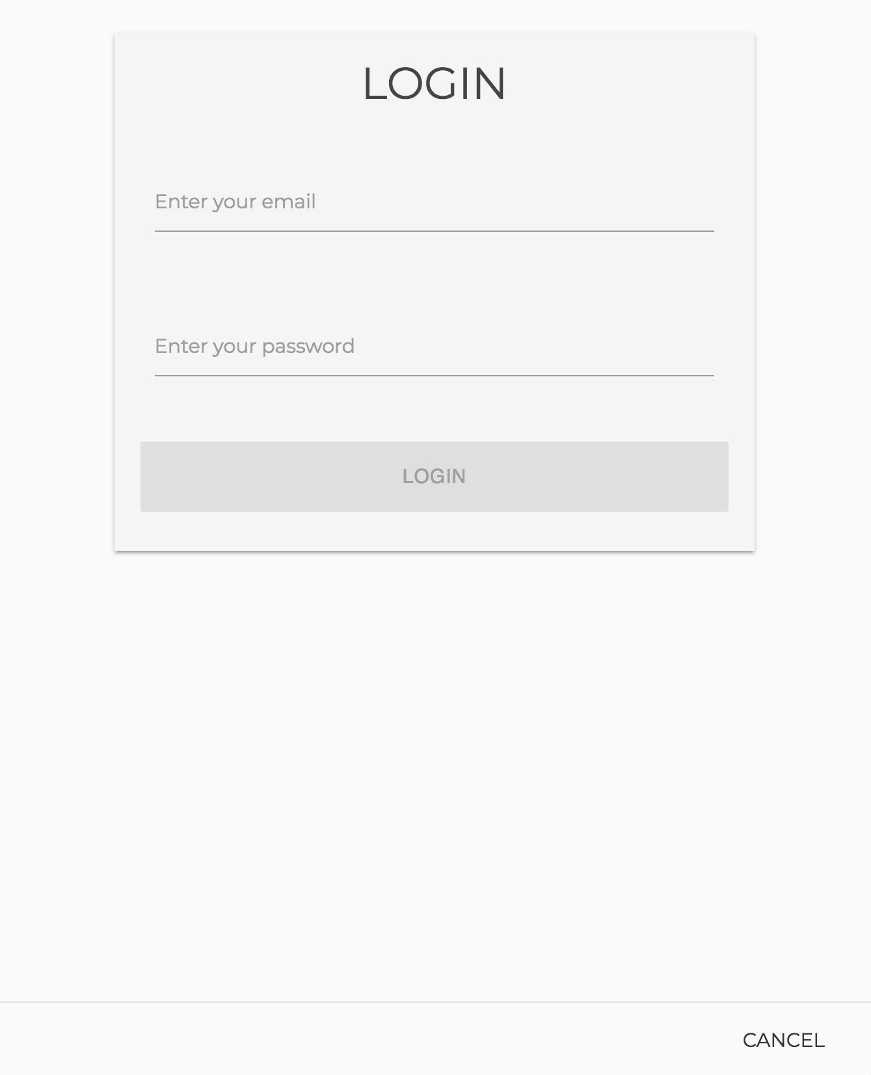
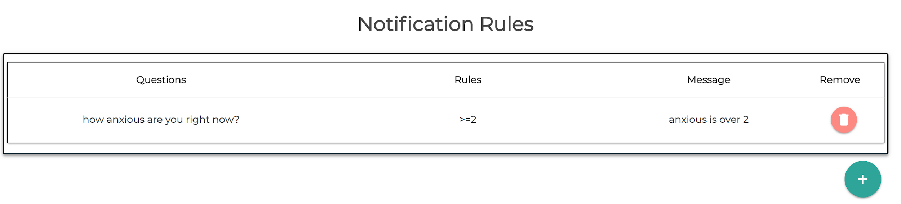
Client Side
Rule Management Module:
  Set up rules based on different question types
  Save corresponding rules into the database
User Management Module:
  Registration and login management
  Show studies based on user information
  Oath protocol
Notes:
Rule Management Module:
In the rules management module,
The user needs to select the question and select the monitoring rule and the notification text to be notified in the server-side notification module. it provides users with the ability to view rules, add rules and delete rules.
User Management Module:
Account management module, which is responsible for registration and login process. When a new user account is registered, their data is sent from this module to the firebase. The procedure is secured using Oath Protocol .
Login is restricted for any unauthorized user, and users can be given access for login using the user management module. This module is accessible only by administrators. When an administrator want authorizes a user, they can give administrator access permission to that user.

Slide 23
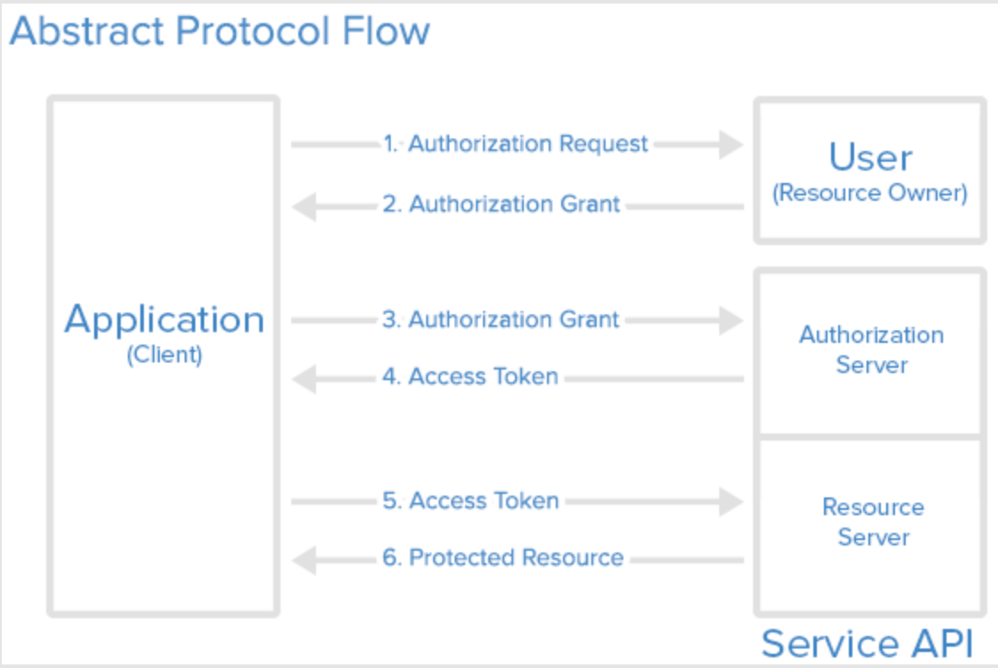
Client Side
Oath protocol
Notes:
The application requests an access token from the authorization server (API) by presenting authentication of its own identity, and the authorization grant
If the application identity is authenticated and the authorization grant is valid, the authorization server (API) issues an access token to the application. Authorization is complete.
The application requests the resource from the resource server (API) and presents the access token for authentication
If the access token is valid, the resource server (API) serves the resource to the application.

Slide 24
Design & Implementation
Notes:
System Design
The proposed system in this project divided into Client Side and Server Side, shown in this figure.
The Client Side can be further divided into
Survey Module
File Management Module
Data Demonstration Module
Rule Management Module
User Management Module
Data Selection Module.
The Server Side is including
Rule-based Notification Module
Data Preprocessing Module
Unsupervised Learning Module.
These modules will be introduced in the following slides.

Slide 25
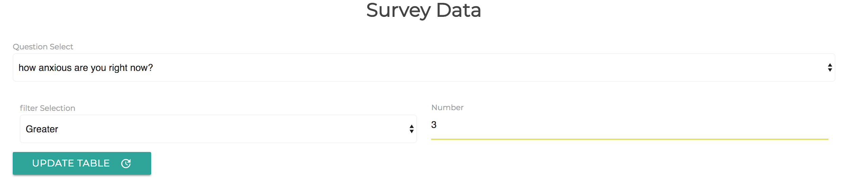
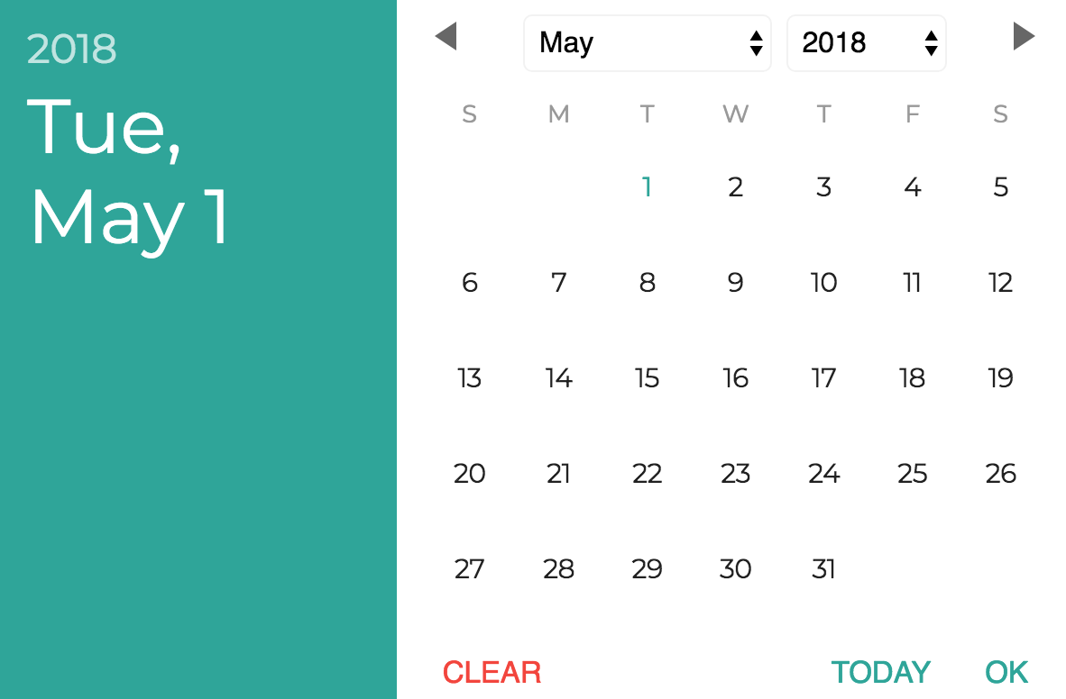
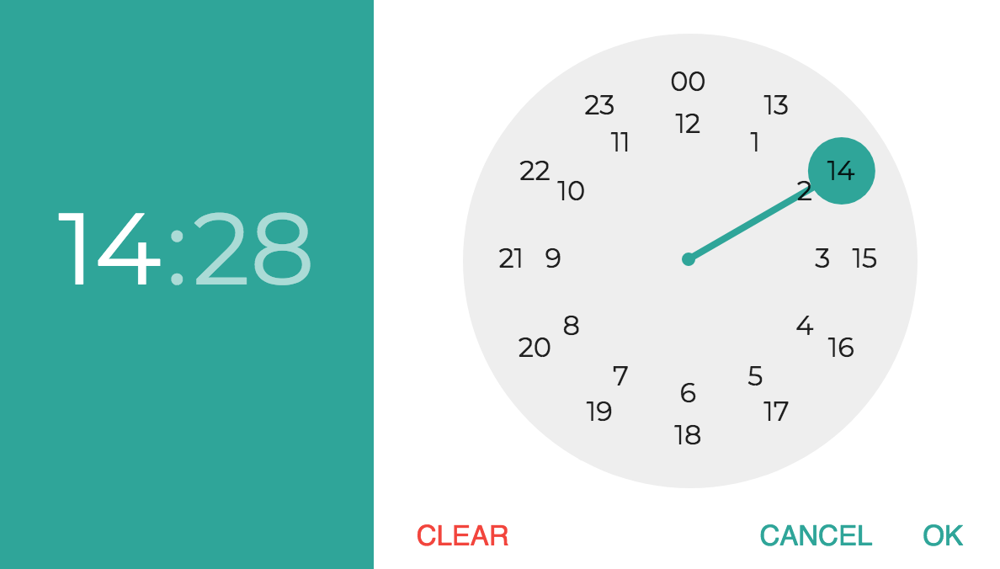
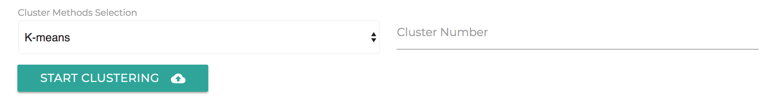
Client Side
Data Selection Module:
  Support numeric and text based responses filter
  Dynamic filter selection based on question types
  Data table update
  Analysis filter
Notes:
Data has been filtered as follow, then selected data will be saved for further process.
for numerical data, the selection is mainly based on data relationships that are greater than, less than, or equal to the chosen value. If the data satisfies the condition, the data is selected and updated data table.
For text-based data, only the text responses contains the chosen keyword will be selected
This module help the data analysis module to filter the data for further analysis.

Slide 26
Design & Implementation
Notes:
System Design
The proposed system in this project divided into Client Side and Server Side, shown in this figure.
The Client Side can be further divided into
Survey Module
File Management Module
Data Demonstration Module
Rule Management Module
User Management Module
Data Selection Module.
The Server Side is including
Rule-based Notification Module
Data Preprocessing Module
Unsupervised Learning Module.
These modules will be introduced in the following slides.

Slide 27
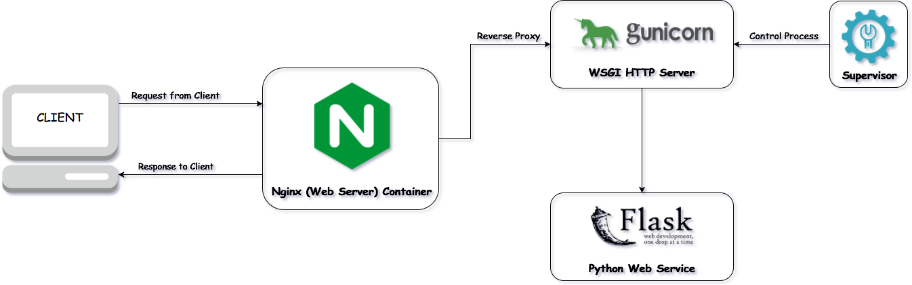
Server Side
Design pipeline:
  Nginx decreases the server response time
  Gunicorn works by internally handling the calling of your flask code.
Notes:
Flask is called a micro framework because it does not require particular tools or libraries.(clean)
Gunicorn works by internally handling the calling of flask code. It is done by having workers ready to handle the requests instead of the sequential one-at-a-time model that the default flask server provides.
Nginx handles communications with clients and doesn't suffer a penalty for handling slow clients. It sends requests to the backend as fast as the backend can handle those requests, enabling the backend to be as efficient with server resources as possible.

Slide 28
Design & Implementation
Notes:
System Design
The proposed system in this project divided into Client Side and Server Side, shown in this figure.
The Client Side can be further divided into
Survey Module
File Management Module
Data Demonstration Module
Rule Management Module
User Management Module
Data Selection Module.
The Server Side is including
Rule-based Notification Module
Data Preprocessing Module
Unsupervised Learning Module.
These modules will be introduced in the following slides.

Slide 29
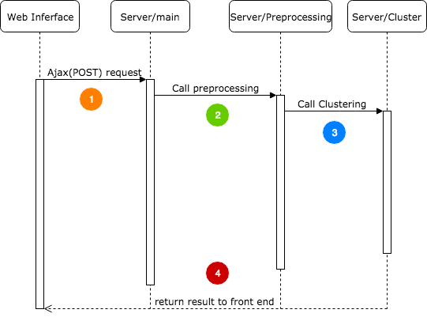
Server Side
Analysis pipeline:
Request from client side through Ajax request
Data Preprocessing
Process data using clustering methods
Return JSON format response to the client side and show result
Notes:
The Analysis pipeline is following these four steps.
Request
Preprocessing
Cluster
Return result

Slide 30
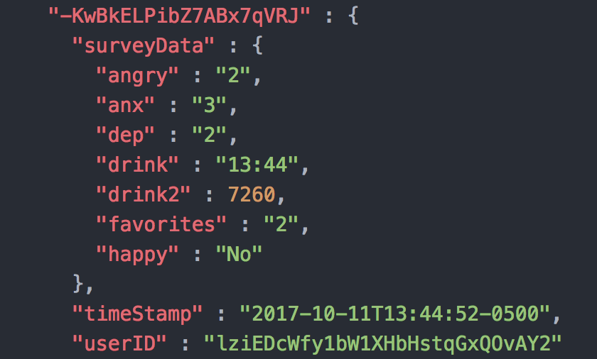
STEP1
STEP2
STEP3
STEP4
Ajax call from web interface:
  Including the target number of clusters and the cluster method want to use.
  Including the answers in the data(protected by AES and RSA)
  Send the data via Ajax call(POST method) to the server.
Notes:
Whenever communication between the front-end and back-end is required without having to reload the entire page, the ajax-handlers are used. This makes the process quicker and less memory intensive

Slide 31
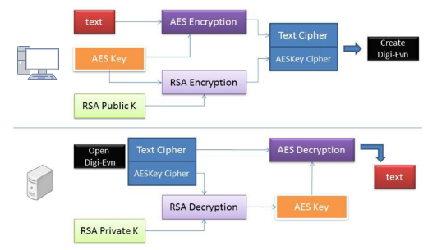
STEP1
STEP2
STEP3
STEP4
Encryption and Decryption:
Notes:
all data are encrypted by a hybrid cryptosystem, as shown in the Figure 4.14, which combines the convenience of an asymmetric public-key cryptosystem with the efficiency of a symmetric-key cryptosystem. RSA algorithm is implemented as the asymmetric cryptography and AES is implemented as the symmetric cryptography. The data is encrypted by AES while the unique AES key is protected by RSA key-pair (public key and private key) cryptography. Thus, even if someone other than the retrieves request data; the encrypted data is extremely difficult to be decrypted, which increases the data security level.

Slide 32
STEP2
STEP1
STEP3
STEP4
Data Preprocessing:
Input Data
Numeric
Text
Delete empty response
Median for missing data
Min-Max normalization
Punctuations Removal
Stopwords Removal
Digital words Removal
Notes:
For the missing data, we have three processing methods:
1. Through the maximum and minimum values in the data, we assign the intermediate value to the missing data;
2. Through the average value of all data attached to the missing data;
3. Delete vacant data items;
The date and time data will translate to the seconds of a day and then normalize as the standard numeric data.
Numeric data is easy to preprocess, but for the text data. We need to make more efforts to make it possible as a feature in the module. The process can be described as follow.
Punctuations Removal: We do not need punctuations as the features, they are just symbols to separate sentences and words.
Stopwords Removal: There is a kind of word called stopword[9]. They are some common function words in a sentence, like ‘a’, ‘the’, ‘and’, ‘to’, ‘at’, etc. These words seem to be useless for sentiment analysis.
Digital words Removal: Some words start with a digit, like a year ‘2018’, ‘2:00 pm’. These words also have no relationship with attitudes or feelings. So these words should be removed.

Slide 33
STEP2
STEP1
STEP3
STEP4
wow | 1
present | 1
gave | 1
great | 1
like | 1
very | 1
much | 1
check | 1
image | 1
Data Preprocessing:
one-hot decoding
Notes:
After the clean and remove these words. The text data contains the word we can treat as the feature. Then use one-hot decoding to decode the text words as one feature.

Slide 34
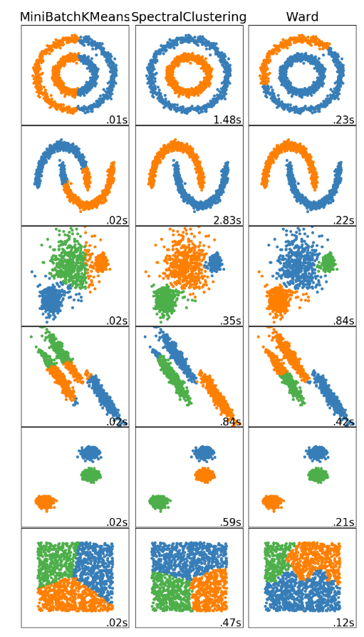
STEP3
STEP1
STEP2
STEP4
Clustering Methods:
Using python library scikit-learn library.
Methods implemented:
K-means
Spectral clustering
Hierarchical clustering
Notes:
With hierarchical clustering, the sum of squares starts out at zero (because every point is in its own cluster) and then grows as we merge clusters. Ward’s method keeps this growth as small as possible. Ward’s method is both greedy and constrained by previous choices as to which clusters to form. This means its sum-of-squares for a given number $k$ of clusters is usually larger than the minimum for that $k$, and even larger than what $k$ -means will achieve. If this is bothersome for application, one common trick is use hierarchical clustering to pick $k$, and then run $k$ -means starting from the clusters found by Ward’s method to reduce the sum of squares from a good starting point.
Figure 4.23: Using Ward’s method to form a hierarchical clustering
The k-means algorithm gives no guidance about what k should be. Ward’s algorithm, on the other hand, can give us a hint through the merging cost. If the cost of merging increases a lot, it’s probably going too far, and losing a lot of structure. So, a rule of thumb is to keep reducing k until the cost jumps, and then use the k right before the jump. Of course, this leaves you to decide how big a merging cost is acceptable, and there’s no theory whatsoever to say that this will often or even usually lead to good choices, but it does make a kind of sense. Of course, the same rule of thumb can be applied to other hierarchical clustering techniques: pick the k just before the merging cost takes off.

Slide 35
STEP3
STEP1
STEP2
STEP4
Clustering Methods:
Using python library scikit-learn library.
Methods implemented:
K-means
Spectral clustering
Hierarchical clustering
Notes:
With hierarchical clustering, the sum of squares starts out at zero (because every point is in its own cluster) and then grows as we merge clusters. Ward’s method keeps this growth as small as possible. Ward’s method is both greedy and constrained by previous choices as to which clusters to form. This means its sum-of-squares for a given number $k$ of clusters is usually larger than the minimum for that $k$, and even larger than what $k$ -means will achieve. If this is bothersome for application, one common trick is use hierarchical clustering to pick $k$, and then run $k$ -means starting from the clusters found by Ward’s method to reduce the sum of squares from a good starting point.
Figure 4.23: Using Ward’s method to form a hierarchical clustering
The k-means algorithm gives no guidance about what k should be. Ward’s algorithm, on the other hand, can give us a hint through the merging cost. If the cost of merging increases a lot, it’s probably going too far, and losing a lot of structure. So, a rule of thumb is to keep reducing k until the cost jumps, and then use the k right before the jump. Of course, this leaves you to decide how big a merging cost is acceptable, and there’s no theory whatsoever to say that this will often or even usually lead to good choices, but it does make a kind of sense. Of course, the same rule of thumb can be applied to other hierarchical clustering techniques: pick the k just before the merging cost takes off.

Slide 36
STEP3
STEP1
STEP2
STEP4
Method | advantage | disadvantage
K-means | Simple Fit to most type of dataset | Sensitive to initial centers Detects spherical clusters Slow with big dataset
Spectral clustering | Allows us to find cluster with non- convex boundaries. | Bad performance when have enormous features
Hierarchical clustering | Clusters have adaptive shapes | May have imbalanced clusters
Notes:
With hierarchical clustering, the sum of squares starts out at zero (because every point is in its own cluster) and then grows as we merge clusters. Ward’s method keeps this growth as small as possible. Ward’s method is both greedy and constrained by previous choices as to which clusters to form. This means its sum-of-squares for a given number $k$ of clusters is usually larger than the minimum for that $k$, and even larger than what $k$ -means will achieve. If this is bothersome for application, one common trick is use hierarchical clustering to pick $k$, and then run $k$ -means starting from the clusters found by Ward’s method to reduce the sum of squares from a good starting point.
Figure 4.23: Using Ward’s method to form a hierarchical clustering
The k-means algorithm gives no guidance about what k should be. Ward’s algorithm, on the other hand, can give us a hint through the merging cost. If the cost of merging increases a lot, it’s probably going too far, and losing a lot of structure. So, a rule of thumb is to keep reducing k until the cost jumps, and then use the k right before the jump. Of course, this leaves you to decide how big a merging cost is acceptable, and there’s no theory whatsoever to say that this will often or even usually lead to good choices, but it does make a kind of sense. Of course, the same rule of thumb can be applied to other hierarchical clustering techniques: pick the k just before the merging cost takes off.

Slide 37
STEP1
STEP2
STEP3
STEP4
Results after clustering: The data returned from server will be use for generate visualization result and data table class(by using PCA).
Show case: National Institute of Diabetes and Digestive and Kidney Diseases.
The objective of the dataset is to diagnostically predict whether or not a patient has diabetes

Slide 38
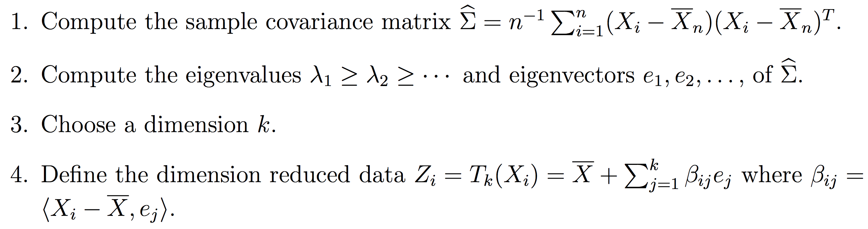
STEP1
STEP2
STEP3
STEP4
PCA(Principle component analysis)：

Slide 39
Design & Implementation
Notes:
Rule-based Notification Module is for emergency notification.

Slide 40
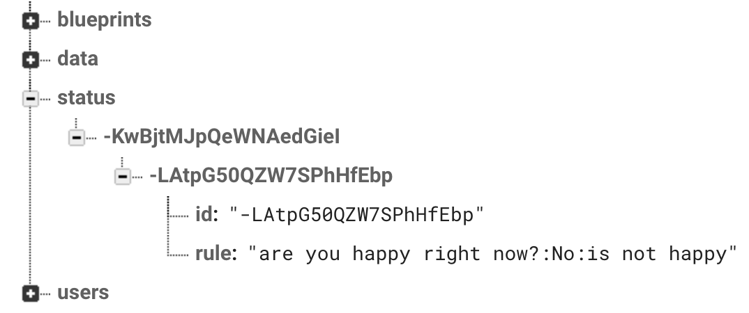
Rule-based Monitor
NodeJS monitor is using firebase Admin SDK to fetch data and monitor the new data coming in. It is a rule based system. When a new rule has been created. The data structure has been saved as the picture below(under status)
Notes:
Rule-based Notification Module is for emergency notification.
Rule-based Notification Module is an independent background process running on the server side.
It is used to read each new data that appears in the database under status and adds a new monitoring process based on the new data under the status object.

Slide 41
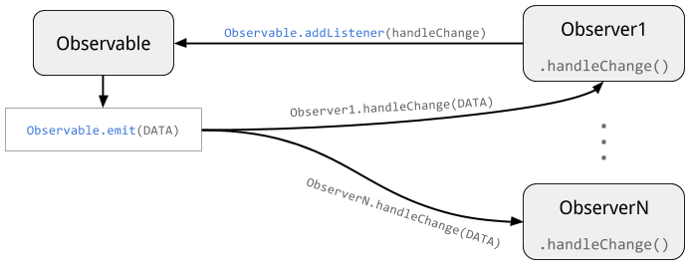
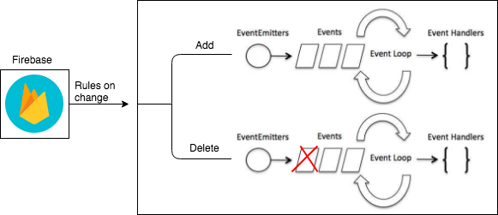
Rule-based Notification Module
Notification Event:
Add event to listen a new rule, send notification email
Remove event to remove one listening rule
Notes:
After the data in the database changes, the process gets changed data. Parsed this piece of data, the data obtained has the index of this rule and the survey information. The name of this listener event is determined using a combination of the name of the survey and the index to make sure it is unique id.
Each event will only focus on one survey and only one rule. Every event will get the new answer when a user has implemented a similar survey. The event has some rule-based methods to judge whether the answer is meet the rule requirement.
All the data will send to Nools rule engine, and only if it met the rule, the message would submit to the administrator. The mail is sent by Nodejs library: Nodemailer. Email sent based on the protocol. The content of the email contains the person who provided the answer, the answer details, and the preset notification content.

Slide 42
Outline
Introduction
Related Work
Data Overview
Design & Implementation
Results
Conclusion
Notes:
Finally, we will see the result of the SAMS system.

Slide 43
Results
demo

Slide 44
Results
Metrics | Paper-Based Logging | SAMS
Convenience |  | 
Reliability |  | 
Speed | Slow | Fast
Security |  | 
Automated |  | 
Real-Time Data |  | 
Advanced Analysis |  | 
Real-time data monitor |  | 

Slide 45
Outline
Introduction
Related Work
Data Overview
Design & Implementation
Results
Conclusion & Future Work

Slide 46
Conclusion
Data collection verification and management
Reliable Restful server for the whole app
Support three clustering methods to analysis data
Notification for administrator
Chart Visualization and data table give insights to data

Slide 47
Future Work
More Methods and charts can be selected based on user preference
Support visualization and management based on each user in the study
Query data at the database server.

Slide 48

Thank You!
Questions?

