Slide 1
APPLICATION OF DEEP LEARNING TO FISH RECOGNITION
Master’s Project Defense
By: Fuming Xiang
Advisor: Dr. Yi Shang
Notes:
Good afternoon and thanks for attending my project defense
My name is Fuming Xiang, advised by Dr. Yi Shang.
welcome Dr. Duan and Dr. Chadha to be my committee member
welcome joel from Missouri Department of Conservation
my project is Application of deep learning to fish recognition

Slide 2
Roadmap
Introduction
Related Works
Design and Implementation
Experiment Results
Conclusion and Future Work
Notes:
In slides, I would like to give a presentation including the brief introduction, the related works, how I designed and implemented the pipelines, what is the result of those pipelines, and give a conclusion and future work

Slide 3
Roadmap
Introduction
Background
Motivation
Dataset Overview
Solution
Related Works
Design and Implementation
Experiment Results
Conclusion and Future Work
Notes:
So first of all, I will introduce the project,to give a brief background introduction, and the motivation of the project
Then I will show the dataset I used in the development
Finally talk about the solution proposed in this project

Slide 4
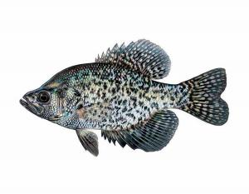
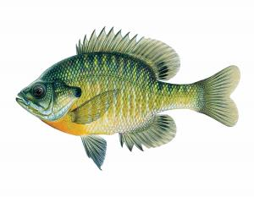
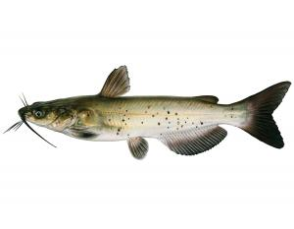
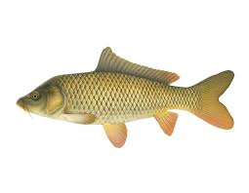
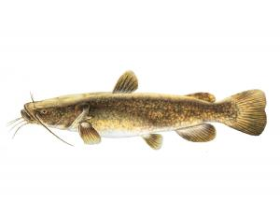
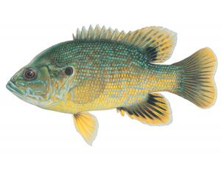
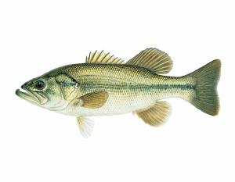
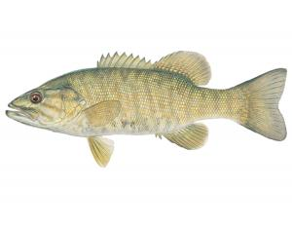
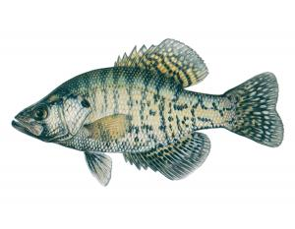
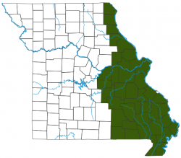
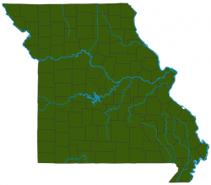
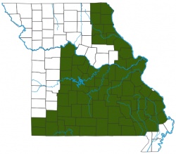
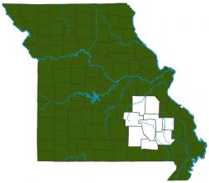
Introduction
Background
Missouri Department of Conservation (MDC) Project
9 species of fish in Missouri River
Goal: Classify fish specie
Input: RGB image(s), output: class of fish
 | Black Crappie | Bluegill | Channel Catfish | Common Crap | Flathead Catfish | Green Sunfish | Largemouth Bass | Smallmouth Bass | White Crappie
Image
Dist
Data source: Missouri Department of Conservation official website
Notes:
The project is proposed by missouri department of conservation.
And the primary task of this project is aiming to classify 9 different species of fish in missouri river.
The classification task is taking a or a batch of RGB images, and return the species or the probability of fish species.
the figure shows the 9 different types of fish and their distributions in Missouri

Slide 5
Introduction
Motivation
Manually counting and classifying fish in images on huge amount of data are time consuming.
Computer works 7-24 with extremely high efficiency.
Image classification on CNN has higher accuracy than human eye recognition in some cases.
Notes:
counting and classifying fish in image manually is a huge amount of work and time consuming.
So our goal is to make the manual process automation by computer program.
Since the Convolutional neural network performs better and better, and for now, the CNN in some case could get higher accuracy than human recognition.

Slide 6
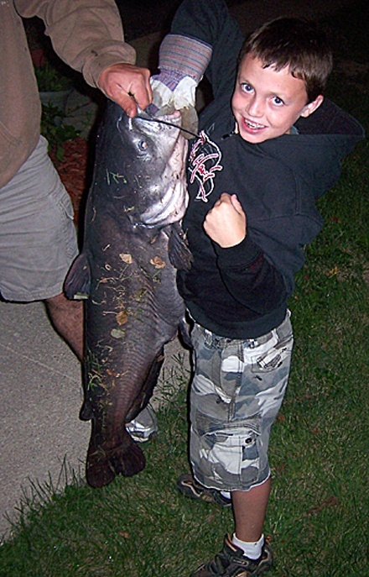
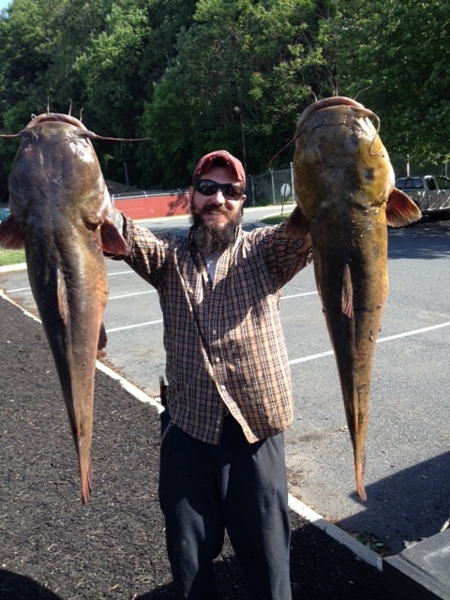
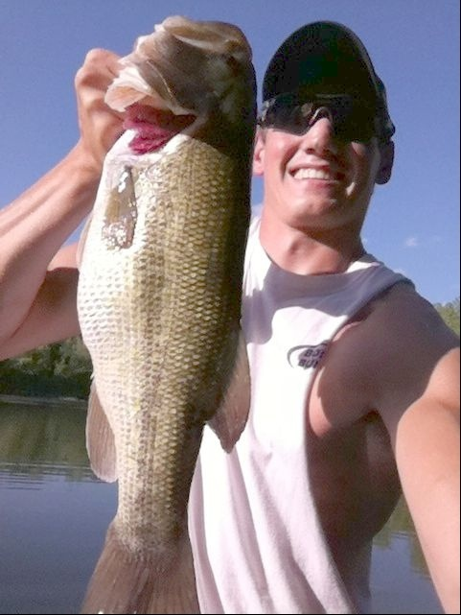
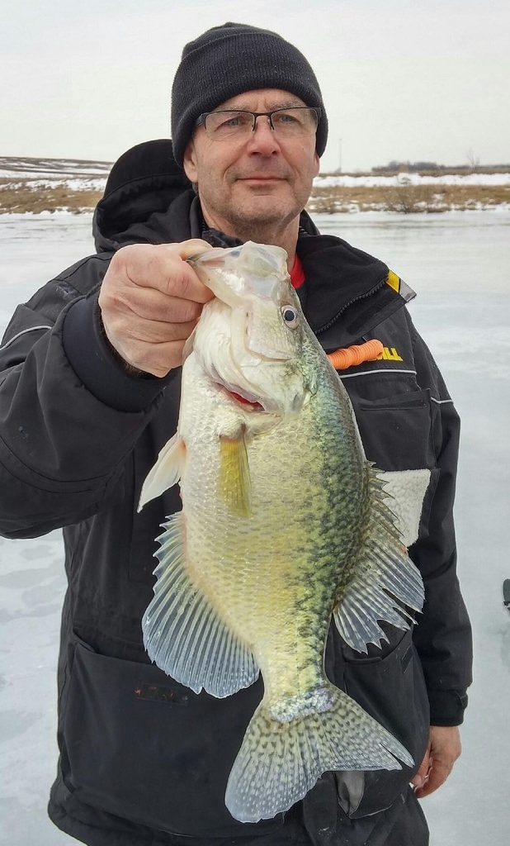
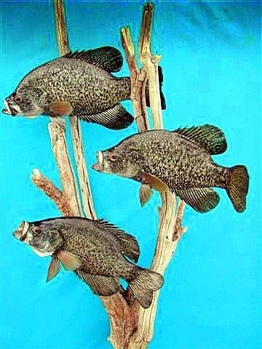
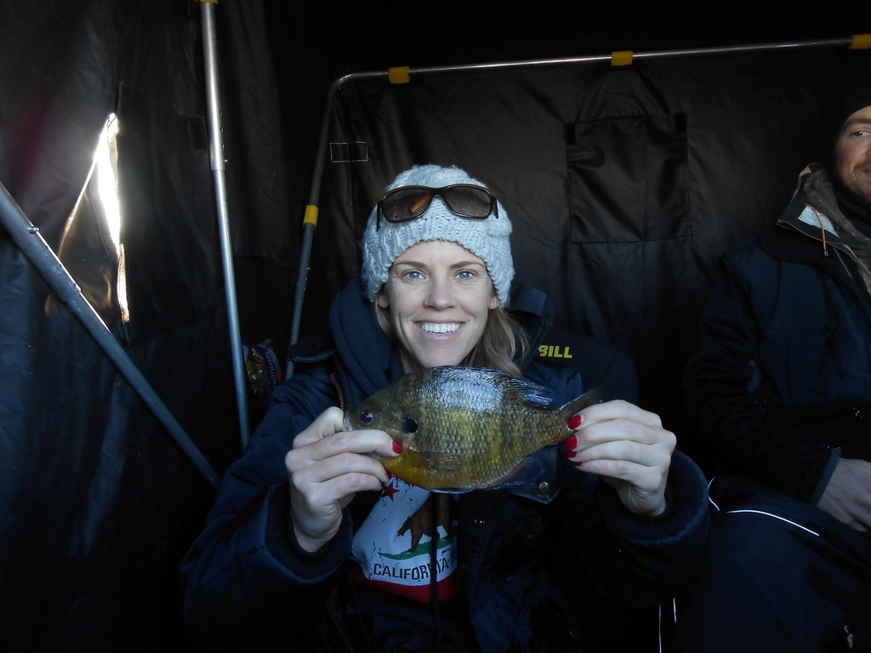
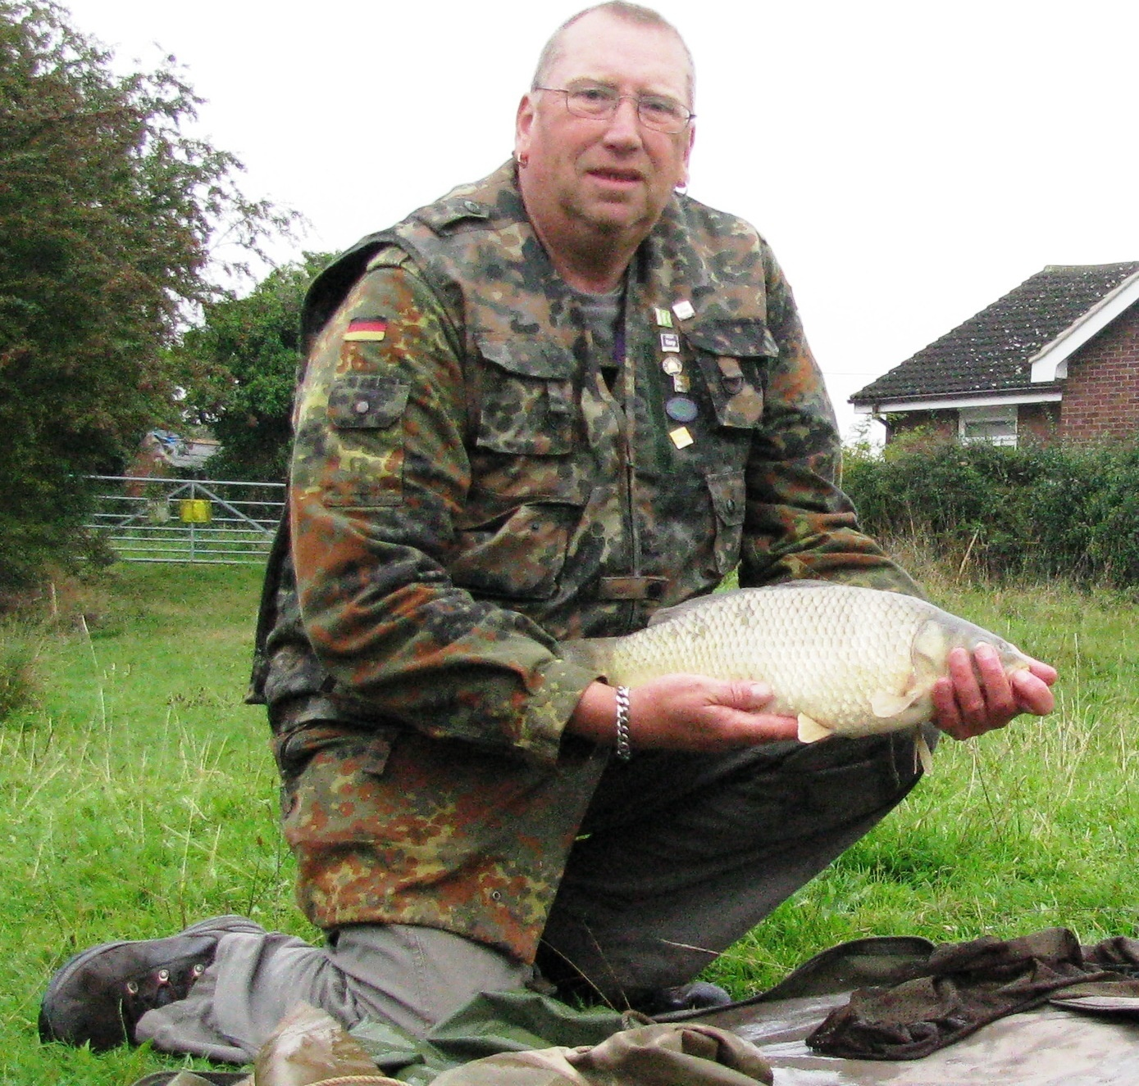
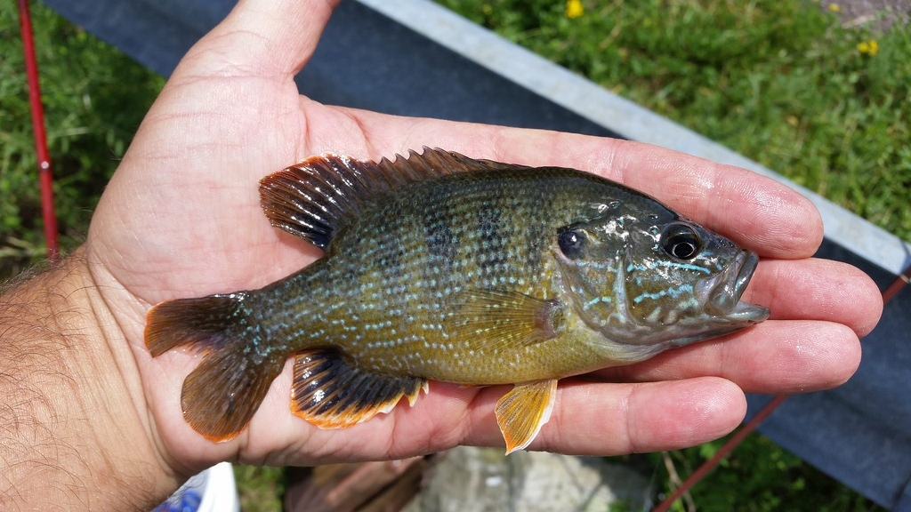
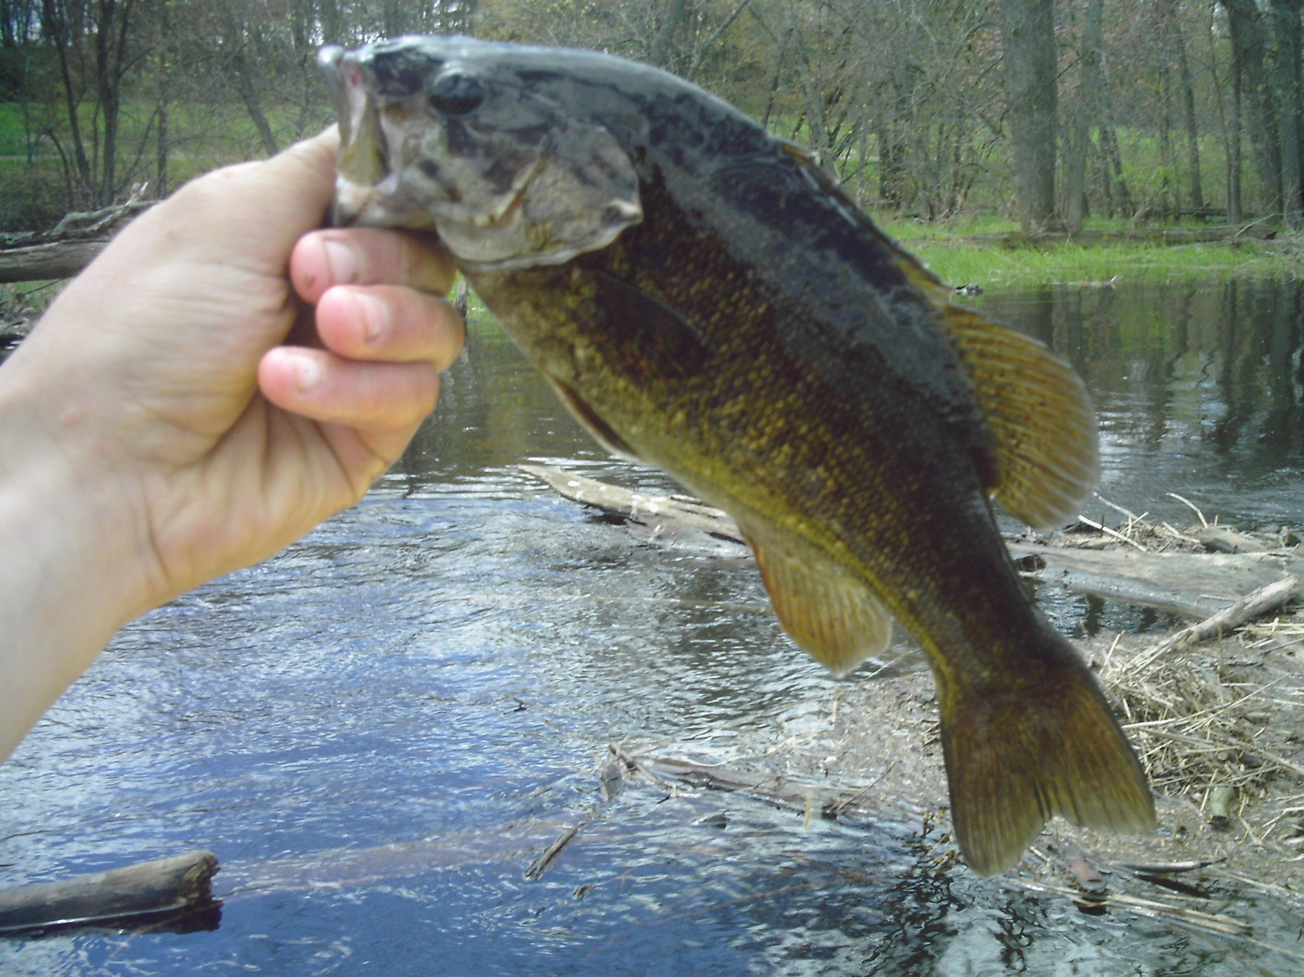
Introduction
Dataset Overview
Abbreviation | BCP | BLG | CCF | CMC | FCF | GSF | LMB | SMB | WCP
Fish (9) | Black Crappie | Bluegill | Channel Catfish | Common Crappie | Flathead Catfish | Green Sunfish | Largemouth Bass | Smallmouth Bass | White Crappie
Images (4842) | 538 | 680 | 606 | 418 | 413 | 574 | 888 | 557 | 168
Data source: image-net.org
Notes:
Those are the data I used in this project.
The data is coming from ImageNet, which is a large image dataset with categorical labels
In the dataset, there are 4t and 8h images distributing in 9 classes
and each image may contain several fish, but only one species.

Slide 7
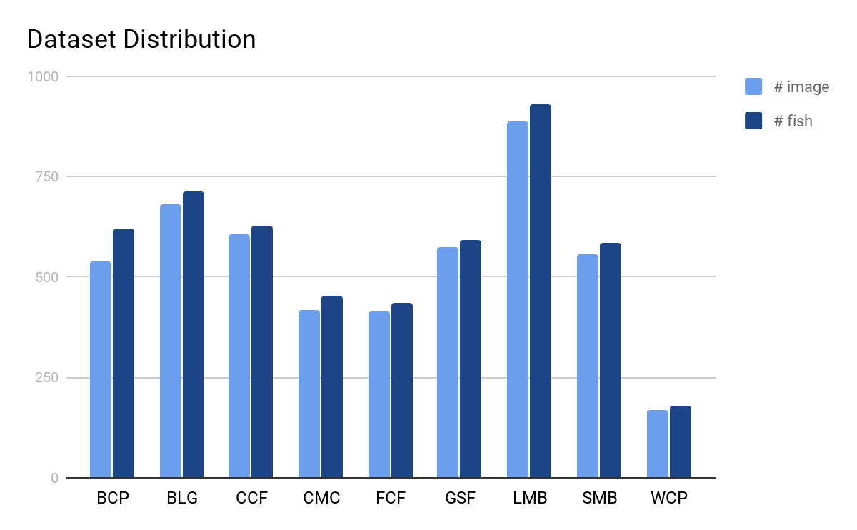
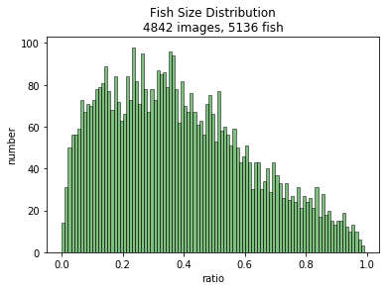
Introduction
Dataset Distribution
Fish ratio = (box area per fish) / (image area)
Data source: image-net.org
Notes:
here is the distribution of dataset
Among the whole dataset, most of the image contain 1 fish
In order to visualize the size of fish, we define the ratio by using this formula
the ratio equals to the labeled box area of fish, divided by the image area in pixel measurement

Slide 8
Introduction
Two Proposed Solutions
Image Classification on CNN
Instance Classification on CNN
Detection, Rotation, Classification, Ensemble model.
Contributions
Come up with fish instance classification pipeline
Find the position, specie of fish as a system
Achieve 87.22% accuracy for classification
Notes:
based on the requirement and dataset, two different proposed solution are used in the project
Image classification and Instance classification.
and in the instance classification, I tried to use some method to improve the accuracy.
At the end of this project, we could build the complete pipeline as a system to do the detection, classification at the same time.
and finally reach 87.22% accuracy

Slide 9
Roadmap
Introduction
Related Works
Image Classification on Convolutional Neural Network
Design and Implementation
Experiment Results
Conclusion and Future Work
Notes:
Next, the most related work is image classification on convolutional neural network.

Slide 10
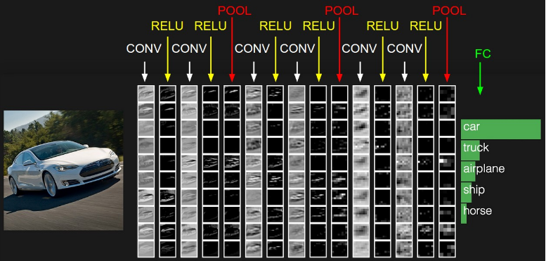
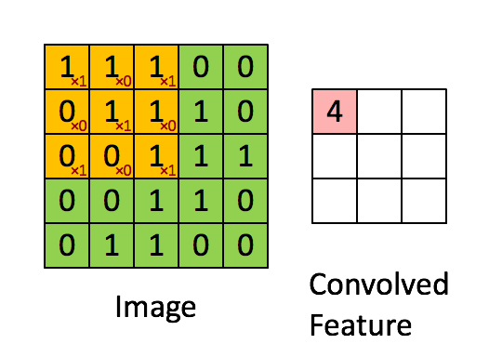
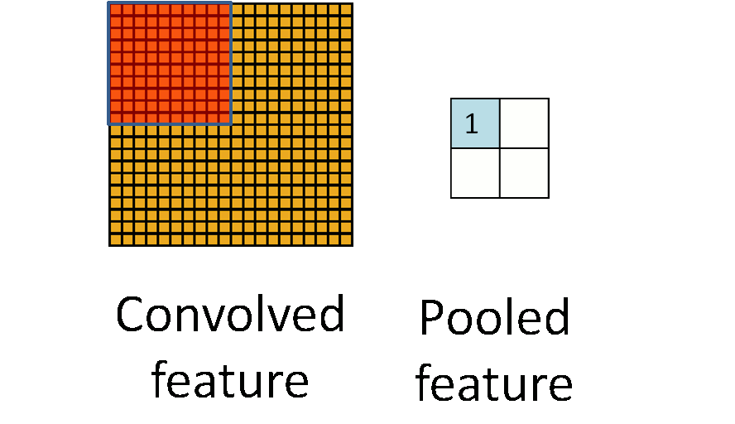
Related Works
Image Classification on CNN
Combination of different layers:
Convolution Layer
Activation Layer
Pooling Layer(max, avg. etc.)
Fully Connected Layer, etc.
Notes:
convolutional neural network is typically the combination of convolution, activation, pooling, and fully connected layers.
In convolutional Neural network, the input is an image, and usually,
pixel values in image would be calculated by convolution first, with a kernel moving to extract the feature, and then use the activation and polling layer. Finally, one or more fully connected layer is added to get the classification result

Slide 11
Related Works
Different Machine Learning model would be used for pipelines
VGG 16
ResNet 50
SSD Caffe
Notes:
In this project, different model would be used for the pipelines
SSD caffe, VGG 16, ResNet 50

Slide 12
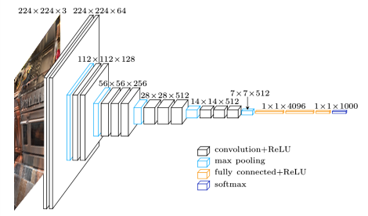
Related Works
Different Machine Learning model would be used for pipelines
VGG 16
ResNet 50
SSD Caffe
K. Simonyan and A. Zisserman. Very deep convolutional networks for large-scale image recognition. In ICLR, 2015
Notes:
VGG has 5 conv block, which including 2 or 3 conv layer with a max pooling, and 3 fully connected layer.

Slide 13
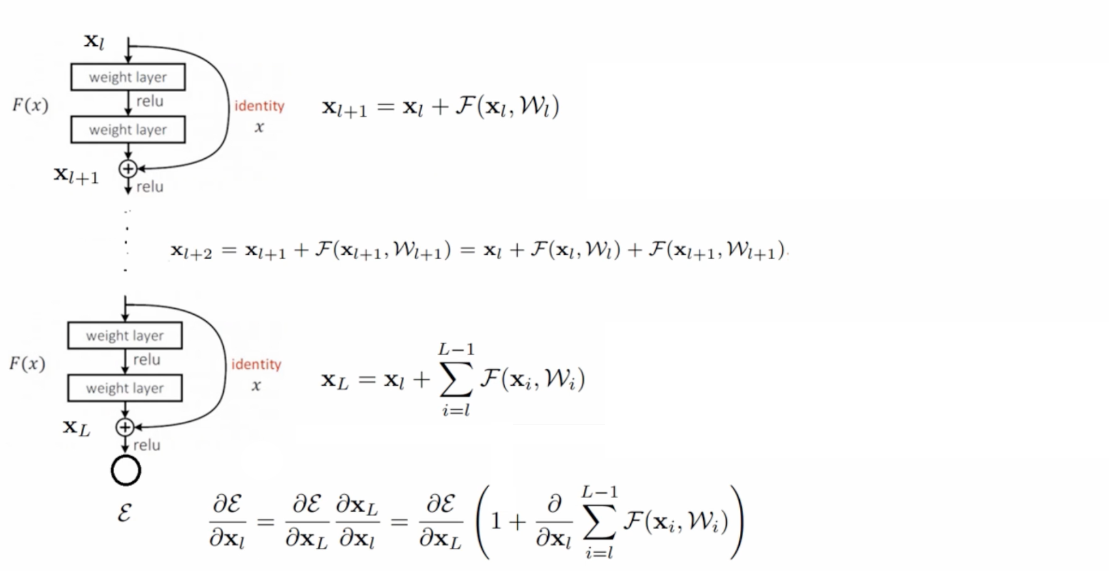
Related Works
Different Machine Learning model would be used for pipelines
VGG 16
ResNet 50
SSD Caffe
Avoid gradient diffusion
He, Kaiming, et al. "Deep residual learning for image recognition." Proceedings of the IEEE conference on computer vision and pattern recognition. 2016.
Notes:
ResNet is a basic Convolutional nn but in each block, they add a identity function, which is just a copy of the input, and add the fx to x as the output.
when we calculate the derivative, the deeper net would avoid gradient diffusion in BP

Slide 14
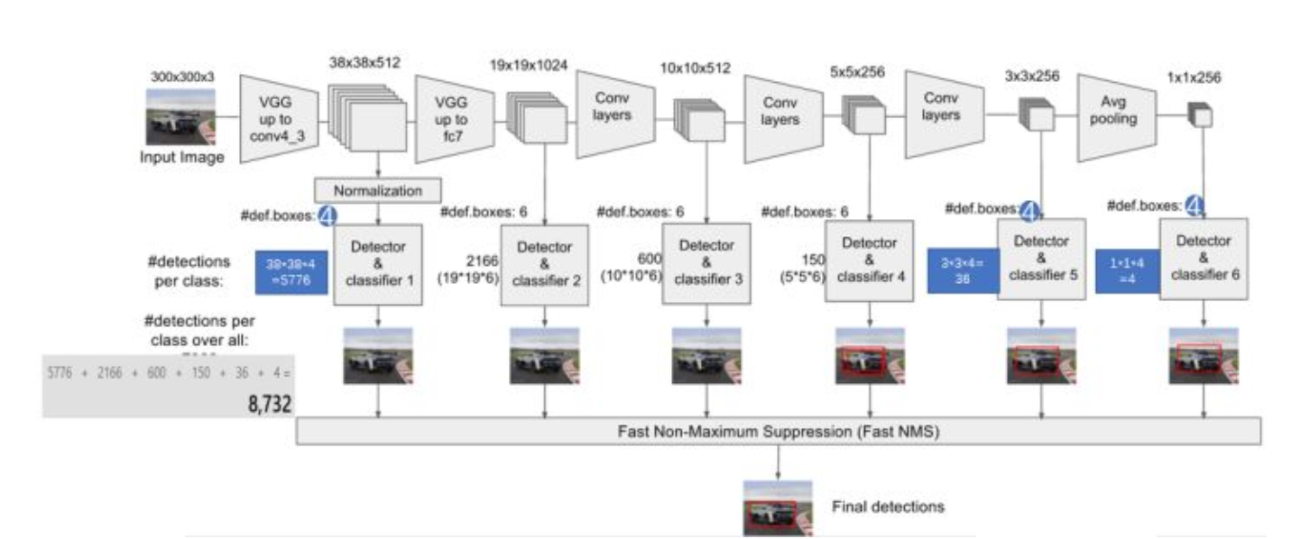
Related Works
Different Machine Learning model would be used for pipelines
VGG 16
ResNet 50
SSD Caffe
Liu, Wei, et al. "Ssd: Single shot multibox detector." European conference on computer vision. Springer, Cham, 2016.
Notes:
SSD caffe is designed by Liu Wei, the input of this network require the image and the coordinate of object bounding box.
SSD is designed with a basic VGG net and modified last 2 layer to conv layers, and adding extra 4 conv layers to extract different feature.

Slide 15
Roadmap
Introduction
Related Works
Design and Implementation
Pipelines Design
Data preprocessing and dataset generating
Evaluation Metric
Training and Testing
Experiment Results
Conclusion and Future Work
Notes:
The next part is the design and implementation of the project.
In this part, I will go through the process that how I design the pipeline
preprocess and generate dataset
How we measure the performance
and what are the results of training and testing phase.

Slide 16
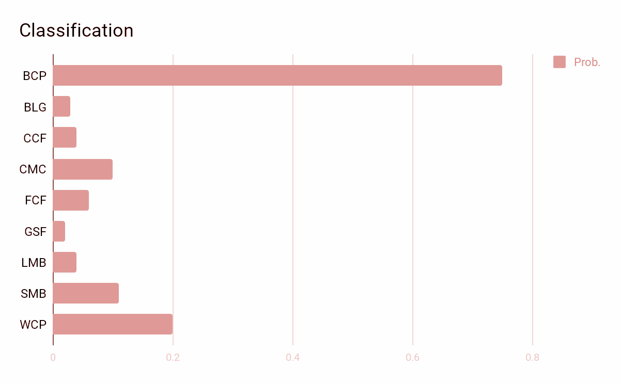
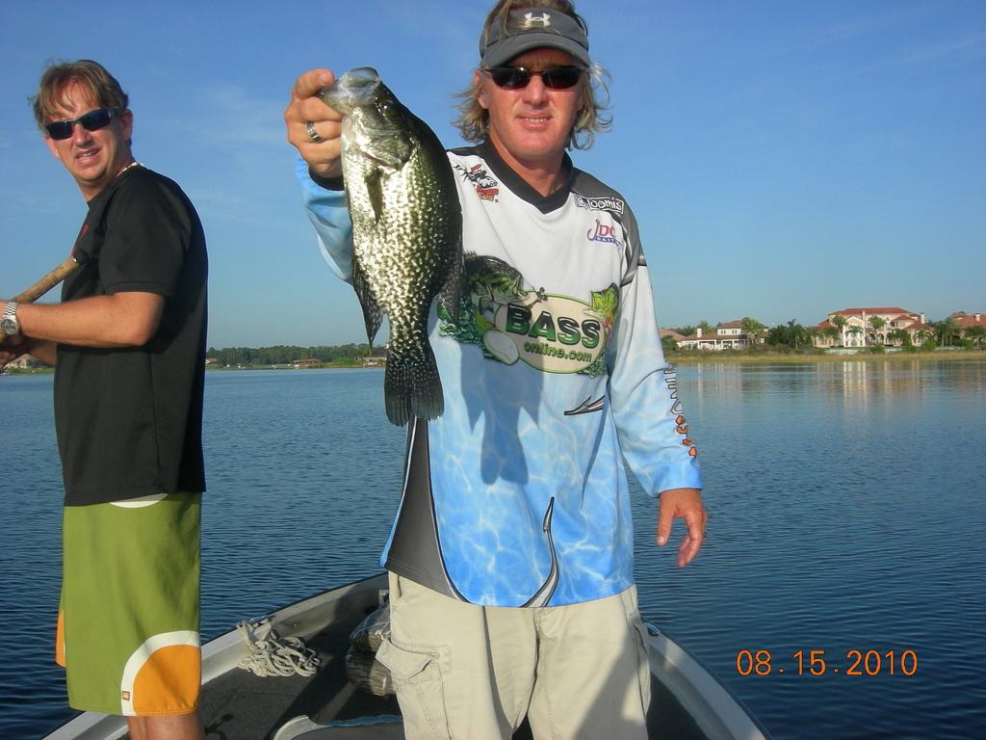
Pipeline Design
Image Pipeline
VGG16
Classifier
Pipeline Design
Notes:
Simply, in image classification, we just need to resize the image to the same size as the network required, train it, monitoring it by validation dataset. and the network would give a softmax result.
but, in our project, like we saw in data overview part, the fish in image is small, mostly smaller that half of the image size, which means, in the image, there are plenty of useless information, which would influence the performance of classification

Slide 17
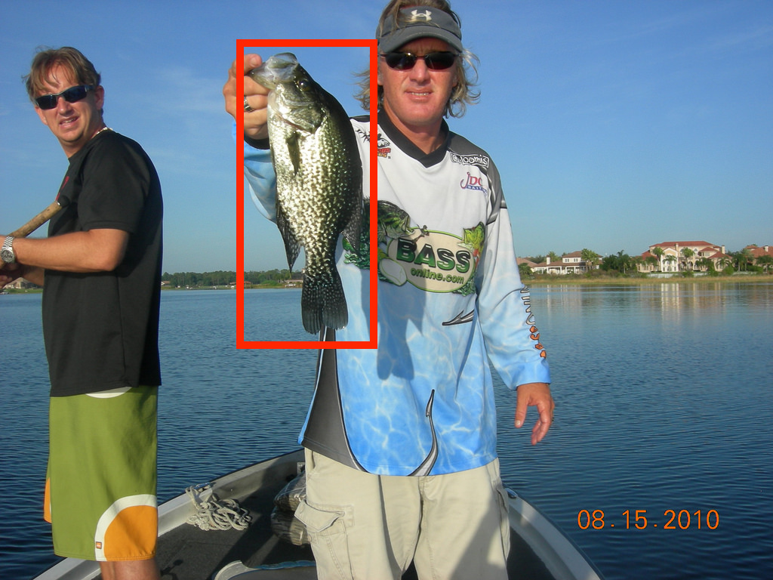
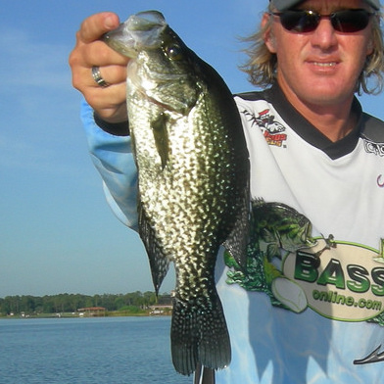
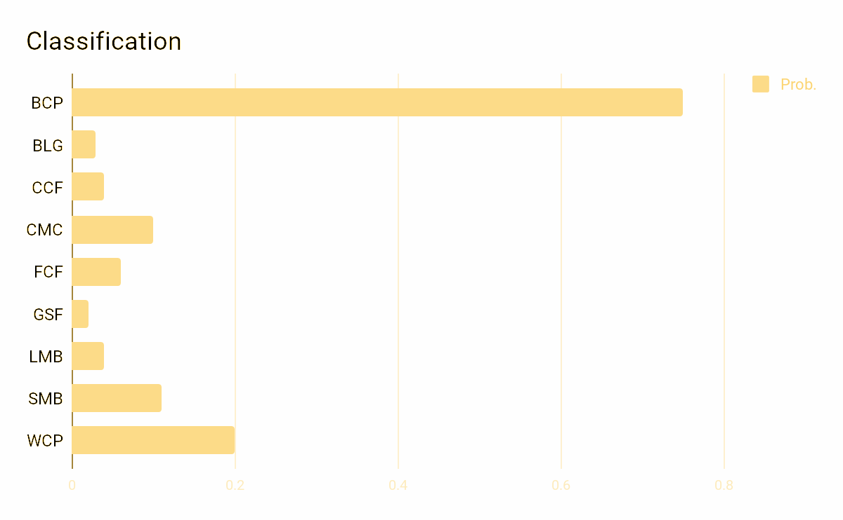
Pipeline Design
Image Pipeline
VGG16
Classifier
Instance Pipeline
SSD Caffe
Detector
padding
crop
VGG16
Classifier
Pipeline Design
Notes:
thus, in order to avoid it, fish detection is necessary,
in this pipeline, detection would output the box position of fish, and we do the padding to avoid distortion and crop it
using the cropped images as the input to do the classification staff.

Slide 18
Pipeline Design
Image Pipeline
VGG16
Classifier
Instance Pipeline
SSD Caffe
Detector
padding
crop
VGG16
Classifier
Pipeline Design
Notes:
but we still have useless information, fish is assigned to different orientation.

Slide 19
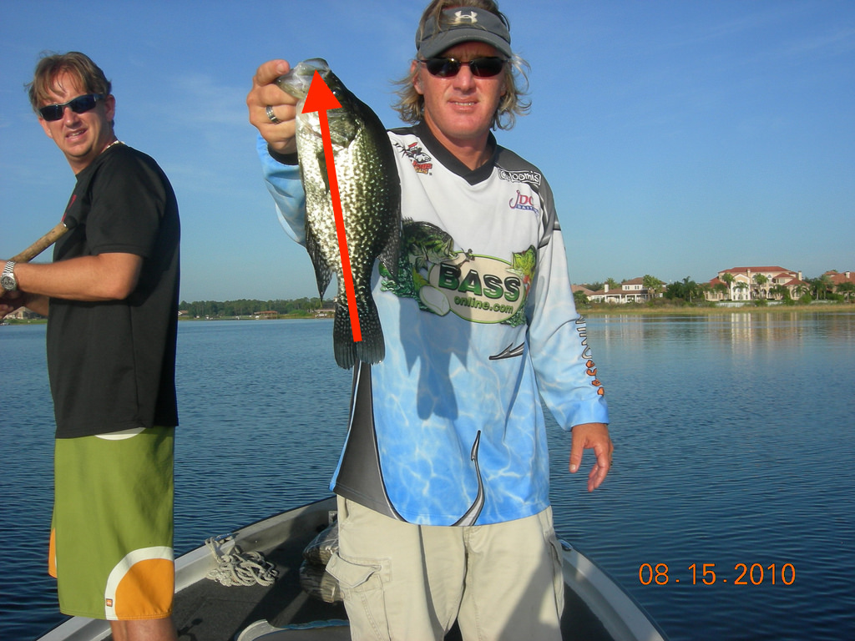
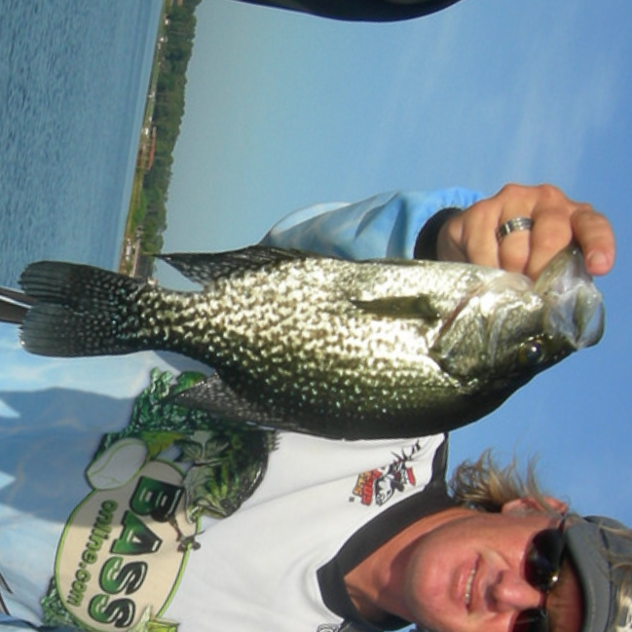
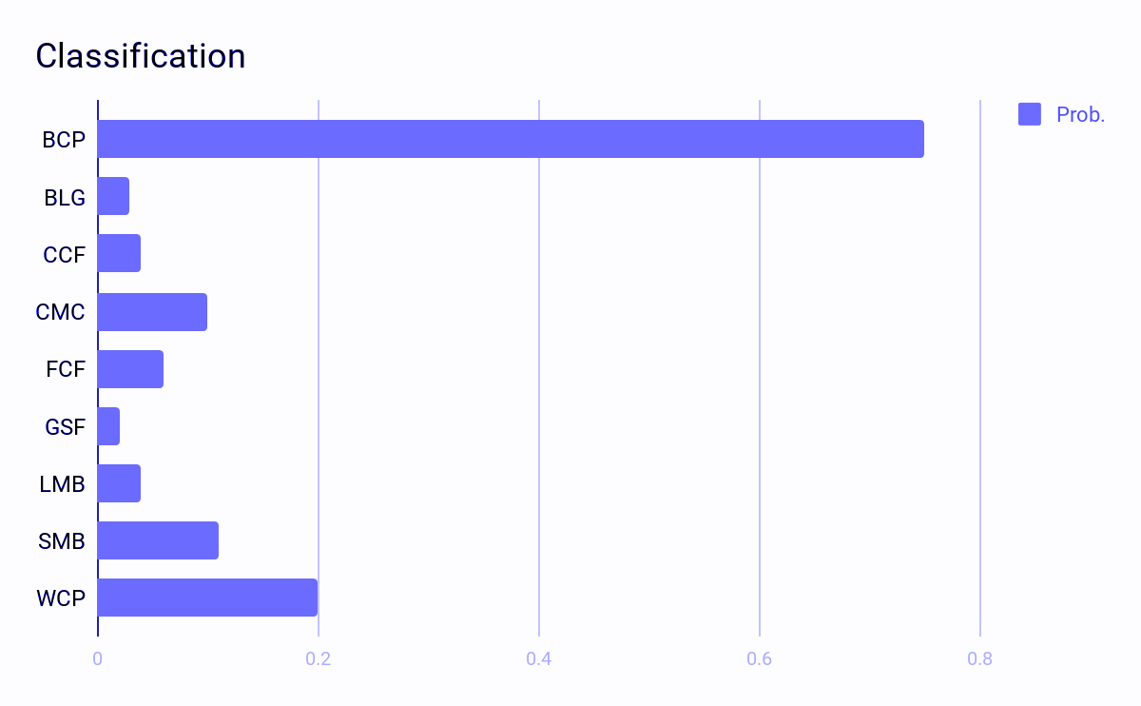
Pipeline Design
Image Pipeline
Instance Rotation Pipeline
VGG16
Classifier
Instance Pipeline
SSD Caffe
Detector
padding
crop
VGG16
Classifier
Pipeline Design
SSD Caffe
Detector
VGG16 pose
Estimator
padding
aligned
crop
VGG16
Classifier
Notes:
So , adding a function to rotate the fish helps to remove the orientation information,
and in the third pipeline, we do the detection first, and estimate the pose of fish, then padding, rotating, cropping,
the generated images would be the input data for the final Classifier

Slide 20
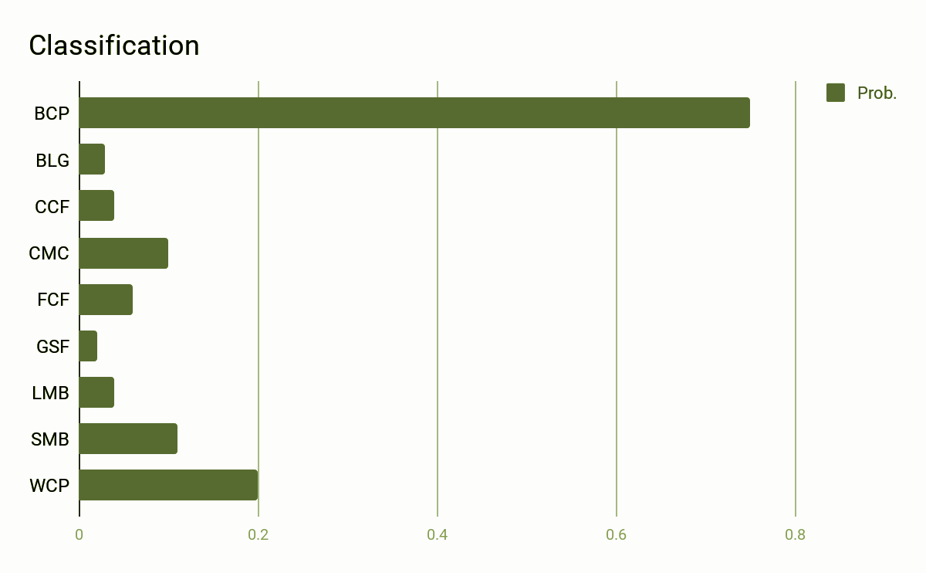
Pipeline Design
Image Pipeline
Instance Rotation Pipeline
VGG16
Classifier
Instance Pipeline
Ensemble Pipeline
SSD Caffe
Detector
padding
crop
VGG16
Classifier
Pipeline Design
SSD Caffe
Detector
VGG16 pose
Estimator
padding
aligned
crop
VGG16
Classifier
Ensemble
Results
ResNet50 Classifier
Notes:
Furthermore, ensemble model is usually used in Kaggle compitation, the result is usually better than using a single model,
So for here, I train another classifier ResNet 50, and take the weighted avg result as the output.

Slide 21
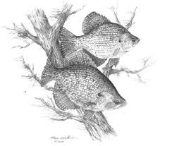
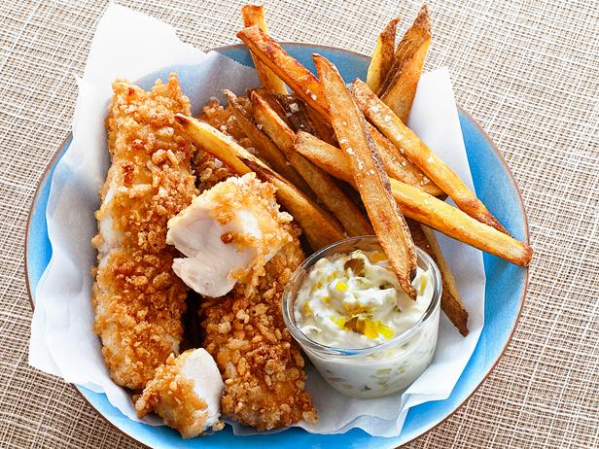
Data Preprocessing
Preprocessing
Grayscale image removal
non-fish or missing-fish image removal
Ambiguity image removal
Notes:
Since the data is downloaded from imageNet by python code, there are severals of images do not meet the requirement, such as the grayscale image, non-fish or missing-fish image
or the ambiguity image including the fake fish.
thus, in data preprocessing phase, we delete those images to clean the whole dataset.

Slide 22
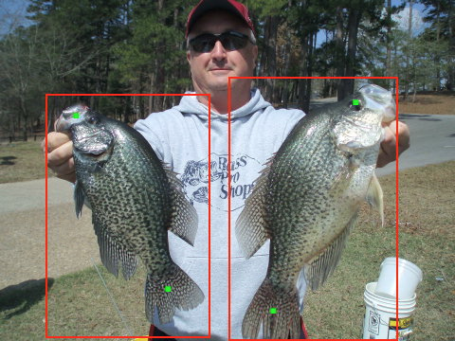
Data Preprocessing
Preprocessing
Grayscale image removal
non-fish or missing-fish image removal
Ambiguity image removal
Labeling
bounding box (Detection & Classification):
left-top (x, y)
width, height
class
· key points (Pose Estimation):
head (x, y)
Tail (x, y)
Notes:
Image net only provide the categorical labels
without any information like the position of fish, or the coordinate of fish eyes and fish tail.
according to the pipeline, I labeled the images in the listed format.
bounding box with left-top coordinate and the width, height of box
key points coordinate such as eyes and tail

Slide 23
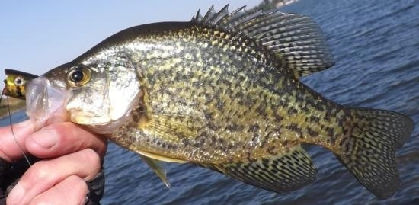
Dataset Generating
Image Classific-ation Classifier Dataset & Detector Dataset | Species | BCP | BLG | CCF | CMC | FCF | GSF | LMB | SMB | WCP | Total
 | train (80%) | 431 | 544 | 485 | 335 | 331 | 460 | 711 | 446 | 135 | 3878
 | val (10%) | 54 | 68 | 61 | 42 | 41 | 57 | 89 | 56 | 17 | 485
 | test (10%) | 53 | 68 | 60 | 41 | 41 | 57 | 88 | 55 | 16 | 479
Notes:
For the Image classification, and Detector, we randomly split the data into 80%for training, 10%for validation, 10% for testing.
Also, the test dataset would be used as the pipeline test dataset to measure the final performance.

Slide 24
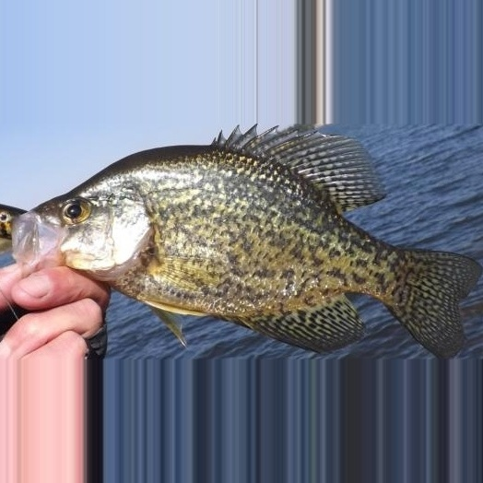
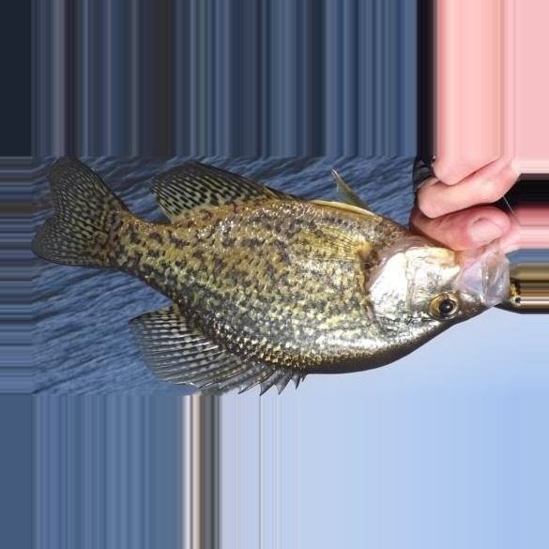
Dataset Generating
Image Classific-ation Classifier Dataset & Detector Dataset | Species | BCP | BLG | CCF | CMC | FCF | GSF | LMB | SMB | WCP | Total
 | train (80%) | 431 | 544 | 485 | 335 | 331 | 460 | 711 | 446 | 135 | 3878
 | val (10%) | 54 | 68 | 61 | 42 | 41 | 57 | 89 | 56 | 17 | 485
 | test (10%) | 53 | 68 | 60 | 41 | 41 | 57 | 88 | 55 | 16 | 479
Crop
Rotate
Padding
Crop
Rotate
Instance Classific-ation Classifier Dataset w/ Aligned or w/o-Aligned | Species | BCP | BLG | CCF | CMC | FCF | GSF | LMB | SMB | WCP | Total
 | train (80%) | 507 | 574 | 507 | 366 | 350 | 474 | 747 | 467 | 144 | 4136
 | val (10%) | 58 | 69 | 61 | 44 | 41 | 59 | 91 | 58 | 18 | 499
 | test (10%) | 56 | 69 | 60 | 44 | 44 | 61 | 92 | 59 | 16 | 501
Notes:
for instance classification, we need cropped and rotated cropped images data from above dataset.
if we generate images first and split twice for two dataset, the testing data in the first dataset maybe in the training data of the second dataset, it would make the accuracy a little bit higher than the actual one
for any image, if the padding fish is out of the border of image or overlap with other fish, we do crop first and padding later to make sure there is only one fish in the cropped image.

Slide 25
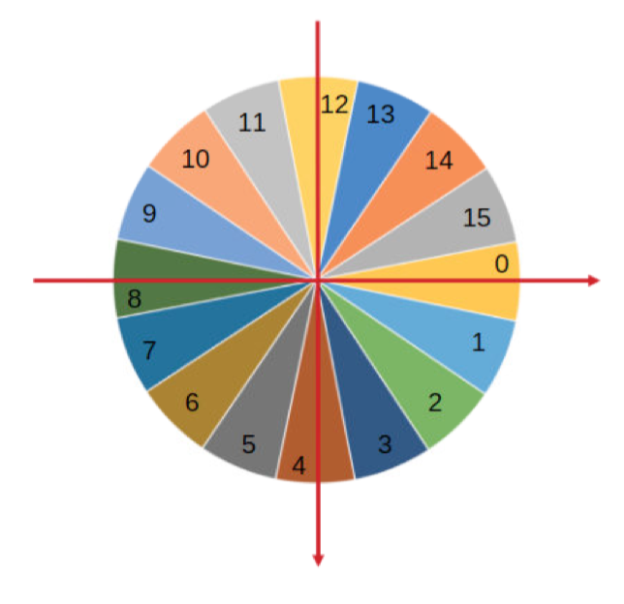
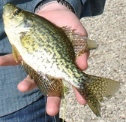
Dataset Generating
22.5º for each sector
16 sectors (16 classes)
Instance Rotation Pipeline Pose Estimator Dataset |  | 0 | 1 | 2 | 3 | 4 | 5 | 6 | 7 | 8 | 9 | 10 | 11 | 12 | 13 | 14 | 15 | Total
 | train | 776 | 508 | 137 | 116 | 817 | 124 | 140 | 528 | 994 | 404 | 122 | 108 | 793 | 106 | 110 | 376 | 6159
 | val | 97 | 63 | 17 | 14 | 102 | 15 | 17 | 66 | 124 | 50 | 15 | 13 | 99 | 13 | 14 | 47 | 766
 | test | 96 | 63 | 17 | 14 | 102 | 15 | 17 | 65 | 124 | 50 | 15 | 13 | 99 | 13 | 13 | 46 | 762
Notes:
For the pose estimation, we assigned the orientations into 16 parts, to calculate which part the fish should be located in, we used the vector calculated by setting the tail as the (0,0) and vector = head -tail
we do Data augmentation, rotation and flipping to expand the dataset

Slide 26
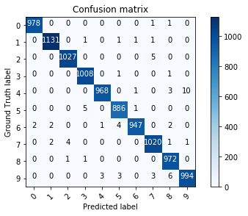
Evaluation Metric
Classification
In Confusion Matrix:
Notes:
Here comes the Evaluation Mertric
In Classification problem, accuracy is the number of correct predictions divided by the total number of predictions
usually, we use a confusion matrix to show the relationship of the true labels and predicted results
In the confusion matrix, diagonal is the what we predicted correctly.
And the accuracy could be calculated easily, which is the trace of the matrix divided by the sum of the matrix

Slide 27
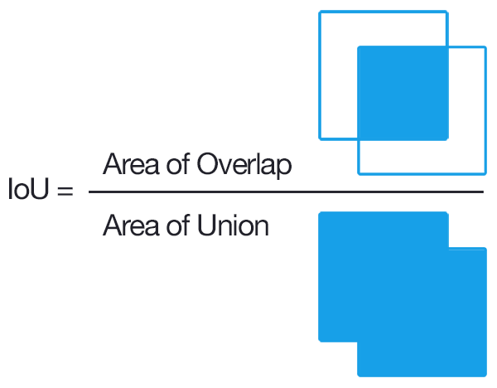
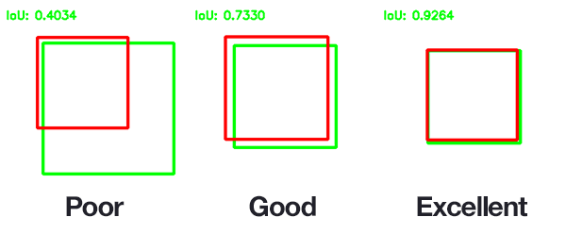
Evaluation Metric
Object Detection
Our IoU Threshold: 0.5
Notes:
for the object detection problem, we need to know whether the predicted box matches with the label box
we use intersection over union to measure it, overlapping area divided by the union area. in our project ,we set the iou threshold to 0.5.

Slide 28
Evaluation Metric
Object Detection
Notes:
given a confidence threshold, we would have a matrix shows the predicted result, with true false, positive and negative.
we used precision and recall to measure the accuracy of the model.
Precision is the correct prediction divided by total prediction
Recall is the correct prediction divided by total target instance

Slide 29
Evaluation Metric
Pose Estimation
Accuracy 0
Accuracy 1
In Numpy:
Notes:
Pose estimation is a typical classification problem, similarly use trace divided by sum of the matrix to get an accuracy.
However, we allow another accuracy with offsetting, which means if the gt is 14, the pred is 13 or 15 is also fine.
and this accuracy could be calculated by the following numpy code.

Slide 30
Image Pipeline
Image Pipeline
Input
Classification
VGG16
VGG16:
Load ImageNet Pretrained Model
Add Dense(9)
Train last two layers
Conv block + ReLU + Max pooling
Conv block + ReLU + Max pooling
Only train last two layer
Fully connected + ReLU
Cross-entropy loss:
Fully connected + ReLU (softmax output 9)
Notes:
here comes the training and testing phase
first, in image level classification, we load the imagenet pretrained model and weight, then add fully connected layer with output 9. train last two layers.
use cross-entropy as the loss function.

Slide 31
Image Pipeline
input | lr | # epoch | time / epoch | total time | last update epoch | loss | val_loss | val_Acc
3,224,224 | 1e-4 : 1e-10 | 56 | 39 s | 36 min 24 s | 25 | 0.1155 | 0.9666 | 0.77
Image Pipeline
Input
Classification
VGG16
Notes:
In keras, the training takes 3 minutes
stop at 56 epoch, 30 epochs without any val_loss decrease.

Slide 32
Image Pipeline
input | lr | # epoch | time / epoch | total time | last update epoch | loss | val_loss | val_Acc
3,224,224 | 1e-4 : 1e-10 | 56 | 39 s | 36 min 24 s | 25 | 0.1155 | 0.9666 | 0.77
Image Pipeline
Input
Classification
VGG16
Notes:
with the confusion matrix,
we could calculate the acc by the formula, accuracy is the correct classified number divided by the number of samples. which is the trace of matrix divided by the sum of matrix
the val_acc is 0.77

Slide 33
Instance Pipeline
Instance Pipeline
input | # Iteration | time / iteration | total time | final loss | Avg Precision
(512, 512, 3) | 20,000 | 2 s | 12 hours | 1.28 | 0.9275
Input
Where:
N is the number of matched box with gt_box
Detection
SSD Caffe
Crop
Classification
VGG16
Notes:
in the second pipeline, we need to train two component, the detector and classifier.
For the detector, we use 512*512 as the input size.
loss is calculated by adding the loss of confidence and loss of bounding box location, and divided by the number of matched box with ground truth.
the final loss is 1.28.
for different confidence threshold, we can calculate the precision and recall, and the PR curve shows here.
in the test dataset, we have the avg. precision with 92%

Slide 34
Instance Pipeline
Instance Pipeline
input | # epoch | time / epoch | total time | last update epoch | loss | val_loss | val_Acc
(3,224,224) | 114 | 37 s | 1 h 10 m 18 s | 83 | 0.3386 | 0.4751 | 0.8236
Input
Detection
SSD Caffe
Crop
Classification
VGG16
Notes:
Netx part, the Instance classifier without rotation.
Similar to the image classification, the different is training data, which is the cropped image without rotation.
after training1 hours 10 minutes
it stops at 114 epoches the val loss of 0.3386

Slide 35
Instance Pipeline
Instance Pipeline
Input
Detection
SSD Caffe
Crop
Classification
VGG16
Notes:
compared to the image classification, the
validation accuracy improves from 77% to 82%
Test accuracy 75.57% to 80.64%

Slide 36
Instance Rotation Pipeline
Instance Rotation Pipeline
input | # epoch | time / epoch | total time | last update epoch | loss | val_loss | val_Acc
3,224,224 | 53 | 54 s | 47 min 42 s | 23 | 0.2951 | 0.2944 | 0.9138
Input
Detection
Pose Estimate
Align
Crop
Classification
Notes:
In the instance rotation pipeline, which is the detection, rotation, and classification,
in training phase, we need to train the pose estimator and classifier.
Similar to classify the fish, I load the pre-trained weight, and add a fully connected layer with the output 16, and train them.
after training 47 minutes, the final val loss 0.29,

Slide 37
Instance Rotation Pipeline
Instance Rotation Pipeline
Input
Detection
Pose Estimate
Align
Crop
Classification
Notes:
so there are two calculation method, for the typical classification, the acc is 91%, and by using the second method, the acc is nearly 100%

Slide 38
Instance Rotation Pipeline
Instance Rotation Pipeline
input | # epoch | time / epoch | total time | last update epoch | loss | val_loss | val_Acc
3,224,224 | 126 | 40 s | 1h 24 m | 96 | 0.1039 | 0.3305 | 0.8938
Input
Detection
Pose Estimate
Align
Crop
Classification
Notes:
For the classifier trained with the rotation instance images on VGG16, the training phase stop at epoch 96
after training 1 hour and 24 minutes
with the val_loss 0.33

Slide 39
Instance Rotation Pipeline
Instance Rotation Pipeline
Input
Detection
Pose Estimate
Align
Crop
Classification
Notes:
and by looking at the cm, we get that, the val acc increase from 82% to 89%
Test -> 80.64% to 83.83

Slide 40
Ensemble Pipeline
VGG16
Ensemble Pipeline
ResNet50
Ensemble
Result
Input
Detection
Pose Estimate
Align
Crop
Classification
input | # epoch | time / epoch | total time | last update epoch | loss | val_loss | val_Acc
3,224,224 | 98 | 46 s | 1h 15 m 8 s | 68 | 0.1912 | 0.27 | 0.8717
Notes:
the last pipeline, model ensemble method, in this pipeline, we use the same detector, same pose estimator, but different CNN model.
ResNet 50.
load weight, add layer,
after training 1 hours and 15 minutes
it stops at epoch 68 with val loss 0.27

Slide 41
Ensemble Pipeline
VGG16
Ensemble Pipeline
ResNet50
Ensemble
Result
Input
Detection
Pose Estimate
Align
Crop
Classification
Notes:
and the val acc is 87%, higher that the VGG16 w/o rotation
VAL 0.8717
test 0.8683

Slide 42
Ensemble Pipeline
VGG16
Ensemble Pipeline
ResNet50
Ensemble
Result
Input
Detection
Pose Estimate
Align
Crop
Classification
Max Accuracy = 0.9098
VGG16 Ratio = 0.501
Notes:
In order to ensemble the model, the output result of VGG and ResNet is summed with weight.
the figure shows that when the VGG takes 50.1% and ResNet takes 49.9, the val acc reach highest point with the value of 90.1%

Slide 43
Ensemble Pipeline
VGG16
Instance Level: (Aligned)
ResNet50
Ensemble
Result
Input
Detection
Pose Estimate
Align
Crop
Classification
Notes:
For the ensemble pipeline
Validation 89.38% to 90.98%
Test 83.83% to 88.02%

Slide 44
Roadmap
Introduction
Related Works
Design and Implementation
Experiment Results
Conclusion and Future Work
Notes:
then, i will give some exp result of the comparison of different classifier on different cleaned data
and the pipeline acc on test dataset

Slide 45
Experiment Results
Notes:
Here shows the val acc and test acc result on different combination of input-image type and the classifier.
only consider the classifier, without any preprocessing, the ensemble method performance best both on val and test.

Slide 46
Image Pipeline Test Result
# of Test Image | # of fish | # of detected ‘fish’ | tp in detection | correct classification | Accuracy correct classification / # fish
479 | - | - | - | 362 | 75.57 %
Bad cases:
label: BLG pred: GSF
label: WCP pred: BCP
Notes:
Image Pipeline has 0.7557 acc on test dataset, with 362 images correctly predicted amoung 479 images.
here are some bad cases

Slide 47
Instance Pipeline Test Result
# of Test Image | # of fish | # of detected ‘fish’ | tp in detection | correct classification | Accuracy correct classification / # fish
479 | 501 | 500 | 494 | 401 | 80.03 %
Bad case:
label: GSF pred: BLG
Notes:
Instance Pipeline has 0.8004 acc on test dataset, with 401 images correctly predicted amoung 501 fish.
here are some bad cases

Slide 48
Instance Rotation Pipeline Test Result
# of Test Image | # of fish | # of detected ‘fish’ | tp in detection | correct classification | Accuracy correct classification / # fish
479 | 501 | 500 | 494 | 415 | 82.83 %
Bad case:
label: LMB pred: SMB
Notes:
Instance Rotation Pipeline has 0.8283 acc on test dataset, with 415 images correctly predicted amoung 501 fish.
here are some bad cases

Slide 49
Ensemble Pipeline Test Result
# of Test Image | # of fish | # of detected ‘fish’ | tp in detection | correct classification | Accuracy correct classification / # fish
479 | 501 | 500 | 494 | 437 | 87.22 %
Bad cases:
label: GSF pred: BLG
Notes:
Ensemble Pipeline has 0.8723 acc on test dataset, with 437 images correctly predicted amoung 501 fish.
here are some bad cases

Slide 50
Experiment Results
Pipeline Test Results
 |  | # of Test Image | # of fish | # of detected ‘fish’ | tp in detection | correct classification | Accuracy correct classification / # fish | Time (s) | Image/s
Classification |  | 479 | - | - | - | 362 | 75.57 % | 13.16 | 36.4
Detection Classification |  | 479 | 501 | 500 | 494 | 401 | 80.03 % | 53.16 | 9
Detection Rotation Classification | VGG16 | 479 | 501 | 500 | 494 | 415 | 82.83 % | 132.15 | 3.6
 | ResNet50 | 479 | 501 | 500 | 494 | 428 | 85.43 % | 138.02 | 3.5
 | Ensemble | 479 | 501 | 500 | 494 | 437 | 87.22 % | 140.58 | 3.4
Notes:
For the whole pipeline test phase, we have 479 images containing 501 fish.
Ensemble Pipeline gets highest test accuracy, but takes logest time, nearly 2 and half minutes.

Slide 51
Experiment Results

Slide 52
Roadmap
Introduction
Related Works
Design and Implementation
Experiment Results
Conclusion and Future Work
Notes:
Conclusion and Future work

Slide 53
Conclusion
Purified images (aligned instance) would help improving classification result a lot:
Background Content Removal
Orientation Content Removal
Ensemble model pipeline would cost more time, but get higher accuracy.
Notes:
By cleaning the input data step by step, we found purified images would help improving classification result.
And ensemble model pipeline would cost more time, but higher acc

Slide 54
Future Works
Add more visualizations.
Improve classification accuracy:
Try Automatic Hyper-Parameter Adjustment
Focusing on obvious features(tail or fins).
Using tiny network instead of weight avg. for ensemble model pipeline.
Notes:
in the future, I would like to add the visualization staff to draw a box to located the fish and show the prob
improve the acc by focusing on the part of the fish feature like tail or fins
replace the weight avg by a layer to retrain the ensemble model.

Slide 55
Thank You!
Questions?

