Slide 1
Design and implementation of orthopedic trauma surgery rehabilitation and Health monitoring system (OTSRS)
Master Thesis Defense
Ailiyasijiang Yilihamujiang
Advisor : Dr. Yi Shang

Slide 2
Overview
Introduction
Related work
Design and implementation
Summary
Future work

Slide 3
What is the problem?
Physical location
Patients from suburb
Financial reason
Average services fee is between $26 and $30 per weighted procedure
single PT session around $100. [1]
Notes:
A very common problem is that patients do not have access, whether for financial reasons or physical location, to physical therapy and rehabilitation services after orthopedic surgery.

Slide 4
What is the problem?
Patients
Lost papers
Not remember to do the exercises
Not able to give feedback
Not able to see the instruction videos
Physicians
No measure of patients compliance
Can not track patients progress
Not able to access patients’ health data
Notes:
In many cases, the exercises we ask them to perform are simple and can be performed at home. The problem is that patients cannot remember what they were supposed to do and have often lost the papers which showed them what to do and how to do it. They also do not remember to do their exercise every day and we have no measure of their compliance.

Slide 5
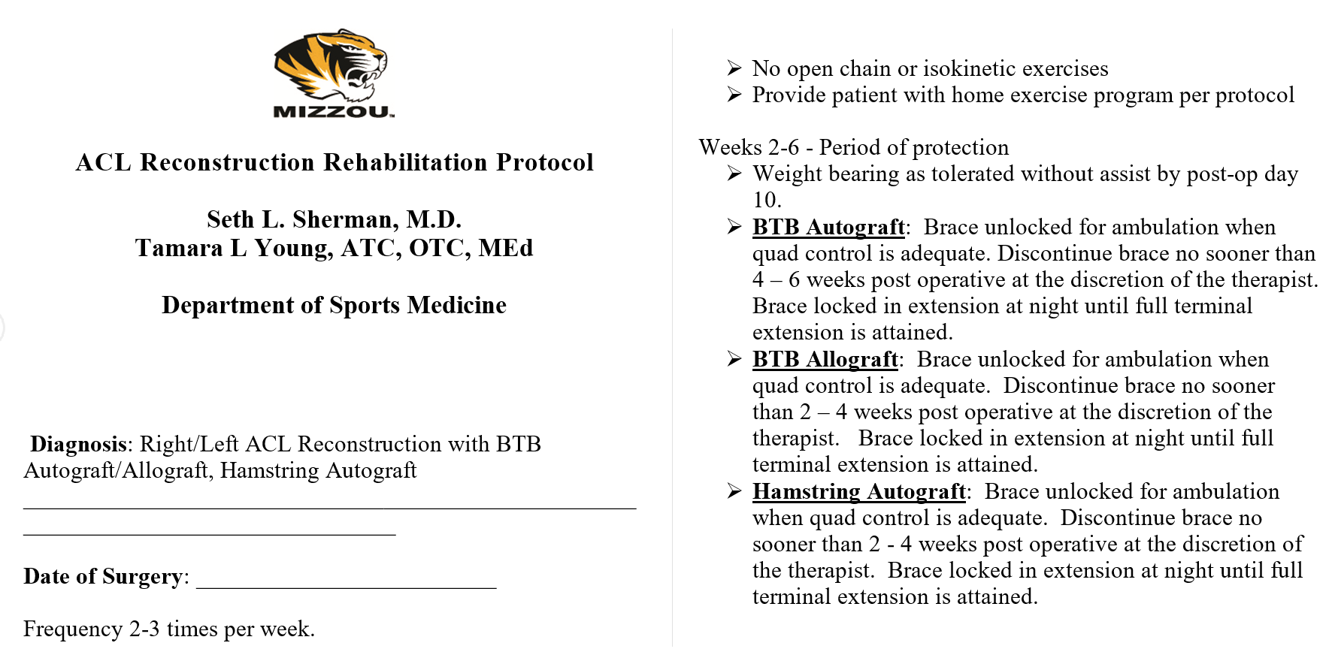
OTSRS
Patients
Exercises details
See own progress against others
Record exercise compliance
Connected to wearable monitors
Receive feedback from physicians
Physicians
Record and edit their protocols through web page
Access patients health data
Send feedback to patients
Monitor the patient’s progress
Notes:
This system (web and mobile) not only allow the patient to see what he/she is supposed to do at this phase of recovery, but also let the patient see his/her progress againts other patients. The app allows the patient to record his/her compliance. It is connected to wearable monitor such as fitbit and ihealth, and can upload users everyday activity and health data to the server. A physician can then monitor the patient’s progress between office visits and determine is he/she is progressing as expected.
Allow patients to see exercises
patient see his/her progress against other patients
Allows the patient to record his/her compliance
Connected to wearable monitors, and can upload users everyday activity and health data to the server
Receive feedback from physicians about his/her recent progress
Allow physician record and edit their protocols through web page
Send feedback to patients
Monitor the patient’s progress between office visits and determine is he/she is progressing as expected

Slide 6
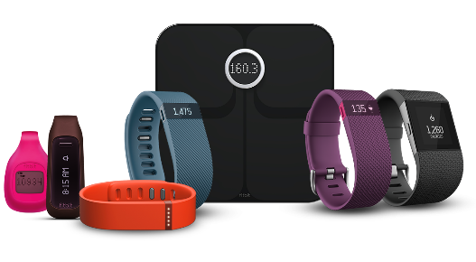
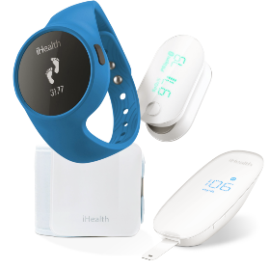
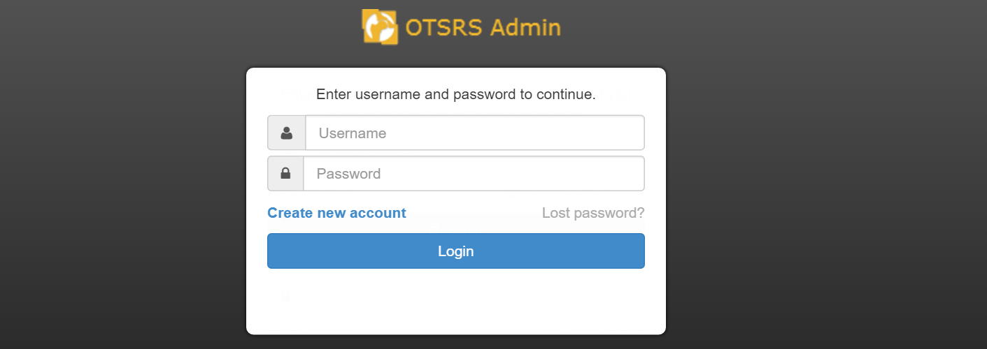
OTSRS
Notes:
This system (web and mobile) not only allow the patient to see what he/she is supposed to do at this phase of recovery, but also let the patient see his/her progress againts other patients. The app allows the patient to record his/her compliance. It is connected to wearable monitor such as fitbit and ihealth, and can upload users everyday activity and health data to the server. A physician can then monitor the patient’s progress between office visits and determine is he/she is progressing as expected.
Allow patients to see exercises
patient see his/her progress against other patients
Allows the patient to record his/her compliance
Connected to wearable monitors, and can upload users everyday activity and health data to the server
Receive feedback from physicians about his/her recent progress
Allow physician record and edit their protocols through web page
Send feedback to patients
Monitor the patient’s progress between office visits and determine is he/she is progressing as expected

Slide 7
Original approach vs OTSRS
 | Cost | Time Consuming | Everyday health data | Progress report | Environmental Friendly
Original | High |  |  |  | 
OTSRS | No |  |  |  | 

Slide 8
Thesis goal
Design and implement orthopedic surgery rehabilitation and health monitoring system
Support Out-clinic rehabilitation
Improve health monitoring
Reduce health care cost
Enhance patient-physician communication

Slide 9
Overview
Introduction
Related work
Design and implementation
Summary
Future work

Slide 10
Related work
Android Based Control and Monitoring System for Leg Orthosis [2]
Control the orthosis during rehabilitation process
Get heart rate data
Notes:
able to help physical therapist and physician in monitoring control the orthosis during rehabilitation process

Slide 11
Related work
Rehabilitation Exercises Feedback on Android Platform [3]
Show exercise details
Upload feedback to server
Notes:
a system called VITFIZ is implemented successfully on Android platform to provide a low cost solution that would make management of out-clinic exercise programs for patients undergoing rehabilitation more efficient

Slide 12
Related work
DroidGlove: An Android Based Application for Wrist Rehabilitation [4]
Sensor data: motion sensor and accelerometers
Store patients data locally
Notes:
has the innovative advantage of allowing ubiquitous game based therapy
has possibility of providing patients’ out-clinic exercise details to the physicians

Slide 13
Comparison
 | Health data collection | Progress report | Out clinic exercises details | Target
Leg Orthosis Control |  |  |  | Leg orthosis
VITFIZ |  |  |  | Rehabilitation Feedback
DroidGlove |  |  |  | Wrist rehabilitation
OTSRS |  |  |  | Orthopedic surgery

Slide 14
Overview
Introduction
Related work
Design and implementation
Summary
Future work

Slide 15
Overall system architecture

Slide 16
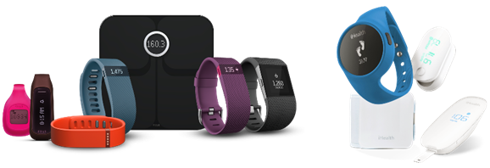
Sensors
Fitbit
Activity tracker
Wireless scale
Heartrate monitor
iHealth
Glucometer
Blood pressure monitor
Wireless pulse oximeter

Slide 17
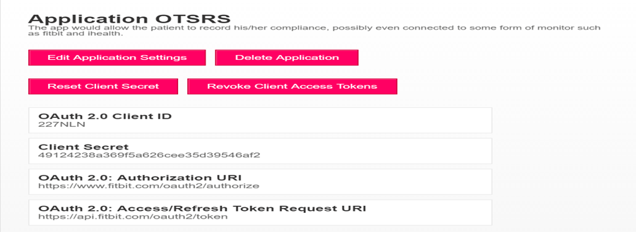
Register application

Slide 18
System environment
Android
IDE: Eclipse
Supported models: 8564
Language: JAVA + XML
Server
Notepad++
Godaddy Linux Server
Database: MYSQL
Language: PHP + JS + HTML + CSS

Slide 19
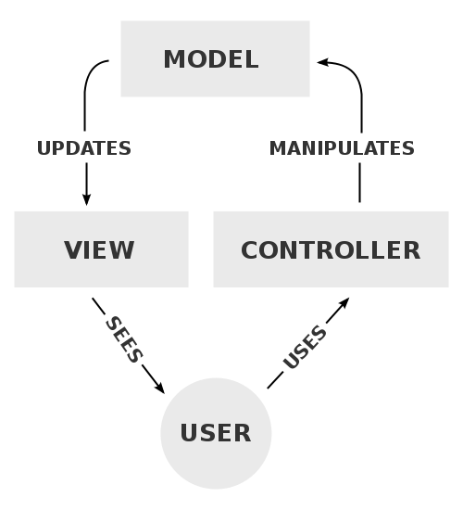
Design Pattern
Model–view–controller
software architectural pattern for implementing user interfaces on software
Notes:
Keeping the user interface changes completely separate from business logic.
helps in easier maintenance of code.
Easier to test the business components, user interface etc...
Secure as the UI pages will not be have the backend table structures/ other logic involved.

Slide 20
Mobile computation module
External Libraries: 9
Modules: 12
Packages: 23
Classes: 47
Lines of code: 19,895

Slide 21
Mobile computation modules relation
In-app messaging Module
Account management Module
Physician Module
Dashboard Module
Background Task Module
Exercises Module
Link account Module
Utility Module
Networking Module
Progress Module
iHealth OAuth2 Module
Fitbit OAuth2 Module

Slide 22
Background task module
Handle data communication
Update UI

Slide 23
Asynctask
Main thread should be able to handle request from different views and components
Activity manager and window manager monitor the application for responsiveness
Anything takes more than 5s on main thread for an activity will trigger ANR error
Notes:
ANR (Application Not Responding) is not exactly an error. It is shown when your application is very sluggish and takes a lot of time to respond, thus making the user wait.

Slide 24
How Asynctask work?
Main/UI thread
Async task
Async task status
Execute
Background thread
onPreExecute
Main thread
Pending
Status
doInBackground
Running
onProgressUpdate
publishProgress
Result
Finished
onPostExcute

Slide 25
Networking module
Check network connection
Parse JSON data
Send and receive HTTP/HTTPS request

Slide 26
Fitbit OAuth2 module
Get authentication code
Access token request
Get user info
Get user health data

Slide 27
iHealth OAuth2 module
Get authentication code
Access token request
Get user info
Get user health data

Slide 28
OAuth2 authorization code flow

Slide 29
Dashboard module
Show health data
active heart rate, blood pressure, body fat, calories burned, distance, duration, floors, resting heartrate, sleep, spo2, steps, weight, water, calories consumed and glucose
Customize dashboard
Refresh data
Auto upload

Slide 30
Exercise module
Show exercises details
Play instruction videos
Mark finished exercises
Calculate finished percentage

Slide 31
Physician module
Show physicians’ details
Direct call
Access in-app messaging module

Slide 32
In-app messaging module
Load message list
Show message details

Slide 33
Account management module
Sign In
Register
Retrieve forgot password
Update password and personal information

Slide 34
Progress module
Upload compliance of exercises
Display progress versus others
Show finished days

Slide 35
Link account module
Shows integrated API list
Trigger corresponding module

Slide 36
Utility module
SQLite database establishment
Send email
Encryption and Decryption
Manage session
Play video base class
Animated button
Image upload

Slide 37
Web server module
Modules: 5
PHP file: 18 + 4
Lines of code: around 8,000

Slide 38
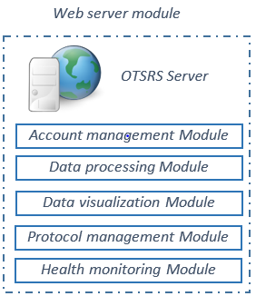
Account management module
Validate login
Validate register
Update account information
Recover user password
Send email

Slide 39
Data processing module
Upload image
Search, add, update and delete
Encryption and decryption

Slide 40
Data visualization module
Visualize region
Progress line chart

Slide 41
Protocol management module
Protocol control
Add, review, edit and update
ACL reconstruction and Rotator Cuff Repair

Slide 42
Health monitoring module
Dynamic table
Show patient health data
Patient progress and information
Send feedback

Slide 43
Live demo

Slide 44
Overview
Introduction
Related work
Design and implementation
Summary
Future work

Slide 45
Summary
OTSRS system is developed and will be tested in medical practice
Mobile computation module:
Provides health data collection
Provides detailed exercise contents
Provides progress report and receive feedback
Provides secure data transfer and storage
Web server module
Provides reliable and secure monitoring and visualization
Sensors API versions
upgraded to the latest version to get full support

Slide 46
Overview
Introduction
Related work
Design and implementation
Summary
Future work

Slide 47
Future Work
More API integrations
Garmin
Extend to IOS
Dashboard module
Upgraded and added support to show bar chart of each field
New social networking
Support the communication between patients.
Notes:
New social networking module will be developed to support the communication between patients. Patients could be able to share their experience, stories and good methods to other patients.

Slide 48
Reference
Stark, Andrew. "What's the Cost of Physical Therapy Without Insurance?" GuideDoc. 2014. Web. 24 Apr. 2016.
Sabani, Azzizatul Huda, and R. Jailani. "Android based control and monitoring system for leg orthosis." Signal Processing & Its Applications (CSPA), 2015 IEEE 11th International Colloquium on. IEEE, 2015.
Caulfield, Brian, et al. "Rehabilitation exercise feedback on Android platform."Proceedings of the 2nd Conference on Wireless Health. ACM, 2011.
Deponti, Dario, Dario Maggiorini, and Claudio E. Palazzi. "DroidGlove: an android-based application for wrist rehabilitation." Ultra Modern Telecommunications & Workshops, 2009. ICUMT'09. International Conference on. IEEE, 2009.

Slide 49
Thank you! Any questions?

Slide 54
OAuth 2 overall workflow

