Slide 1

WEARABLE SENSING ANALYSIS
– IDENTIFYING ALCOHOL DRINKING
FROM DAILY PHYSIOLOGICAL DATA
Thesis Defense of Master’s Degree
Chen Zhang
Advisor: Dr. Yi Shang

Slide 2

Contents
Introduction
  Problem
  Contribution
  Motivation
Related Work
System Improvement
Data Analysis Pipeline
Conclusion and Future Work
Notes:
The presentation can be generalized to five parts
Introduce a little about the thesis work
35 pages in total

Slide 3
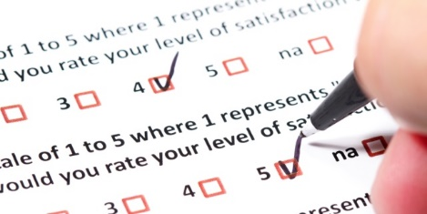
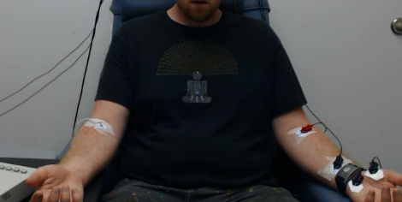
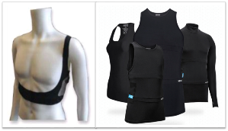


Introduction
A practical psychology study about Alcohol Craving
  Cooperated with Psychology Sciences
  Based on questionnaires and body physiological readings
A mobile ambulatory assessment system
  Data collecting system links wearable sensors with smartphones and servers
  Dispatching/Collecting surveys, and physiological sensor measurements
Data
Stored
dslsrv8
Sensor Suites
Data Logging

Slide 4




Problem
During implementing
  Extendable issue
    Similar studies required system migrating with little changes, esp. for survey part
  Security issue
    Personal information and responses were transmitting through public network
After data collected and stored
  Analysis issue
    Only preliminary analysis has been applied since collected
    Ways of preprocessing data and evaluation on that is blank
Craving
Emotion
HIV
Pain
Notes:
Participated in system implementation about two years ago
Data stay there since collected

Slide 5
Contribution and Motivation
Improvements on existing application
  A truly randomized survey scheduler
  - meet original system design
  A redesign of OOP for survey component
  - Uniform structure facilitating system migration
  A novel Digital Envelope approach for a secure data-transfer encryption
  - Enhanced security is guaranteed
New pipeline on data analysis
  Data cleaning procedures
  - Methods and rules are first time defined and tried, on real subjects
  Physiological features extraction
  - Useful features are extracted and testified
  Classification on drinking from daily readings
  - Based on machine learning methods, with nearly 80% accuracies

Slide 6
Related Work
Ganesan, Ramachandran, Mohan Gobi, and Kanniappan Vivekanandan. "A Novel Digital Envelope Approach for A Secure E-Commerce Channel." IJ Network Security 11.3 (2010): 121-127.
Introduced concept of Digital Envelope
Ways to combine two methods together, to get both fast and strengthened data-encryption channel

Slide 7
Related Work (cont’d)
Plarre, Kurt, et al. "Continuous inference of psychological stress from sensory measurements collected in the natural environment." Information Processing in Sensor Networks (IPSN), 2011 10th International Conference on. IEEE, 2011.
Ways of data preprocessing/cleaning are discussed in detail, rules and standards are given as references.
Many useful features are introduced by their work
Physiological responding, such as HRV and BR, can be useful in proposing a behavior related classifier

Slide 8
Related Work (cont’d)
Hossain, Syed Monowar, et al. "Identifying drug (cocaine) intake events from acute physiological response in the presence of free-living physical activity." Proceedings of the 13th international symposium on Information processing in sensor networks. IEEE Press, 2014.
Acute stimulation would instantly be reflected on physiological reactions, dosages may affect differently
The way of physiological responding to events can be examined through short-term and long-term changing. MACD line can do the job of measuring and discriminating

Slide 9
Contents
Introduction
Related Work
System Improvement
  Random Scheduler
  OOP Redesign
  Digital Envelope
Data Analysis Pipeline
Conclusion and Future Work

Slide 10
System Improvement – Random Scheduler
Random Survey
  Requirements
    Randomly appeared
    Six times in a day
    Without overlapping
  Implements
    Started at noon of a day or time of finishing a Morning Report
    Ended at midnight of a day
    Divided with 3x(6+1) equal portions
    Left necessary gaps between two consecutive surveys
    Scheduled surveys randomly within each selected portion
1st RS
2nd RS
3rd RS
4th RS
5th RS
6th RS
Time of a day
Necessary safe gap between two consecutive surveys
Randomized schedule during this period of time
Notes:
Talk about in-residence protocol, about random surveys
It’s a simple requirement, but no one did that, so I implemented it.

Slide 11
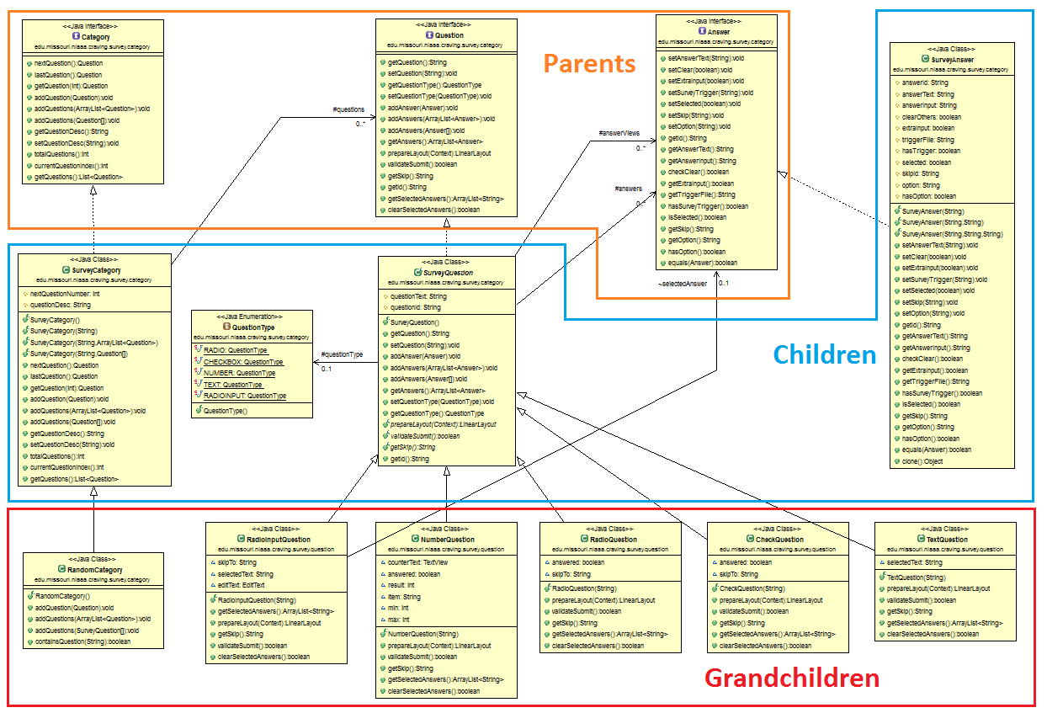
System Improvement – OOP Redesign
Category
Question
Answer
UML graph generated by codes
  Three layer
    Parents - Abstract
    Children - Semi-abstract
    Grandchildren - Implemented
  Three Objects
    Survey Category
    Question
    Answer
Advantages
  Readable and maintainable
  Highly Reusable (within project)
  Ease of extendable (across projects)

Slide 12
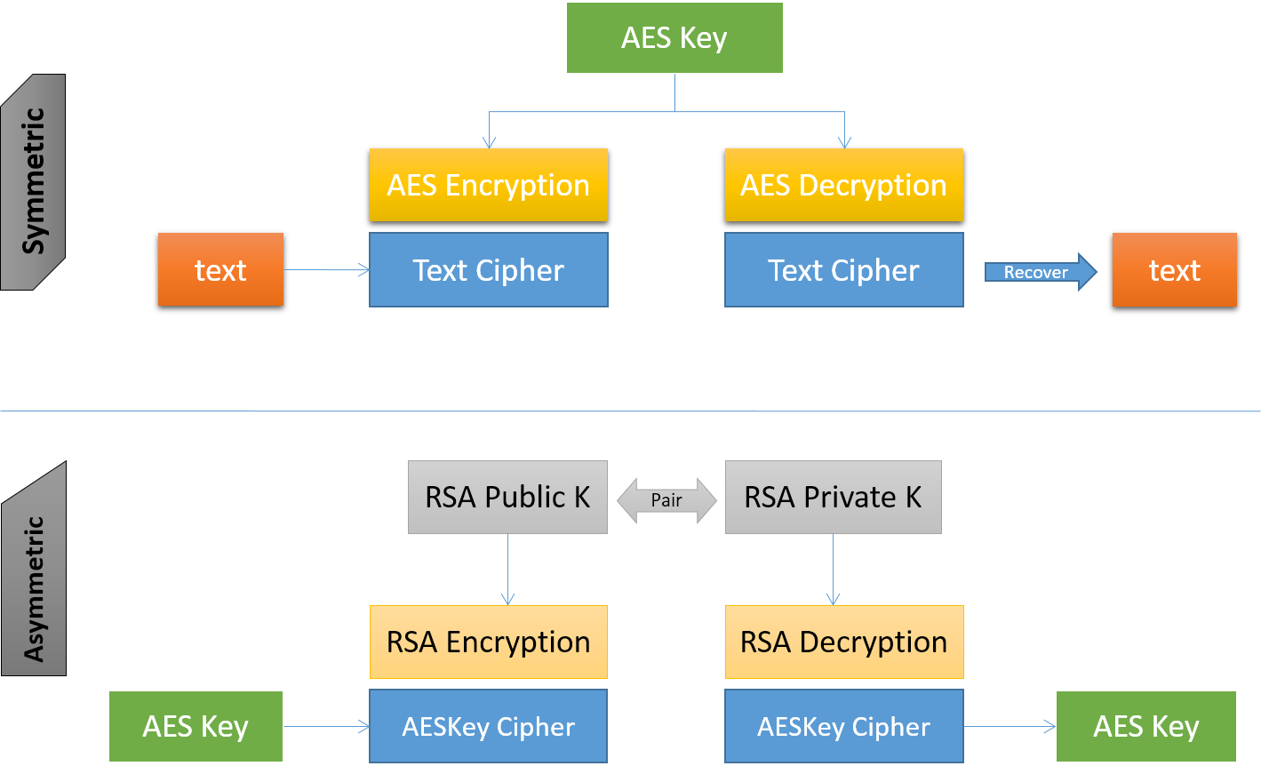
System Improvement – Digital Envelope
Sender
Receiver
Encryption Methods
  Symmetric - AES
    Single key cipher
    Shared secret
    Fast
  Asymmetric – RSA
    Key cipher pairs
    Public and private
    Slow
Notes:
The key point here is AES has single key and has sharing secure issue

Slide 13
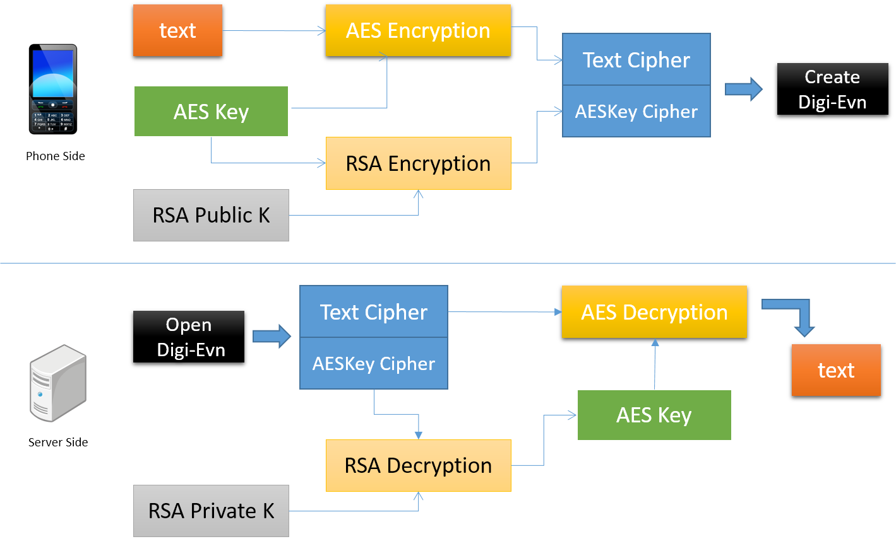
Digital Envelope (cont’d)
Digital Envelope
  AES
    Fast but has key sharing issue
  RSA
    Slow but has private key
  Combine – Digital Envelope
    Both fast
    And secure
Notes:
Both encryption algorithm have some limitation
Combine them together to make full use of them

Slide 14
Contents
Introduction
Related Work
System Improvement
Data Analysis Pipeline
  Pipeline Overview
  Data Cleaning
  Feature Extraction
  Classification
Conclusion and Future Work

Slide 15
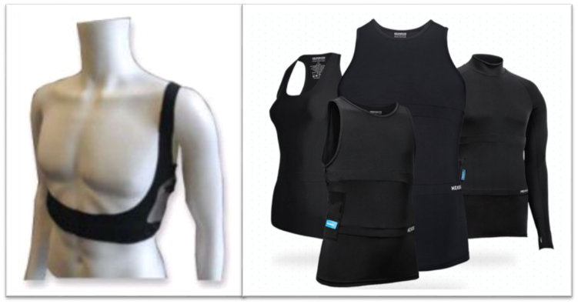
Statistical Overview
SEM
Hexoskin
Two types of sensor
  SEM and Hexoskin
  ECG(256 Hz), RIP(128 Hz), Temperature, etc.
Raw data (RR Int.)
  SEM – 101 days
  Hexoskin – 236 days
  1382.8h /w 22 users
  403 drinking surveys
Notes:
Two types of sensor, they gave almost the same physiological readings

Slide 16
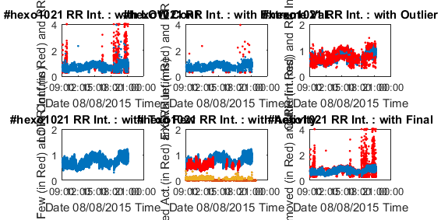
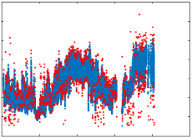
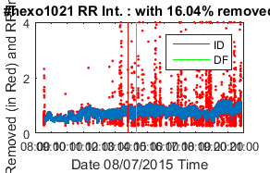
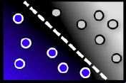
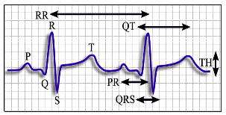
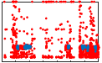
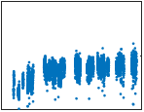
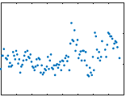
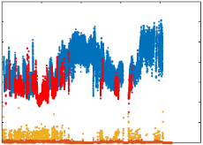
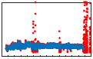
Data Analysis Pipeline
Data Collection (step 1,2)
Data Cleaning (3-7)
Feature Extraction (8)
Classification (9)
1
2
3
4
dslsrv8
Sensor Suites
Data Logging
Trimming and Matching
Outliers Removal
9
8
7
6
5
Gaps and
Insufficient Data
Classification
Feature Extraction
Valid User Selection
Activities Removal
Notes:
Four stages

Slide 17
Data Cleaning
Five Steps
  Trimming and Matching
  Outliers Removal
  Activities Removal
  Gaps and Insufficient Data
  Valid User Selection
1
2
Trimming and Matching
Outliers Removal
5
4
3
Gaps and
Insufficient Data
Valid User Selection
Activities Removal

Slide 18
1. Trimming and Matching
Trimming
  Blank and Zero values appeared in the dataset
  Data points under indications of LOW confidence
  Extreme values that out of normal range
    Heart rate (40~200), Breathing rate (10~100)
Matching
  Unifying DateTime format
  Using the same time-zone
  Align data from different sources by timestamps

Slide 19
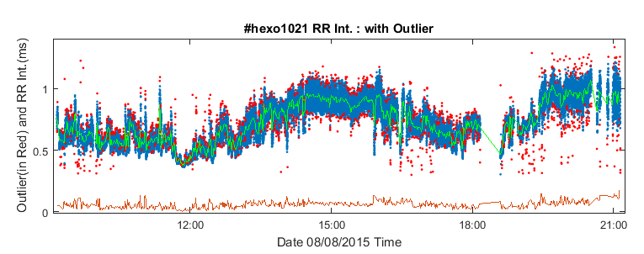
2. Outliers removal
Assumption
  RR Intervals follow Normal distribution
Outliers defined as:
  Data away from
  1-min moving average
  2*standard deviations

Slide 20

3. Activity Affected Data Removal
Intensive activities are main confounders
  Significantly change physio. readings
  Much stronger than alcohol does
Screening out the affected minutes
  Calculate activity magnitude
  Standard deviation in 10s window
  Set a threshold to discriminate
  Majority will decide the action
RR
Intervals
Acc
Readings

Slide 21
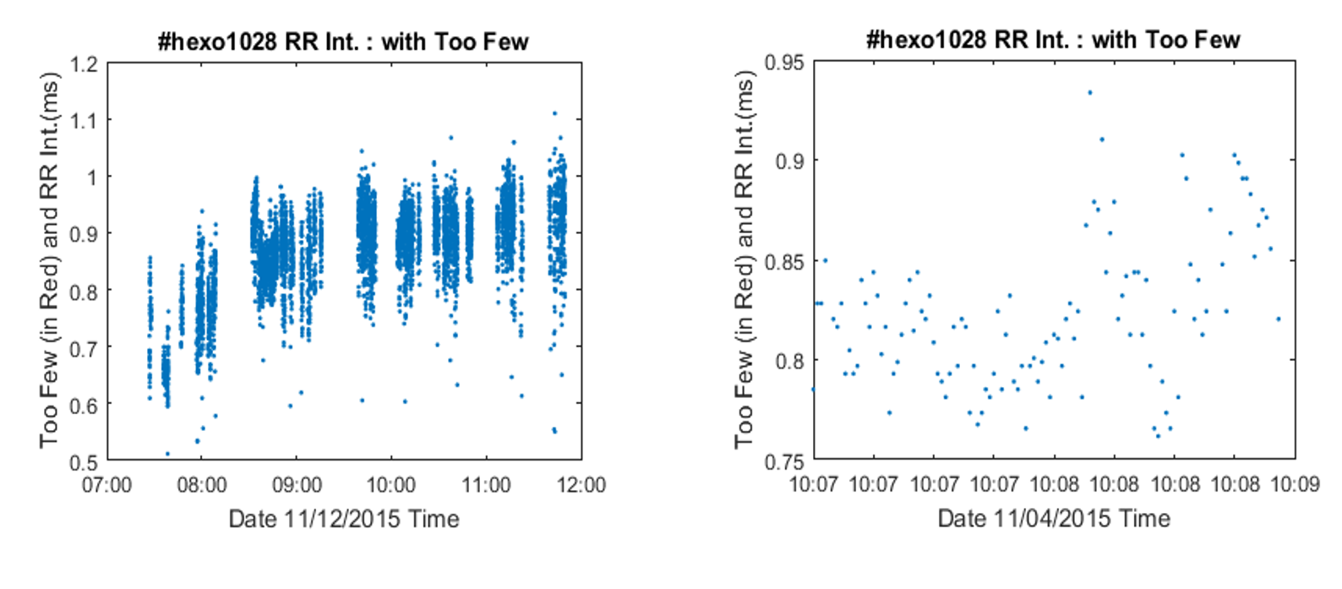
4. Gaps and Insufficient Data Removal
Less than 50 data points in a one-minute window
10 minutes duration without or with few data points

Slide 22
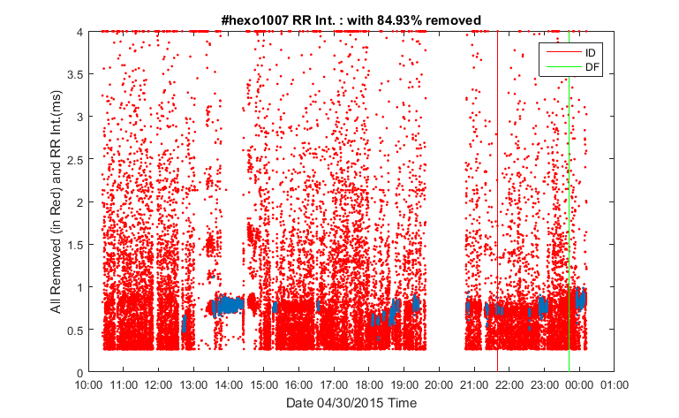
5. Valid User Selection
Some users or some days of a user contain too much invalid data
  Extreme value
  Blank value
  Noisy value
  …
Rules to screen out
  Less than 1.5h in a day
  More than 75% invalid

Slide 23
Statistics After Cleaning
Good
Bad
Cleaned data
  SEM – 76 days
  Hexoskin – 140 days
Data valid rate
  SEM – 77.5% (7.8h per day)
  Hexoskin – 63.1% (5.6h per day)
  Overall only 68% data are valid
 | Users | Drink days | Valid days | Total days | Drink rate | Valid rate
SEM | 9 | 24 | 76 (35725 mins) | 101 (46087 mins) | 31.58% | 77.52%
Hexoskin | 13 | 34 | 140 (47243 mins) | 236 (74902 mins) | 24.29% | 63.07%
Total | 21 | 58 | 216 (82968 mins) | 337 (120989) | 26.85% | 68.57%
Notes:
24 out of 101 days are drinking day for SEM
1/3 of data are dropped with cleaning procedure

Slide 24
Contents
Introduction
Related Work
System Improvement
Data Analysis Pipeline
  Pipeline Overview
  Data Cleaning
  Feature Extraction
  Classification
Conclusion and Future Work

Slide 25
Feature Extraction
Category | Restriction | Features
Non-HRV | 1 minute | HR, mean, median, 20th percentile, 80th percentile, quartile deviation --(6 features)
HRV | 1 minute | Orig. RR: RMSSD, SDSD, NN50, pNN50, NN20, pNN20 Norm. RR: Variance; LowBand(0.1-0.2Hz), MB(0.2-0.3Hz), HB(0.3-0.4Hz), LB/HB --(11 features)
 | 5 minutes | Norm. RR: SDANN; LowFrequency(0.04-0.15Hz), HF(0.15-0.4Hz), LF/HF --(4 features)
RIP (Resp.) | Basic | Breath rate, Minute Ventilation, Inspiration duration, expiration duration, respiration duration, I/E, stretch
 | Aggregation | Mean, median, 80th percentile, quartile deviation
HRV-Resp. | Per cycle of respiration | RSA – Respiratory Sinus Arrhythmia
ECG features (Heart Related)
  QD – quartile deviation, (Q3-Q1) / 2
  RMSDD – rms of successive differences
  SDSD – std of successive differences
  NN50 – # of pairs of successive RRs differ > 50ms
  pNN50 – proportion of NN50 divided by total
  PSD method – total spectral power of RR Interval for each pre-defined band
RIP features (Respiration Related)
  Breathing Cycle – an inhalation and an exhalation period
  Minute Ventilation – volume of inhaled air in a minute
  Stretch – volume of air breathed from last breathing cycle
  I/E – ratio of inhalation and exhalation duration
Other features
  RSA – difference of RR within each breathing cycle
  ECG based features – duration of QT, PR, TH …

Slide 26
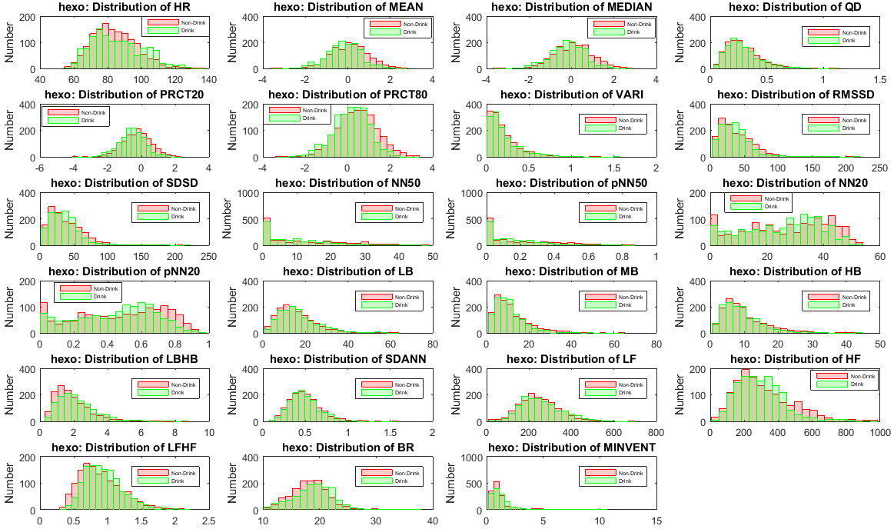
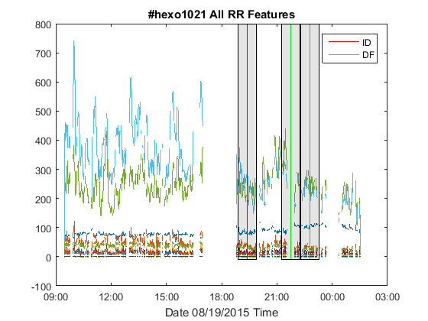
Feature Visualization
SEM
  76 days with 24 drinking days
  Only ECG features – 1777 mins drinking
Hexoskin
140 days with 34 drinking days
Only ECG features – 2125 mins drinking
Both ECG and RIP – 1320 mins drinking
Plot for one day:
Whole datasets:
  Hexoskin: 23 features
  Non-Drink / Drink

Slide 27
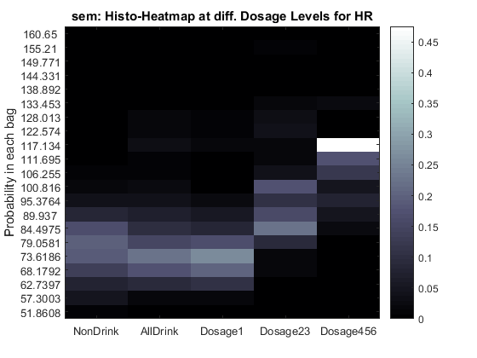
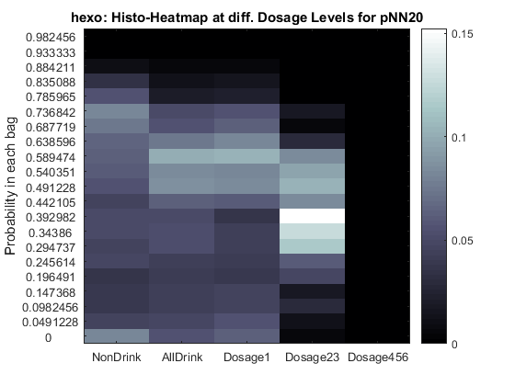
Feature Analysis – Dosage Levels
Histograms of Heart Rate and pNN20
  Represented as heat map, for different dosage levels
  The more dosage of drinking, the higher HR, lower HRV

Slide 28
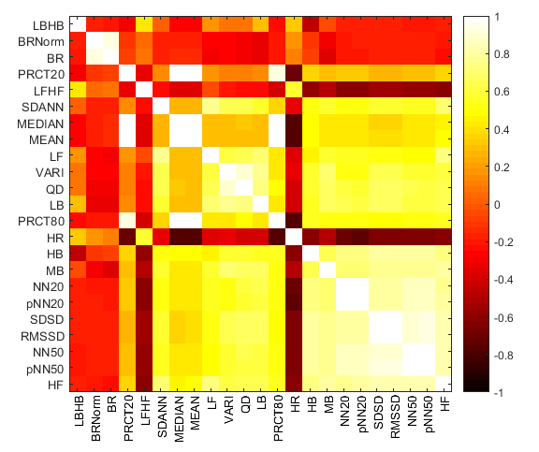
Feature Analysis – Pairwise Correlation
Top-left most shows feature with least correlation with all others
PCA: 95% info, 25 to 10 features
Ranks of features with least correlation in each category
 | 1-5 | 6-10 | 11-15 | 16-20 | 21-23 | Total
Non-HRV | 1 | 2 | 3 |  |  | 6
1min HRV | 1 | 1 | 2 | 5 | 2 | 11
5min HRV | 1 | 2 |  |  | 1 | 4
BR | 2 |  |  |  |  | 2
Notes:
PCA
25 reduced to 10 feature space, while maintain 95% information

Slide 29
Contents
Introduction
Related Work
System Improvement
Data Analysis Pipeline
  Pipeline Overview
  Data Cleaning
  Feature Extraction
  Classification
Conclusion and Future Work

Slide 30
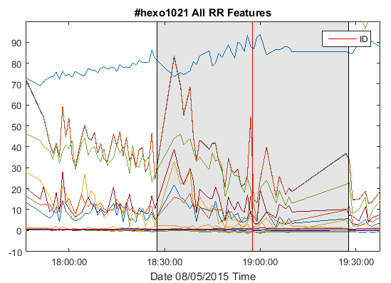
Classification
1 hour
Class labeling expansion
  Drinking surveys: ID, DF and RS
  Mark duration of 1 hour
  Half hour before and after
Classifiers and Evaluators
  Working with WEKA machine learning toolbox
  J48 decision tree, Adaboost J48 and SVM
  Confusion Matrix, Accuracy, Kappa and ROC
    kappa >0.4 is acceptable, >0.75 is better
  Purpose: to classify drinking and non-drinking from physiologic features.

Slide 31
Results on ECG Features - SEM
Datasets
  SEM: ECG (1777 mins drink)
Training and testing with 10-fold cross validation
  Benchmark is 50%, randomly selecting from non-drink features
  Adaboost J48 decision tree gives the highest performance, 82.3% accuracy.
  Result with J48 decision tree Comparison among three methods
 | Accuracy | Kappa | ROC | Confusion Matrix
 |  |  |  |  | 0 | 1
SEM (1777) | 78.5% | 0.5696 | 0.801 | Non-drink | 1377 | 423
 |  |  |  | Drink | 347 | 1430
 | Accuracy | Kappa | ROC
J48 Decision Tree | 78.5% | 0.5696 | 0.785
J48 with Adaboost | 82.3% | 0.6467 | 0.823
SVM (normalized) | 66.8% | 0.337 | 0.668

Slide 32
Results on ECG Features - Hexoskin
Datasets
  Hexoskin: ECG (2125 mins drink)
Benchmark 50%
Comparison
  Again, Adaboost J48 gives the best performance
  Comparatively worse than those of SEM results (82.3%)
 | Accuracy | Kappa | ROC | Confusion Matrix
 |  |  |  |  | 0 | 1
J48 Decision Tree | 66.8% | 0.3357 | 0.701 | Non-drink | 1489 | 711
 |  |  |  | Drink | 725 | 1400
J48 with Adaboost | 68.6% | 0.371 | 0.748 | Non-drink | 1508 | 692
 |  |  |  | Drink | 668 | 1457
SVM (normalized) | 60.1% | 0.2021 | 0.601 | Non-drink | 1262 | 938
 |  |  |  | Drink | 789 | 1336

Slide 33
Results on All Features - Hexoskin
  Hexoskin: ECG + RIP (1320 mins drink)
  Adaboost J48 Classifier
  Benchmark 50%
Comparison
  ECG and RIP perform the best (74.1%)
  Compare ECG only and RIP only
    ECG only with 70.9%
    RIP only with 59.6%
  ECG with one of RIP features
    With BR (71.2%), with MV (72.5%)
    Both give acceptable results (k>0.4)
 | Accuracy | Kappa | ROC | Confusion Matrix
 |  |  |  |  | 0 | 1
ECG & RIP (1320) | 74.1% | 0.4821 | 0.819 | Non-drink | 1039 | 361
 |  |  |  | Drink | 343 | 977
ECG Only (1320) | 70.9% | 0.4179 | 0.771 | Non-drink | 1004 | 396
 |  |  |  | Drink | 395 | 925
RIP Only (1320) | 59.6% | 0.1855 | 0.628 | Non-drink | 1013 | 387
 |  |  |  | Drink | 712 | 608
ECG & BR (1320) | 71.2% | 0.423 | 0.785 | Non-drink | 1011 | 389
 |  |  |  | Drink | 395 | 925
ECG & MV (1320) | 72.5% | 0.4499 | 0.802 | Non-drink | 1043 | 357
 |  |  |  | Drink | 390 | 930

Slide 34
Case Study – Most Recent 5 Users
Users {1032,1031,1030,1029,1028}, they supposed to be more stable
ECG and RIP Features(323) ECG Only Features(323)
BR Only Features(323) MV Only Features(323)
 | Accuracy | Kappa | ROC
J48 | 81.3% | 0.6255 | 0.827
J48 Ada | 87.1% | 0.7414 | 0.936
SVM | 70.3% | 0.4011 | 0.701
 | Accuracy | Kappa | ROC
J48 | 81.3% | 0.6235 | 0.822
J48 Ada | 85.9% | 0.7144 | 0.918
SVM | 66.9% | 0.3331 | 0.667
 | Accuracy | Kappa | ROC
J48 | 77.7% | 0.5583 | 0.823
J48 Ada | 78.8% | 0.5761 | 0.845
SVM | 76.6% | 0.5295 | 0.766
 | Accuracy | Kappa | ROC
J48 | 75.9% | 0.5126 | 0.813
J48 Ada | 75.8% | 0.5067 | 0.816
SVM | 55.3% | 0 | 0.5

Slide 35
Conclusion and Future Work
Conclusion
  In field study, about 1/3 more of data is needed before preprocessing
  Body physiological measurements could reflect drinking respondings
  Adaboost J48 is the most suitable classifier with this thesis work
  ECG features alone can do the job, but with addition information provided by RIP features, the performance is improved
Future work
  Craving as another aspect of study with alcohol drinking
  Probabilistic models with time relations can be followed
  Advanced machine learning methods with spectrograms

Slide 36

Thank You!
Question?

