Slide 1
Applications of Deep Neural Network to Protein Structure Prediction
Department of Electrical Engineering and Computer Science
Advisors: Professor Yi Shang and Professor Dong Xu
Speaker: Chao Fang

Slide 2
Outline
Introduction and Overview
Proposed Methods:
DeepNRN and Deep3I for secondary structure prediction
DeepRIN for backbone torsion angle prediction
DeepIDN for beta turn prediction
DeepICN for gamma turn prediction
MUFold-SS-Angle server
Summary
2
Notes:
Change order ss-> angle-> beta -> gamma- > server

Slide 3
Introduction and overview
four distinct levels of protein structure
3
Notes:
Draw pictures relationship more slides link different topic together
Method page problem, features, techniques, tool

Slide 4
Our research work mainly focus on:
Psi-Phi angle
Gamma-turn
4

Slide 5
Why predict secondary or super-secondary structure?
Determine how proteins fold into 3D shape
Provide useful features for 3D structure prediction
Super-secondary structure motif is helpful to discover the protein functions

Slide 6
Why use deep learning?
Achieve great success in computer vision, speech recognition, natural language processing, etc.
Extract high-level hierarchical features by itself, rather than rely on labeling by human experts
Discover complex relationships between input features to output labels

Slide 7
Some successful deep learning applications in biological sequence analysis:
Methods | Problem solved | DNN model used
SPIDER3 (Heffernan et al., 2017) | Backbone torsion angle | Deep Bi-RNN
RaptorX-SS (Wang et al., 2017) | Secondary structure | Deep CNF
DNCON2 (Adhikari et al., 2017) | Protein contact map | Deep CNN

Slide 8
Inspired by those successful research work, here we propose:
Proposed Methods | Based on what DNN models | Problem solved | Features used
Deep3I, DeepNRN | ResNet, InceptionNet | Secondary Structure | physico-chemical(PC), Psiblast and HHBlits
DeepRIN | ResNet, InceptionNet | Backbone torsion angle | PC, Psiblast, HHBlits, predSS8
DeepDIN | DenseNet, InceptionNet, Balanced learning, transfer learning | Beta turn | PC, Shape string, HHBlits, predSS8
DeepICN | InceptionNet, CapsuleNet | Gamma Turn | Shape String and HHBlits
8
Notes:
Define MCC mearning

Slide 9
Outline
Introduction and Overview
Proposed Methods:
DeepNRN and Deep3I for secondary structure prediction
DeepRIN for backbone torsion angle prediction
DeepIDN for beta turn prediction
DeepICN for gamma turn prediction
MUFold-SS-Angle server
Summary
9

Slide 10
Introduction
Protein sequence: 20 types of amino acids
GKSSKALNEAAEQGDLAKVKNLVQKNKIDLNAQDETGMTPLMNAAMGGNLDIVKFLLSKKVNLELKNNGGET
Predict
Secondary Structure: 8 states
CCCCCHHHHHHHTTCHHHHHHHHHTTSCCTTCCCTTSCCHHHHHHTTTCHHHHHHHHHTTCCTTCCCTTSCCHH
Protein 1KFV structure
Figure credit: PDBsum
Helix: (H = ⍺-helix, G = $3_{10}$-helix, I = ᴨ-helix)
Sheet: (B = β-bridge, E = strand)
Coil: (T = turn, S = bend, C = coil)
Helix
Strand
10

Slide 11
Related Work
Authors | Methods
Rost and Sander., 1993 | Neural Network(NN)
Jones, 1999 | NN
Cheng et al., 2005 | RNN
Zhou and Troyanskaya, 2014 | Generative stochastic networks
Li and Yu, 2016 | CNN+RNN
Wang et al., 2016 | CRF
Busia et al., 2017 | CNN
11
Notes:
This result are not comparison in this published paper.

Slide 12
Proposed methods for SS Prediction
Deep neighbor-residual network (DeepNRN)
A variant of residual network
Deep inception-inside-inception network (Deep3I)
Using hierarchical of inception network

Slide 13
1. DeepNRN -> Residual block (He et al., 2015)
Plain
Residual
Image Credit: http://cs231n.stanford.edu/slides/2017/cs231n_2017_lecture9.pdf
Without residual (“shortcut”) blocks, the training loss wouldn’t decrease monotonically as network grows deeper.
13

Slide 14
ResNet (He et al., 2015) in ImageNet 2015
Image Credit: (He et al., 2016)
14

Slide 15
1. DeepNRN -> new neighbor-residual block
Neighbor-residual block has stacks of neighbor-residual units.
15
Notes:
We design the network

Slide 16
1. DeepNRN -> DeepNRN overall architecture
Inputs:
1) Sequence L-by-20
2) PSIBLAST L-by-20
3) HHBlits L-by-30
Outputs:
Predicted SS[L-by-8]
16

Slide 17
2. Deep3I -> Inception Block (Szegedy et al., 2017)
17

Slide 18
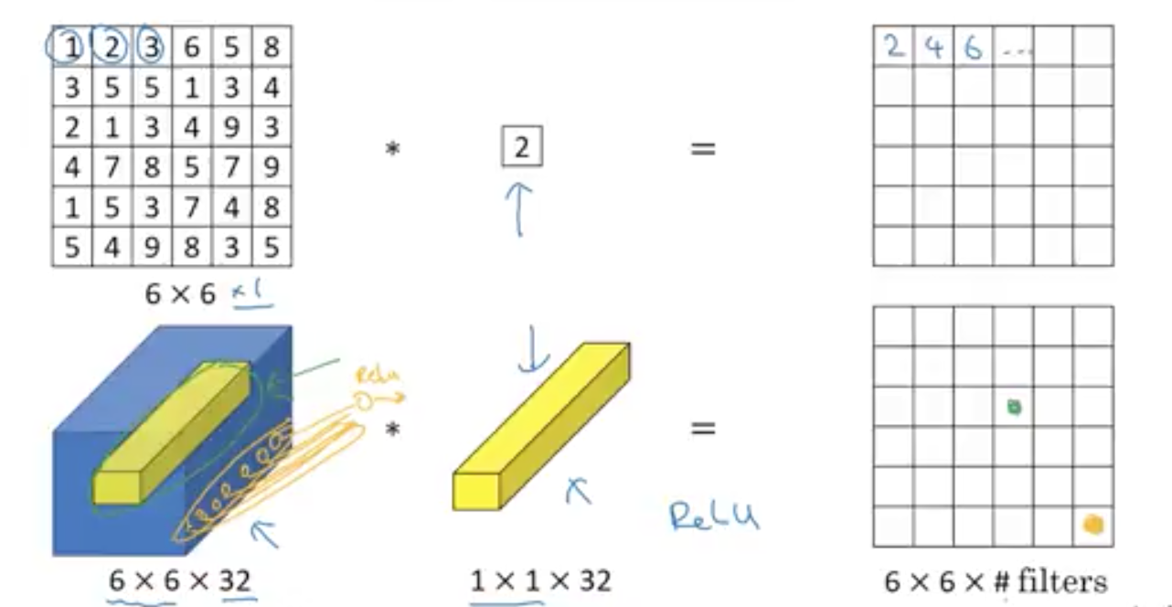
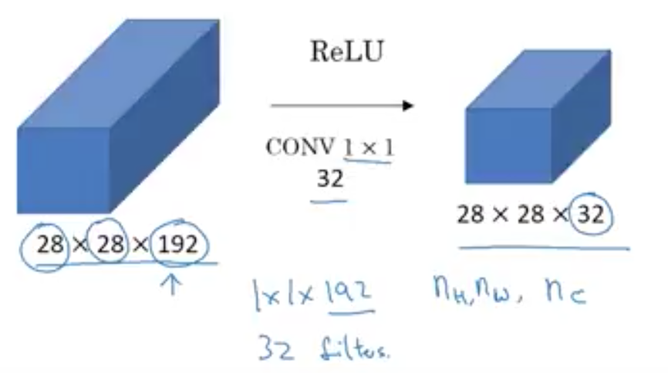
1x1 Convolution
(Lin et al., 2013 network in network)
Reduce the number of inputs
Decreases computation cost dramatically
18

Slide 19
Inception-v4 (Szegedy et al., 2017)
19

Slide 20
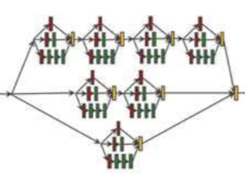
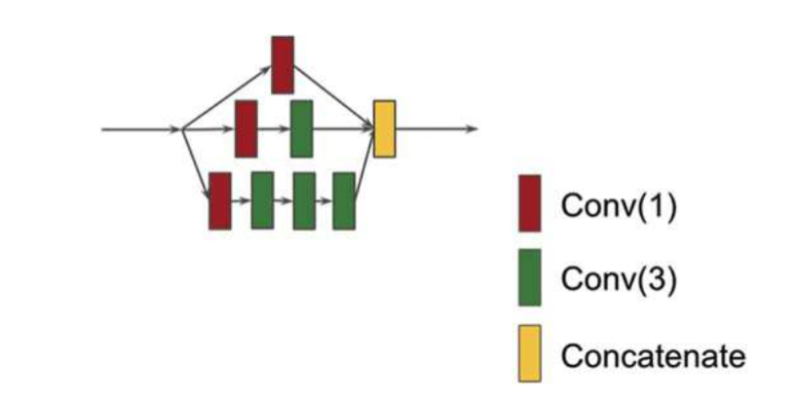
2.Deep3I -> new Deep3I block
20

Slide 21
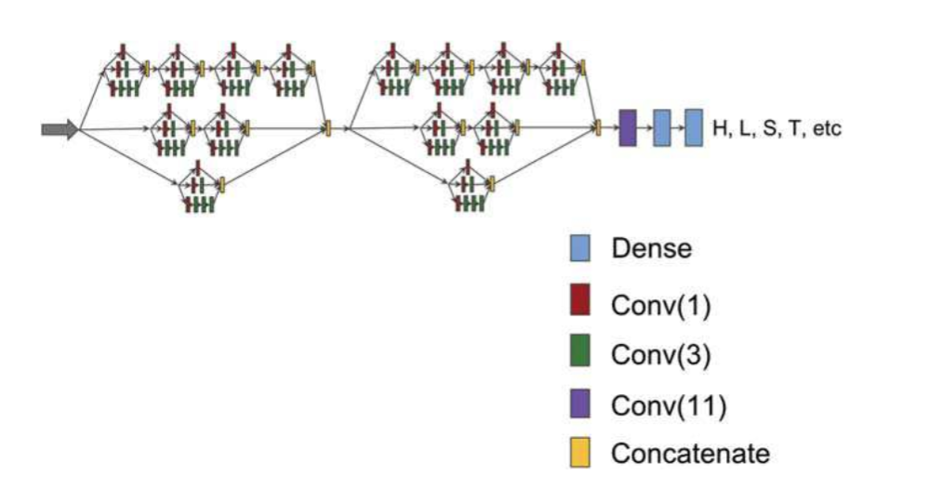
2. Deep3I -> Overall Deep3I architecture
https://dslsrv8.cs.missouri.edu/~cf797/MUFoldSS/
21

Slide 22
Dataset and Performance Measure
Datasets
CASPs (Critical Assessment of protein Structure Prediction) a community-wide worldwide experiment for protein structure prediction
CASP10 used 98/103 proteins
CASP11 used 83/85 proteins
CASP12 used 40/40
Performance measure
$Q3=\frac{correctly predicted residues in 3 states}{number of residues}$
$Q8=\frac{correctly predicted residues in 8 states}{number of residues}$
22

Slide 23
Compare with state-of-the-art tools
SSPro (Cheng et al., 2005) using RNN
PSIPRED (Jones 1999) using two layer NN
DeepCNF (Wang et al., 2016) using deep convolutional neural fields
SPIDER3 (Heffernan et al., 2017) using deep Bi-RNN

Slide 24
Q3 accuracy results of various prediction methods on CASP dataset
24

Slide 25
Q8 accuracy results of various prediction methods on CASP dataset
25

Slide 26
Outline
Introduction and Overview
Proposed Methods:
DeepNRN and Deep3I for secondary structure prediction
DeepRIN for backbone torsion angle prediction
DeepIDN for beta turn prediction
DeepICN for gamma turn prediction
MUFold-SS-Angle server
Summary
26

Slide 27
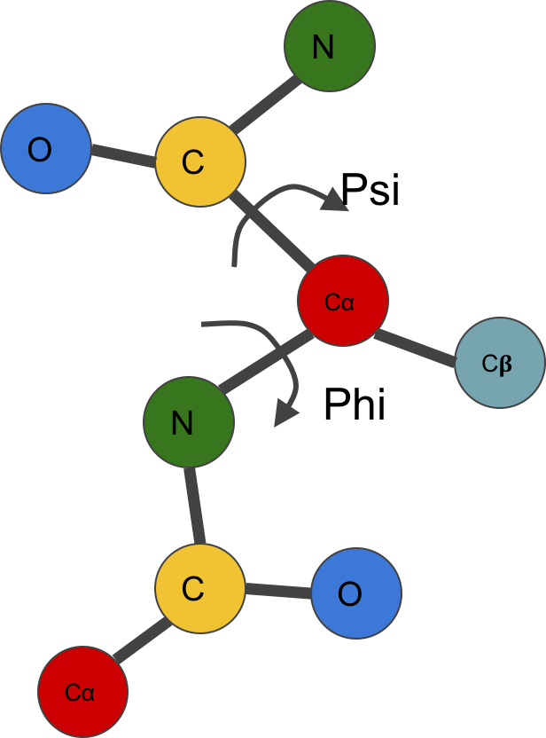
Introduction
Protein sequence: 20 types of amino acids
GKSSKALNEAAEQGDLAKVKNLVQKNKIDLNAQDETGMTPLMNAAMGGNLDIVKFLLSKKVNLELKNNGGET
Predict
Psi Phi Angle: a real value
Usually predict sine and cosine Psi and Phi
Then convert back to angle using $arctan⁡(\frac{\sin{x}}{\cos{x}})$
Psi angle is between Plane O-C-C𝛼 and N-C-C𝛼
Phi angle is between Plane C-C𝛼-N and N-C𝛼-C𝛽
27
Notes:
Write the angle definition

Slide 28
Related Work
Authors | Methods
Wu and Zhang 2008 Anglor | SVM, NN
Kountouris and Hirst, 2009 | SVM
Song et al., 2012 | SVM
Li et al., 2017 | RBM
Yang et al., 2016 SPIDER2 | DNN
Heffernan et al., 2017 SPIDER3 | LSTM biRNN
28

Slide 29
Propose method for torsion angle prediction
Deep residual inception network (DeepRIN)
Use inception and residual network
Use physico-chemical feature
Use PSI-Blast and HHBlits Profile
Predicted SS8

Slide 30
New DeepRIN Block
http://dslsrv8.cs.missouri.edu/~cf797/MUFoldAngle/
30

Slide 31
DeepRIN architecture
31

Slide 32
Dataset and Performance Measure
Datasets
CASPs (Critical Assessment of protein Structure Prediction) a community-wide worldwide experiment for protein structure prediction
Performance measure
$MAE=mean abosolute error (predicted angles, true angles)$
PCC: Pearson Correlation Coefficient
32

Slide 33
MAE among three tools
33

Slide 34
PCC among three tools
34

Slide 35
MAE and PCC of Psi-Phi angle prediction between SPIDER2, SPIDER3 and DeepRIN on recent PDB
 | Angle | Easy(226) | Hard(94)
SPIDER2 | Psi | 28.13(0.849) | 33.42(0.808)
 | Phi | 18.46(0.850) | 20.24(0.830)
SPIDER3 | Psi | 24.93(0.867) | 29.53(0.827)
 | Phi | 17.49(0.861) | 19.35(0.838)
DeepRIN | Psi | 22.67(0.882) | 28.94(0.834)
 | Phi | 15.98(0.881) | 18.67(0.850)
35

Slide 36
Outline
Introduction and Overview
Proposed Methods:
DeepNRN and Deep3I for secondary structure prediction
DeepRIN for backbone torsion angle prediction
DeepIDN for beta turn prediction
DeepICN for gamma turn prediction
MUFold-SS-Angle server
Summary
36

Slide 37
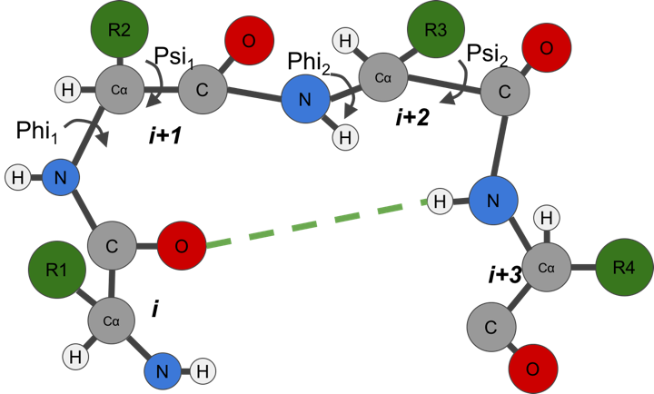
Introduction
Protein sequence: 20 types of amino acids
GKSSKALNEAAEQGDLAKVKNLVQKN
Predict
Type | Phi₁ | Psi₁ | Phi₂ | Psi₂
I | -60 | -30 | -90 | 0
I | 60 | 30 | 90 | 0
II | -60 | 120 | 80 | 0
II’ | 60 | -120 | -80 | 0
IV | -61 | 10 | -53 | 17
VIII | -60 | -30 | -120 | 120
VIb | -135 | 135 | -75 | 160
VIa1 | -60 | 120 | -90 | 0
VIa2 | -120 | 120 | -60 | 0
Turn or nonturn:
nnnnnnttttnnnnnnnnnnnttttnnnnnnn
A β turn, consisting four consecutive amino acids, is a type of non-regular secondary structure in proteins that causes a change in direction of the polypeptide chain.
37
Notes:
Define 4 consecutative amnio acid

Slide 38
Related work
Authors | Methods
McGregor et al., 1989 | Neural networks (NN)
Kim 2004 | K Nearest Neighbor
Kaur and Raghava, 2004 | Two layer NN
Kirschner and Frishman, 2008 | Bi-RNN
Hu and Li 2008 | SVM
Petersen et al., 2010 | Using four models to predict four position
Singh et al 2015 | Random forest
38
Notes:
Define MCC mearning

Slide 39
Propose method for Beta-turn prediction
Deep Dense Inception network (DeepDIN)
Use DenseNet and inception networks
Add a new feature: predicted Shape String from Frag1D (Zhou et al., 2010)

Slide 40
DeepDIN -> DenseNet (Huang et al., 2016)
Figure credit: (Huang et al., 2016)
DenseNets: to get around the vanishing gradient problem via its inter-layer connection architecture
40

Slide 41
New DeepDIN module
Conv3
Concatenate
http://dslsrv8.cs.missouri.edu/~cf797/MUFoldBetaTurn/download.html
41

Slide 42
DeepDIN architecture
42

Slide 43
DeepDIN -> Model Learning Strategy
Apply balanced learning to handle imbalanced dataset
For example, TypeI beta-turn positive v.s. negative samples ratio is 0.031
Assign class weights during training
Apply transfer learning to handle small dataset
For example, TypeVIa2 has only 177 proteins (188 turns)
Use large turn/non-turn data to train DeepDIN
Feed the pre-train network with small class data

Slide 44
Dataset and Performance Measure
Datasets
BT6376: contains 6376 proteins with sequence similarity less than 30%
BT426: contains 426 proteins with sequence similarity less than 30%
Performance measure
$MCC=\frac{TP∗TN−FP∗FN}{\sqrt{(TP+FP)(TP+FN)(TN+FP)(TN+FN)}}$
44

Slide 45
Prediction on BT426
Predictor | MCC
BTPRED (Shepherd et al., 1999) | 0.35
BetaTPred2 (Kaur and Raghava, 2002, 2004) | 0.43
Hu and Li (2008) | 0.47
NetTurnP (Petersen et al., 2010) | 0.50
BetaTPred3-Tweak (Singh et al., 2015) | 0.50
BetaTPred3-7Fold (Singh et al., 2015) | 0.51
BetaTPred3 (Singh et al., 2015) | 0.51
DeepDIN | 0.647(+/-0.016)
45

Slide 46
Nine-class beta-turn and non turn class size in BT6376
turn types | # of proteins | # of turns | # of non-turns | ratio
Type I | 6039 | 42,393 | 1,366,911 | 0.031
Type I’ | 2786 | 4353 | 747,596 | 0.005
Type II | 4750 | 13,559 | 1,183,457 | 0.011
Type II’ | 1995 | 2643 | 545,300 | 0.004
Type IV | 5950 | 38,201 | 1,360,907 | 0.028
Type VIa1 | 600 | 654 | 182,122 | 0.003
Type VIa2 | 177 | 188 | 56,761 | 0.003
Type VIb | 914 | 1082 | 236,099 | 0.004
Type VIII | 4257 | 10,111 | 1,114,707 | 0.009
46

Slide 47
Beta turn prediction result comparing with state-of-the-art tool BetaTPred3
47

Slide 48
How different features affect the results
physicochemical | SS8 | Shape string | HHBlits profile | MCC
x |  |  |  | 0.183(±0.002)
 | x |  |  | 0.321(±0.004)
 |  | x |  | 0.371(±0.001)
 |  |  | x | 0.326(±0.002)
x | x |  |  | 0.405(±0.002)
x |  | x |  | 0.400(±0.002)
x |  |  | x | 0.365(±0.001)
 | x |  | x | 0.369(±0.002)
 | x | x |  | 0.435(±0.005)
 |  | x | x | 0.421(±0.003)
 | x | x | x | 0.451(±0.002)
x | x | x |  | 0.465(±0.002)
x |  | x | x | 0.439(±0.002)
x | x |  | x | 0.416(±0.001)
x | x | x | x | 0.468(±0.002)
48

Slide 49
Outline
Introduction and Overview
Proposed Methods:
DeepNRN and Deep3I for secondary structure prediction
DeepRIN for backbone torsion angle prediction
DeepIDN for beta turn prediction
DeepICN for gamma turn prediction
MUFold-SS-Angle server
Summary
49

Slide 50
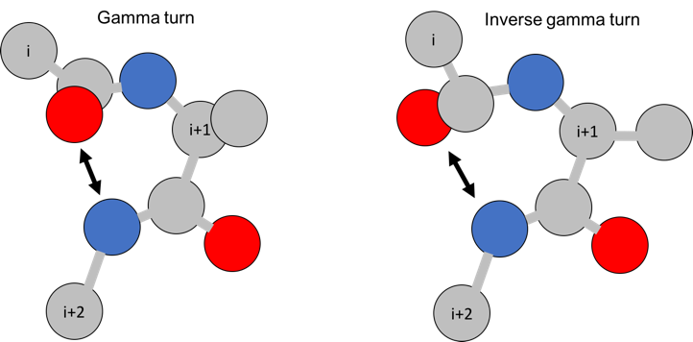
Introduction
Protein sequence: 20 types of amino acids
GKSSKALNEAAEQGDLAKVKNLVQKN
Predict
Turn or nonturn:
nnnnnnntttnnnnnnnnnnntttnnnnnnnn
A Gamma turn contains 3 consecutive residues with H-bond between the carbonyl oxygen of residue (i) and the hydrogen of the amide group of residue (i+2).
50
Notes:
Write the definition

Slide 51
Related Work
Authors | Features used | Methods
Chou and Blinn, 1997 | Sequence | Residue-coupled model
Kaur and Raghava, 2002 | Pred SS3 | naïve Bayes
Kaur and Raghava, 2002 | Pred SS3 | SVM
Kaur and Raghava, 2003 | Multiple sequence alignment+ Pred SS3 | Neural network
Hu and Li, 2008 | PSSM, predict SS3 | SVM
Zhu et al 2012 | Predicted Shape String, Pred SS3 | SVM
51
Notes:
Merge related work to result use this format!

Slide 52
Propose method for gamma-turn prediction
Deep inception capsule networks (DeepICN)
Use inception and capsule networks
Use predicted shape string and HHBlits profile

Slide 53
DeepICN -> Capsule Network (Sabour et al., 2017)
Hinton’s breakthrough AI research work in the past 10 years.
Stimulate additional wave of research and very cool applications
Capsules can discover the orientation and relative spatial relationships between object and/or object components, where CNN cannot.

Slide 54
Capsule (Sabour et al., 2017)
A neuron detects a
specific pattern, beak.
Neuron A Neuron B
Neuron: output a value, Capsule: output a vector
_{𝑣}1
Detect one type
of patterns
Cap
1.0
⋮
𝑣
Cap
−1.0
⋮
_{𝑣}2
Cap
Each dimension of v represents the characteristics of patterns.
The norm of v represents the existence.
54

Slide 55
Dynamic routing (Sabour et al., 2017)
Capsules at one level make predictions, via transformation matrices, for higher-level capsules.
When multiple predictions agree, a higher level capsule becomes active.
Strong
agreement
55

Slide 56
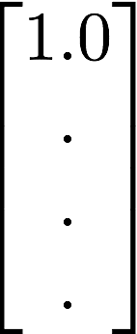
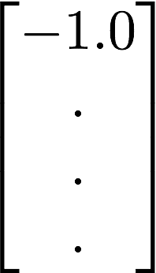
What is a Capsule? (Sabour et al., 2017)
“A capsule is a group of neurons whose activity vector represents the instantiation parameters of a specific type of entity such as an object or an object part.”
General ideas:
Each dimension of v represents the characteristic of pattern;
The norm of v represents the existence (confidence).
Caps
group of neurons
Caps
Caps
activity vector
object parts
entity

Slide 57
Traditional v.s. Capsule Neuron
Scalar
????
Column Vector
Activation
function
Squashing
Traditional Neuron: Scalar → Scalar
Capsule Neuron: Vector → Vector
????
[ Sabour, S., Frosst, N., & Hinton, G. E. (2017). Dynamic Routing Between Capsules. arXiv preprint arXiv:1710.09829. ]

Slide 58
Dynamic Routing (by Agreement)
Initialize
Routing
Algorithm
for r in range(1...T)
is confidence
Squashing
Here: T=2
“agreement”
update “agreement”
Squashing
RNN????
[ Sabour, S., Frosst, N., & Hinton, G. E. (2017). Dynamic Routing Between Capsules. arXiv preprint arXiv:1710.09829. ]

Slide 59
Capsules (Sabour et al., 2017)
capsule length represents the probability of the entity being present at the specific location in the image
capsule angle encodes other properties of the objects such as the rotation angle, skew, thickness, size, etc.

Slide 60
Dynamic routing algorithm (Sabour et al., 2017)
Routing is the act of relaying information to another actor who can more effectively process it.
CapsuleNet’s way of routing, different from MaxPooling, sends the information to the capsule above it that is best at dealing with it
60

Slide 61
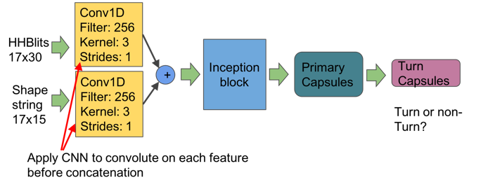
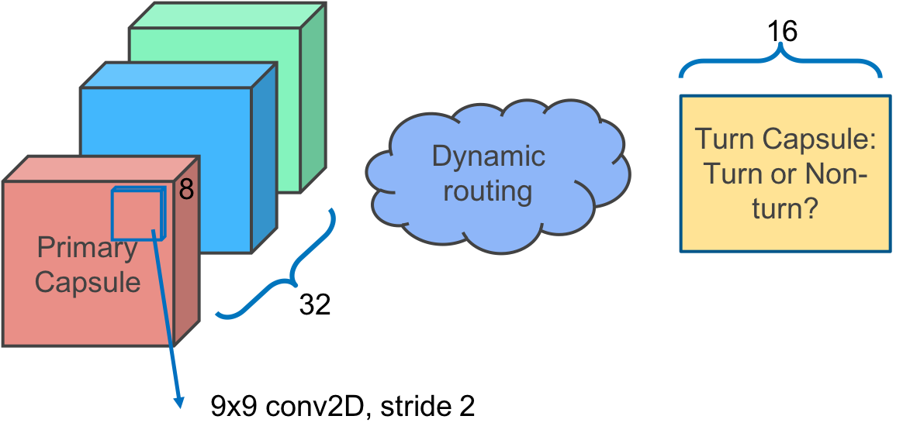
DeepICN architecture
New features
Conv before concatenate
Inception + CapsNet
Capsule Length
61
Notes:
Capcity o fnetwork and genalization of the network pu the network result into this network
List the technequie
expand

Slide 62
Dataset and Performance Measure
Datasets
GT360, contains 360 proteins with sequence identity less than 30%
GT19651, contains 19561 proteins with sequence identity less than 30%
Performance measure
$MCC=\frac{TP∗TN−FP∗FN}{\sqrt{(TP+FP)(TP+FN)(TN+FP)(TN+FN)}}$
62

Slide 63
Performance comparison with previous predictors on GT320 benchmark
Authors | Methods | MCC
Fang et al., 2018 | Our approach | 0.45
Zhu et al., 2012 | SVM | 0.38
Hu and Li, 2008 | SVM | 0.18
Kaur and Raghava, 2003 | SVM | 0.12
Kaur and Raghava, 2003 | Logistic regression | 0.12
Kaur and Raghava, 2003 | Naïve Bayers | 0.11
63

Slide 64
Prediction confidence: the capsule length (norm)
64

Slide 65
Discover gamma turn (Classical, Inverse and non) motif using WebLogo (Crooks et al., 2004)
65

Slide 66
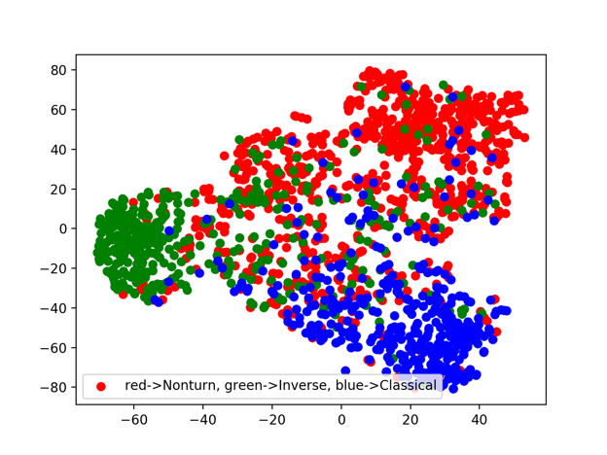
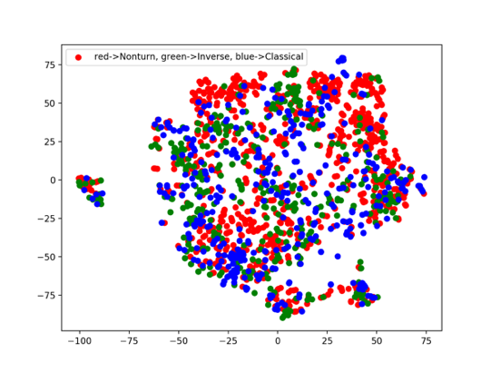
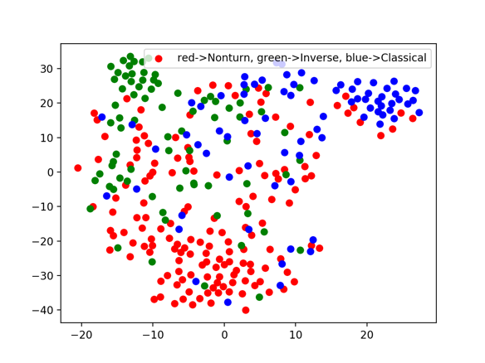
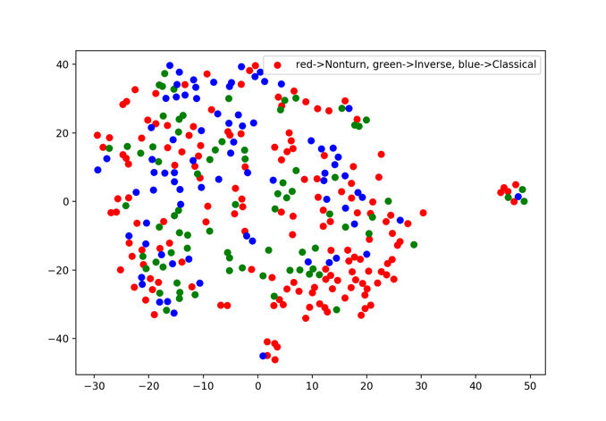
T-SNE (van der Maaten and Hinton, 2008) visualization of features of input and learnt by capsules
3000 training
500 test
66
Notes:
Use trained network and talk about the dataset how many training how many testing

Slide 67
Outline
Introduction and Overview
Proposed Methods:
DeepNRN and Deep3I for secondary structure prediction
DeepRIN for backbone torsion angle prediction
DeepIDN for beta turn prediction
DeepICN for gamma turn prediction
MUFold-SS-Angle server
Summary
67

Slide 68
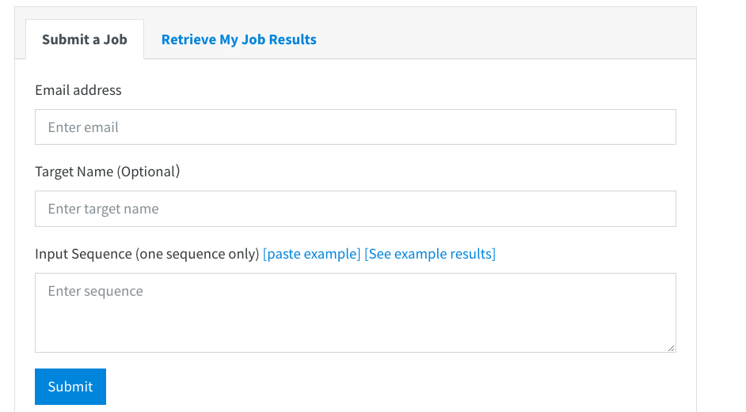
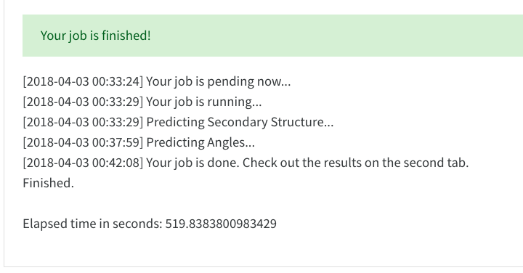
Submit a job and system log
68

Slide 69
Retrieve prediction results
69

Slide 70
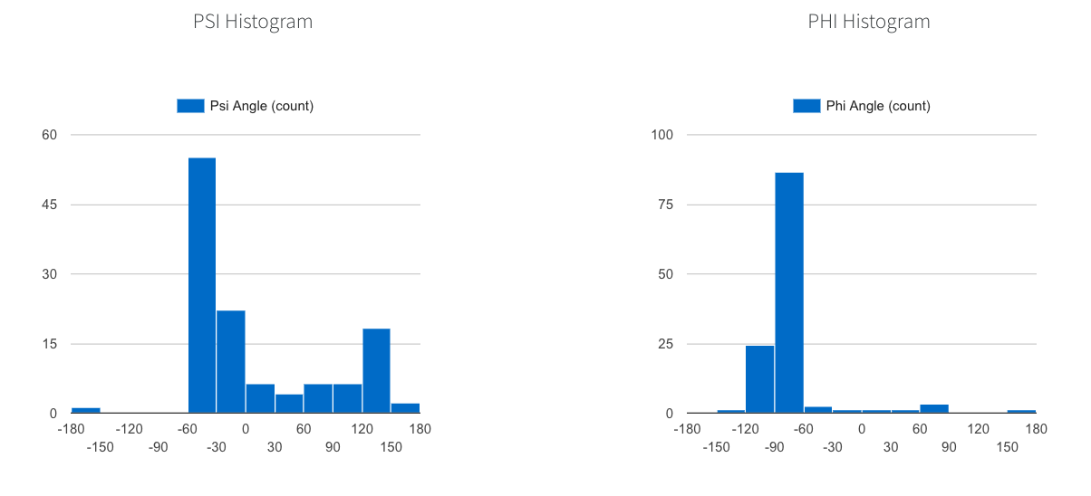
Data visualization
70

Slide 71
Outline
Introduction and Overview
Proposed Methods:
DeepNRN and Deep3I for secondary structure prediction
DeepRIN for backbone torsion angle prediction
DeepIDN for beta turn prediction
DeepICN for gamma turn prediction
MUFold-SS-Angle server
Summary
71

Slide 72
Summary Table
Name | Methods | Problem solved | Result we achieved
DeepNRN, Deep3I | InceptionNet, ResNet | Secondary Structure | Increased 4% Q8 and 3% Q3 than previous state-of-the-art
DeepRIN | ResNet | Torsion Angle | Reduce Psi MAE by 5 degree and Phi MAE by 2 degree over SPIDER3
DeepDIN | DenseNet, InceptionNet | Beta-turn | Increase 25% MCC than previous state-of-the-art
DeepICN | InceptionNet, CapsuleNet | Gamma-turn | Increase 18% MCC than previous state-of-the-art
MUFold-SS-Angle server | Deep3I, DeepRIN | Secondary Structure and Torsion Angle | Predict SS and angles for sequence one at a time. Execution time 5-40 minutes
72

Slide 73
Refereed Publications
Fang, Chao, Yi Shang and Dong Xu. " A New deep neighbor-residual neural network for protein secondary structure prediction. " Tools with Artificial Intelligence (ICTAI), 2017 IEEE 29th International Conference on. IEEE, 2017.
Fang, Chao, Yi Shang and Dong Xu. "MUFOLD-SS: New Deep Inception-Inside-Inception Networks for Protein Secondary Structure.” Proteins: Structure Function and Bioinformatics.
Fang, Chao, Yi Shang and Dong Xu. “Prediction of Protein Backbone Torsion Angles Using Deep Residual Inception Neural Networks.” IEEE/ACM Transactions on Computational Biology and Bioinformatics
Fang, Chao, Yi Shang and Dong Xu. “MUFold-BetaTurn: Improving Beta Turn Prediction Using Deep Dense Networks.” (submitted to journal)
Fang, Chao, Yi Shang and Dong Xu. “MUFold-GammaTurn: Improving Gamma Turn Prediction Using CapsuleNets.” (submitted to journal)
Fang, Chao, Zhaoyu Li, Yi Shang and Dong Xu. “MUFold-SS-Angle: A Web Server for Protein Secondary Structure and Backbone Torsion Angle Prediction.” (submitted to journal)
73

Slide 74
Acknowledgement
This work was partially supported by National Institutes of Health (NIH) grant R01-GM100701
The high-performance computing infrastructure was partially supported by National Science Foundation (NSF) under grant number CNS-142929.
Some materials (including figures and text) were taken from the Internet at the public domain.
74

Slide 75
Database study
HHBlits (incetpion)+pyhsicahmeical
Database filter using sequence length
Server long to short

Slide 76
Thank you
76

