Slide 1
Inferring human activity from GPS tracks
Sun Simiao

Slide 2
Study Human Activity from Raw GPS Data
Current Condition:
Lots of GPS devices provide us huge amount of GPS data
GPS data does not improve semantic richness
Problem:
How to conquer the semantic gap between raw data and personal activity

Slide 3
Solution to the Problem
Provide algorithm to automatically annotating raw trajectories with the activities performed by users
Key points:
Stops(Absence of movement)
POI(Point of Interests)
Gravity Model(Probability measure based on Gravity Law)

Slide 4
Motivation
Study on human activity helps with several application areas:
Traffic management
Public transportation
Location based service
Security and police

Slide 5
Related Works
Related work for analysis of raw trajectories

Slide 6
Related Works
Two trends of analysis for GPS tracks.
Trend 1: Concentrate on identification of the transportation means
Trend 2: Focus on identification of human activity

Slide 7
Previous Works
STPA: the attractiveness for a POI changes with time and space. (eg. Restaurants are more attractive at noon )
Mainly provide us with two different approaches:
Use Spatial Temporal POI’s Attractiveness (STPA) to identify activity-locations and durations
Use stops in the trajectories to infer visited POIs and then infer the corresponding activities

Slide 8
Compare Similar Previous Work with Our Approach
Similar Previous Work
Our Approach
No relationship to link POIs with spatial and temporal aspects
Annotating each trajectories with a behavior
Directly compute uniform probability for POI
Consider spatial and temporal aspects(Opening hours, stop duration)
Concentrate in annotating single stops with activities
Use Gravity model to select the most probable POI category

Slide 9
Methodology
Based on Stops in trajectories, POI, Gravity Law

Slide 10
Schema of the Process

Slide 11
Input for the Process
POI: {Coordinates(Lat, Lon); Category(C); Opening Hours(H)}
Trajectories (T): {Coordinates(Lat, Lon); Timestamps(ts)}
Users(U): {Max walking distance(Mwd)}
Activities(A)
Mapping(μ) of the POI categories to activities
Probability model: P(POI_{i}, Stop_{j})=f(dis(POI_{i}, Stop_{j}))

Slide 12
Pseudo Code for the Algorithm

Slide 13
Associate Stops with POI
Spatio-temporal clustering has been introduced in another paper as a reference.
Stops can be detected by spatio-temporal clustering method
Select POI that satisfies these two requirements
If POI is reachable
dis(POI, Stop) < MaxWalkDistance
If the opening time of POI intersects the stop time duration

Slide 14
Infer Activity from POIs
GravLaw = mass1*mass2/(distance²)
(mass1 will always be 1, mass2 will be the number of POIs related to the same activity)
Use Gravity Model(derived from Newton’s Law of Gravitation) to determine the probability(P) of an activity(act) for a stop(s):
Choose the Max(P(s,act)) to infer the activity

Slide 15
Experiments

Slide 16
Experiment Dataset
Data gathered from one year of observation
28 volunteers moving by car in Flanders(Belgium)
Around 30000 annotated trips
Activities retrieved from the diaries
POIs from Google Place and OpenStreetMap

Slide 17
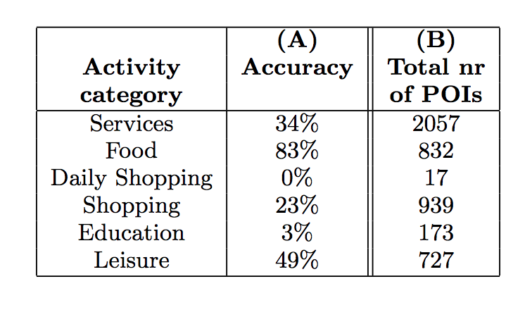
Experiment Result
Compare the stops annotated with the most probable activity by the algorithm, obtain global accuracy of 43%
Detailed accuracy:

Slide 18
Experiment Explanation
Results are related to the availability of the POIs around the stops
Daily shopping activity only has 17 POIs for all the stops in the experiment
Results depend on the Input data
Need more constraint on POI
Better mapping from POI categories to activities

Slide 19
Conclusion

Slide 20
Conclusion
Innovative probability model
Accuracy is not entirely satisfactory
Remaining Issues:
Lack of rich POI datasets
Need to better define the mapping

Slide 21
Questions?

